Slide 1
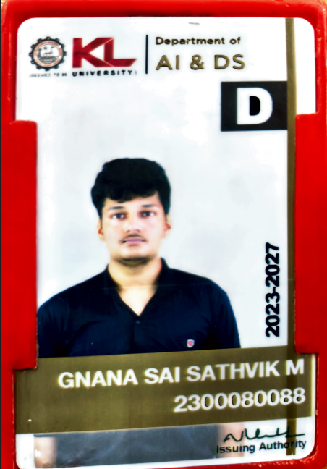
CAPSTONE PROJECT
PROJECT TITLE: WildVision – Real-Time Multi-Class Animal Detection Using YOLOv11s
Presented By : Machavarapu Gnana Sai Sathvik
College Name: KL University
Department: Artificial Intelligence and Data Science
Email ID: 2300080088@kluniversity.in
AICTE Student ID: STU6631d638cff1c1714542136

Slide 2
OUTLINE
Problem Statement
Proposed Solution
System Development Approach
Algorithm & Deployment
Result
Conclusion
Future Scope
References

Slide 3
Problem Statement
Manual wildlife observation is often limited in scope, time, and accuracy. Traditional surveillance systems struggle to detect and identify multiple animal species in real time, especially in complex and resource-constrained environments. There is a pressing need for an automated, efficient, and scalable animal detection system for conservation and monitoring.

Slide 4
Proposed Solution
WildVision introduces a lightweight, high-speed multi-class animal detection system built on YOLOv11s.
- Data Collection from diverse wildlife image datasets.
- Preprocessing using techniques like resizing, normalization, Mosaic, and HSV transformations.
- Real-time inference via YOLOv11s optimized for edge deployment.
- Post-processing using Non-Maximum Suppression (NMS).
- Deployment on portable platforms like drones or surveillance cameras.

Slide 5
System Development Approach
Technology Stack:
- Language: Python
- Libraries: PyTorch, OpenCV, YOLOv11s
- Platform: Google Colab, Edge Devices (NVIDIA Jetson, Raspberry Pi)
Steps Followed:
1. Dataset Preparation and Annotation
2. YOLOv11s Configuration and Training
3. Model Optimization (Pruning, Quantization)
4. Testing on validation datasets
5. Deployment-ready packaging

Slide 6
Algorithm & Deployment
Algorithm: YOLOv11s
- Backbone: CSPNet/ShuffleNet
- Neck: PANet / BiFPN
- Head: Anchor-free with CIoU & Focal Loss
- Training: Annotated animal datasets
- Deployment: YOLOv11s model (.pt) on Jetson Nano / edge devices
Training Command:
!yolo detect train data=data.yaml model=yolo11s.pt epochs=60 imgsz=640

Slide 7
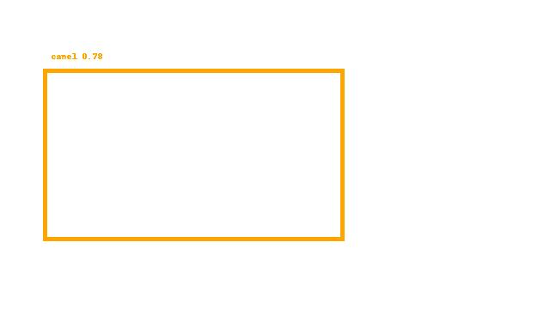
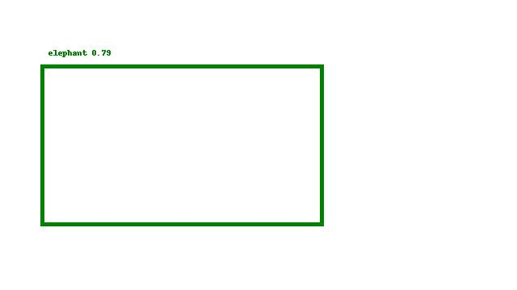
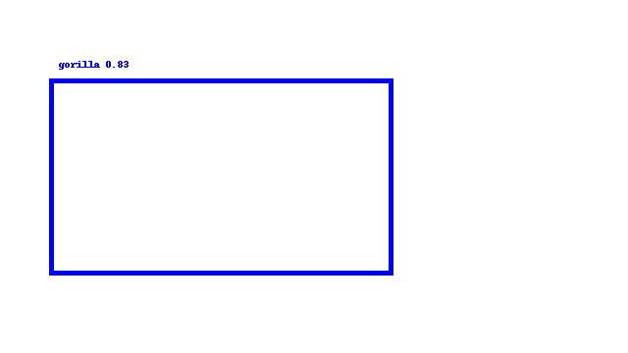
Detected animals with high confidence:
• Camel – 0.78 Elephant – 0.79 • Gorilla – 0.83
Strong performance in precision, recall, and mAP.
(Add visual examples of detected animals with bounding boxes here.)

Slide 8
Conclusion
WildVision delivers a scalable real-time animal detection solution using YOLOv11s.
- Accurate multi-class detection in complex scenes
- Valuable for conservationists and environmental monitoring
- Enables automated tracking, poaching prevention, and ecological research

Slide 9
Future Scope
- Enhanced YOLO architectures for better accuracy
- Integration with drones, surveillance cameras
- Improved generalization across environments
- AI-assisted endangered species tracking

Slide 10
References
https://www.kaggle.com/code/rajansh87/animal-species-detection-project
https://www.kaggle.com/code/nimapourmoradi/animal-detection
https://arxiv.org/abs/2410.11741
https://www.sciencedirect.com/science/article/abs/pii/S0168169916303180

Slide 11
Model Training & Deployment Code
1. Upload Dataset: from google.colab import drive drive.mount('/content/gdrive') !cp /content/gdrive/MyDrive/path/to/data.zip /content 2. Preprocessing: - Split into train/validation - Augment with Mosaic, HSV, flip - Normalize & resize 3. Training: !yolo detect train data=data.yaml model=yolo11s.pt epochs=60 imgsz=640 4. Prediction: !yolo detect predict model=best.pt source=data/validation/images save=True

Slide 12
Result Analysis
Result Analysis:
• Camel detected with confidence 0.78
• Elephant detected with confidence 0.79
• Gorilla detected with confidence 0.83
• High mAP, precision, and recall achieved
• Bounding boxes successfully localized animals

Slide 13
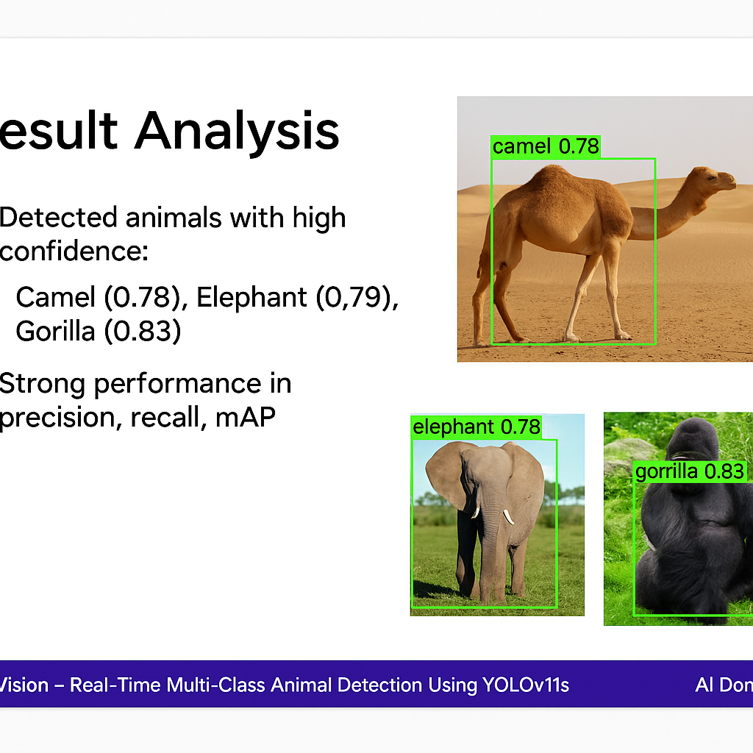
Result Visualization

Slide 14
Thank you

