Slide 1
Data Analytics
Project Presentation
CUSTOMER PERSONALITY ANALYSIS
Name : Sathvik A PES1UG20CS493
Name : Jeevan R PES1UG20CS179
Name : Sankalp Kundu PES1IG20CS383

Slide 2
Abstract and Scope
Customer Personality Analysis is a detailed analysis of a company’s ideal customers. It helps a business to better understand its customers and makes it easier for them to modify products according to the specific needs, behaviors and concerns of different types of customers.
Customer personality analysis helps a business to modify its product based on its target customers from different types of customer segments. For example, instead of spending money to market a new product to every customer in the company’s database, a company can analyze which customer segment is most likely to buy the product and then market the product only on that particular segment.

Slide 3
Implementation Details
Modules/Packages used :
Numpy : python library used for working with arrays.
Pandas : It provides ready to use high-performance data structures and data analysis tools.
Matplotlib: Matplotlib is a cross-platform, data visualization and graphical plotting library for Python.
Seaborn : Seaborn is a python data visualization library based on matplotlib. It provides a high-level interface for drawing attractive and informative statistical graphics.
sklearn.preprocessing: helps in normalization of given data so that it can benefit the learning algorithms.
sklearn.decomposition.PCA : Linear dimensionality reduction using Singular Value Decomposition of the data to project it to a lower dimensional space.
yellowbrick.cluster : to visualize and evaluate clustering behavior.
mpl_toolkits.mplot3d : used to generate 3D plots.
Warnings : Warning messages are typically issued in situations where it is useful to alert the user of some condition in a program, where that condition (normally) doesn’t warrant raising an exception and terminating the program.

Slide 4
Techniques Used
1) K-means : K-Means clustering is an unsupervised machine learning algorithm that divides the given data into the given number of clusters. Here, the “K” is the given number of predefined clusters, that need to be created. It is a centroid based algorithm in which each cluster is associated with a centroid. The main idea is to reduce the distance between the data points and their respective cluster centroid. The algorithm takes raw unlabelled data as an input and divides the dataset into clusters and the process is repeated until the best clusters are found. Hence , this technique could be used to group customers with similarities into one cluster.
2)Agglomerative clustering : it is an unsupervised ML algorithm that groups similar objects into clusters. We start with individual clusters for each data point and merge the clusters in a ranked manner based on their closeness. The final cluster contains all the data points. Here , the number of iterations required can be derived from a dendogram.
3) DBSCAN : There are two parameters that play a vital role in the algorithm.
1) Min points : MinPoints are the number of points that must exist within ɛ distance from the point.
2) Epsilon : It is the distance or radius around each object.
The algorithm works by processing each and every data point individually in particular for each point. It will construct a kind of a circle with the point being in the center and having the radius equal to the Epsilon.

Slide 5
4)Gradient boosting classifier : are a group of machine learning algorithms that combine many weak learning models together to create a strong predictive model. Decision trees are usually used when doing gradient boosting. Gradient boosting models are becoming popular because of their effectiveness at classifying complex datasets. They provide really high accuracies in the final results.
5) PCA : The main idea of principal component analysis (PCA) is to reduce the dimensionality of a data set consisting of many variables correlated with each other while retaining the variation present in the dataset.
6) Label encoding : refers to converting the labels into a numeric form so as to convert them into the machine-readable form. Machine learning algorithms can then decide in a better way how those labels must be operated.
7) Standard scaling : It's a common practice to apply standard scaling to the data before training these machine learning algorithms on the dataset. In standard scaling, a feature is scaled by subtracting the mean from all the data points and dividing the resultant values by the standard deviation of the data.

Slide 6
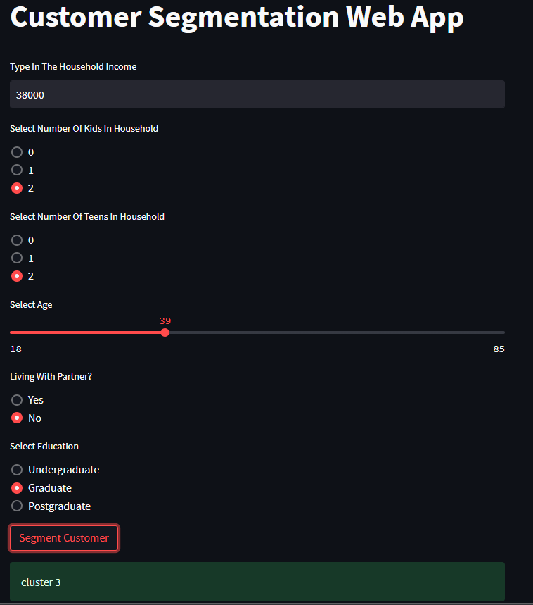
Project Demonstration
Our User Interface of our project is deployed on Streamlit.
Based on the characteristics of the customer, the customer is classified into the cluster, so that a particular strategy can be used to market a particular product, to save the company’s time and money.

Slide 7
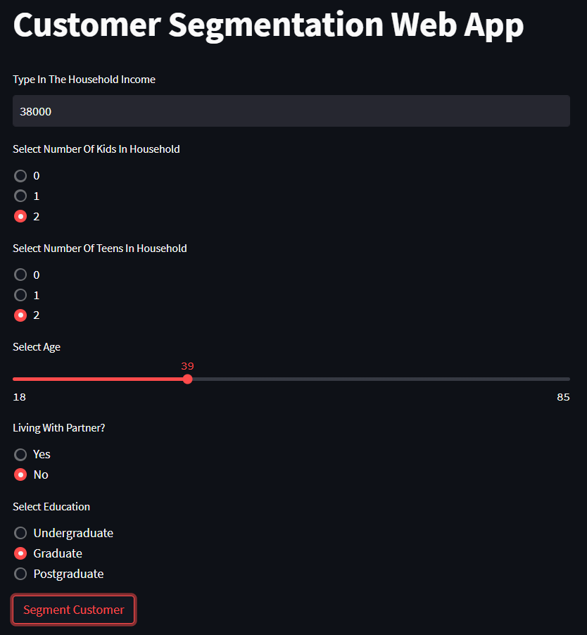
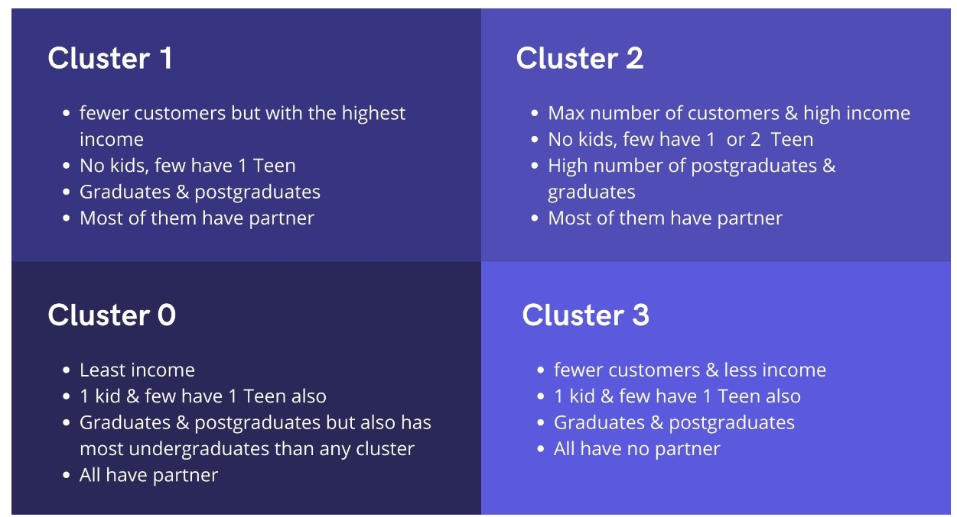
Results and Discussion
The User Interface
Characteristics of cluster

Slide 8
Conclusion and Future work
The customers are clustered into four clusters based on the properties like the Household income and expenses with the company, Kids and Teenagers present at home and the family size.
The classification can be enhanced.
It can be further used to provide the customer life time value and RFM values.

Slide 9
References
[1] C. Stachl, G. Harari, S. Hilbert and R. Schoedel, "Personality Research and Assessment in the Era of Machine Learning".
[2] O. Ejimogu and S. Basaran, "A Neural Network Approach for Predicting Personality From Facebook Data“
[3] D. Suhartono, E. W. Andangsari, V. Ong and M. N. Suprayogi, "Personality Prediction Based on Twitter Information in Bahasa Indonesia".
[4] R. Bin Tareaf, P. Berger, P. Hennig and C. Meinel, "Personality Exploration System for Online Social Networks: Facebook Brands As a Use Case," 2018 IEEE/WIC/ACM International Conference on Web Intelligence (WI), 2018, pp. 301-309, doi: 10.1109/WI.2018.00-76.
[5] K. Maheswari and P. P. A. Priya, "Predicting customer behavior in online shopping using SVM classifier," 2017 IEEE International Conference on Intelligent Techniques in Control, Optimization and Signal Processing (INCOS), 2017, pp. 1-5, doi: 10.1109/ITCOSP.2017.8303085.
[6] P. Cong, G. Xu, J. Zhou, M. Chen, T. Wei and M. Qiu, "Personality and Value-aware Scheduling of User Requests in Cloud for Profit Maximization," in IEEE Transactions on Cloud Computing, doi: 10.1109/TCC.2020.3000792.

Slide 10
Thank You

