Slide 1

Linear Regression for Stock Price Prediction
CSE-AI
Notes:
1. Table of contents
2. Introduction
3. Our company
4. Our team
5. Problem
6. Them vs. us
7. Solution
8. SWOT analysis
9. Product overview
10. Our plans
11. Product demo
12. Traction
13. Case study
14. Reviews
15. Awards
16. Market size
17. Target
18. Competitors
19. Business model
20. Timing
21. Predicted growth
22. Investment

Slide 2
Team Members
DARIPELLI MANISH[20011] ​
DARIPELLI MEHUL [20012] ​
SHAIK NAWAB MUDASSIR [20061] ​
SIRIGIRI NAGA PAVAN SATHVIK REDDY [20062]​
MADISETTY THARUN KUMAR [20067]​

Slide 3
Table of Contents
01
03
02
04
Linear Regression Lasso Ridge
Introduction
Data Set
Implementation

Slide 4
Objectives
Implementation of stock prediction using Linear Regression, Lasso, Ridge
Calculating Accuracy
Difference b/w Regression Models

Slide 5

Introduction
Briefing the project with Regression Models

Slide 6
Stock Market and It’s Importance
A stock market is a public market where you can buy and sell shares for publicly listed companies. The stocks, also known as equities, represent ownership in the company.
Stock markets help companies to raise capital.
Stock markets serve as an indicator of the state of the economy.
It is a widely used source for people to invest money in companies with high growth potential.

Slide 7
Stock Price Prediction
Stock Price Prediction using machine learning helps you discover the future value of company stock and other financial assets traded on an exchange
There are other factors involved in the prediction, such as physical and psychological factors, rational and irrational behavior, and so on
This makes it very difficult to predict stock prices with high accuracy.

Slide 8

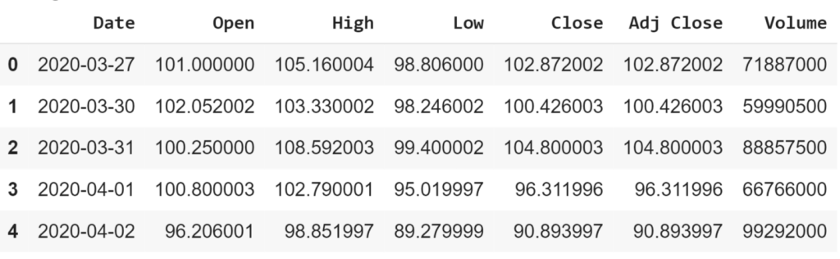
Dataset

Slide 9
Regression Models
Linear Regression Lasso Ridge

Slide 10
01
Linear Regression

Slide 11
The simplest form of the regression equation with one dependent and one independent variable.
y = m * x + b
y = estimated dependent value.
b = constant or bias.
m = regression coefficient or slope.
x = value of the independent variable.

Slide 12
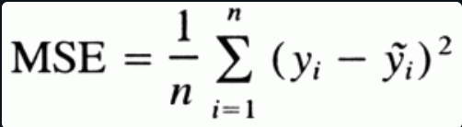
Understanding Loss Function
A mean squared error function as the name suggests is the mean of squared sum of difference between true and predicted value.
As the predicted value of y depends on the slope and constant, hence our goal is to find the values for slope and constant that minimize the loss function or in other words, minimize the difference between y predicted and true values.

Slide 13
Optimization Algorithm
Optimization algorithms are used to find the optimal set of parameters given a training dataset that minimizes the loss function, in our case we need to find the optimal value of slope (m) and constant (b).
One such Algorithm is Gradient Descent.
Gradient descent is by far the most popular optimization algorithm used in machine learning.
Using gradient descent we iteratively calculate the gradients of the loss function with respect to the parameters and keep on updating the parameters till we reach the local minima.

Slide 14
Steps to Implement Gradient Descent

Slide 15
Step-1 Initializing the parameters
Here, we need to initialize the values for our parameters. Let’s keep slope = 0 and constant = 0.
We will also need a learning rate to determine the step size at each iteration while moving toward a minimum value of our loss function.

Slide 16
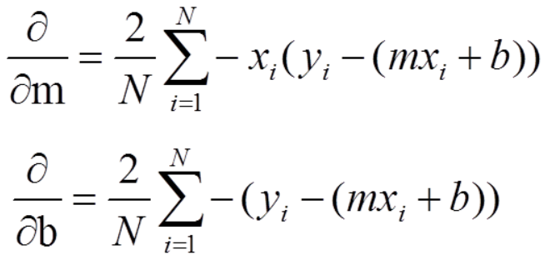
Step -2 Calculate the Partial Derivatives with respect to parameters
Here we partially differentiate our loss function with respect to the parameters we have.

Slide 17
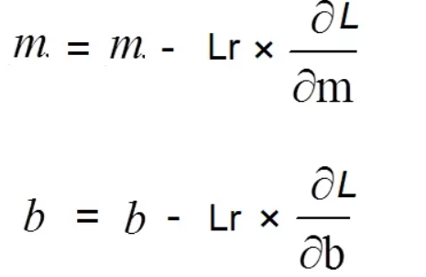
Step – 3 Updating the parameters
The updated values for our parameters will be the values with which, each step minimizes our loss function and reduces the difference between the true and predicted values.
Repeat the process to reach a point of local minima.

Slide 18
02
Lasso

Slide 19
In statistics and Machine Learning Lasso(Least absolute shrinkage and selection operator) is a regression analysis method that performs both variable selection and regularization in order to enhance the prediction accuracy and interpretability of the resulting statistical model.
Lasso Regression uses L1 regularization technique. It is used when we have more number of features because it automatically performs feature selection.

Slide 20
L1 regularization
If a regression model uses the L1 Regularization technique, then it is called Lasso Regression. If it used the L2 regularization technique, it’s called Ridge Regression. We will study more about these in the later sections.
L1 regularization adds a penalty that is equal to the absolute value of the magnitude of the coefficient. This regularization type can result in sparse models with few coefficients. Some coefficients might become zero and get eliminated from the model. Larger penalties result in coefficient values that are closer to zero (ideal for producing simpler models).

Slide 21
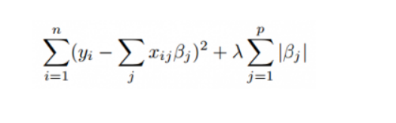
Mathematical Equation
Residual Sum of Squares + λ * (Sum of the absolute value of the magnitude of coefficients)

Slide 22
03
Ridge

Slide 23
Ridge
Prerequisites :-
Linear Regression
Gradient Descent
Ridge Regression ( or L2 Regularization ) is a variation of Linear Regression. In Linear Regression, it minimizes the Residual Sum of Squares ( or RSS or cost function ) to fit the training examples perfectly as possible. The cost function is also represented by J.

Slide 24


Cost Function for Linear Regression
for Ridge Regression is given below:
Here, wj represents the weight for jth feature.
n is the number of features in the dataset.

Slide 25
Mathematical Intuition
During gradient descent optimization of its cost function, added l2 penalty term leads to reduces the weights of the model to zero or close to zero. Due to the penalization of weights, our hypothesis gets simpler, more generalized, and less prone to overfitting. All weights are reduced by the same factor lambda. We can control the strength of regularization by hyperparameter lambda.
Different cases for tuning values of lambda.
If lambda is set to be 0, Ridge Regression equals Linear Regression
If lambda is set to be infinity, all weights are shrunk to zero.
So, we should set lambda somewhere in between 0 and infinity.

Slide 26
Implementation

Slide 27
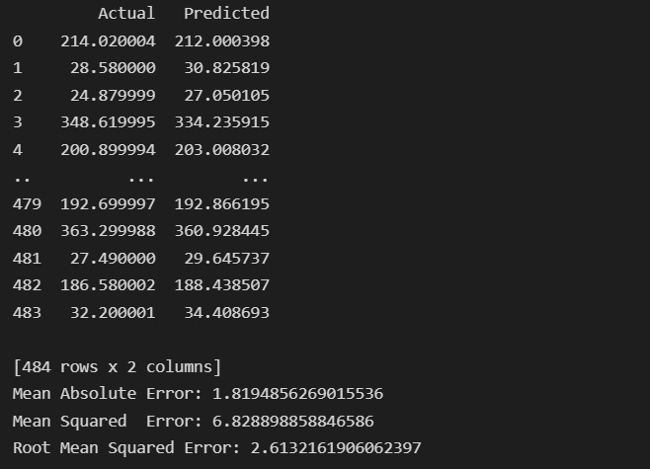
Results

Slide 28
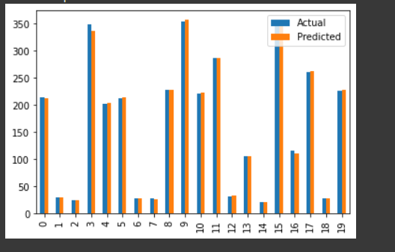
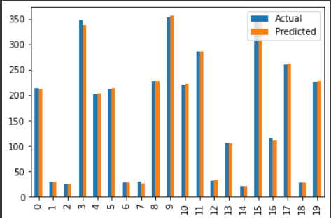
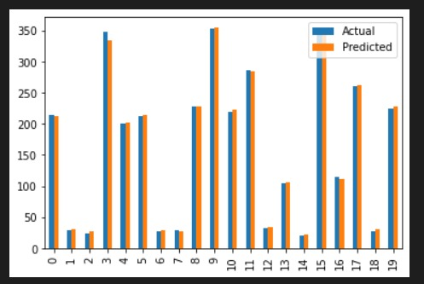
Linear Regression Lasso Ridge

Slide 29

Thank You
- Team 13

