Slide 1

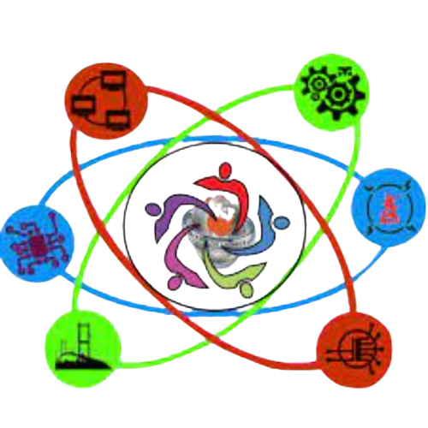
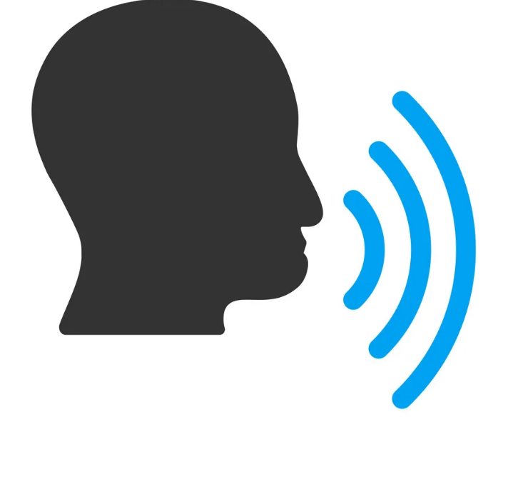
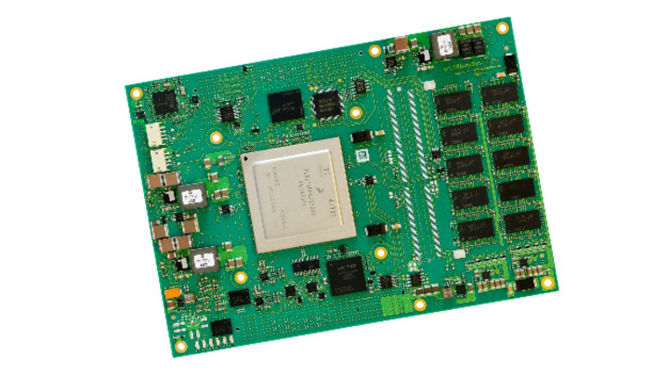

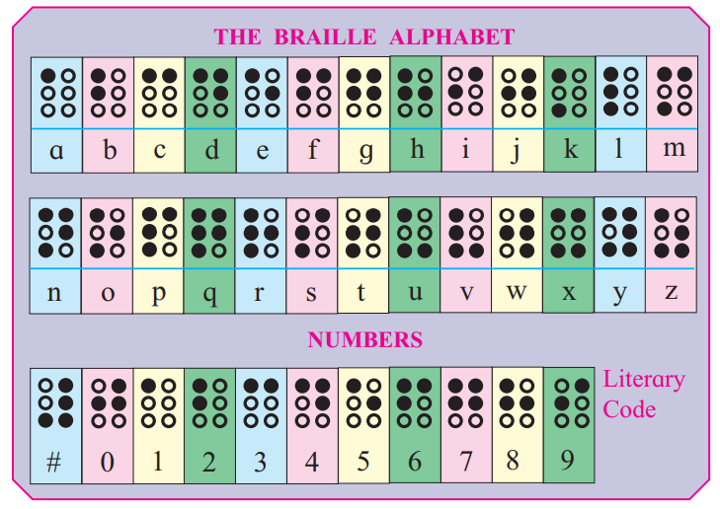
VALLURUPALLI NAGESWARA RAO VIGNANA JYOTHI
INSTITUTE OF ENGINEERING AND TECHNOLOGY
OPEN HOUSE’23
Braille Computer
Abstract
Methodology
.
We have Computers…
What does Disabled persons have??
We got updated from books to computers but did People who use braille Update?
We wanted to bring change in the lives of Disabled persons who use braille script .
Our model converts speech into text and it displays it on a digital board made by us, which is capable of displaying braille language
Speech
Computer converts text to speech
Converts text to braille language
Braille Script Display
Results
Team
This is helpful to people whose daily life depends on braille script.
As we got upgraded from books to computers our idea is to provide a computerized model through which even disabled people can communicate.
This could be the first step for the evolution of computers in the lives of disabled people.
Sathvik
Bhavishya
Sireesha
Shashidhar Reddy

