Slide 1
TELUGU PHASE
MULTILINGUAL
NEXT-WORD
PREDICTION
LSTM, Bi-LSTM and convolutional models
15 October 2026
UROP PROJECT REVIEW
Notes:
Our project predicts the next word from a short text prefix. The overall scope is multilingual, with Telugu as the current implementation. All four models have completed five epochs, held-out evaluation and verification.
Evidence:

Slide 2
INTRODUCTION
Multilingual next-word prediction: current focus on Telugu
01
Goal: suggest the next word from the phrase a user has typed.
02
Current scope: Telugu input and five ranked word suggestions.
03
Approach: compare LSTM, Bi-LSTM and two CNN models.
04
Application: a Streamlit demo using the saved LSTM checkpoint.
UROP / TELUGU PHASE
02
Notes:
Multilingual describes the overall project scope. The verified interface currently supports Telugu only. The project predicts a next word rather than generating a full sentence.
Evidence: src/telugu_app.py; FINAL_DELIVERY.md

Slide 3
ABSTRACT
This project studies multilingual next-word prediction with Telugu as the current language. Native Telugu text from Alpaca and GPTeacher supplies the training data.
We compare LSTM, Bi-LSTM, a causal word CNN and a gated word–character CNN using eight-word contexts. The character model learns to combine whole-word and spelling features.
All models completed five epochs. Bi-LSTM achieved 18.82% top-1 accuracy. Character fusion improved over word CNN, including on inputs containing unknown words. A Streamlit interface provides five suggestions.
UROP / TELUGU PHASE
03
Notes:
Test size 200,092. Word CNN top-1 17.67%, gated word-character CNN 18.55%. Results are single seed with different parameter counts. Research originality and the gate-specific benefit remain unestablished.
Evidence: FINAL_MODEL_RESULTS.md; TELUGU_FREQUENCY_RESULTS.md

Slide 4
WHAT WE USED
Component | Current experiment
Data | Telugu-LLM-Labs Alpaca and GPTeacher
Software | Python, PyTorch, NumPy and Streamlit
Representations | 20,000-token vocabulary, 8-word context
Models | LSTM, Bi-LSTM, word CNN, word–character CNN
Training | Adam, learning rate 0.001, batch 512, 5 epochs
Train: 3,483,073 examples. Validation: 198,928. Test: 200,092.
Native Telugu fields, grouped splits and training-only vocabulary.
UROP / TELUGU PHASE
04
Notes:
Full dataset IDs: Telugu-LLM-Labs/telugu_alpaca_yahma_cleaned_filtered_romanized and Telugu-LLM-Labs/telugu_teknium_GPTeacher_general_instruct_filtered_romanized. We use native Telugu instruction/input/output fields, not romanized fields. Seed 42, CPU execution, gradient clipping 1.0, dropout 0. Flower is a legacy dependency, not part of the current training.
Evidence: data_telugu_llm/provenance.json; src/train_telugu_comparison.py

Slide 5
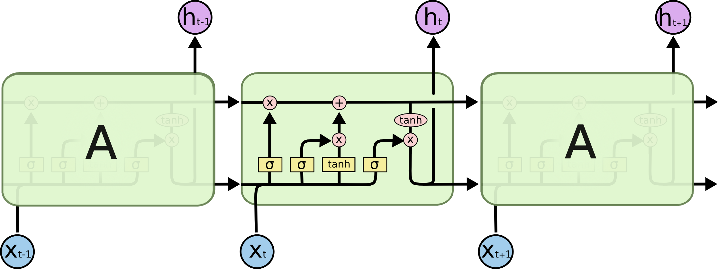
LSTM: PUBLISHED ARCHITECTURE
Original reference illustration showing the cell state and internal gates
The memory path runs across time. Gates regulate retention, updates and output.
Image: Christopher Olah, Understanding LSTM Networks (2015). Unmodified.
UROP / TELUGU PHASE
05
Notes:
Original image, not an illustration generated for this project. The repeating blocks depict time steps of one LSTM, not separate stacked layers. Our implementation uses 64-dimensional embeddings and one 128-unit LSTM layer.
Evidence: https://colah.github.io/posts/2015-08-Understanding-LSTMs/; https://colah.github.io/posts/2015-08-Understanding-LSTMs/img/LSTM3-chain.png

Slide 6
LSTM ARCHITECTURE
Sequential memory over the observed input words
8-word prefix
Token IDs
→
Word embedding
64 dimensions
→
LSTM layer
128 hidden units
→
Dense + softmax
20,000 outputs
cₜ = fₜ ⊙ cₜ₋₁ + iₜ ⊙ gₜ
hₜ = oₜ ⊙ tanh(cₜ)
The final hidden state predicts the next word. Test top-1 accuracy: 18.03%.
UROP / TELUGU PHASE
06
Notes:
One recurrent layer. f, i and o are sigmoid forget, input and output gates. g is the tanh candidate state, c is cell memory. The prediction head consumes the final hidden state.
Evidence: src/model.py; outputs/telugu_comparison/lstm_test_metrics.json

Slide 7
LSTM: GATES AND MEMORY
Each gate learns what information to retain, add or expose
fₜ = σ(Wf xₜ + Uf hₜ₋₁ + bf)
Forget: retain old memory
iₜ = σ(Wi xₜ + Ui hₜ₋₁ + bi)
Input: select new information
gₜ = tanh(Wg xₜ + Ug hₜ₋₁ + bg)
Candidate: propose an update
cₜ = fₜ ⊙ cₜ₋₁ + iₜ ⊙ gₜ
Memory: combine old and new
oₜ = σ(Wo xₜ + Uo hₜ₋₁ + bo)
Output: control exposure
hₜ = oₜ ⊙ tanh(cₜ)
Hidden state: feed the predictor
x: word embedding h: hidden state c: memory σ: sigmoid ⊙: element-wise product
UROP / TELUGU PHASE
07
Notes:
W, U and b are learned parameters. The sigmoid gates range from zero to one. These standard equations describe the implemented PyTorch LSTM, with combined bias notation.
Evidence: src/model.py; https://colah.github.io/posts/2015-08-Understanding-LSTMs/

Slide 8
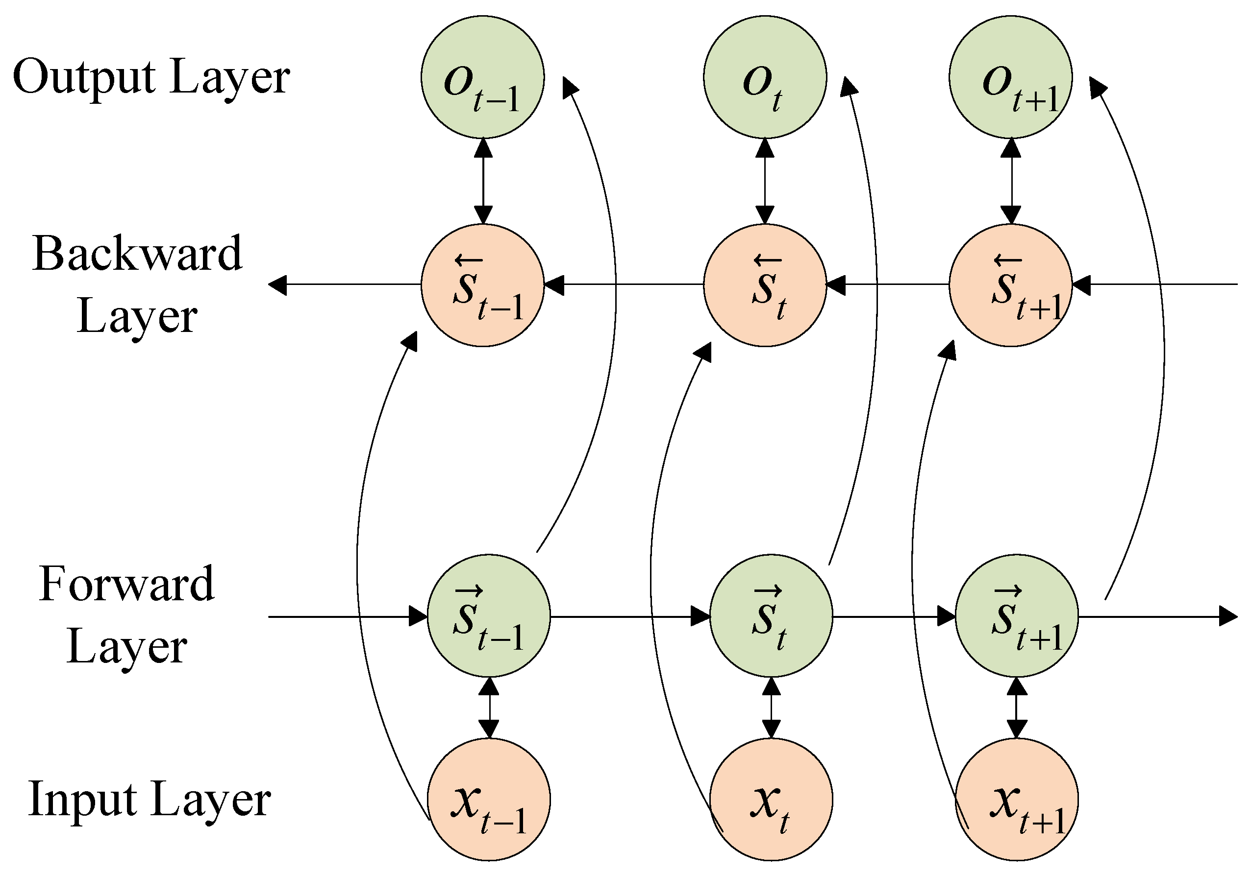
BI-LSTM: PUBLISHED ARCHITECTURE
Original reference diagram of forward and backward recurrent processing
Forward branch
Processes the prefix in its original order.
Backward branch
Processes that same prefix in reverse.
Our project
Combines terminal states to predict one next word. The target stays unseen.
Image: Applied Sciences 11(17), 8129 (2021), Figure 3. Unmodified.
UROP / TELUGU PHASE
08
Notes:
Reference: Short-Term Load Forecasting Based on Deep Learning Bidirectional LSTM Neural Network, Applied Sciences 2021, 11, 8129, Figure 3. Publisher original image reproduced with attribution (CC BY 4.0 article). The source depicts outputs at several positions; our model instead concatenates terminal states for a single next-word output. All input positions shown correspond to an observed prefix in our application.
Evidence: https://www.mdpi.com/2076-3417/11/17/8129; https://doi.org/10.3390/app11178129; https://mdpi-res.com/d_attachment/applsci/applsci-11-08129/article_deploy/html/images/applsci-11-08129-g003.png

Slide 9
BI-LSTM ARCHITECTURE
Two directions process the same observed prefix
Forward LSTM
128 units
Prefix embedding
64 dimensions
Concatenate
256 dimensions
→
Dense + softmax
20,000 outputs
Reverse LSTM
128 units
h = concat(hforward, hreverse)
Neither direction sees the target word. Test top-1 accuracy: 18.82%.
UROP / TELUGU PHASE
09
Notes:
Both branches receive the same input embedding sequence. Their terminal hidden states concatenate before output projection. Arrows indicate branch flow. More parameters than the LSTM baseline, so the comparison does not isolate directionality alone.
Evidence: src/model.py; outputs/telugu_comparison/bilstm_test_metrics.json

Slide 10
WORD CNN ARCHITECTURE
Gated causal convolutions over word embeddings
Word embeddings
64 dimensions
→
1×1 projection
128 channels
→
3 causal blocks
Dilations 1, 2, 4
→
Final position
Dense + softmax
h′ = (h + v ⊙ σ(u)) / √2
Kernel size 3. Left padding prevents access to later input positions.
The receptive field covers the eight-word context. Test top-1: 17.67%.
UROP / TELUGU PHASE
10
Notes:
Each convolution outputs value v and gate logits u. The sigmoid gate modulates the residual update. The last position representation feeds a 20,000-class head. This model uses word embeddings only.
Evidence: src/model.py; outputs/telugu_cnn/cnn_test_metrics.json

Slide 11
GATED WORD–CHARACTER CNN
Learned fusion of whole-word and spelling representations
Word embedding
64 dimensions
Learned gate
Word + character
→
Causal CNN
3 blocks
→
Dense + softmax
Next word
Character CNN
64-d features
g = σ(Wg [e ; c] + bg)
fused = g ⊙ e + (1 − g) ⊙ c
Test top-1: 18.55%. Output vocabulary stays fixed at 20,000 tokens.
UROP / TELUGU PHASE
11
Notes:
Both branches receive the same input word. The character branch uses a training-only alphabet, 16-d character embeddings, kernel-3 convolution, ReLU and masked max pooling. It retains the last 32 code points. Word and character features combine through an element-wise sigmoid gate, then a projection and the causal CNN. Unknown-prefix top-1 improves from 13.13% to 14.64% over word CNN; rare-target improvement was not demonstrated. Gate ablation and research originality remain future validation.
Evidence: src/wordchar_model.py; outputs/telugu_wordchar/wordchar_cnn_test_metrics.json; TELUGU_FREQUENCY_RESULTS.md

Slide 12
TRAINING WORKFLOW
Learning happens offline before the user opens the web application
1. Native Telugu
Extract text fields
→
2. Prepare data
Normalize + split
→
3. Build examples
Prefix + target
→
4. Train models
Adam, 5 epochs
Training text alone defines the vocabulary. Validation selects checkpoints.
5. Validation
Lowest loss wins
→
6. Held-out test
Accuracy + loss
→
7. Verify artifacts
Load + inference
→
8. Deploy LSTM
Streamlit demo
The test set is used for final evaluation, not gradient updates or checkpoint selection.
UROP / TELUGU PHASE
12
Notes:
The data is grouped by normalized instruction, and exact sentence overlaps are removed. Semantic duplication is not ruled out. There are 3,483,073 training, 198,928 validation and 200,092 test examples. Each model uses seed 42 and 5 epochs. The web application remains LSTM by user preference.
Evidence: src/prepare_telugu_llm_data.py; src/train_telugu_comparison.py; FINAL_DELIVERY.md

Slide 13
WHOLE PROJECT FLOW
Offline learning supplies saved weights to the live prediction application
Telugu datasets
→
Clean + split
Train / val / test
→
Build vocabulary
Create word pairs
→
Train 4 models
Evaluate + verify
↓
User enters Telugu
Clicks Predict
→
Check + tokenize
Keep last 8 words
→
Map IDs + left-pad
Run saved LSTM
←
Saved LSTM
Weights + vocabulary
↓
Score vocabulary
Filter PAD / UNK
→
Rank + decode
Show 5 suggestions
Training runs offline. Each click follows the lower path using the saved checkpoint.
UROP / TELUGU PHASE
13
Notes:
The top row describes the experiment. All four architectures train independently. The live UI uses the saved LSTM checkpoint. Saved weights feed inference, and the text is never used to update model weights during prediction.
Evidence: src/telugu_app.py; src/telugu_neural_predictor.py

Slide 14
INPUT CHECKS AND DECISION BRANCHES
What happens immediately after you click Predict next word
1. Read the typed phrase
Checkpoint available?
No: Predict stays disabled
↓
2. Normalize + extract Telugu
Keep the last 8 tokens
Load failure?
Show an error and allow retry
↓
NO
3. Any Telugu tokens?
→
Show: enter Telugu words
User edits and retries
→
YES
4. Compare each token with the saved vocabulary
UROP / TELUGU PHASE
14
Notes:
The UI disables Predict when neither best nor latest checkpoint exists. On click, it loads or reuses the cached predictor and handles loading/inference exceptions. The predictor normalizes and extracts Telugu tokens, then truncates context. No extracted tokens produces a warning. Arrows show the normal text-processing path. The right upper boxes describe application prerequisites and failure handling.
Evidence: src/telugu_app.py; src/text_utils.py; src/telugu_neural_predictor.py

Slide 15
VOCABULARY BRANCHES AND PREDICTION
The retained words become a fixed-size numeric input
NO
Any known word
in the context?
→
All words unknown: show warning
Ask for a familiar Telugu word
↓
YES
Known word
Use vocabulary ID
Unknown word
Use UNK ID = 1
→
Left-pad with 0
Tensor shape: 1 × 8
→
Run LSTM
20,000 scores
↓
Softmax → exclude PAD / UNK → top 5 IDs → Telugu words + probabilities
UROP / TELUGU PHASE
15
Notes:
For mixed input, unknown tokens map to ID 1 and known tokens keep their learned IDs. All-unknown contexts return no predictions. Padding brings the input length to 8. The 64-dimensional embedding and 128-unit LSTM produce logits through a linear head. Original softmax probabilities are computed before PAD and UNK are excluded from ranking. The UI lists any unknown input words and displays five predictions. These branches describe the deployed LSTM, not an ensemble.
Evidence: src/telugu_neural_predictor.py; src/model.py

Slide 16
INPUT TO OUTPUT: PREPARATION
Steps 1–4 in the live Telugu application
1. Telugu phrase
User types text
→
2. Tokenize
Normalize text
→
3. Keep context
Last 8 words
→
4. Encode + pad
8 integer IDs
Input example: ఆరోగ్యంగా ఉండటానికి
Known words use vocabulary IDs. Unknown words use ID 1.
Short inputs receive padding ID 0 on the left.
Empty, non-Telugu or entirely unknown input produces a warning.
UROP / TELUGU PHASE
16
Notes:
The tokenizer normalizes and extracts Telugu tokens. The last seq_length tokens form the context. The predictor rejects an empty context and an all-unknown context before running inference. It maps remaining unknown tokens to 1 and left-pads to eight tokens with 0. This diagram describes the deployed word-level LSTM path.
Evidence: src/text_utils.py; src/telugu_neural_predictor.py

Slide 17
INPUT TO OUTPUT: PREDICTION
Steps 5–8 after the input becomes eight token IDs
5. Embed words
8 × 64 features
→
6. Saved LSTM
128-d final state
→
7. Output layer
20,000 scores
→
8. Rank + display
Top 5 words
z = Wout h + bout pⱼ = exp(zⱼ) / Σₖ exp(zₖ)
Exclude PAD and UNK from suggestions. Convert the highest-ranked
word IDs back to Telugu words and show their probabilities.
Inference uses saved weights. Clicking Predict does not retrain the model.
UROP / TELUGU PHASE
17
Notes:
Softmax uses all logits. Special-token logits are masked only for ranking. Displayed probabilities are original softmax values and are not renormalized after filtering. Each button click invokes inference on the selected context. The cached model reloads if the checkpoint modification time changes. The default remains LSTM; no model selector or training panel is shown.
Evidence: src/telugu_neural_predictor.py; src/telugu_app.py

Slide 18
RESULTS AND CONTRIBUTION
All four models completed five epochs and checkpoint verification
Model | Top-1 | Top-5 | Perplexity
LSTM | 18.03% | 33.57% | 199.02
Bi-LSTM | 18.82% | 35.00% | 178.60
Word CNN | 17.67% | 33.53% | 193.76
Word–character CNN | 18.55% | 34.68% | 167.13
Unknown-input examples: character CNN top-1 14.64%, word CNN 13.13%.
Single-seed evidence. Rare-target gains and the gate’s specific benefit remain unproven.
UROP / TELUGU PHASE
18
Notes:
All overall results use 200,092 held-out examples. The unknown-prefix subgroup includes 57,089 examples. It does not mean unseen target words can be generated. Bi-LSTM achieves the highest top-1 accuracy, character CNN the lowest vocabulary perplexity. Different parameter counts limit attribution. Literature comparison, ungated-fusion ablation and multiple seeds remain future work.
Evidence: FINAL_MODEL_RESULTS.md; TELUGU_FREQUENCY_RESULTS.md

