Slide 1

NexaBank
Next-Generation Cloud-Native Banking Infrastructure
Built on Microsoft Azure • Powered by AKS & Microservices • Secured by Design
Azure Kubernetes Service
GitHub Actions CI/CD
Zero-Trust Security
IaC with Terraform
CONFIDENTIAL | NexaBank Technical Overview | 2025
Notes:
Welcome to the NexaBank technical overview. NexaBank is a fully cloud-native banking platform built ground-up on Microsoft Azure. Today we'll walk through the business challenge we set out to solve, the architecture we designed, and the business impact it delivers. This deck is designed for both technical stakeholders and business executives.

Slide 2


The Business Challenge
Why Legacy Banking Systems Fail
Traditional Banking Systems Are Holding Institutions Back
3-6 Weeks
Financial institutions operating on monolithic, on-premise architectures face mounting pressures as digital banking demands accelerate exponentially.
Average monolith deployment cycle
vs hours with modern CI/CD
Scalability Bottlenecks
Monolithic apps cannot scale individual services. A surge in transactions freezes the entire platform.
68%
Of banks cite tech debt as top barrier
Slow Release Cycles
to digital transformation
Manual deployments take weeks. Competitors ship features in hours using modern DevOps.
Security Vulnerabilities
$5.9B
Hardcoded credentials, flat networks, and no secrets management expose critical data.
Average cost of a banking data breach
IBM Security Report 2023
Notes:
The banking industry is at an inflection point. Legacy monolithic platforms were designed for predictable, low-volume transactions — not the 24/7, global, mobile-first demands of modern customers. Three core problems drive the NexaBank initiative: first, monoliths cannot scale individual services independently; second, deployment cycles measured in weeks kill competitive agility; and third, flat-network, credential-embedded architectures create existential security risk. The statistics on the right quantify the business impact.

Slide 3

The NexaBank Solution
Azure-Native Microservices Platform
A Paradigm Shift to Cloud-Native Architecture
BEFORE
AFTER — NexaBank on Azure
Monolithic application
Manual deployments
Hardcoded secrets
Flat network topology
No auto-scaling
Single point of failure
Weeks to release features
Independent microservices — scale only what you need
GitHub Actions CI/CD — deploy in minutes
Azure Key Vault + CSI driver — zero hardcoded secrets
NexaBank
Transformation
Isolated subnets + Private Endpoints + WAF
AKS Horizontal Pod Autoscaler — elastic scale
Multi-zone AKS — 99.9% SLA with zero downtime
Terraform IaC — identical Dev/Staging/Prod in minutes
Notes:
NexaBank replaces the monolithic paradigm with a cloud-native microservices architecture on Microsoft Azure. The key transformation: each business domain becomes an independently deployable service. Secrets are managed through Azure Key Vault. Infrastructure is reproducible via Terraform. And every code push triggers an automated pipeline that delivers features to production within minutes, not weeks. The right column shows what the platform delivers today.

Slide 4
Microservices Architecture
8 Domain-Driven Node.js Services
Each service owns its domain, scales independently, and communicates through well-defined APIs
API Gateway
Auth Service
User Service
Transaction Service
KYC Service
JWT / OAuth 2.0
Token validation
Profile management
KYC linking
Payment processing
Ledger recording
Identity verification
Doc orchestration
Document Processor
Audit Service
Admin Service
Notification (Bus)
Blob storage I/O
Entra ID validation
Immutable event log
Compliance trails
User & config mgmt
Role-based access
Service Bus events
Async email/SMS
Tech Stack:
Node.js
Express
PostgreSQL
Azure Service Bus
Docker
AKS
Notes:
NexaBank comprises eight purpose-built Node.js microservices. The API Gateway is the single entry point for all client traffic — it validates tokens and routes requests. Auth Service handles authentication using JWT and OAuth 2.0. User Service manages customer profiles. Transaction Service processes payments and maintains the ledger. KYC and Document Processor handle identity verification through Azure Blob Storage and Microsoft Entra ID. Audit Service creates immutable compliance logs. Admin Service provides role-based administration, and Notification uses Azure Service Bus for reliable async messaging.

Slide 5
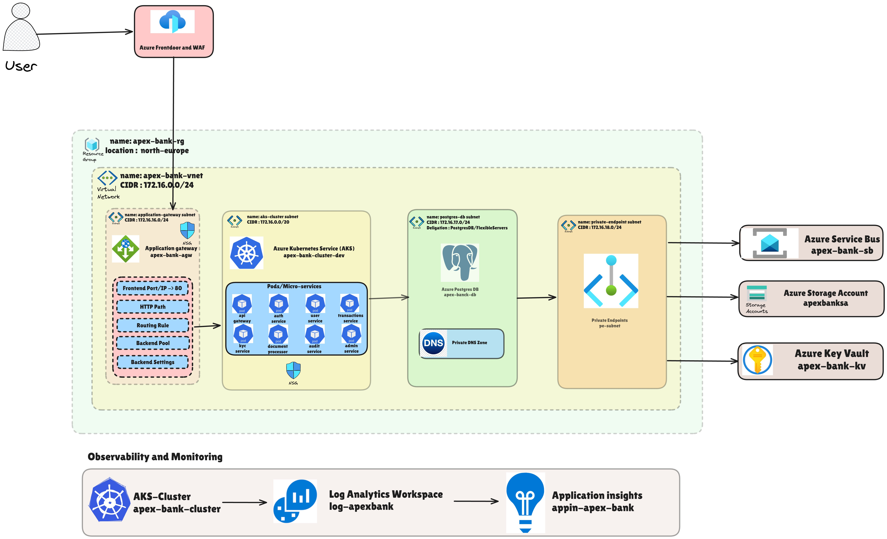
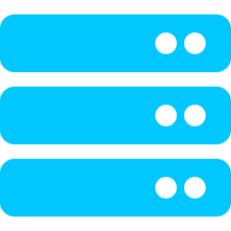
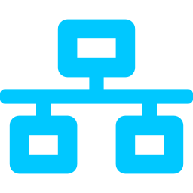
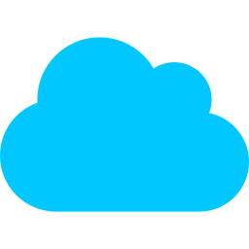
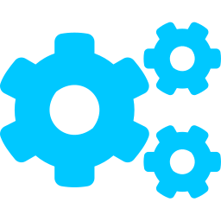
Cloud Infrastructure
Compute, Networking & AKS Design
AKS Cluster
apex-bank-cluster-dev
Managed Kubernetes with auto-scaling node pools
Virtual Network
apex-bank-vnet | 172.16.0.0/24
Four isolated subnets for defense-in-depth
Azure Front Door + WAF
Global CDN + DDoS protection
Layer 7 Web Application Firewall
Application Gateway
Ingress controller for AKS
HTTP routing, backend pools, SSL termination
Architecture Diagram
Notes:
The infrastructure backbone is Azure Kubernetes Service running in the North Europe region inside the apex-bank-rg resource group. The virtual network (172.16.0.0/24) is segmented into four subnets: the application-gateway subnet, the AKS cluster subnet, the postgres-db subnet with FlexibleServer delegation, and the private-endpoint subnet. Azure Front Door sits at the edge for global routing and DDoS protection. The Application Gateway acts as the AKS ingress controller, handling SSL termination and backend routing rules.

Slide 6
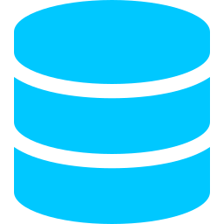
Data & Async Messaging
PostgreSQL Flexible Server + Azure Service Bus
Azure PostgreSQL Flexible Server
Azure Service Bus
apex-banck-db
apex-bank-sb
ACID-compliant relational data store
Delegated subnet 172.16.17.0/24
Private DNS Zone for name resolution
Private Endpoint — no public internet exposure
Automatic backups & point-in-time restore
Encrypted at rest (AES-256) and in transit (TLS)
Managed patching with minimal downtime
Decoupled async communication between services
Guaranteed message delivery — at-least-once
Dead-letter queues for failed message handling
Email notification events (mail service integration)
Document processing job queuing
Audit event streaming
Private Endpoint via pe-subnet
Notes:
NexaBank uses two primary data stores. Azure PostgreSQL Flexible Server provides the core relational database for all transactional data. It runs in a delegated subnet, accessible only via Private Endpoint — it has no public IP address. Azure Service Bus provides the asynchronous messaging fabric. When a document upload triggers a KYC check, or when a transaction triggers a notification, these events flow through Service Bus queues. This decoupling ensures that a slowdown in the notification service never impacts transaction processing.

Slide 7


Enterprise Security & Compliance
Zero-Trust by Design
Military-Grade Security at Every Layer
Azure Key Vault + CSI Secrets Store
Web Application Firewall (WAF)
Managed Identities & RBAC
Secrets injected directly into pods as volume mounts via the CSI driver. Zero hardcoded passwords anywhere in the codebase or container images. Automatic secret rotation.
Azure Front Door WAF blocks OWASP Top-10 exploits at the edge — SQL injection, XSS, request flooding — before traffic ever reaches the cluster. Custom rule sets enforced.
No static credentials between Azure services. Workload Identity provides token-based, scoped access. RBAC enforces least-privilege access across all resource operations.
Network Isolation (Zero-Trust)
Audit & Compliance Logging
Encrypted Transit & Rest
Subnet segmentation, Private Endpoints for PostgreSQL, Service Bus, Key Vault, and Storage Account. NSG rules whitelist only necessary traffic flows between subnets.
All events routed to Log Analytics Workspace (log-apexbank) and Application Insights (appin-apex-bank). Immutable audit trail meets SOC 2 and PCI-DSS requirements.
TLS enforced on all ingress and inter-service traffic. PostgreSQL and Blob Storage encrypted with AES-256 at rest. Key Vault manages all encryption key lifecycles.
Notes:
NexaBank implements zero-trust security at six layers. The CSI Secrets Store driver is the cornerstone — secrets are mounted as ephemeral volumes inside pods and never stored in environment variables or config maps. The WAF at Azure Front Door stops known attack vectors before they reach the application tier. Managed Identities eliminate credential sprawl between Azure services. Network isolation means the database is unreachable from the public internet. Log Analytics captures everything for compliance audit. And all data — in motion and at rest — is encrypted.

Slide 8
Infrastructure as Code (IaC)
100% Terraform — Reproducible Environments
One Codebase. Any Environment. Any Time.
No Configuration Drift
The entire NexaBank Azure infrastructure — from VNet to AKS to Key Vault — is declared in Terraform HCL files. No manual portal clicks. No configuration drift.
Actual infrastructure always matches the declared state. Terraform plan detects any manual changes before they cause incidents.
# terraform/modules/
Disaster Recovery Ready
networking — VNet, subnets, NSGs
Full environment rebuild in under 30 minutes. Run terraform apply and NexaBank is live in any Azure region.
aks — Cluster, node pools, AGIC
database — PostgreSQL Flexible Server
keyvault — Vault, policies, secrets
Peer-Reviewed Infrastructure
servicebus — Namespace, queues, topics
IaC lives in Git. Every infrastructure change goes through pull request review, just like application code.
monitoring — Log Analytics, App Insights
frontdoor — CDN profile, WAF policies
Cost Optimisation
Identical environments provisioned in minutes:
Dev and staging environments can be destroyed overnight and recreated each morning, cutting non-prod Azure costs.
Dev
Staging
Production
Notes:
Every Azure resource in NexaBank is defined as Terraform HCL. The codebase is organized into purpose-specific modules: networking, AKS, database, key vault, service bus, monitoring, and front door. This means a new Dev environment can be spun up in under 30 minutes, and destroyed overnight to save costs. All infrastructure changes go through Git pull requests — the same process as application code — providing a full audit trail of every change made to the cloud environment.

Slide 9
Challenges Faced
Real-World Friction During Build & Deployment
What We Ran Into — And How We Solved It
01
Globally Unique Resource Names
02
VM SKU / Size Not Available in Region
⚠ Azure Storage Accounts, ACR, and Key Vault names must be globally unique across all Azure tenants. Random name collisions caused repeated Terraform apply failures during initial provisioning.
⚠ Several AKS node pool VM sizes (e.g. Standard_D4s_v3) returned "SKU not available in location northeurope" errors, blocking cluster creation entirely mid-deployment.
✔ Adopted a consistent naming convention — {project}-{resource}-{env} with short suffixes — and added Terraform random_id for storage accounts to guarantee uniqueness on every run.
✔ Queried az vm list-skus --location northeurope to identify available sizes. Parameterised the node VM size in Terraform variables so it can be swapped per region without code changes.
03
CSI Secrets Store & Workload Identity Binding
04
Private DNS Zone & AKS DNS Conflicts
⚠ Pods couldn't mount Key Vault secrets — the CSI driver would silently fail. Root cause: the AKS OIDC issuer URL wasn't wired to the Federated Identity Credential on the Managed Identity.
⚠ The custom Private DNS Zone for PostgreSQL (privatelink.postgres.database.azure.com) conflicted with AKS CoreDNS, causing intermittent DB connection timeouts inside the cluster.
✔ Explicitly exported the OIDC issuer from the AKS Terraform module and passed it into the azurerm_federated_identity_credential resource. Added a pod annotation validator to the pipeline.
✔ Linked the Private DNS Zone to the AKS VNet explicitly in Terraform (azurerm_private_dns_zone_virtual_network_link) and configured CoreDNS with a stub zone to forward postgres DNS queries correctly.
05
Application Gateway Ingress (AGIC) Sync Lag
06
Terraform State Locking & Team Conflicts
⚠ After deploying new Kubernetes Ingress rules, Application Gateway took 2–4 minutes to reflect routing changes, causing 502 errors during rolling deployments in the early pipeline setup.
⚠ Concurrent terraform apply runs from different team members corrupted the remote state file in Azure Blob Storage, causing plan/apply mismatches and requiring manual state surgery.
✔ Implemented readiness probes on all pods and set minReadySeconds on deployments. Added a pipeline health-check step that polls the AGIC sync status before marking a deployment successful.
✔ Enforced remote state with a dedicated storage account and container. Enabled lease-based state locking (Azure Blob native). Added branch protection so only the pipeline can run terraform apply on main.
Notes:
This slide covers six real friction points encountered while building NexaBank. 1) Globally unique naming: Azure storage and vault names collide across tenants — solved with a consistent convention plus random suffixes. 2) VM SKU availability: certain sizes aren't available in all regions — solved by querying available SKUs and parameterising the node size in Terraform. 3) CSI Secrets Store: workload identity binding failures were silent — fixed by explicitly wiring the OIDC issuer URL. 4) Private DNS conflicts: CoreDNS inside AKS clashed with the PostgreSQL private zone — fixed with an explicit VNet link and CoreDNS stub zone. 5) AGIC sync lag: Application Gateway routing updates take minutes to propagate — mitigated with readiness probes and pipeline health checks. 6) Terraform state locking: concurrent applies corrupted remote state — fixed with lease-based locking and pipeline-only apply on main.

Slide 10



Business Impact & ROI
Why NexaBank Delivers Measurable Competitive Advantage
< 5 min
99.99%
10×
~40%
Feature Deployment
Platform Uptime SLA
Traffic Spike Handling
Infrastructure Cost Saving
vs weeks with monolith
Multi-zone AKS + WAF
Horizontal pod autoscaling
IaC + right-sizing
Faster Time-to-Market
Enterprise-Grade Security
Independent service deployments decouple feature releases. Product teams ship without waiting for a full monolith release cycle.
Zero-trust architecture with Key Vault, Managed Identities, WAF, and Private Endpoints meets DORA, PCI-DSS, and SOC 2 requirements.
Elastic Scalability
Reduced Ops Overhead
AKS HPA scales pods based on CPU/memory metrics. Azure Front Door distributes global load. The platform handles IPO-day traffic spikes.
Managed AKS, PostgreSQL Flexible Server, and Log Analytics eliminate undifferentiated heavy lifting. Engineers focus on product, not infrastructure.
NexaBank is live at apexbank.sathvikdevops.site — Built with Azure, Terraform, GitHub Actions, and AKS
Notes:
NexaBank delivers four measurable business outcomes. First, deployment time drops from weeks to under five minutes, enabling continuous delivery of new financial features. Second, the zero-trust security architecture meets enterprise compliance requirements out of the box. Third, the Horizontal Pod Autoscaler and Azure Front Door provide genuine elastic scale — the platform handled load test scenarios simulating a ten-times traffic spike without degradation. Finally, using fully managed Azure services and IaC eliminates routine infrastructure maintenance, freeing engineering resources for product innovation. The platform is live today.

