Slide 1
Gen AI Orchestrator for Email and Document Triage/Routing
Team: WorldisAI
Jayaprakash Baduru
Pradeep Narayanaswamy
Thrivikram Chintalapalle
Sathvik S Gunda
Bikash Bhanjababu

Slide 2
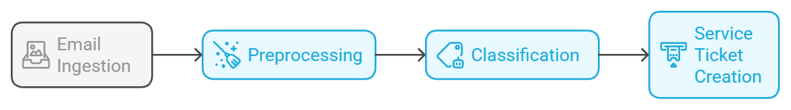
Solution Overview
Email Ingestion – Extracting content & attachments from EML files.
Preprocessing – Cleaning & structuring the data.
Classification – Using GenAI (zero-shot, few-shot, or fine-tuning).
Service Ticket Creation – Automatically generating tickets based on classification results.
Benefits
Quickly route the Customer requests
AI agent classifies the content and automatically creates Service ticket.
Scale on demand & reduce 95% of manual effort
Auto learn based on the Context
Generic Architecture to expand the Solution across Operations.

Slide 3
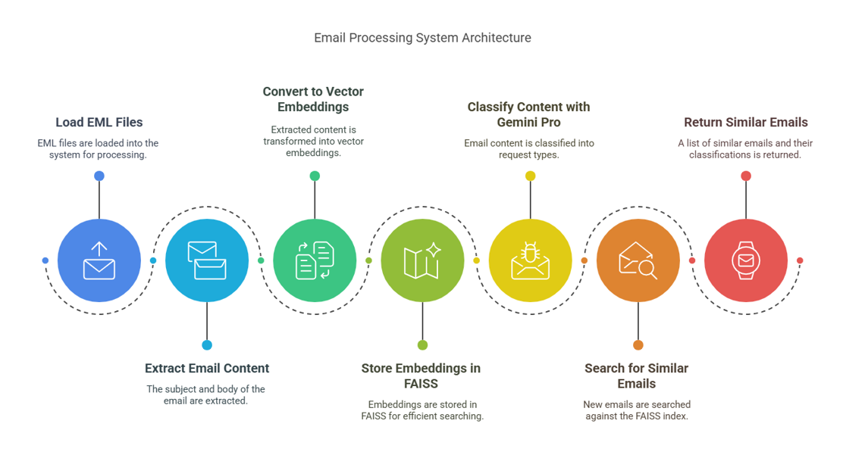
Architecture Overview

Slide 4
Architecture Description
Input: EML Files
EML files are loaded into the system.
eml_extractor.py extracts the subject and body of the email.
Embedding & Indexing
Extracted email content is converted into vector embeddings using SentenceTransformers.
FAISS is used to store and search these embeddings efficiently (faiss_indexer.py).
Classification
Extracted email content is sent to Gemini 1.5 Pro latest which classifies it into request type and sub-request type (classifier.py).
The classification schema is predefined with fuzzy matching.
Querying & Similarity Search
A new email is classified and searched against the FAISS index to find similar past emails (main.py).
The system returns a list of similar emails along with their classifications.
Tech Stack
Python
Gemini-1.5-pro-latest LLM
FAISS vectordb
Sentence-transformer embeddings

Slide 5
Demo
Link:
https://www.loom.com/share/693f397ef591411aaa06bf4e5b8ad53a?sid=cc0adb35-81e8-4750-bb4f-8e1abac6c573

Slide 6
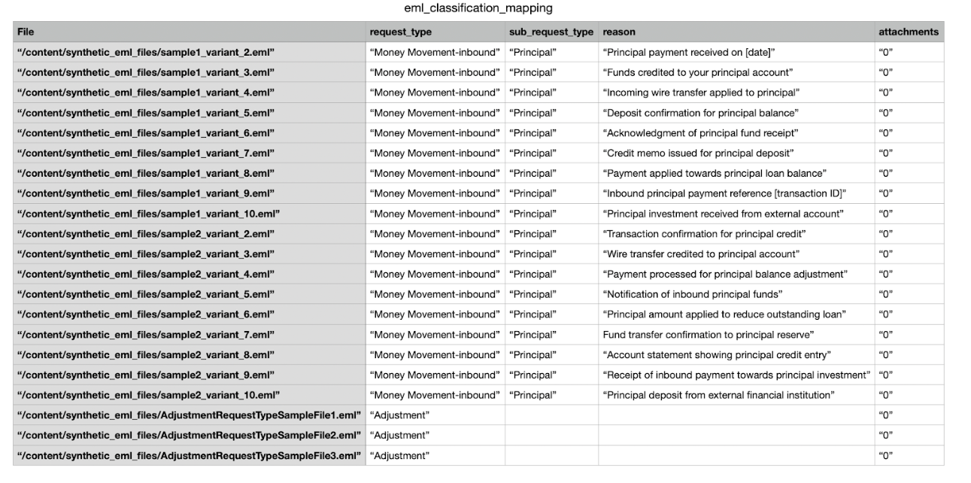
Model Training Data

Slide 7
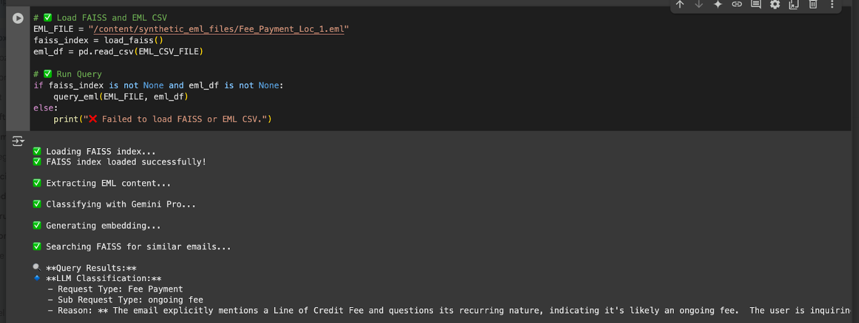
Email Query and Classification Output
Input Email:
Output:

Slide 8
Thankyou

