Slide 1
MACHINE LEARNING PROJECT | CNN + AUDIO CLASSIFICATION
CNN Based Car Model
Detection Using
Car Horn Sound
Audio Signal Processing • Deep Learning • Transfer Learning • Image Classification
PyTorch
GoogLeNet
ResNet50
librosa
Mel Spectrogram
MFCC
Google Colab

Slide 2
Problem Statement
"Can we identify a car model just by listening to its horn?"
The Challenge
The Motivation
Our Approach
Every car model has a distinct horn frequency and timbre — but identifying it manually is difficult, inconsistent, and time-consuming.
Useful in smart traffic systems, vehicle identification in fog/night conditions, and law-enforcement vehicle monitoring.
Record horn audio → convert to Mel Spectrogram & MFCC images → train CNN (GoogLeNet / ResNet50) to classify car model.

Slide 3
Project Pipeline
01
Data Collection
02
Augmentation
03
Feature Extraction
26 car horn files
(.mp3 / .m4a / no-ext)
7 transforms
Gaussian, pitch, stretch…
Mel Spectrogram
+ MFCC images
04
Dataset Split
05
CNN Training
06
Prediction
70% train
15% val / 15% test
GoogLeNet &
ResNet50
Confidence filter
+ Majority voting

Slide 4
Data Collection & Augmentation
Dataset Statistics
7 Augmentation Techniques
Car Models
26
Gaussian Noise
Simulates road background noise
Raw Audio Files
26 files
Pitch Shift ↑
Higher frequency variation
Format
.mp3, .m4a, no-extension
Duration per file
~10 seconds
Pitch Shift ↓
Lower frequency variation
Chunk Size
2 sec (50% overlap)
Time Stretch ↑
Faster horn playback
Chunks per file
~9 chunks
Augmentations
7 types
Time Stretch ↓
Slower horn playback
Images per chunk
2 (Spec + MFCC)
Gain (±6dB)
Volume variation
Total Images
~3,200+
Train / Val / Test
70 / 15 / 15 %
Time Shift
Temporal offset of clip

Slide 5
Feature Extraction — Mel Spectrogram & MFCC
Raw Audio
(.mp3/.m4a)
Load with
librosa
Split into
2s chunks
Mel Spec
+ MFCC
224×224
PNG image
Mel Spectrogram (cmap: inferno)
MFCC (cmap: viridis)
Converts audio to frequency vs time image
Mel Frequency Cepstral Coefficients
Uses Mel scale — mimics human hearing
40 MFCC coefficients extracted
Power converted to dB (log scale)
Captures vocal-tract like characteristics
128 frequency bins × time frames
Better at capturing texture/timbre
Captures horn pitch & timbre patterns
Complementary to Mel Spectrogram

Slide 6
Model Architecture — Two CNN Models Compared
GoogLeNet (Inception v1)
ResNet50 (Fine-Tuned)
Pretrained
ImageNet weights (pretrained=True)
Pretrained
ImageNet weights (pretrained=True)
Frozen layers
All layers frozen except final fc
Frozen
Early layers frozen
Final layer
fc replaced → Linear(1024, 26)
Unfrozen
layer3 + layer4 trainable
Optimizer
Adam, LR = 0.001
Final layer
Dropout(0.5) + Linear(2048, 26)
Loss
CrossEntropyLoss
Optimizer
Adam (layer-wise LR: 1e-4 / 1e-3)
Epochs
20 epochs
Scheduler
ReduceLROnPlateau (patience=2)
Batch size
32
Epochs
20 epochs
Output
Tuple → outputs[0] used
Best model
Saved via val accuracy checkpoint

Slide 7
Training Strategy & Data Transforms
GoogLeNet Training
ResNet50 Training
Simple transform: Resize(224,224) + ToTensor()
Rich transforms: Flip, Rotate±15°, ColorJitter
Handles tuple output → outputs[0]
Affine translate, Normalize ImageNet stats
20 epochs, batch=32, validation after each epoch
Up to 20 epochs with early stopping (patience=5)
Model saved as car_model.pth
Best model saved as best_model.pth
Prediction Logic
Chunk audio Audio split into 2-second non-overlapping chunks
Majority voting Final car model = class with most valid votes across all chunks
Dual features Each chunk → Mel Spectrogram + MFCC image → both fed to model
Entropy check ResNet50: if entropy > 2.5 → result flagged as UNCERTAIN
Confidence filter Only predictions with confidence > 70% are kept

Slide 8
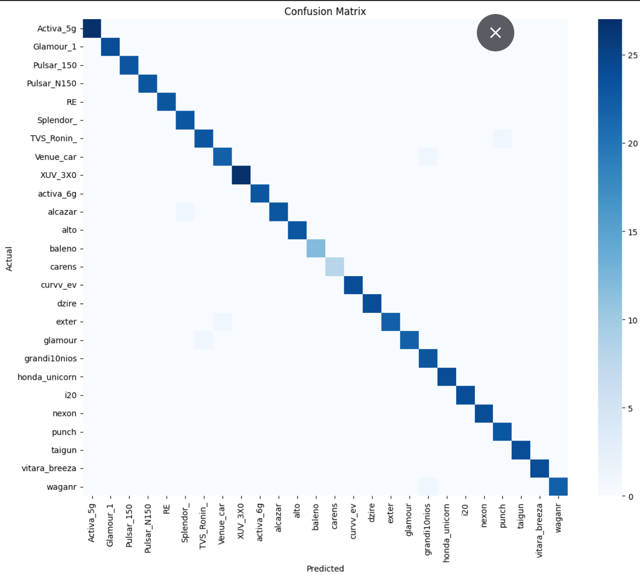
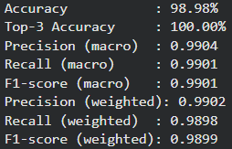
Results & Evaluation Metrics

Slide 9
Tools & Technologies
Platform
Audio Processing
Google Colab Free GPU (T4), Drive integration
librosa Load audio, Mel Spectrogram, MFCC
Python 3 Core programming language
audiomentations 7 augmentation transforms
PyTorch Deep learning framework (not TensorFlow)
pydub + ffmpeg Handle .mp3, .m4a, no-extension files
CNN Models
Evaluation
GoogLeNet (Inception v1) Pretrained, 5 epochs, simple classifier
scikit-learn Accuracy, Precision, Recall, F1, Confusion Matrix
ResNet50 Fine-tuned layers 3+4, Dropout, 20 epochs
seaborn + matplotlib Heatmap visualisation
torchvision.models Pre-trained model loading
torch.topk Top-3 accuracy computation

Slide 10
Challenges & Future Scope
Challenges Faced
Future Scope
Limited Raw Samples
Real-time Detection
Only 26 audio files — solved via 7-type augmentation
Deploy on mobile/web app for live horn identification
Mixed Audio Formats
Larger Dataset
.mp3, .m4a, no-extension — pydub + ffmpeg fallback
100+ samples per class for higher classification accuracy
EfficientNetB0
GoogLeNet Tuple Output
Swap backbone for potentially better accuracy/speed tradeoff
model() returns tuple — must use outputs[0]
Edge Deployment
Overfitting Risk
Run on Raspberry Pi for smart traffic intersection systems
Dropout + early stopping + rich data transforms
Multi-horn Detection
Real-world Noise
Classify multiple simultaneous horns in busy street audio
Gaussian noise aug simulates road background noise
LSTM + CNN Hybrid
Add temporal sequence modeling for richer feature capture

Slide 11
Conclusion
We successfully built a complete end-to-end CNN pipeline that identifies car models from horn sounds — using audio features as images and transfer learning on pretrained CNNs.
01
Collected 26 real car horn recordings and expanded to 3,200+ images using 7 augmentation techniques + Mel Spectrogram & MFCC dual features
02
Trained and compared two CNN models — GoogLeNet (5 epochs, simple) and ResNet50 (fine-tuned layer3+4, early stopping, richer transforms)
03
Implemented a robust prediction system with 70% confidence filtering, majority voting across chunks, and entropy-based rejection
04
Evaluated using Accuracy, Top-3 Accuracy, Precision, Recall, F1-score (macro & weighted) and Confusion Matrix via scikit-learn
Thank You

