Slide 1




SAFE-STREET
23P81A6905
Mentor – Mrs.Navatha
A.RUSHIKA
- Road-Damage Detection
G-386
AI-powered Damage-Detection:
End-Deliveries:
The system will analyze road images using a VIT model, detect damage types, assess severity, assign repair priority, and generate summary reports with classification and confidence scores.
Our project uses Vision Transformers (VIT) to automate damage detection and prioritization, making inspections faster, smarter, and more reliable.
01
03
Business Problems:
Our Solution:
02
04
Current road inspections are time-consuming, error-prone, and lack consistency. Subjective evaluations cause reporting issues, and poor prioritization leads to inefficient maintenance scheduling.
Our system automates damage detection and categorization using deep learning ,ensures standardized reporting and provides data-driven sights to help prioritize urgent repairs

Slide 2





Productivity Enhancement
Pain Points Resolved
Our system automates damage detection and reporting, improving accuracy and speeding up decisions.
Uses AI and a real-time dashboard to eliminate delays, errors, and inconsistent assessments.
Roles
Common People
Admin
Maintainance
AI-Engineer
Upload road images and receive damage reports
Manage users and monitor reports via dashboard.
Ensure server health and app uptime.
Monitor model performance and handle retraining.

Slide 3




DATA-SET : Road-damage data set
DATA-SOURCE : Collected from Data Ninjas platform
TECH - STACK
Front End:
React
Resizing
01
Back End:
Normalization
02
Express & Node
Noise Reduction
03
Data Augmentation
04
Contrast Echancement
AI Models:
05
VIT
Edge Detection
06
RGB Conversion
07
Database:
MongoDB

Slide 4
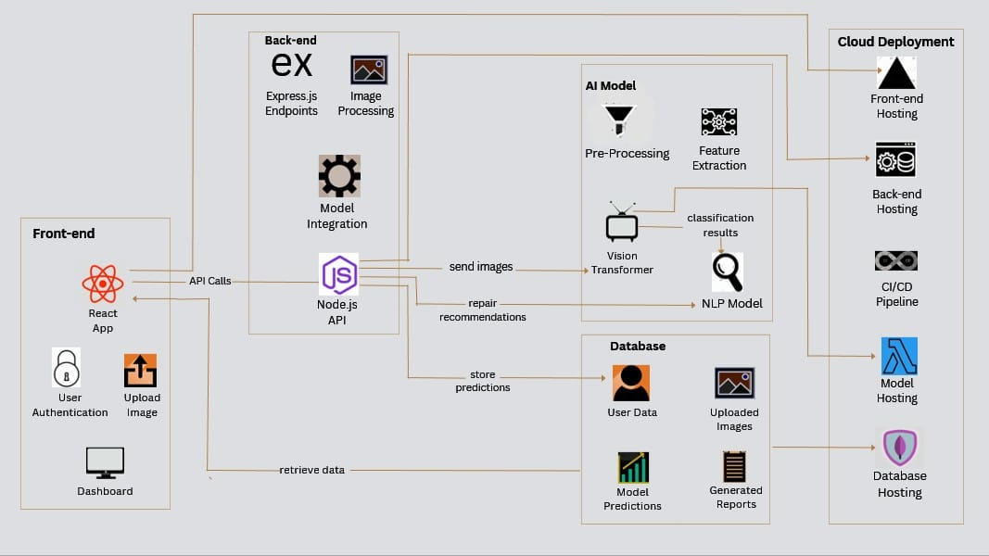
Architecture-Diagram:

