Slide 1

Lost & Found Application
Presented By:
T K S Sathvik
Navya Sri
Vinay Karthik
Vyshnavi
Mounika
Under The Guidance of
Suramya Biswas

Slide 2

Identifying the Campus Lost Item Problem
In a busy college environment, students often misplace items like ID cards, books, or gadgets. Without a proper system, these items are hard to recover.
Our Lost and Found Management System provides a secure and centralized platform where users can easily report lost or found items.
It helps save time, improves communication, and builds a more responsible and connected campus community.

Slide 3

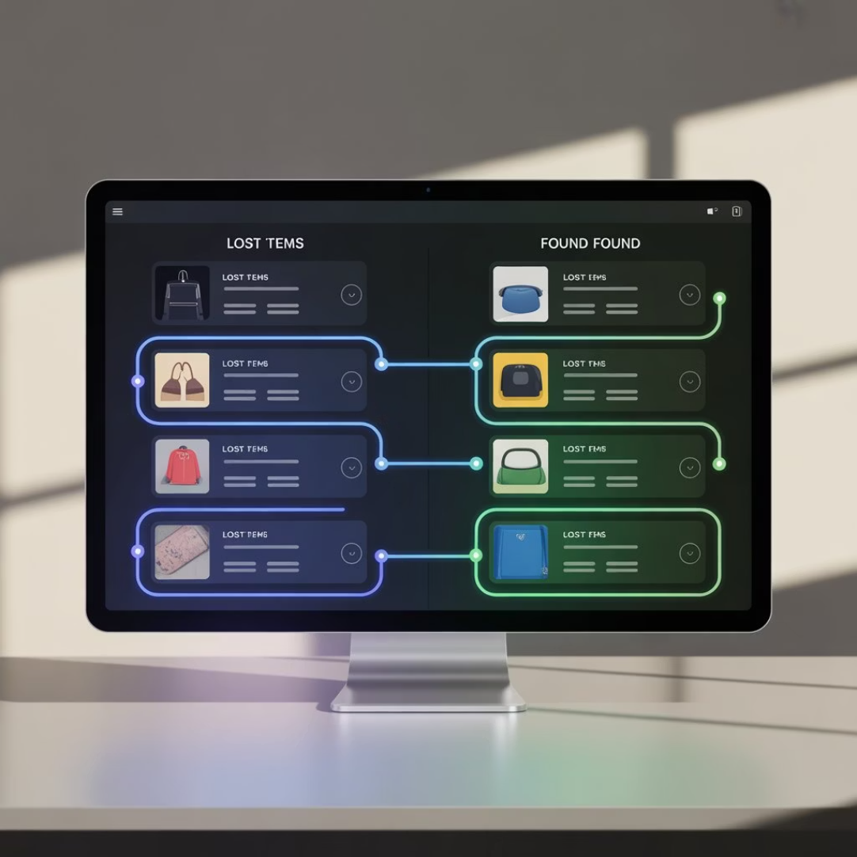
Problem Identification & Proposed Solution
The Problem: Lost Items on Campus
The Proposed Solution: A Digital Platform
Lost items in college campus often lead to frustration and inefficiency due to reliance on manual processes (e.g., physical notice boards, security office visits). There is a clear need for a streamlined, digital solution to manage these incidents effectively.
We propose a web application designed to connect users who lost or found items using smart matching technology. This digital solution will centralize the process, making it easier and faster for items to be returned to their rightful owners.

Slide 4



Our Mission and Goals
Security Digital platform
Quick Connection
Transparency and Safety
To create a secure digital platform that simplifies lost & found item management.
Enable quick connection between users through automated item matching.
Enhance transparency and campus safety through verified listings and admin moderation.

Slide 5
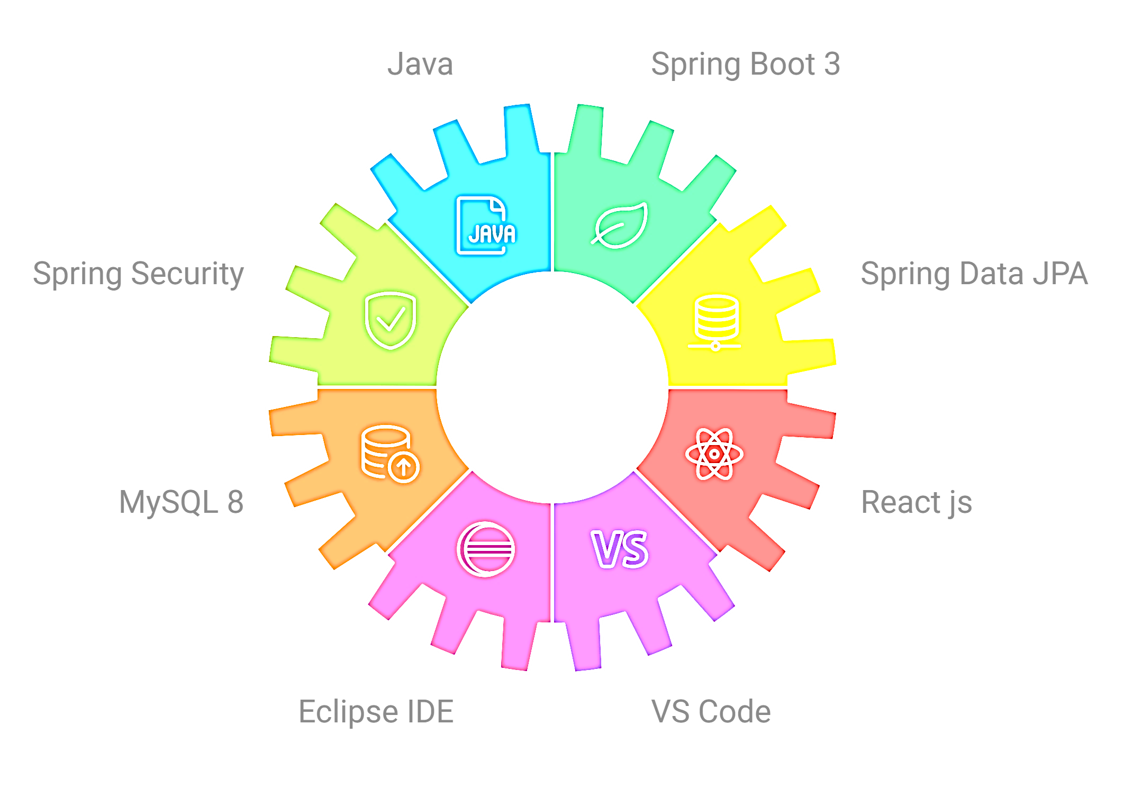
Development Environment & Tools
TECHNOLOGY STACK

Slide 6
System Architecture
Frontend(react)
React-based dynamic UI
User
End user interacting with UI
System Architecture
Flow
Backend(spring boot)
REST APIs handling logic
Database(SQL)
Persistence via Spring Data JPA

Slide 7
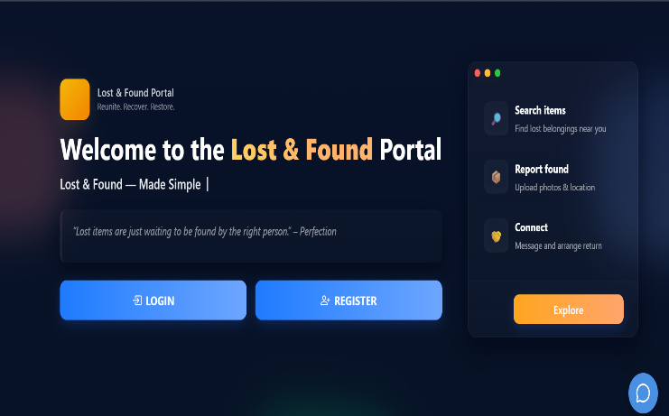
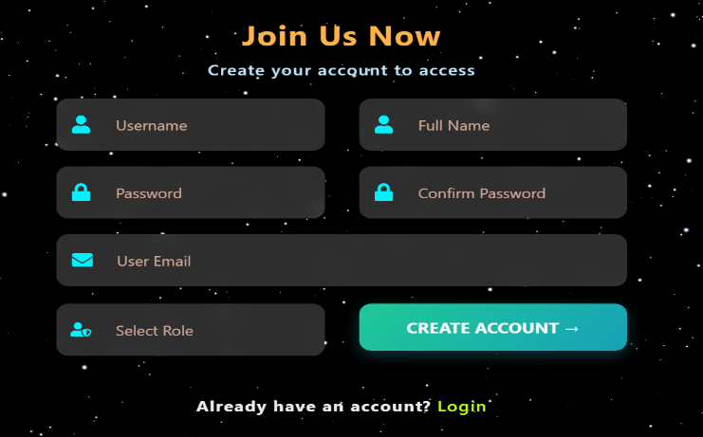
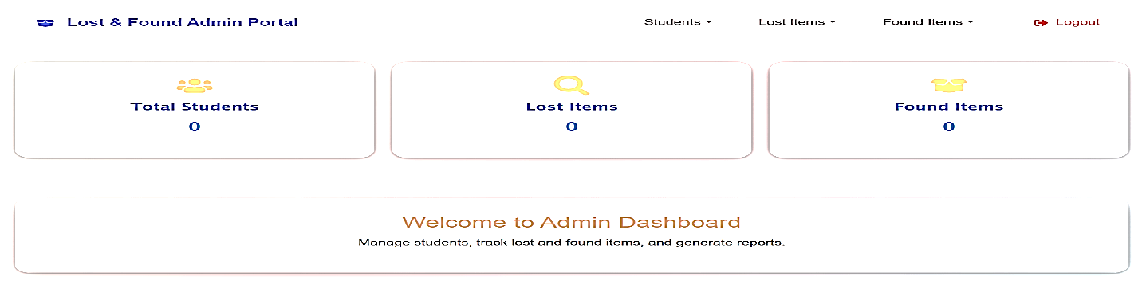
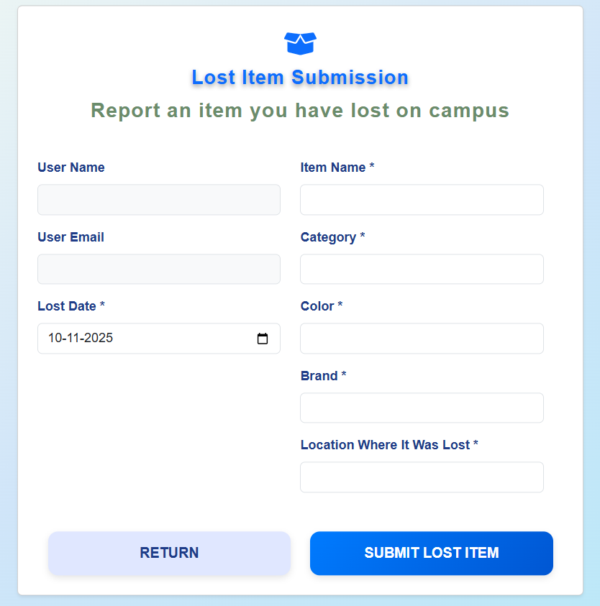
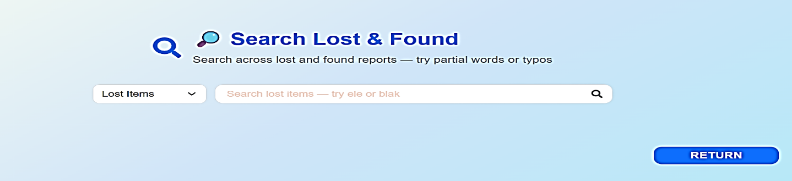
Implementation SnapShots
Secure RESTful APIs
Built with Spring Boot, providing a reliable and scalable backend.
Smart Matching & Search Features
Implements fuzzy search and potential match detection using intelligent comparison algorithms.
Real-Time Communication
Integrated WebSocket-based Chat System for direct interaction between students.
Integrated MySQL Database
Backend integrated with MySQL to store user and item details securely.

Slide 8
Core Modules & Functionalities
Authentication & Role Management
Auto-Matching & Smart Search
Post Lost / Found Items
Admin Dashboard & Analytics
Chat / Contact System
Extras:
Campus-restricted listings
Admin moderation for content quality
Real-time matching engine

Slide 9



User Roles
Student: Can post sand search for lost or found items.
Admin: Verifies and moderates posts for security.
Finder: Helps connect and return found items.

Slide 10





Planned Enhancements & Roadmap
AI-based Search
Email / Notification System
Image Recognition
Semantic keyword matching
For alerts and updates
To identify visuality
Mobile App Integration
Advanced Analytic Dashboard
For better accessibility
For admins

Slide 11
Overcoming Development Challenges
Integrating frontend & backend
Used REST APIs and CORS configuration
Data consistency
Implemented JPA Repository with proper constraints
Matching lost/found items efficiently
Developed keyword-based matching algorithm

Slide 12

Conclusion & Learnings
Scalable Application
Full-Stack Development
Successfully developed a scalable full-stack web application.
Improved understanding of full-stack development lifecycle.
Teamwork & Skills
Strengthened teamwork, version control, and deployment skills.

Slide 13
Thank you

