Slide 1
Numpy Structured Arrays

Slide 2
Introduction
A Structured Array in NumPy is a special type of array where each element can contain multiple named fields — similar to columns in a database table or attributes in a record.
It allows you to store heterogeneous data (mixed types — integers, floats, strings, etc.) in a single NumPy array.
Think of it as a table:
Each row = one record (like a student or employee)
Each column (field) = one attribute (like name, age, salary, etc.

Slide 3
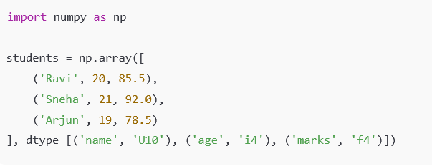
Syntax
numpy.array(data, dtype=[(field_name, data_type), ...])
Example:

Slide 4
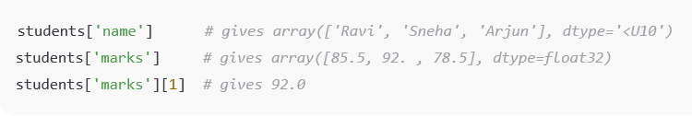

Accessing Data
You can access fields using their names (just like dictionary keys):
Performing Operations:You can use NumPy operations directly on a specific field:
Output:
[90.5 97. 83.5]
Sorting Structured Arrays:Use the np.sort() function with the field name in the order
argument.
Sorts by the ‘marks’ field (ascending by default).
Use [::-1] to reverse (for descending order).

Slide 5


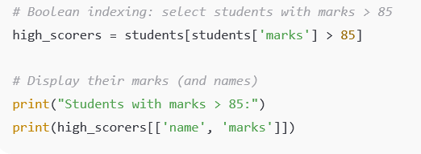
Filtering Data:Apply conditions directly on fields
Adding New Records:You can add new rows using np.append()
Using Boolean Indexing
students['marks'] > 85 → returns a Boolean array: [ True, True, False, True ]
This is used to filter only the rows where the condition is True.
Then [['name', 'marks']] extracts only those two fields for display.

Slide 6
Display all marks:
print("All marks:", students['marks'])
Find minimum mark
min_mark = np.min(students['marks'])
print("Minimum mark:", min_mark)
Find Maximum mark:
max_mark = np.max(students['marks'])
print("Maximum mark:", max_mark)
Find average mark:
avg_mark = np.mean(students['marks'])
print("Average mark:", avg_mark)

Slide 7
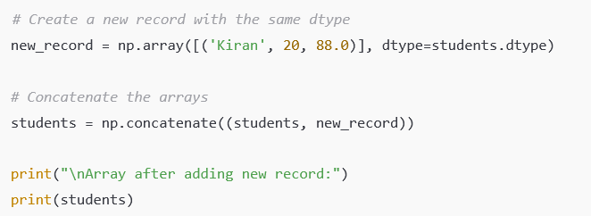
Add a New Record Using Concatenation
Array Creation and Concatenation
Function | Purpose | Example
np.array() | Create a structured array | np.array([...], dtype=...)
np.concatenate() | Combine two arrays | np.concatenate((a, b))
np.append() | Add elements to the end | np.append(a, new_record)
np.zeros() | Create an empty array with zero values | np.zeros(3, dtype=[('x','i4'),('y','f4')])
np.empty() | Create an uninitialized array | np.empty(2, dtype=students.dtype)

Slide 8
Information and Inspection
Function | Purpose | Example
arr.dtype | Show structure definition (field names & types) | students.dtype
arr.shape | Get number of rows | students.shape
arr.size | Count number of elements (records) | students.size
arr.ndim | Number of dimensions | students.ndim
arr.itemsize | Bytes per element | students.itemsize
arr.nbytes | Total memory usage | students.nbytes
arr['field'].dtype | Type of a specific field | students['marks'].dtype

Slide 9
Mathematical and Statistical Operations
Function | Purpose | Example
np.min() | Minimum value | np.min(students['marks'])
np.max() | Maximum value | np.max(students['marks'])
np.mean() | Average value | np.mean(students['marks'])
np.median() | Median value | np.median(students['marks'])
np.std() | Standard deviation | np.std(students['marks'])
np.sum() | Sum of field values | np.sum(students['marks'])

Slide 10
Sorting and Filtering
Function | Purpose | Example
np.sort() | Sort array by field | np.sort(students, order='marks')
np.argsort() | Get sorted index positions | students[np.argsort(students['marks'])]
Boolean Indexing | Filter records | students[students['marks'] > 85]
Compound Filter | Combine conditions | students[(students['marks']>80) & (students['age']>20)]

Slide 11
Field and Record Access
Function | Purpose | Example
arr['field'] | Access single field | students['name']
arr[['field1','field2']] | Access multiple fields | students[['name','marks']]
arr[index] | Access specific record | students[2]
arr[index]['field'] | Field from a specific record | students[2]['marks']
Utility Functions
Function | Purpose | Example
np.unique() | Get unique values | np.unique(students['age'])
np.where() | Find indices meeting condition | np.where(students['marks'] > 90)
np.copy() | Make a deep copy | new_arr = np.copy(students)
np.delete() | Remove records | np.delete(students, 1)
np.save() | Save to .npy file | np.save('students.npy', students)
np.load() | Load .npy file | students = np.load('students.npy')

