Slide 1
Productivity Shocks and Sectoral Output Dynamics in India
A DSGE-Inspired Empirical Analysis
Maddipati Sathvika
22113083

Slide 2
Problem Statement & Motivation
Why this study?
Productivity shocks do not affect all sectors equally
Sectoral heterogeneity matters for policy and business strategy
India-focused evidence is limited
Conceptual intuition
Productivity shocks → deviations from trend
Sectoral output responds differently over time

Slide 3
Data & Preprocessing
Key Transformations
Per-worker normalization (GDP, capital)
Growth rates to capture short-run dynamics
Annual data aligned across sources
Why this matters
Ensures macroeconomic comparability
Focuses analysis on productivity and dynamics, not raw scale
Raw data
Per-worker Measures
Growth Rates

Slide 4
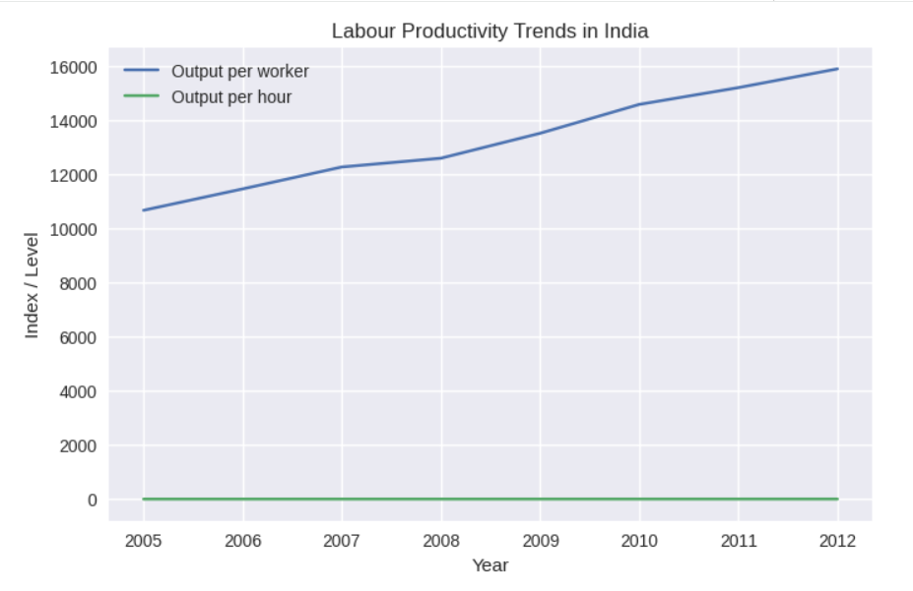
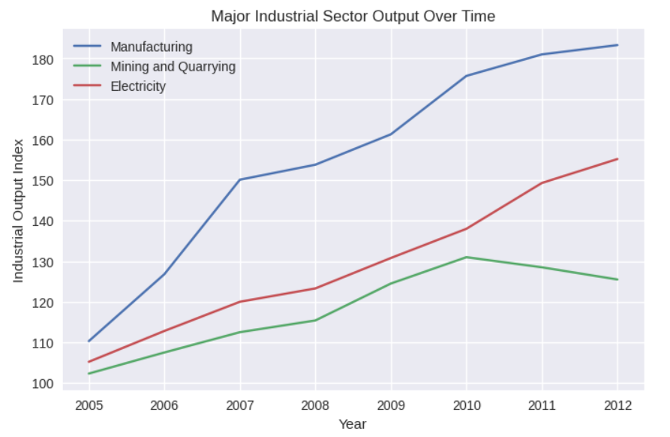
Exploratory Data Analysis (EDA)
Key EDA Insights
Productivity shows long-run growth with cyclical fluctuations
Manufacturing & mining are more volatile
Utilities are relatively stable

Slide 5
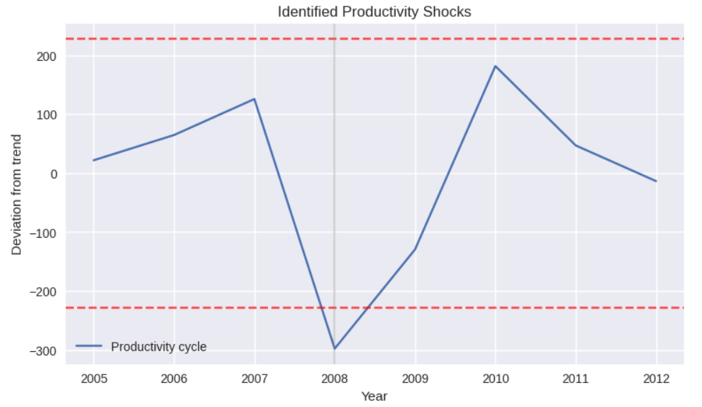
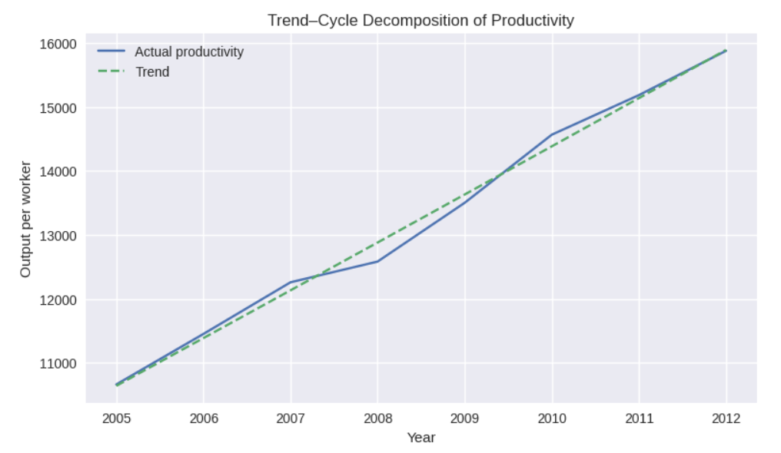
Identifying Productivity Shocks
Method
Decompose productivity into:
  Long-run trend
  Short-run cyclical component
Define shocks as unusually large negative deviations from trend.
Interpretation
Shocks represent economy-wide disturbances.
No reliance on historical event labeling.
Transparent, rule-based identification.

Slide 6
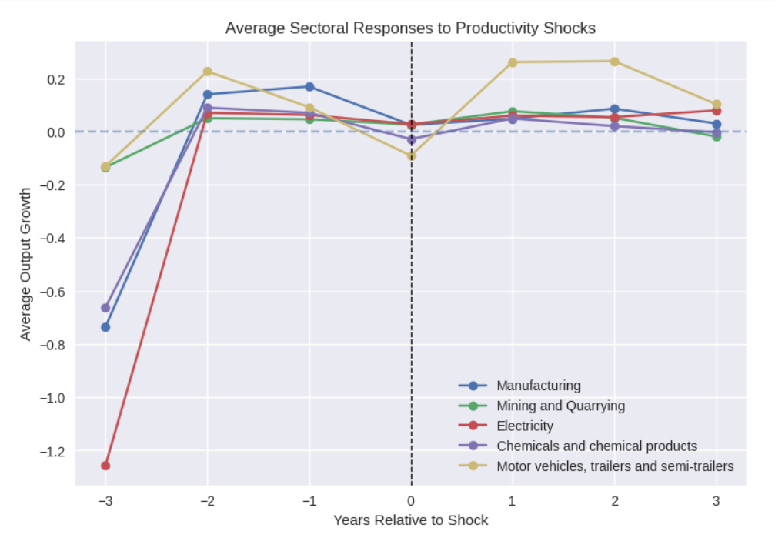
Event Study – Sectoral Responses
Approach
Track sectoral output growth:
  Before the shock
  During the shock
  After the shock
Key Findings
Manufacturing exhibits stronger sensitivity to productivity shocks.
Capital-intensive sectors adjust more slowly.
Electricity and utilities display greater resilience.

Slide 7
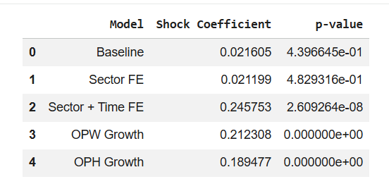
Modelling & Benchmarking
Models Used
Linear regressions with productivity and macro controls
Sector fixed effects
Naive benchmarks for comparison
Results
Interpretation
Associations, not causal claims.
Emphasis on consistency and interpretability.

Slide 8
Implications & Conclusion
Key Takeaways
Productivity shocks matter for sectoral output
Manufacturing is most exposed
Utilities are more resilient
Implications
Targeted policy beats uniform policy
Risk-sensitive sectoral investment is essential

Slide 9
Thank You

