Slide 1

Summer Internship
Estimation of Traffic Flow Using Google API
Prof Satish Chandra
Maddipati Sathvika
22113083

Slide 2
Origin of the idea
Traffic performance measures—speed, density, and flow—form the basis of congestion assessment, road capacity planning, and operational control.
Traditional survey methods like manual counts, road-side cameras, and sensors are reliable but resource-intensive and difficult to scale.
This internship explores digital mobility data coupled with computer vision-based vehicle detection to build a scalable, low-cost approach for traffic monitoring.
Research Problem - How can traffic flow be estimated in real time using digital speed streams and field-verified vehicle counts, without depending on physical sensing infrastructure?

Slide 3
Objectives
To estimate traffic flow using real-time stream speed data from the Google Distance Matrix API.
To predict the number of vehicle present on a road segment at any given time.
To reduce the dependency on physical infrastructure like sensors and manual surveys.
To develop a cost-effective, scalable, and practical solution for traffic monitoring and management.
To improve the accuracy of traffic flow estimation while keeping the model simple and efficient.

Slide 4
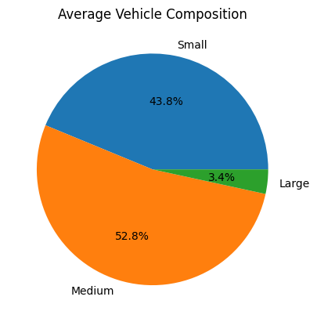
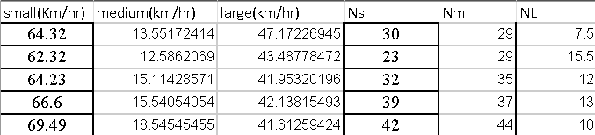
Training Dataset
The training dataset was collected from four different locations to capture variability in traffic conditions and ensure that the model learns from diverse scenarios.
The vehicles were categorized into three types:
Small → two-wheelers such as bikes and scooters
Medium → cars, vans, and three-wheelers
Large → heavy vehicles such as buses and trucks

Slide 5
Testing Dataset – Collection
Data Acquisition Pipeline
Component | Purpose
Google mobility API | Extract real-time stream speed
Field video recordings | Generate ground-truth vehicle counts
YOLO-based object detection | Classify vehicles from video frames
ML models | Predict traffic density & flow
API Based Speed Collection
Real-time speeds queried at ~5-minute intervals
API parameters included origins, destinations, mode, departure time
Extracted travel time → converted to average stream speed

Slide 6
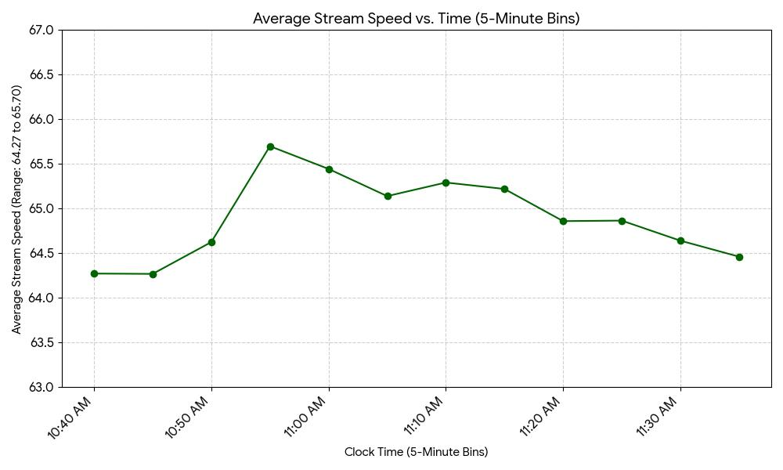
Testing dataset – Collection

Slide 7
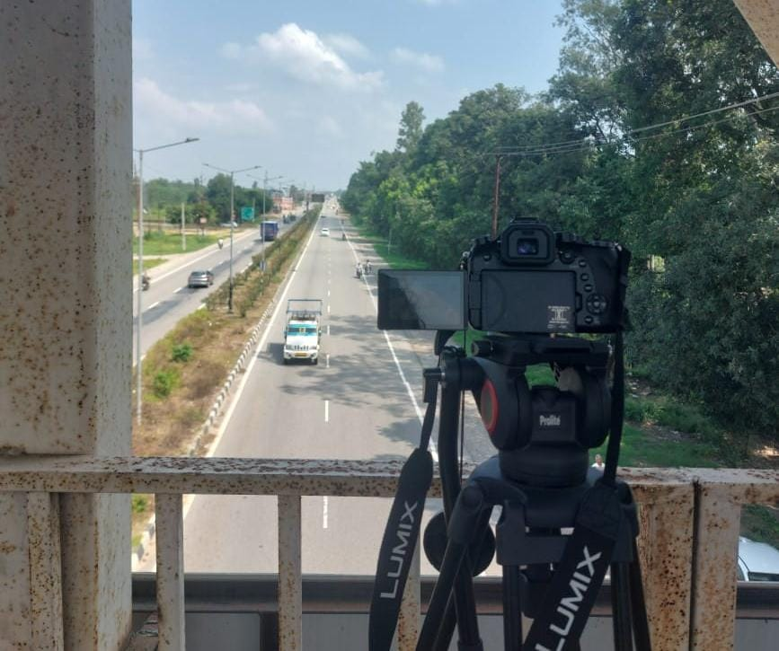
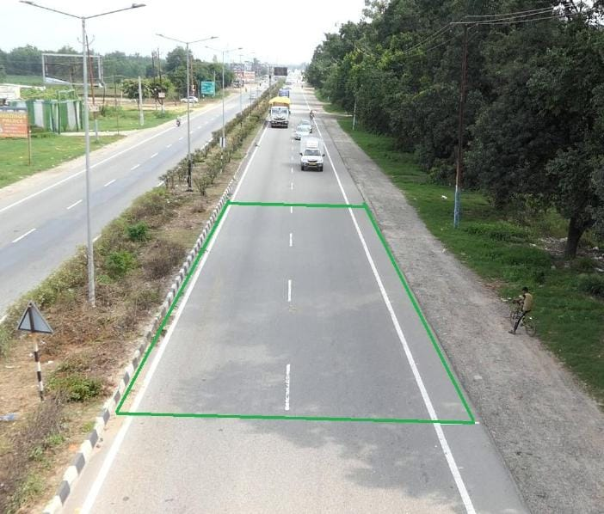
Testing Dataset – Collection
Field Video Capture
Foot-over-bridge vantage for clear view
Road section (“trap”) length: 40m × 7m
Footage synchronized with speed extracts
Ensured complete vehicular visibility & frame alignment
Camera setup for video recording
Defined trap region on the roadway for
vehicle detection

Slide 8
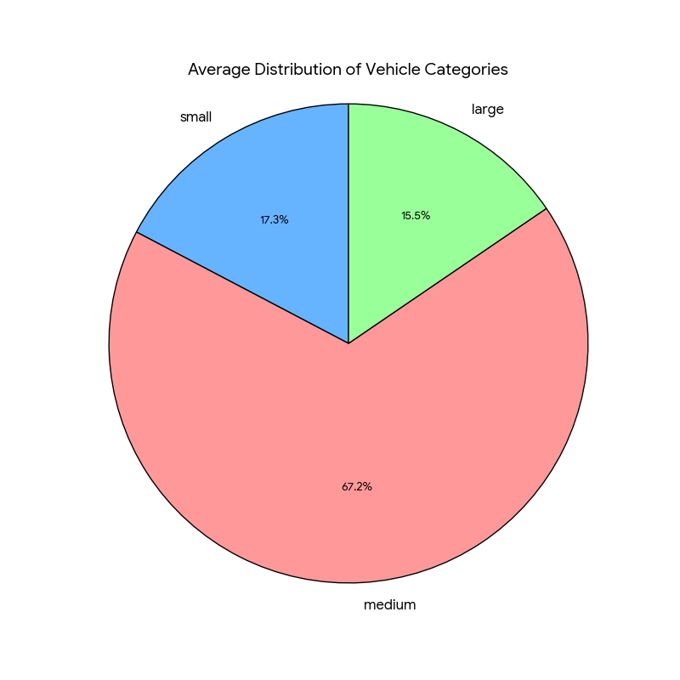
Testing dataset – Extraction
The recorded video was processed using YOLOv8s, an object detection model optimized for real-time detection and classification of vehicles.
YOLOv8s divided each frame into grids, predicted bounding boxes and class probabilities, and identified vehicles such as cars, bikes, buses, and trucks.
The extracted vehicle counts were grouped into small, medium, and large categories, serving as the ground truth for validating the model’s predictions.

Slide 9
Modelling
Machine Learning Models
K-Nearest Neighbors (KNN)
Random Forest
Gradient Boosting
Support Vector Regression (SVR)
Why these models? To balance non-linear learning, robustness to noise, and interpretability.

Slide 10
Results
1. RMSE
MODEL | Small | Medium | Large | Combined
KNN | 20.055 | 15.586 | 5.550 | 15.010
Gradient Boosting | 20.548 | 16.323 | 6.304 | 15.582
Random Forest | 21.048 | 16.071 | 6.111 | 15.691
SVR | 22.956 | 19.135 | 4.950 | 17.489
2. MAE
Model | Small | Medium | Large
KNN | 17.914 | 11.722 | 4.111
Gradient Boosting | 18.622 | 12.960 | 4.940
Random Forest | 18.652 | 13.212 | 4.819
SVR | 22.370 | 15.256 | 3.771

Slide 11
Inferences
KNN achieved the lowest combined SE, making it the best overall model.
Random Forest produced the best results for small vehicles, showing strong stability in high-variability flows.
KNN performed best for medium and large vehicles, capturing local traffic patterns effectively.
SVR achieved the lowest error for large vehicles but was weaker for small and medium categories.

Slide 12
Modelling – Density and Flow
Traffic flow can be estimated using the basic transport equation:
Flow (Q)=Density (k)×Velocity (v)
Velocity (v): Average speed of vehicles in the traffic stream.
Density (k): Number of vehicles per unit length of roadway (vehicle/km/lane).
Once density is determined, flow can be directly estimated using observed or predicted velocity values.
Stream speed
Density
Model training
Flow Prediction

Slide 13
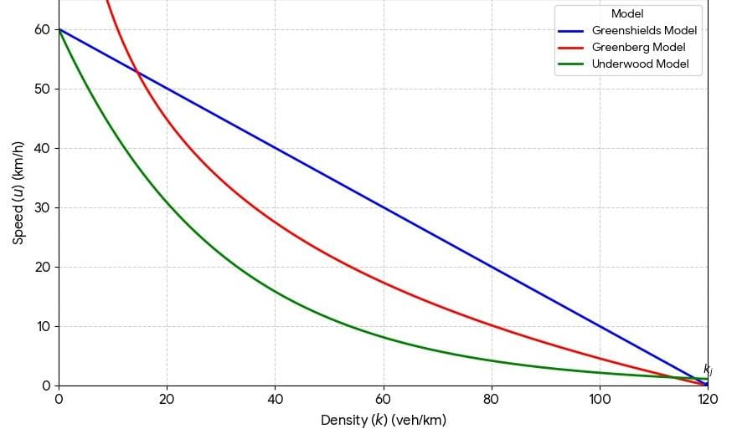
Density Calculation
Since no single model performs well across all velocities, a hybrid model combining the three is used for better accuracy.

Slide 14
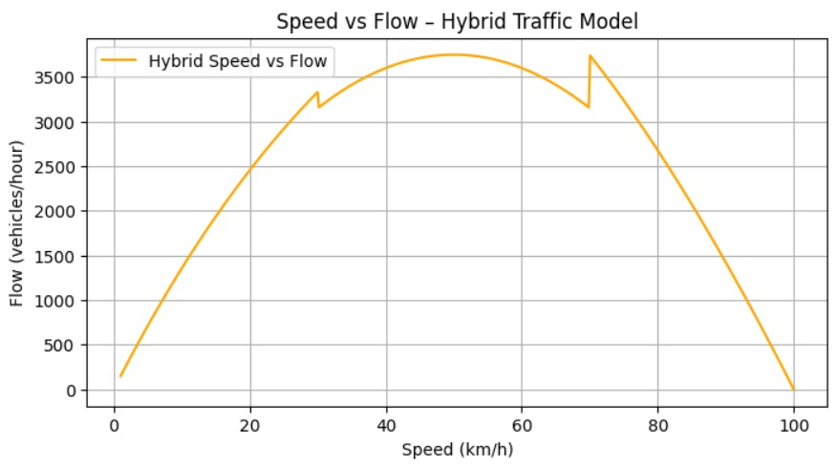
Hybrid Model
Speed- Regime Based Density Allocation
Model | Speed Range | Condition
Underwood | 56-80 km/h | Free-flow, higher speeds
Greenshields | 24-56 km/h | Mid – Density Regime
Greenberg | 0-24 km/h | Congested Conditions, Low speed

Slide 15
Conclusion
Explored mathematical + ML approaches for traffic flow estimation
KNN : Best overall for total vehicles (lowest SE)
Random Forest & Gradient Boosting : Stable and reliable alternatives
SVR : Strong for heavy vehicle patterns
Hybrid Density Model: Effective for total vehicle estimation and provides interpretability grounded in traffic theory
Overall Insight:
ML outperforms classical methods
Hybrid Density is valuable for aggregate flow prediction
Future Work:
Multi-lane vehicle distribution modelling
Extended local training dataset for YOLO
Testing deep learning architectures (e.g., LSTM, TCN) for temporal traffic patterns
Applications in urban ITS & congestion analytics

Slide 16
Thank you

