Slide 1

CEN-300:Practical Problem
Visual Attention Behavior of Distracted Pedestrians
Hansika Soni(22113054)
Kare Dinesh Kumar(22113071)
Khushi Bhati(22113077)
Maddipati Sathvika(22113083)

Slide 2
Index
Introduction
Experiment Simulator
Conditions of Experiment
Activities Recorded
Data Extraction
Data Transformation
Data Description
Results

Slide 3
Introduction
Pedestrian safety remains a critical global issue, with road crossing being one of the most cognitively demanding pedestrian tasks. Successful crossing requires constant situational awareness and relies heavily on both explicit cues (such as traffic signals and honking) and implicit communication (such as gaze and gestures). Among these, gaze behavior plays a vital role in helping pedestrians assess traffic dynamics and determine safe crossing opportunities. However, multitasking activities like using a mobile phone or observing roadside advertisements can disrupt gaze patterns and impair attention. This study aims to model Average Fixation Duration (AFD) as a metric to understand how such distractions impact situational awareness during road crossings.

Slide 4
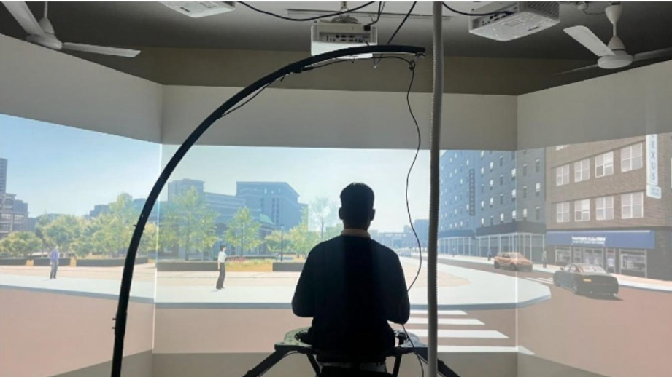
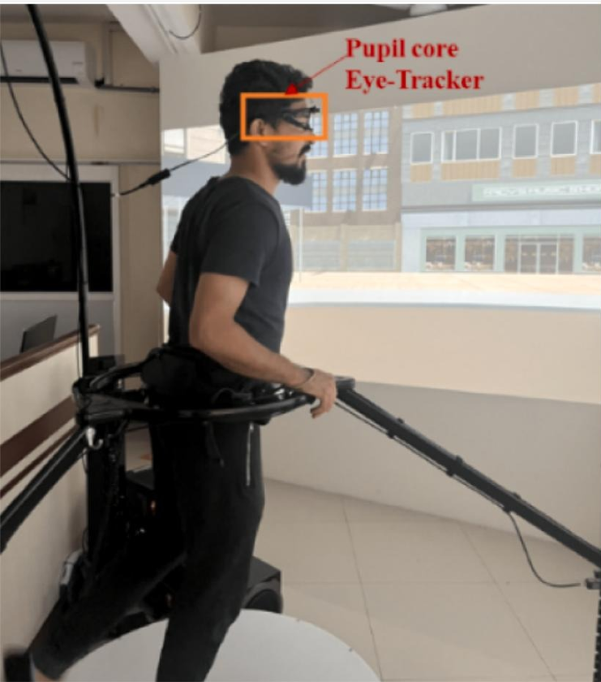
Pedestrian Simulator
A pedestrian simulator was used to replicate real-world road-crossing scenarios in a controlled environment.
Eye-tracking equipment was used to record gaze behavior, focusing on fixation-related metrics like Total Fixation Duration, Fixation Count, and Average Fixation Duration.

Slide 5
Conditions of Experiment
Signalized
1. No Countermeasure (NoCM)
Crosswalk is illuminated with in-ground red lights and synchronized with pedestrian traffic signals, enhancing visibility and communication.
Light plates at both ends of the crosswalk act as visual cues, alerting both pedestrians and drivers to active crossing.
Pedestrian movement is guided and reinforced through clear signal phases and visual infrastructure.
2. Illuminated Crosswalks
No in-ground lighting or illuminated crosswalk; standard zebra markings only present.
No plates or additional visual cues to indicate crossing activity or alert drivers.
Pedestrian crossing is based purely on individual judgment and standard traffic lights, with reduced visibility and support.

Slide 6
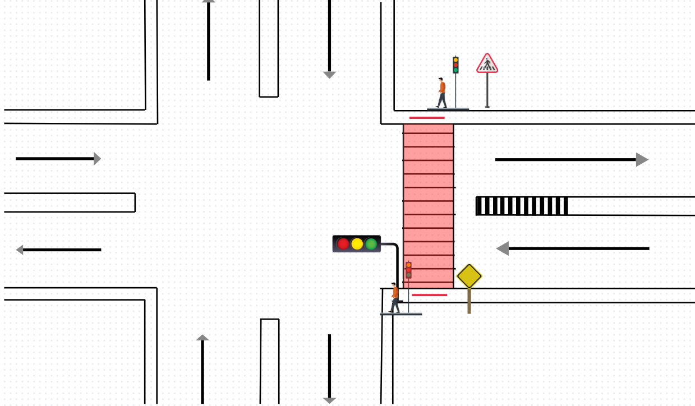
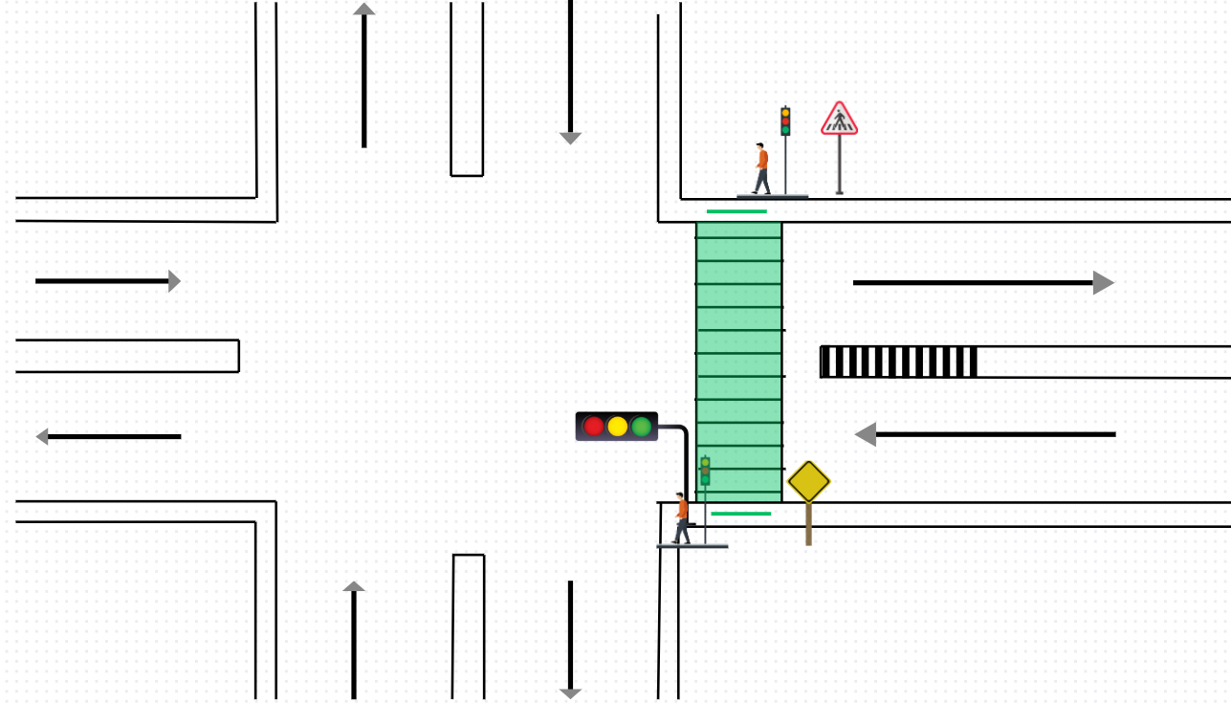
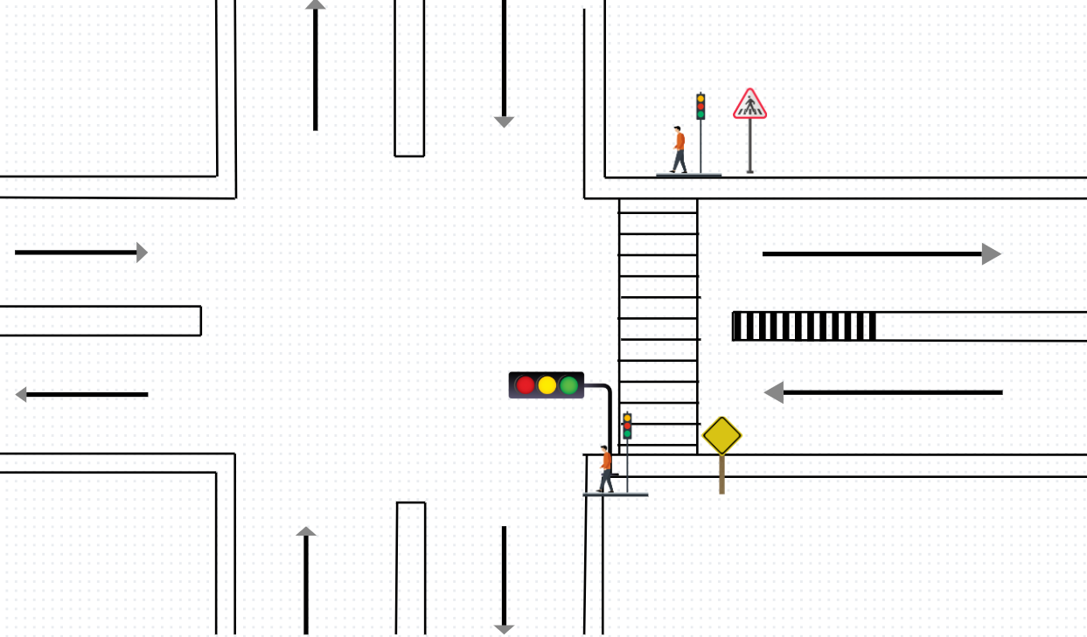
Conditions of Experiment

Slide 7
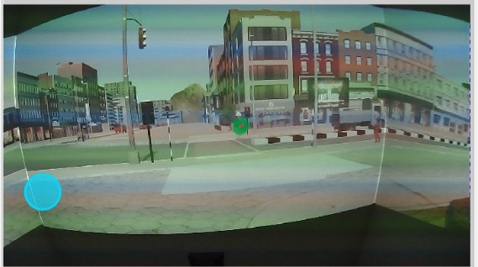
Activities Recorded
Baseline- Participants were not involved in any multi-tasking activity.
BB- Participants were asked to read the information on the billboard.
LM- Participants were listening to music via earphones.
TXT- Participants were instructed to respond to the questions asked by the experimenter via text messages on phone.
TLK- Participants were instructed to answer the questions asked by experimenter via voice call.

Slide 8
Data Extraction
Person
IC
NO_CM
Baseline
BB
LM
2W
4W
HV
IR
REM
TXT
TLK

Slide 9
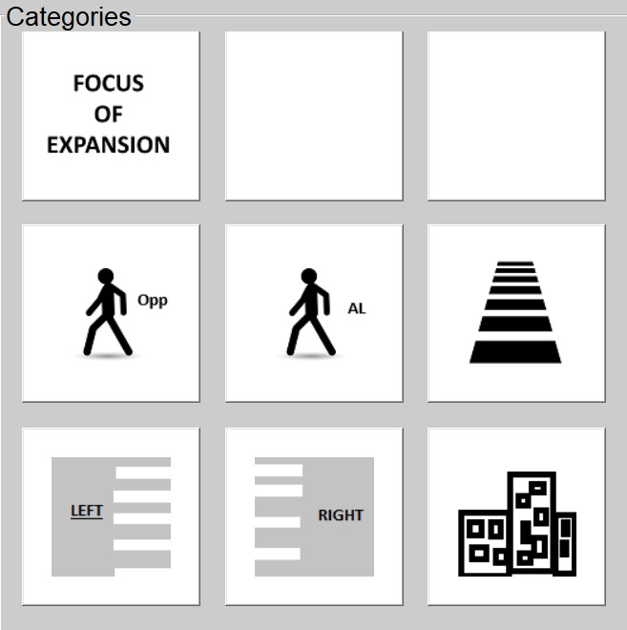
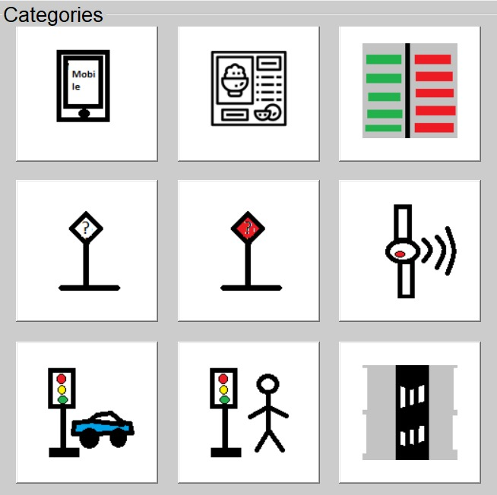
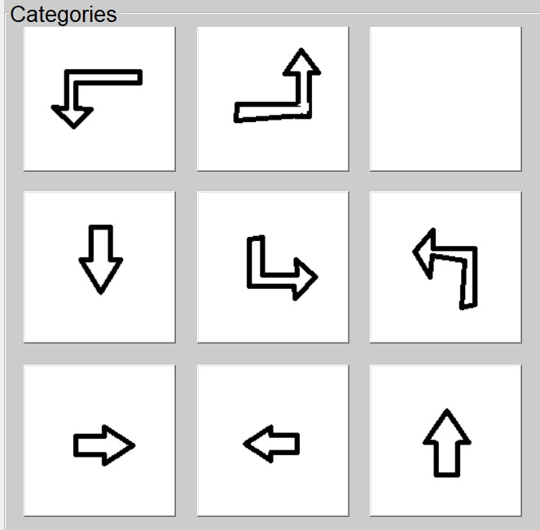
Areas of Interest(AOIs)
Two Wheeler(2W)
Four Wheeler(4W)
Heavy Vehicle(HV)
Infrastructure Related (IR)
Remaining

Slide 10
Data Extraction
Utilized Pupil Player to systematically extract high-resolution frames from MP4 video recordings for subsequent analysis.
Synchronized gaze position data with corresponding video frames extracted from MP4 recordings using Pupil Player, enabling precise mapping of eye-tracking events to visual stimuli.

Slide 11
Data Extraction
Conducted frame-by-frame manual annotation of fixations through a custom-developed Python-based graphical user interface (GUI), utilizing timestamp-aligned mid-frames and intuitive button/shortcut controls for accurate category labeling.
Exported the annotated fixation dataset in .xls format, including fixation number, start and end times, duration, spatial coordinates, and assigned labels ensuring compatibility for downstream analysis and reporting.

Slide 12
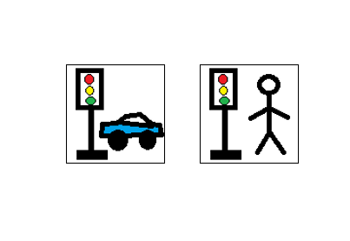

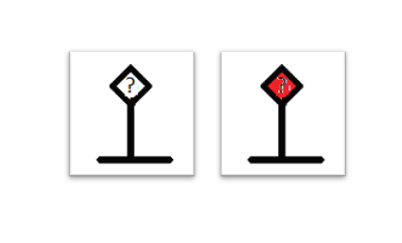
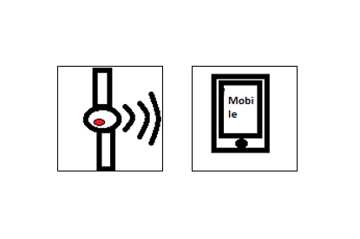

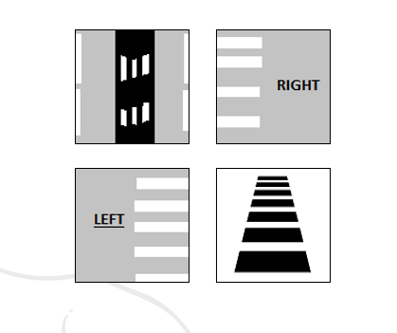
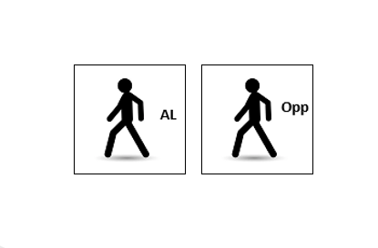
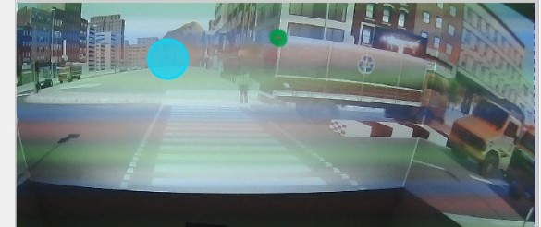
Data Transformation
Vehicle
Traffic Signals
Sign Boards
Gadgets
Billboards
Buildings and Structures
Fellow Pedestrians
Road Elements

Slide 13
Data Description
Eye-tracking data included key fixation-related metrics:
Fixation Count (FC) – number of times a participant fixated on an area.
Total Fixation Duration (TFD) – overall time spent focusing on specific areas.
Average Fixation Duration (AFD) – average time per fixation, indicating cognitive load.
These metrics help assess attention and situational awareness during distracted and undistracted road-crossing scenarios.

Slide 14
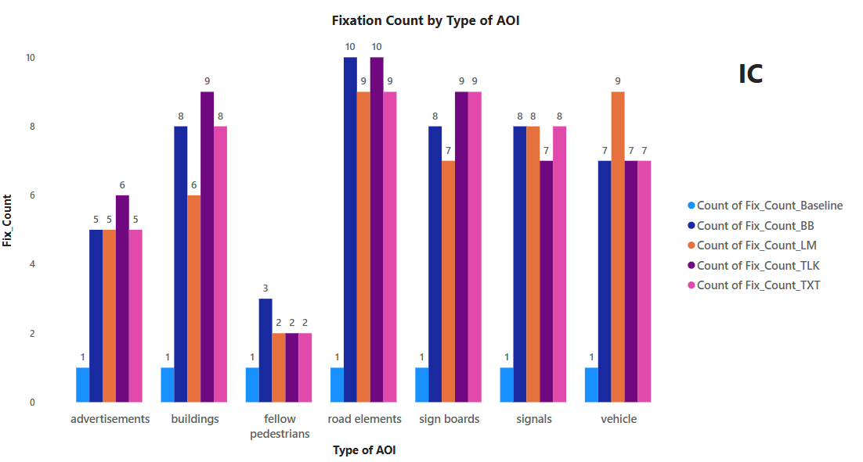
Results

Slide 15
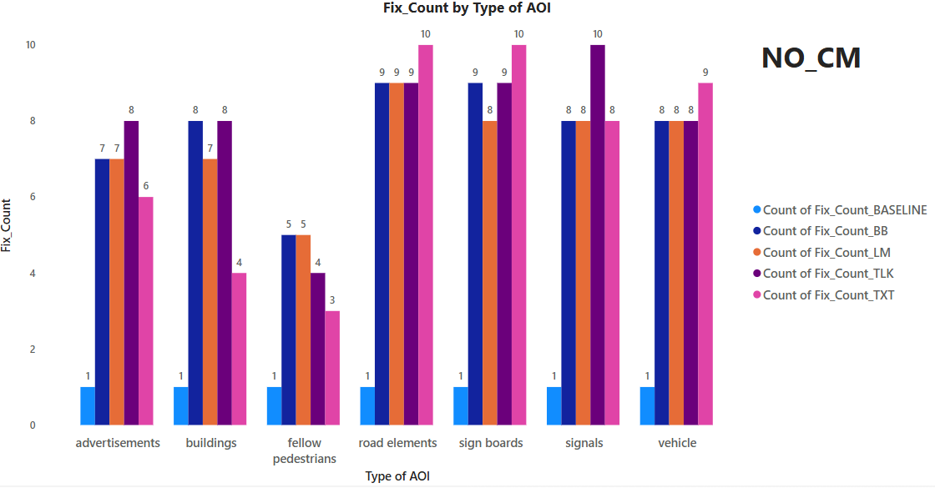

Slide 16
Fix_Count by Type of AOI (IC vs NO_CM)
Distractions increase fixation counts, especially during texting and talking, indicating higher cognitive load.
Road elements and sign boards consistently receive high attention across all conditions.
Illuminated Crosswalks (IC) help reduce variability in gaze behavior, suggesting improved situational awareness.
Fixation on fellow pedestrians drops during distractions, even with IC, highlighting reduced social awareness.
IC mitigates, but does not eliminate, distraction effects—supporting the need for both infrastructure improvements and behavior awareness.

Slide 17
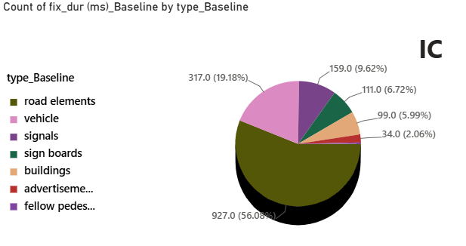
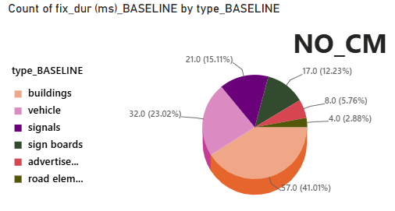
Fix_Dur(ms)_Baseline (IC vs NO_CM)

Slide 18
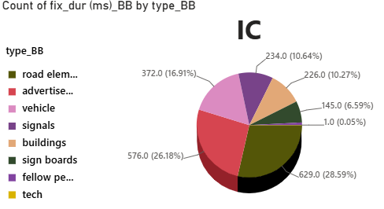
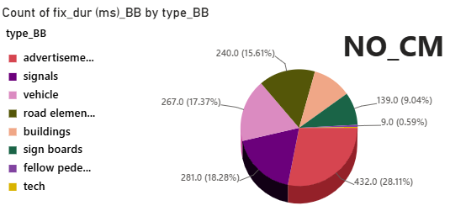
Fix_Dur(ms)_BB

Slide 19
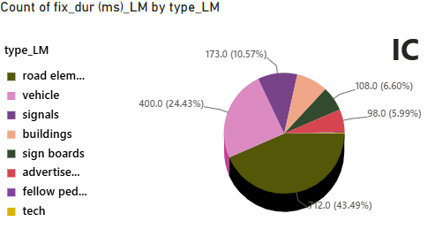
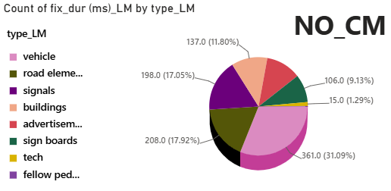
Fix_Dur(ms)_LM

Slide 20
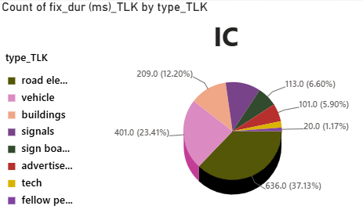
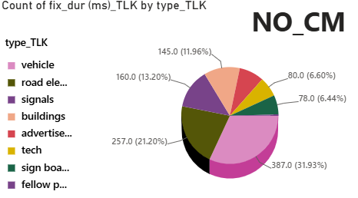
Fix_Dur(ms)_TLK

Slide 21
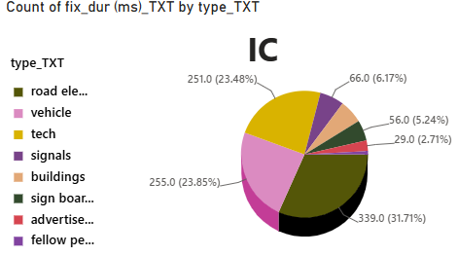
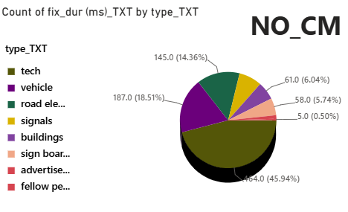
Fix_Dur(ms)_TXT

Slide 22
Inference from Pie-Charts
Baseline:
IC: 56% of gaze focused on road elements — indicating strong situational awareness.
NO_CM: Only 41% on road elements — more scattered attention due to lack of visual guidance.
Billboard (BB):
IC: 28.6% on road elements, 26.2% on ads — IC helps retain focus despite distraction.
NO_CM: Only 9% on road elements, while ads dominate with 28.1% — distraction severely impairs focus.
Listening to Music (LM):
IC: 43.5% on road elements — IC effectively directs attention during auditory distraction.
NO_CM: Only 17.1% on road elements; buildings (31.1%) and ads (17.9%) attract more gaze.

Slide 23
Inference from Pie-Charts
Talking on the Phone (TLK):
IC: 37.1% on road elements — shows IC's strength even under cognitive load.
NO_CM: Just 12% on road elements, with 31.9% on fellow pedestrians and 21.2% on tech — highly fragmented gaze.
Texting (TXT):
IC: 31.7% on traffic signals, 23.5% each on buildings and vehicles — attention is fairly structured.
NO_CM: 46% on fellow pedestrians, only ~6% on road elements and signals — major drop in safety-critical focus.

Slide 24
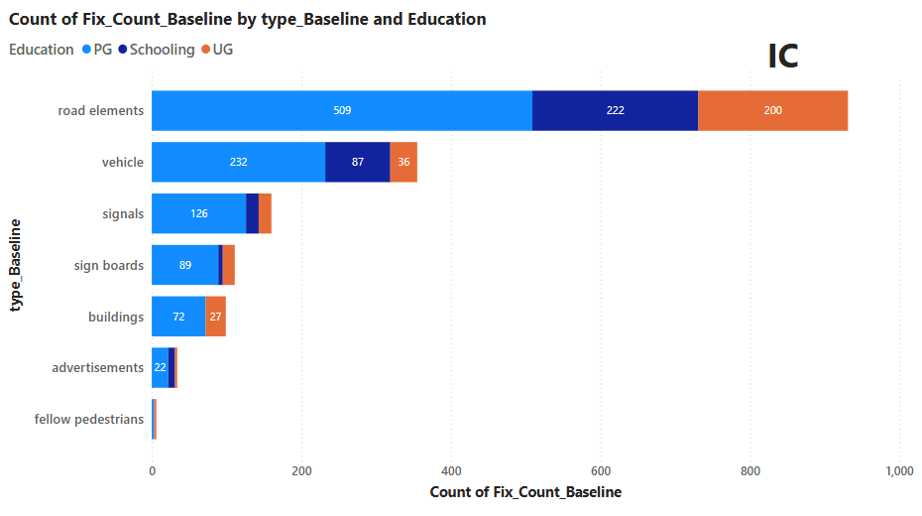
Fix_Count by Type of AOI & Education

Slide 25
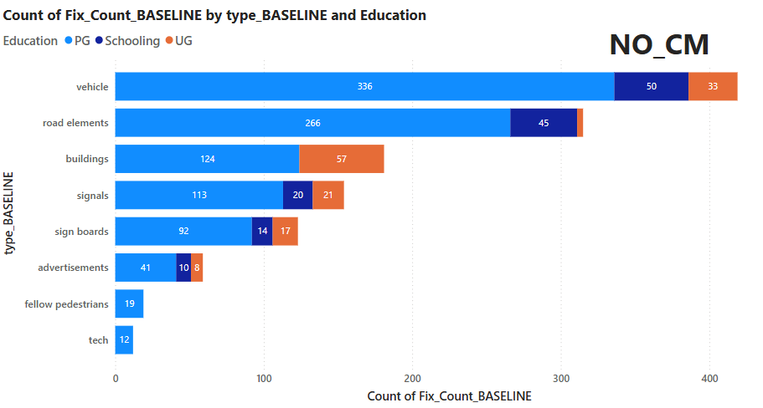

Slide 26
Fix_Count by Type of AOI and Education
IC promotes focused visual behavior on road elements (931 fixations), with vehicles and signals also receiving structured attention.
NO_CM shifts focus to vehicles (419 fixations) and buildings, while increasing attention to distractions like ads and tech.
PG participants show the highest fixation activity in both conditions, but their gaze is better directed under IC.
IC significantly enhances fixation consistency on safety-critical elements, reducing distraction across education levels. In contrast, NO_CM environments lead to scattered, less efficient gaze behavior, especially in UG and schooling-level participants.

Slide 27
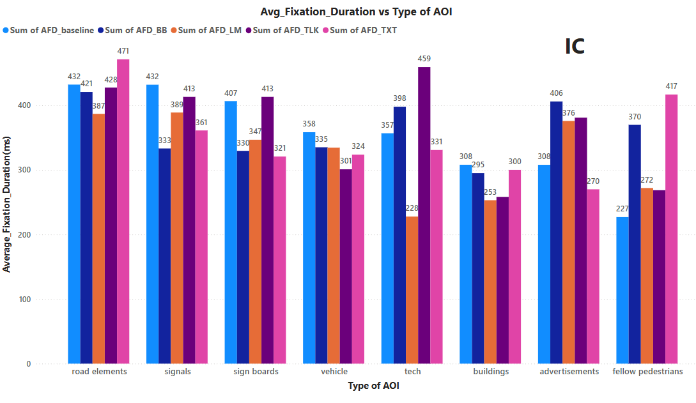
Avg_Fix_Dur(ms) vs Type of AOI

Slide 28
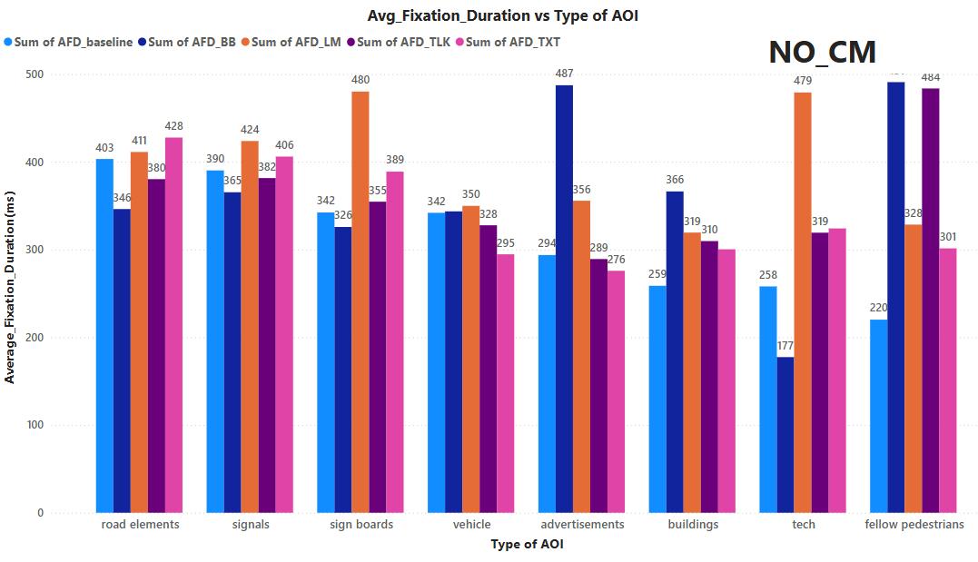
Avg_Fix_Dur(ms) vs Type of AOI

Slide 29
Avg_Fix_Dur(ms) vs Type of AOI
IC (Illuminated Crosswalk):
Road elements (432 ms) and signals (471 ms) receive the longest attention, showing effective guidance.
Distractions like tech (228–459 ms) and ads (270–406 ms) have limited impact due to focused gaze.
TXT and TLK still raise AFD on non-critical areas (e.g., fellow pedestrians: 417 ms under TXT).
NO_CM (No Countermeasure):
AFD is more scattered — ads (487 ms) and tech (up to 479 ms) dominate in BB and LM conditions.
Safety cues like road elements (as low as 346 ms) are less prioritized.
TXT and TLK cause major shifts to fellow pedestrians (484 ms) and sign boards (480 ms).

Slide 30
Conclusion
Illuminated Crosswalks (IC) significantly improve pedestrian situational awareness by increasing focus on road elements (up to 56%) and reducing attention to distractions like ads and fellow pedestrians.
Under No Countermeasure (NO_CM), pedestrians show scattered gaze behavior, with increased fixation on irrelevant AOIs, leading to reduced safety.
IC mitigates the impact of distractions (e.g., texting, phone calls, music), guiding attention toward critical areas like signals and vehicles.
Across all education levels, IC leads to more structured and safety-oriented gaze patterns, proving its effectiveness as a low-effort, high-impact safety intervention.

Slide 31
References
https://www.sciencedirect.com/science/article/pii/S0001457524004573#f0015
Endsley, M. R. (1995). Toward a theory of situation awareness in dynamic systems. Human Factors, 37(1), 32–64.
Oxley, J., Ihsen, E., Fildes, B., Charlton, J., & Day, R. (2005). Crossing roads safely: An experimental study of age differences in gap selection by pedestrians. Accident Analysis & Prevention, 37(5), 962–971.

Slide 32
Thank You

