Slide 1

VERA – AI-Driven Movie Recommendation and Analytics System
DATA SCIENCE (24AD3107) Project Review-1
 | Under the Guidance of Mrs. B Prathusha Guide, Department of Computer Science and Engineering, KLH CSE Bowrampet Campus
Team Members Kayenat Zabeen-2420030492 Nakshitha P -2420030025 Sathvika P -2420030654

Slide 2
Outline of Project Work
Focus
Introduction
Literature Survey
Challenges
Research Objectives
Conclusion & Future Work
References
Publications Details

Slide 3
Problem Statement
Streaming catalogs now hold tens of thousands of titles, making it hard for users to find movies that truly match their taste.
Most recommender systems optimize for prediction accuracy or popularity, so results feel repetitive and predictable.
Context that strongly influences what a person wants to watch — their current mood and how much time they have — is largely ignored.
Recommendations are typically a black box: users are not told why a movie was suggested, which limits trust.
There is a need for a system that balances relevance with novelty, diversity and serendipity while staying context-aware and explainable.

Slide 4
Objectives
Design a hybrid recommendation engine that combines content-based filtering (genres, keywords, cast, crew) with collaborative filtering (ratings, viewing history).
Introduce novelty, diversity and serendipity into ranking and re-ranking so recommendations avoid repetitive, over-popular titles.
Enable mood-based and time-aware filtering so suggestions match how the user feels and how much time they have available.
Provide an optional SHAP-based explanation layer so users can see why a specific movie was recommended.
Build a feedback loop that learns from user interactions (likes, skips, watches) to continuously refine future recommendations.

Slide 5
Literature Survey
Authors | Title of the Paper | Methodology | Inferences | Limitation/Future work
Melville, Mooney & Nagarajan | Content-Boosted Collaborative Filtering for Improved Recommendations | Uses a content-based predictor to fill in missing ratings in the user-item matrix, then applies collaborative filtering on the enhanced data | Hybridizing content-based and collaborative filtering improves accuracy over either method alone Reduces cold-start and sparsity problems | Does not consider contextual factors like mood, time, or explanation of results
Nair & Preethi | A Pragmatic Study on Movie Recommender Systems Using Hybrid Collaborative Filtering | Reviews content-based, collaborative and hybrid (deep learning + KNN) approaches for movie recommendation | Hybrid collaborative filtering with deep learning reduces cold-start, first-rater and gray-sheep problems better than single approaches | Focuses only on rating-prediction accuracy; diversity, novelty and explainability are not addressed
Kaminskas & Bridge (2016); Kotkov et al. | Beyond-accuracy objectives: Diversity, Novelty, Coverage and Serendipity in Recommender Systems | Surveys definitions and computational models for novelty, diversity, coverage and serendipity beyond rating-accuracy metrics | Optimizing purely for accuracy leads to repetitive, over-popular recommendations Re-ranking strategies can balance relevance with serendipitous discovery | Serendipity remains hard to quantify and there is no universally agreed evaluation metric
Winoto & Tang (Expert Systems with Applications, ); Wakil et al. (IJACSA) | The Role of User Mood in Movie Recommendations / Improving Web Movie Recommender Systems Based on Emotions | Injects user mood into a collaborative-filtering pipeline; combines emotion detection with content-based and collaborative filtering | Mood-aware recommendation outperforms mood-agnostic collaborative filtering Emotional context significantly changes which movies users prefer at a given time | Mood detection relies on limited self-reported or textual cues; does not consider available viewing time

Slide 6
Problem Gap Identification
Content-based and collaborative filtering methods individually suffer from cold-start, sparsity and over-specialization problems.
Existing hybrid systems mainly optimize rating-prediction accuracy and rarely balance it with novelty, diversity or serendipity together.
Very few movie recommenders factor in real-time context such as the user's mood or the time they have available to watch.
Explainability is largely missing — most systems recommend without revealing the reasoning, which reduces user trust and engagement.
VERA addresses these gaps together in one pipeline: hybrid filtering + beyond-accuracy re-ranking + mood/time awareness + SHAP explanations + feedback-driven learning.

Slide 7
Innovation, Creativity, and Novelty
Mood-aware recommendations: users can ask for movies that match an experience — happy, emotional, thrilling or relaxing — not just their historical taste.
Time-aware filtering: recommendations are adjusted to the runtime the user can actually spare, something most recommenders ignore.
Re-ranking for novelty, diversity and serendipity: VERA deliberately surfaces well-matched but less-obvious titles instead of only the most popular ones.
Explainable AI with SHAP: an optional “Why was this recommended?” view builds transparency and trust that typical black-box recommenders lack.
A closed feedback loop lets the system keep learning from user reactions, so recommendation quality improves over time.

Slide 8
Project Workflow
1. User Input — user provides preferences, ratings, viewing history, mood and available time
2. Data Collection & Preprocessing — movie details and user interaction data are gathered and cleaned
3. Candidate Generation — content-based and collaborative filtering generate potential movies
4. Intelligent Ranking — candidate movies are scored and ranked by relevance to the user
5. Re-Ranking & Personalization — results are balanced across relevance, novelty, diversity, serendipity, mood and time
6. Final Recommendations — VERA presents a personalized, ranked list of movies
7. Optional Explanation — user can ask “Why was this recommended?” and SHAP provides the reasoning
8. Feedback & Learning — user feedback is captured and used to improve future recommendations

Slide 9
Key Features
Personalized Hybrid Recommendations: combines content-based and collaborative filtering using preferences, ratings, history, genres, actors and directors
Novelty, Diversity & Serendipity: discovers unseen, less-popular movies and reduces repetitive suggestions
Mood-Based Recommendations: adapts suggestions to the user's current mood — happy, emotional, thrilling or relaxing
Time-Aware Recommendations: considers the user's available viewing time and recommends by runtime
Intelligent Ranking & Explainability: ranks and re-ranks movies, with optional SHAP-based explanations for why a movie was recommended
Feedback & Analytics: learns from user feedback and tracks relevance, diversity, novelty, serendipity and catalogue coverage

Slide 10
Feasibility and Project Plan
Technical feasibility: built on open-source Python libraries (scikit-learn, Surprise/LightFM, pandas) and public datasets (MovieLens, TMDB) — no specialized hardware required.
Phase 1 – Data collection & preprocessing: gather movie metadata and user interaction data; clean and structure it.
Phase 2 – Candidate generation: implement content-based and collaborative filtering models.
Phase 3 – Ranking & re-ranking: build the scoring model and add novelty/diversity/serendipity/mood/time re-ranking.
Phase 4 – Explainability & feedback: integrate SHAP-based explanations and a feedback-driven learning loop.
Phase 5 – Evaluation & deployment: test with relevance, diversity, novelty, serendipity and coverage metrics, then package the system.

Slide 11
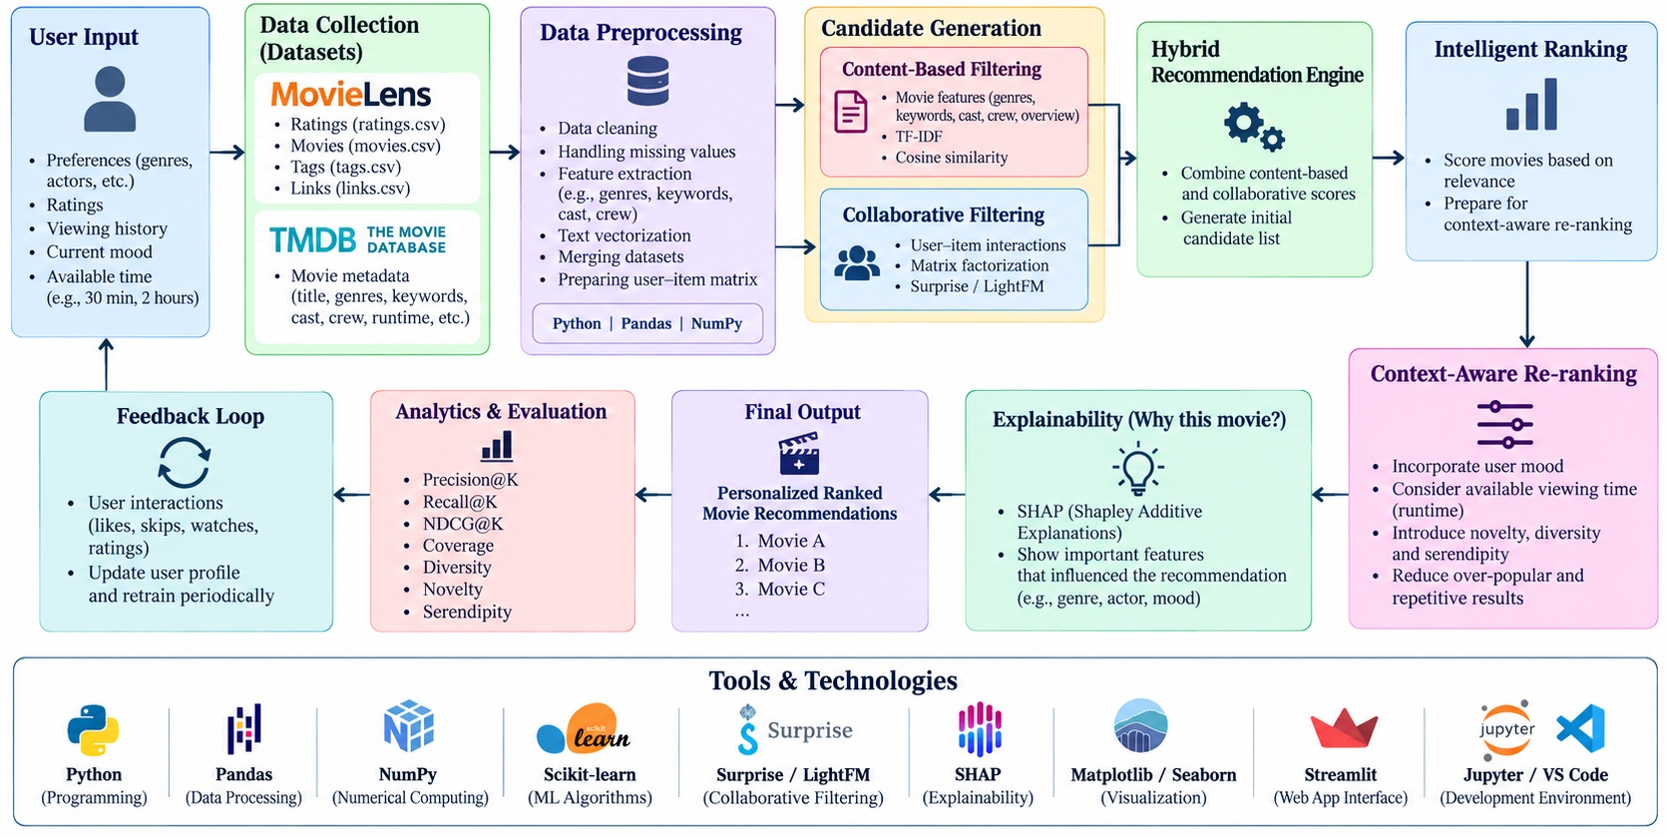
Project Flow

