Slide 1
AI Travel agent
IBM AICTE PROJECT
Presented By:
Student name : Somineni Sathvika
College Name & Department : Gokaraju Lailavathi Engineering College & CSE dept.

Slide 2
OUTLINE
Problem Statement
Technology used
Wow factor
End users
Result
Conclusion
Git-hub Link
Future scope
IBM Certifications

Slide 3
Problem Statement
Travelers often face challenges when planning trips due to the overwhelming amount of fragmented information across various platforms. From selecting destinations and accommodations to organizing transport, activities, and staying updated with local conditions, managing all aspects of travel can be time-consuming, stressful, and prone to error—especially for those with limited time, travel experience, or specific constraints such as budget and accessibility.
Proposed Solution:
An AI-powered Travel Planner Agent built using IBM Cloud Lite and IBM Granite models that helps users create smart, personalized travel plans. It suggests destinations, builds itineraries, manages bookings, and provides real-time updates—making travel planning easy, efficient, and enjoyable.

Slide 4
Technology used
IBM cloud lite services
IBM Granite Foundation Models
Natural Language Processing (NLP)
Real-time Data Integration APIs

Slide 5
IBM cloud services used
IBM Cloud Watsonx AI Studio
IBM Cloud Watsonx AI runtime
IBM Cloud Agent Lab
IBM Granite foundation model

Slide 6
Wow factors
This smart assistant will dramatically reduce travel planning effort and time, enhance personalization, and make trip organization accessible and enjoyable for all users—whether first-time travelers or seasoned explorers.
Unique features:
AI-powered Destination Recommendation
Personalized Itinerary Generation
Real-Time Travel Alerts & Updates
Integrated Transport & Hotel Booking
Budget-based Trip Optimization
Map & Weather Integration
Natural Language Interaction (via IBM Granite)

Slide 7
End users
Individual Travelers
Families & Groups
Corporate Travelers
Travel Agencies & Agents
Students & Backpackers

Slide 8
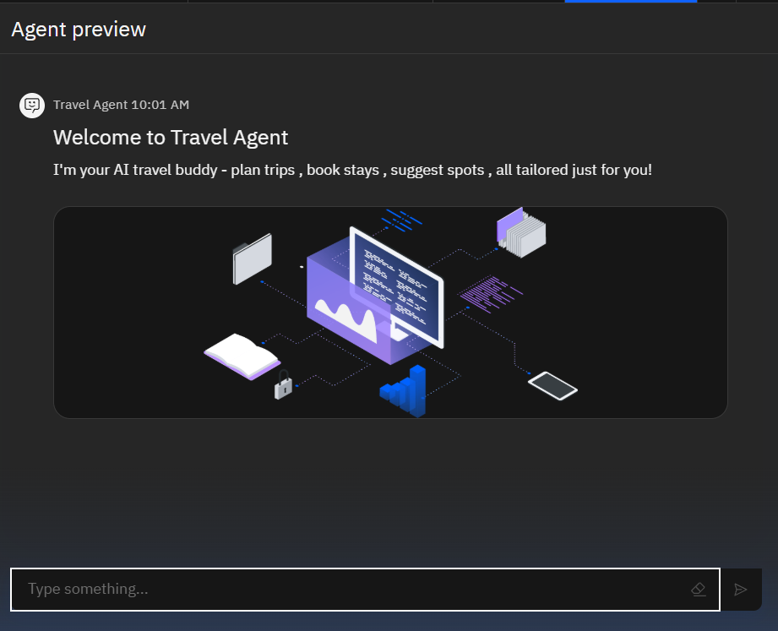
Results

Slide 9
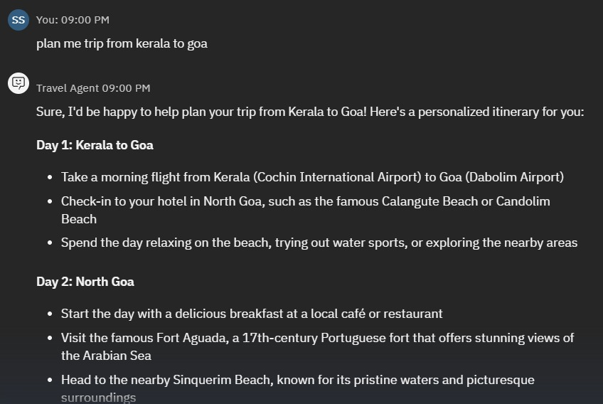
Results

Slide 10
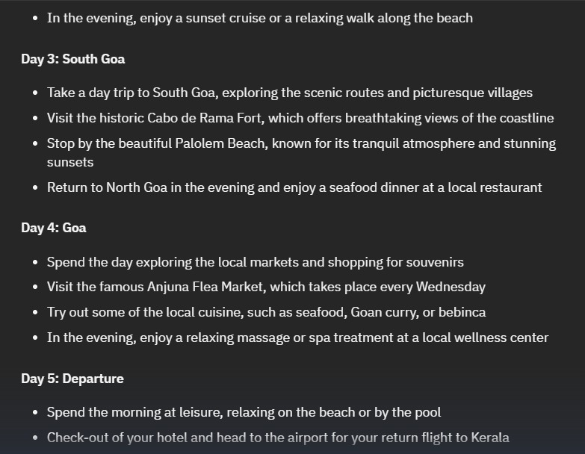
Results

Slide 11
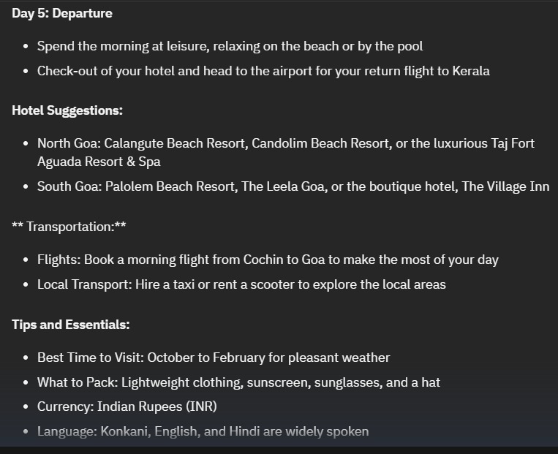
RESULTS

Slide 12
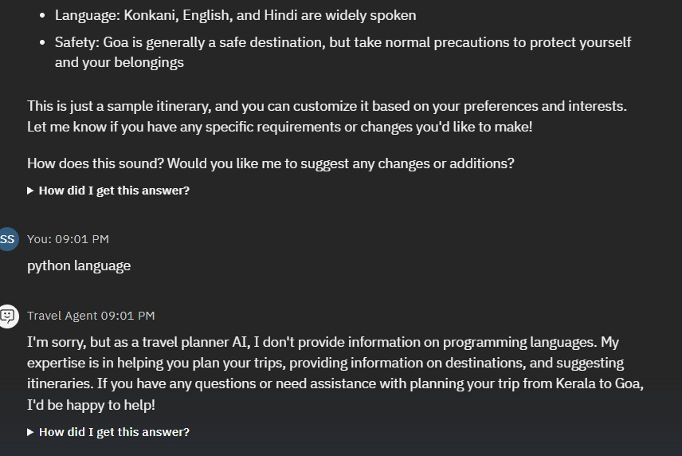
ReSULTS

Slide 13
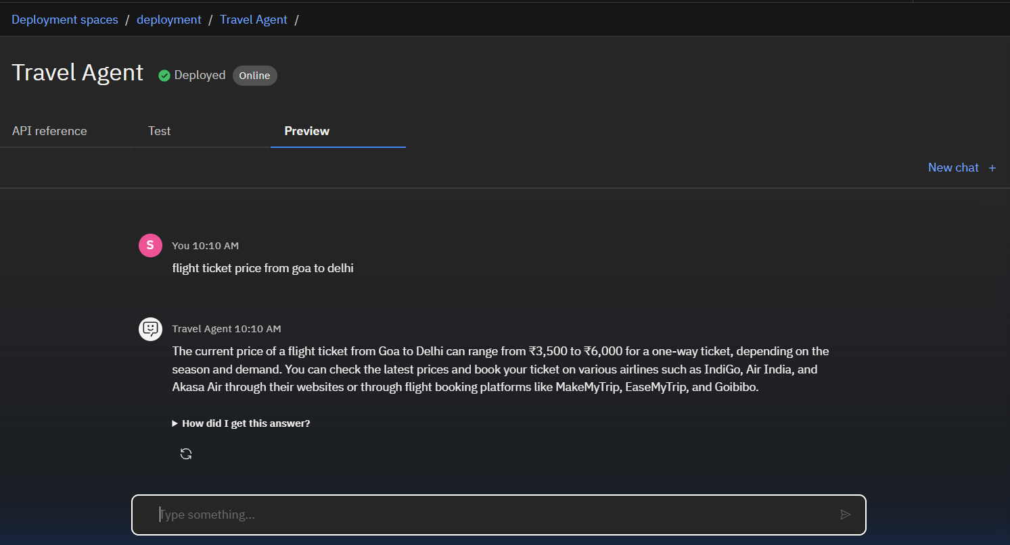
Results
Deployed AI Agent

Slide 14
Conclusion
The Travel Planner Agent creates personalized travel plans by analyzing user preferences, budget, and travel constraints using IBM Granite models.
It leverages real-time data to recommend destinations, transport, accommodations, and local experiences.
The system dynamically updates itineraries with live weather, traffic, and schedule changes for a smooth travel experience.
It integrates booking, maps, and local guide features to offer a complete travel solution in one platform.
Built on IBM Cloud Lite services, the solution ensures high scalability, performance, and accessibility.

Slide 15
GitHub Link
https://github.com/SathvikaSomineni/Travel_agent

Slide 16
Future scope
Add AR/VR for virtual destination previews.
Enable voice-based travel planning and assistance.
Suggest eco-friendly travel options.
Partner with travel agencies for better deals.
Include AI-based budget and expense tracking.

Slide 17
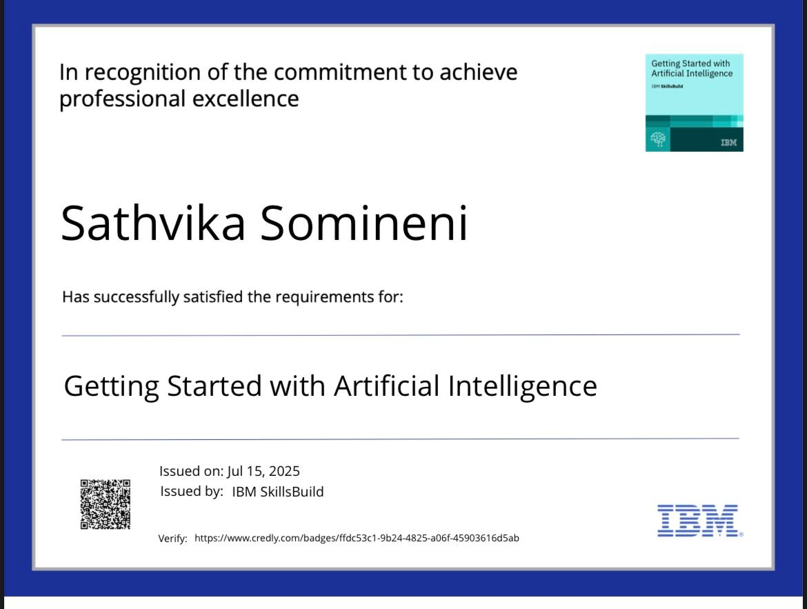
IBM Certifications

Slide 18
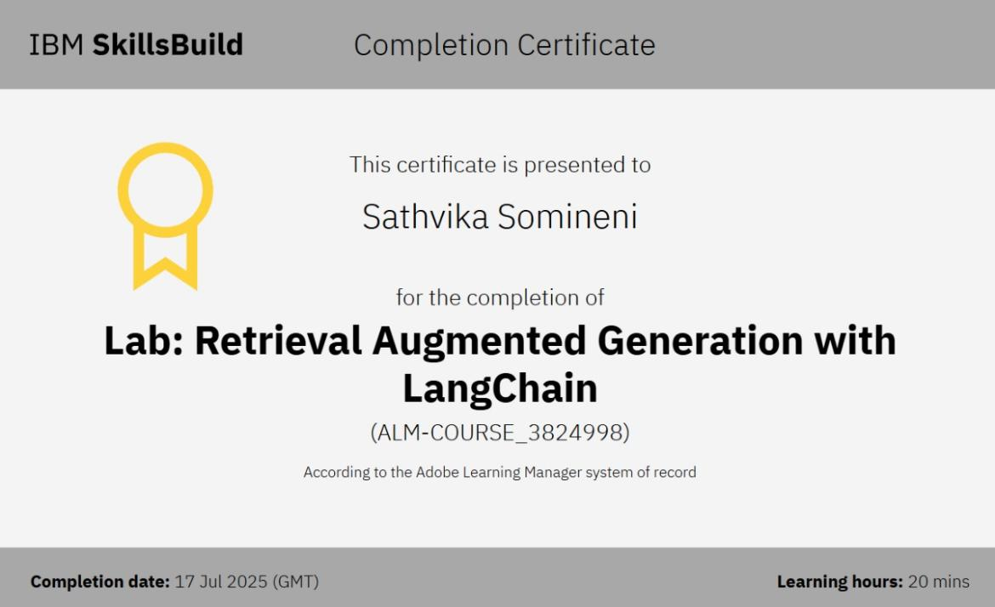

Slide 19
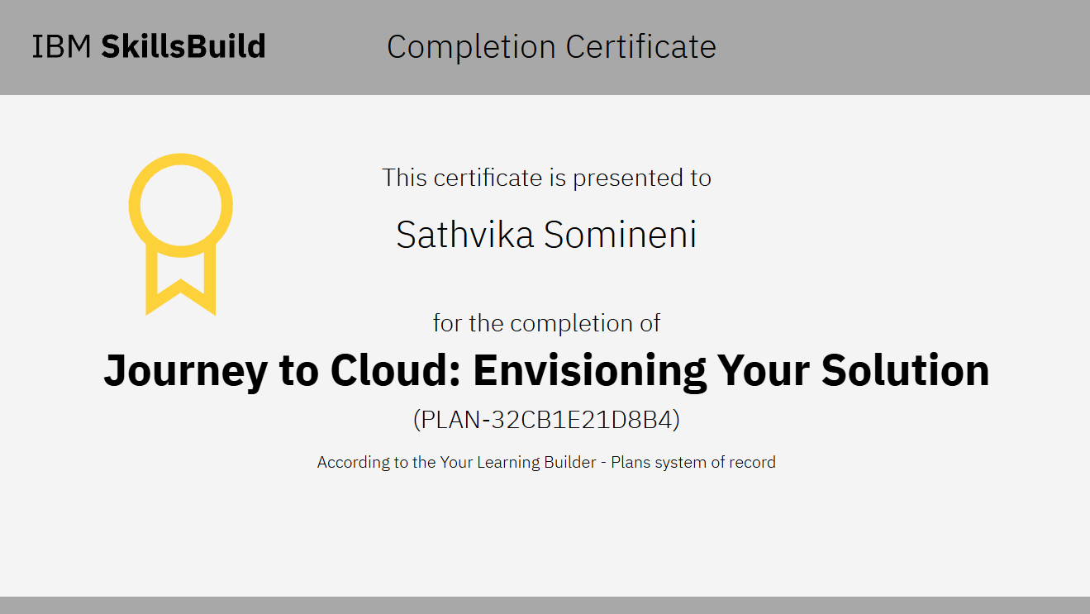

Slide 20
THANK YOU

