Slide 1
RAG and Its Types

Slide 2
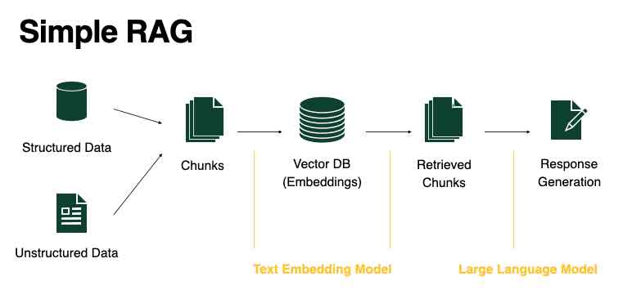
What is RAG?
RAG stands for Retrieval-Augmented Generation. It helps computers give better answers by finding useful information and using it to make great responses.

Slide 3
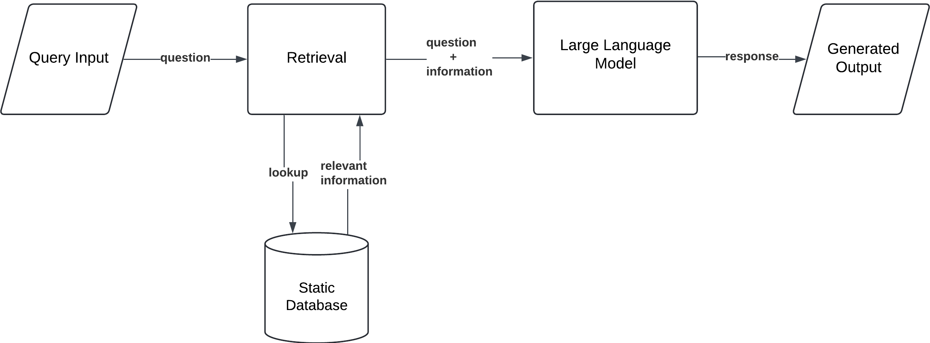
Standard RAG
This type of RAG finds useful information and gives an answer right away.

Slide 4
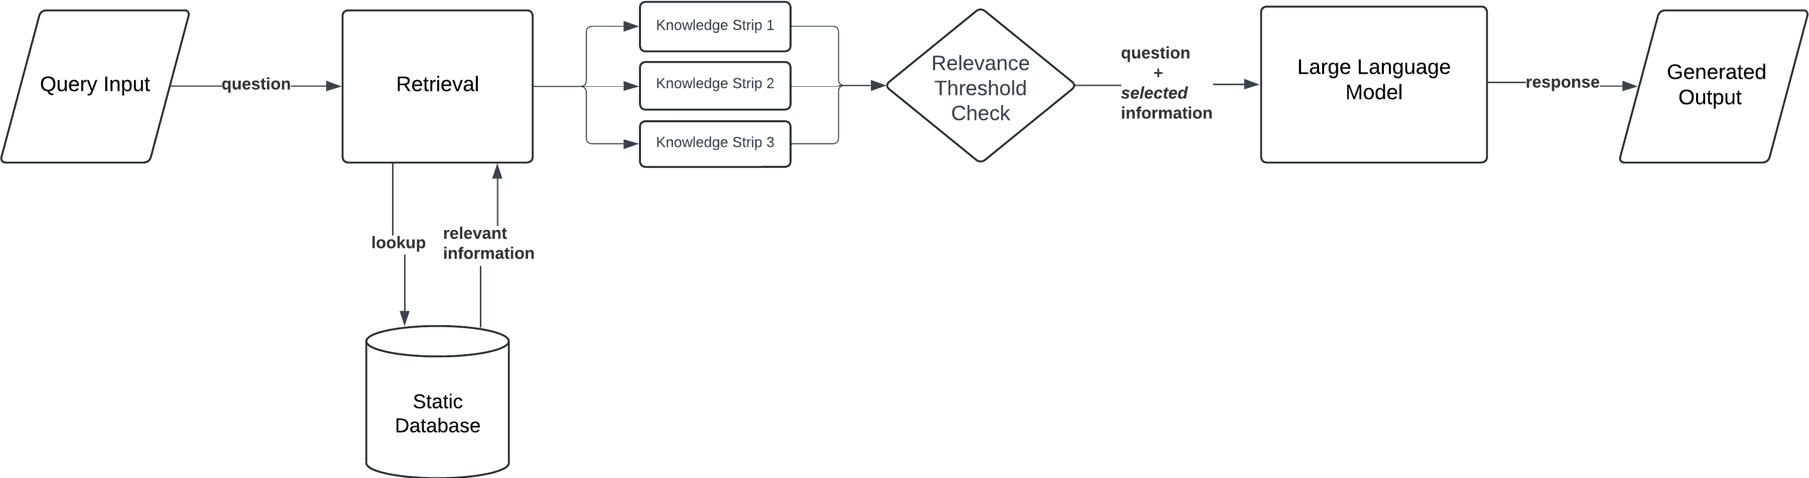
Corrective RAG
The user submits a query or promptThe model retrieves documents from the knowledge base and evaluates their relevance.

Slide 5
Speculative RAG
This RAG guesses what you might ask and prepares answers in advance.

Slide 6
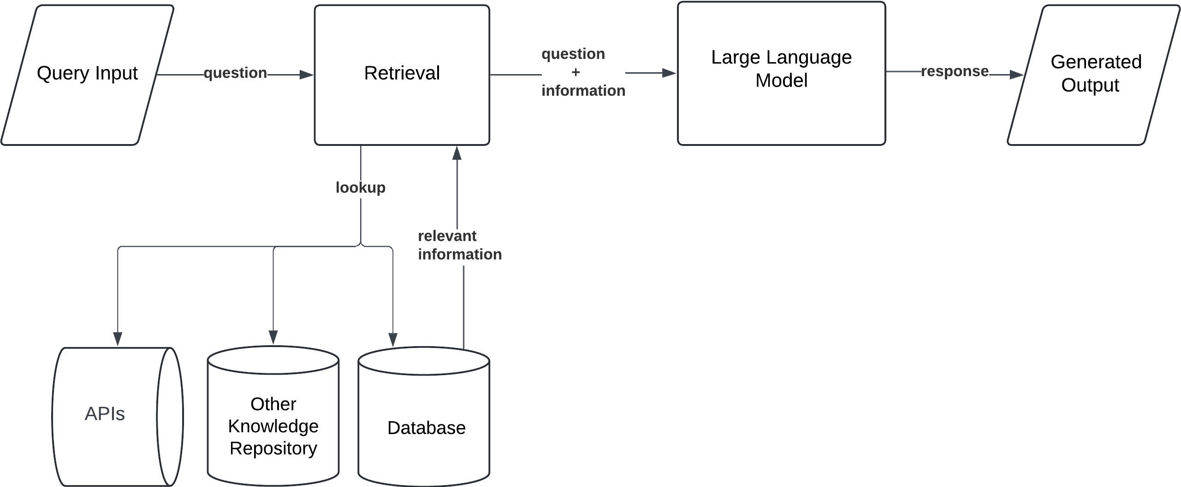
Fusion RAG
The user submits a prompt, The model evaluates multiple retrieval sources and selects the most relevant one based on the query

Slide 7
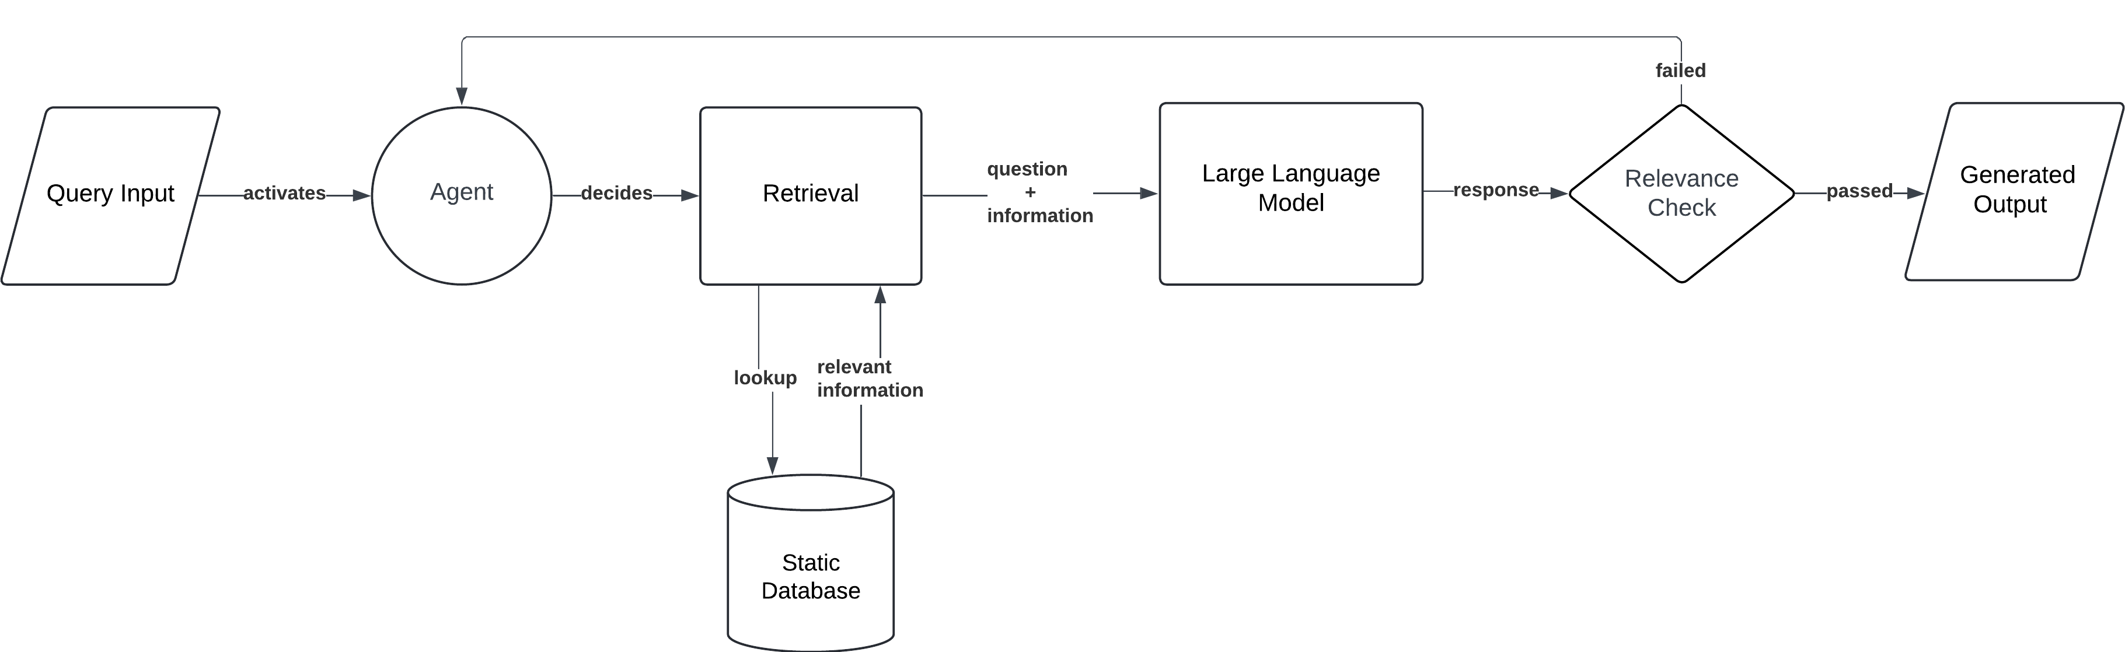
Agentic RAG
The model activates multiple agents. Each Document Agent is responsible for a specific document, capable of answering questions and summarising information from that document.

