Slide 1
Scenario Data Summary

Slide 2
Item #5: Half-life scenario for services
Event: Processing of requests from some users is frequently delayed.
Cause: One of the duplicated pods in the load balancer is running, but a latent bug causes the cpu to rise, resulting in a slowdown in processing speed. As a result, latency increases for some users accessing the slow pod.
Difficulty in identifying the cause
  Since the pod or service itself is not dead, autoscaling does not take place and is difficult to notice.
  One POD is processing as usual, so there is no continuous effect on latency.
  Since it does not appear in error rates, it is difficult to notice a failure without pinpointing and setting an alert for cpu utilization of individual pods, which may be similar to a silent failure.
  Events that may be noticed by user reports.

Slide 3
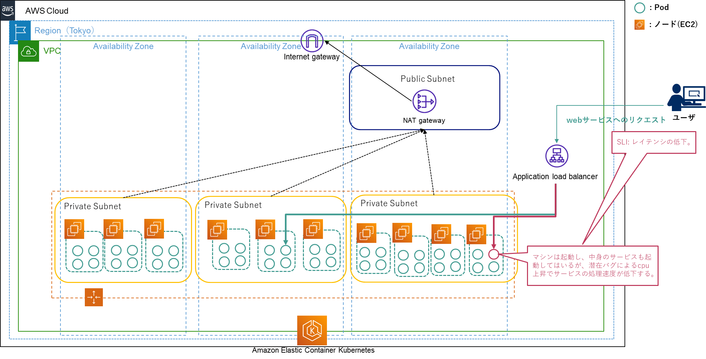
Scenario Environment Diagram
Node
Requests
User
Worse latency
Machine and its service are working,
but a software bug causes worse latency
with increase of CPU utilization.

Slide 4
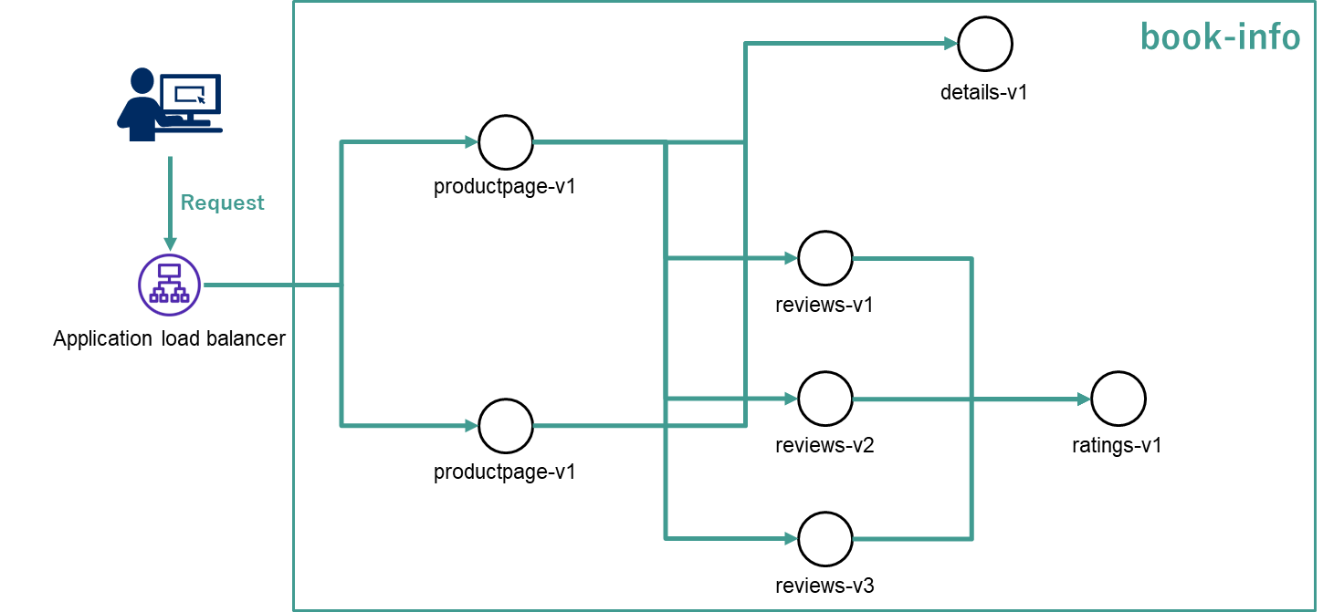
Scenario Environment Details
*Because EKS is fully managed, there is no Master Node (managed by AWS).
Environmental Information
  Usage environment
    AWS EKS
  Number of Entities
    Number of Nodes (Worker Node only*): 10
    Number of pods: 206
  Fault Target Microservice
    book-info
  Root Cause Location
    Increased cpu utilization due to latent bug in multiplexed productpage-v1
    Potential bug generation time: 2023/12/07 16:48~.
  SLI
    Latency of book-info
  Failure time (time to start affecting SLI)
    2023-12-07 16:53:03 (Response time was on average about 30~40 ms, but now it exceeds 100 ms.)
  Time for people to notice obstacles (assumed detection time)
    2023-12-07 19:32:44 (time over 300 ms.)
Figure: book-info configuration diagram (details omitted, as this is the same as before)

Slide 5
Scenario Creation/Procedures
Measurement period: 2023/12/06 18:45 ~ 2023/12/08 17:00 (46 hours 15 minutes)
Time of cpu load increase: 2023/12/07 16:48
Affected pods: productpage-v1 one system
Root cause: A bug develops and at some time the cpu load increases, affecting service processing.
KPI(SLI): Latency increases when accessing a faulty productpage.
Periodically send requests to microservice A (book-info) from the outside.
After 1 day, the cpu load is increased within one system productpage-v1 to mimic a latent bug.
No errors or other symptoms occur.
Latency to one system gradually increases.
KPI (SLI) will use JMeter.
All pod and node metrics (CPU usage, memory usage, etc.) are obtained from CloudWatch Metrics.
All pod and node logs are obtained from CloudWatch Logs.
Based on the data from 5~7, etc., identify the root cause (cpu load increase in one system pod) related to SLI.

Slide 6
Stored Data Summary

Slide 7
sampling data
SLI
  folder
    /JMeter/result
  JMeter Data
    Same as existing but this time latency is used as external form monitoring.
    Data in the third column from the right (in the figure below, 29, 188, 47)
configuration data
  folder
    /Configuration
  pod - node configuration data
    Data on which pods are assigned to which node.
    Static data, acquired before and after scenario measurement.
      all_pod_before.txt
      all_pod_after.txt
JMeter Data
1701945200153,29,book_info,200,OK,Book_Info_Case05_1_49h 1-179981,text,true,,5485,200,41,41,http://internal-k8s-bookinfo-ingressp- 3969330968-763775053.ap-northeast-1.elb.amazonaws.com/productpage,29,0,1
1701945200653,188,book_info,200,OK,Book_Info_Case05_1_49h 1-179982,text,true,,4486,200,41,41,http://internal-k8s-bookinfo-ingressp- 3969330968-763775053.ap-northeast-1.elb.amazonaws.com/productpage,188,0,1
1701945201153,47,book_info,200,OK,Book_Info_Case05_1_49h 1-179983,text,true,,5482,200,41,41,http://internal-k8s-bookinfo-ingressp- 3969330968-763775053.ap-northeast-1.elb.amazonaws.com/productpage,47,0,0
...
configuration data
NAMESPACE NAME READY STATUS RESTARTS AGE IP NODE NOMINATED NODE READINESS GATES
amazon-cloudwatch cloudwatch-agent-4fzgp 1/1 Running 0 9h 10.1.64.209 ip-10-1-64-10.ap-northeast-1.compute.internal <none> <none& gt;
amazon-cloudwatch cloudwatch-agent-7ppkh 1/1 Running 0 2d8h 10.1.32.25 ip-10-1-32-147.ap-northeast-1.compute.internal <none <none
amazon-cloudwatch cloudwatch-agent-cz6m4 1/1 Running 0 2d8h 10.1.32.65 ip-10-1-32-15.ap-northeast-1.compute.internal <none> <none& gt;.
amazon-cloudwatch cloudwatch-agent-gsdlz 1/1 Running 0 2d8h 10.1.128.178 ip-10-1-128-219.ap-northeast-1.compute.internal <none> < none> <none> <none> <none> <none> <none
amazon-cloudwatch cloudwatch-agent-lsl49 1/1 Running 0 2d8h 10.1.64.32 ip-10-1-64-27.ap-northeast-1.compute.internal <none> <none& gt;.

Slide 8
sampling data
metrics
  folder
    /Metric/node
    /Metric/pod
    /Metric/alb
  Prometheus Data
    The format is json data similar to existing ones.
    There is a slight difference in the data collected.
      NODE: No data for saturation system. Six types in total.
      pod: storage_iops data added. Total of 7 types.
  ALB (Application Load Balancer) Data
    Metrics data for the load balancer itself and incoming requests.
    They are stored in a single csv file.
    Data collected is on the next page.
Table: Contents of files in /Metric/node
file-name | Contents
node_cpu_usage | Node cpu utilization
node_memory_usage | Node memory utilization
node_net_usage_receive(bytes) | Incoming network utilization (bytes/second)
node_net_usage_transmit(bytes) | Transmission network utilization (bytes/second)
node_net_disk_io_usage | disk utilization rate
node_net_disk_space_usage | disk capacity
Table: Contents of files in /Metric/pod
file-name | Contents
{namespace}_cpu_usage | pod cpu utilization
{namespace}_memory_usage | Memory usage of pod
{namespace}_received_bandwidth | Received bandwidth of pod (bytes/second)
{namespace}_transmit_bandwidth | Transmission bandwidth of pod (bytes/second)
{namespace}_rate_received_packets | Packets received by pod (bytes/second)
{namespace}_rate_transmitted_packets | Packets sent by pod (bytes/second)
{namespace}_rate_storage_iops | Storage IOPS of pod

Slide 9
sampling data
Table: Contents of files in /Metric/alb
file-name | Contents
HTTPCode_ELB_503_Count | Number of HTTP 503 error codes sent by the load balancer.
HTTPCode_ELB_5XX_Count | Number of HTTP 5XX server error codes sent by the load balancer.
HTTPCode_Target_3XX_Count | Number of HTTP response codes generated by the target.
RequestCount | Number of requests successfully processed via IPv4 and IPv6.
RuleEvaluations | Number of rules processed by the load balancer based on average request frequency per hour.
ProcessedBytes | Total bytes processed by the load balancer using IPv4 and IPv6 (HTTP headers and HTTP payload).
ActiveConnectionCount | Total number of active concurrent TCP connections from the client to the load balancer and from the load balancer to the target.
HTTPCode_Target_2XX_Count | Number of HTTP response codes generated by the target.
TargetResponseTime | Elapsed time (in seconds) between when a request is sent from the load balancer and when a response is received from the target.
NewConnectionCount | Total number of newly established TCP connections from the client to the load balancer and from the load balancer to the target.
HTTPCode_Target_4XX_Count | Number of HTTP response codes generated by the target.
ConsumedLCUs | Number of load balancer capacity units (LCUs) used by the load balancer.
HTTPCode_Target_5XX_Count | Number of HTTP response codes generated by the target.
UnhealthyRoutingRequestCount | Number of requests routed using routing failover action (fail open).
HTTPCode_ELB_500_Count | Number of HTTP 500 error codes sent by the load balancer.
HTTPCode_ELB_4XX_Count | Number of HTTP 4XX client error codes sent by the load balancer.

Slide 10
sampling data
log
  folder
    /Log/eks_log/
  CloudWatch Data
    All pod and node logs are stored in text format. 1st column log time, 2nd column log details.
    Data Type
      /application: all log files in /var/log/containers of node. In other words, container logs.
      /dataplane: docker.service logs for node's /var/log/journal, kubelet.service, and kubeproxy.service.
      /host: Logs from /var/log/dmesg, /var/log/secure, and /var/log/messages of node. In other words, node logs.
      /performance: Metrics data for node and pod. However, it is not possible to identify even the random string part of the pod name.
  ALB Data
    Provides an access log that captures detailed information about requests sent to the load balancer.
    See the official log for the contents of the log.
      https://docs.aws.amazon.com/elasticloadbalancing/latest/application/load-balancer-access-logs.html

