Slide 1
DeepSeek RAG Chatbot
Detailed Project Overview, Architecture, Retrieval Strategy, and Deployment Guide

Slide 2
Agenda
What a RAG chatbot is and why it matters
Project goals and feature set in this repository
Architecture and end-to-end request flow
Implementation details: ingestion, retrieval, GraphRAG, reranking, LLM routing
Deployment options, configuration, limitations, and roadmap

Slide 3
What Is A RAG Chatbot?
RAG = Retrieval-Augmented Generation
Retrieval fetches relevant context from your documents
Generation uses an LLM to produce grounded answers
Why it is useful
Reduces hallucinations by grounding responses in sources
Works with private/domain-specific data without full model retraining
Faster iteration than fine-tuning for most document Q&A use cases

Slide 4
RAG Lifecycle (Conceptual)
1. Ingest documents (PDF, DOCX, TXT)
2. Split into chunks and compute embeddings
3. Index chunks in retrieval stores (lexical + vector)
4. Retrieve candidates for a user question
5. Rerank best contexts
6. Ask LLM to answer using only retrieved evidence

Slide 5
Project Goals In This Repository
Deliver a local-first, practical RAG chatbot with modern retrieval quality
Support both local and online generation providers
Ollama for local/offline use
NVIDIA OpenAI-compatible endpoint for hosted inference
Improve answer quality through hybrid retrieval + reranking + graph signals
Provide interactive Streamlit UI for non-technical and technical users

Slide 6
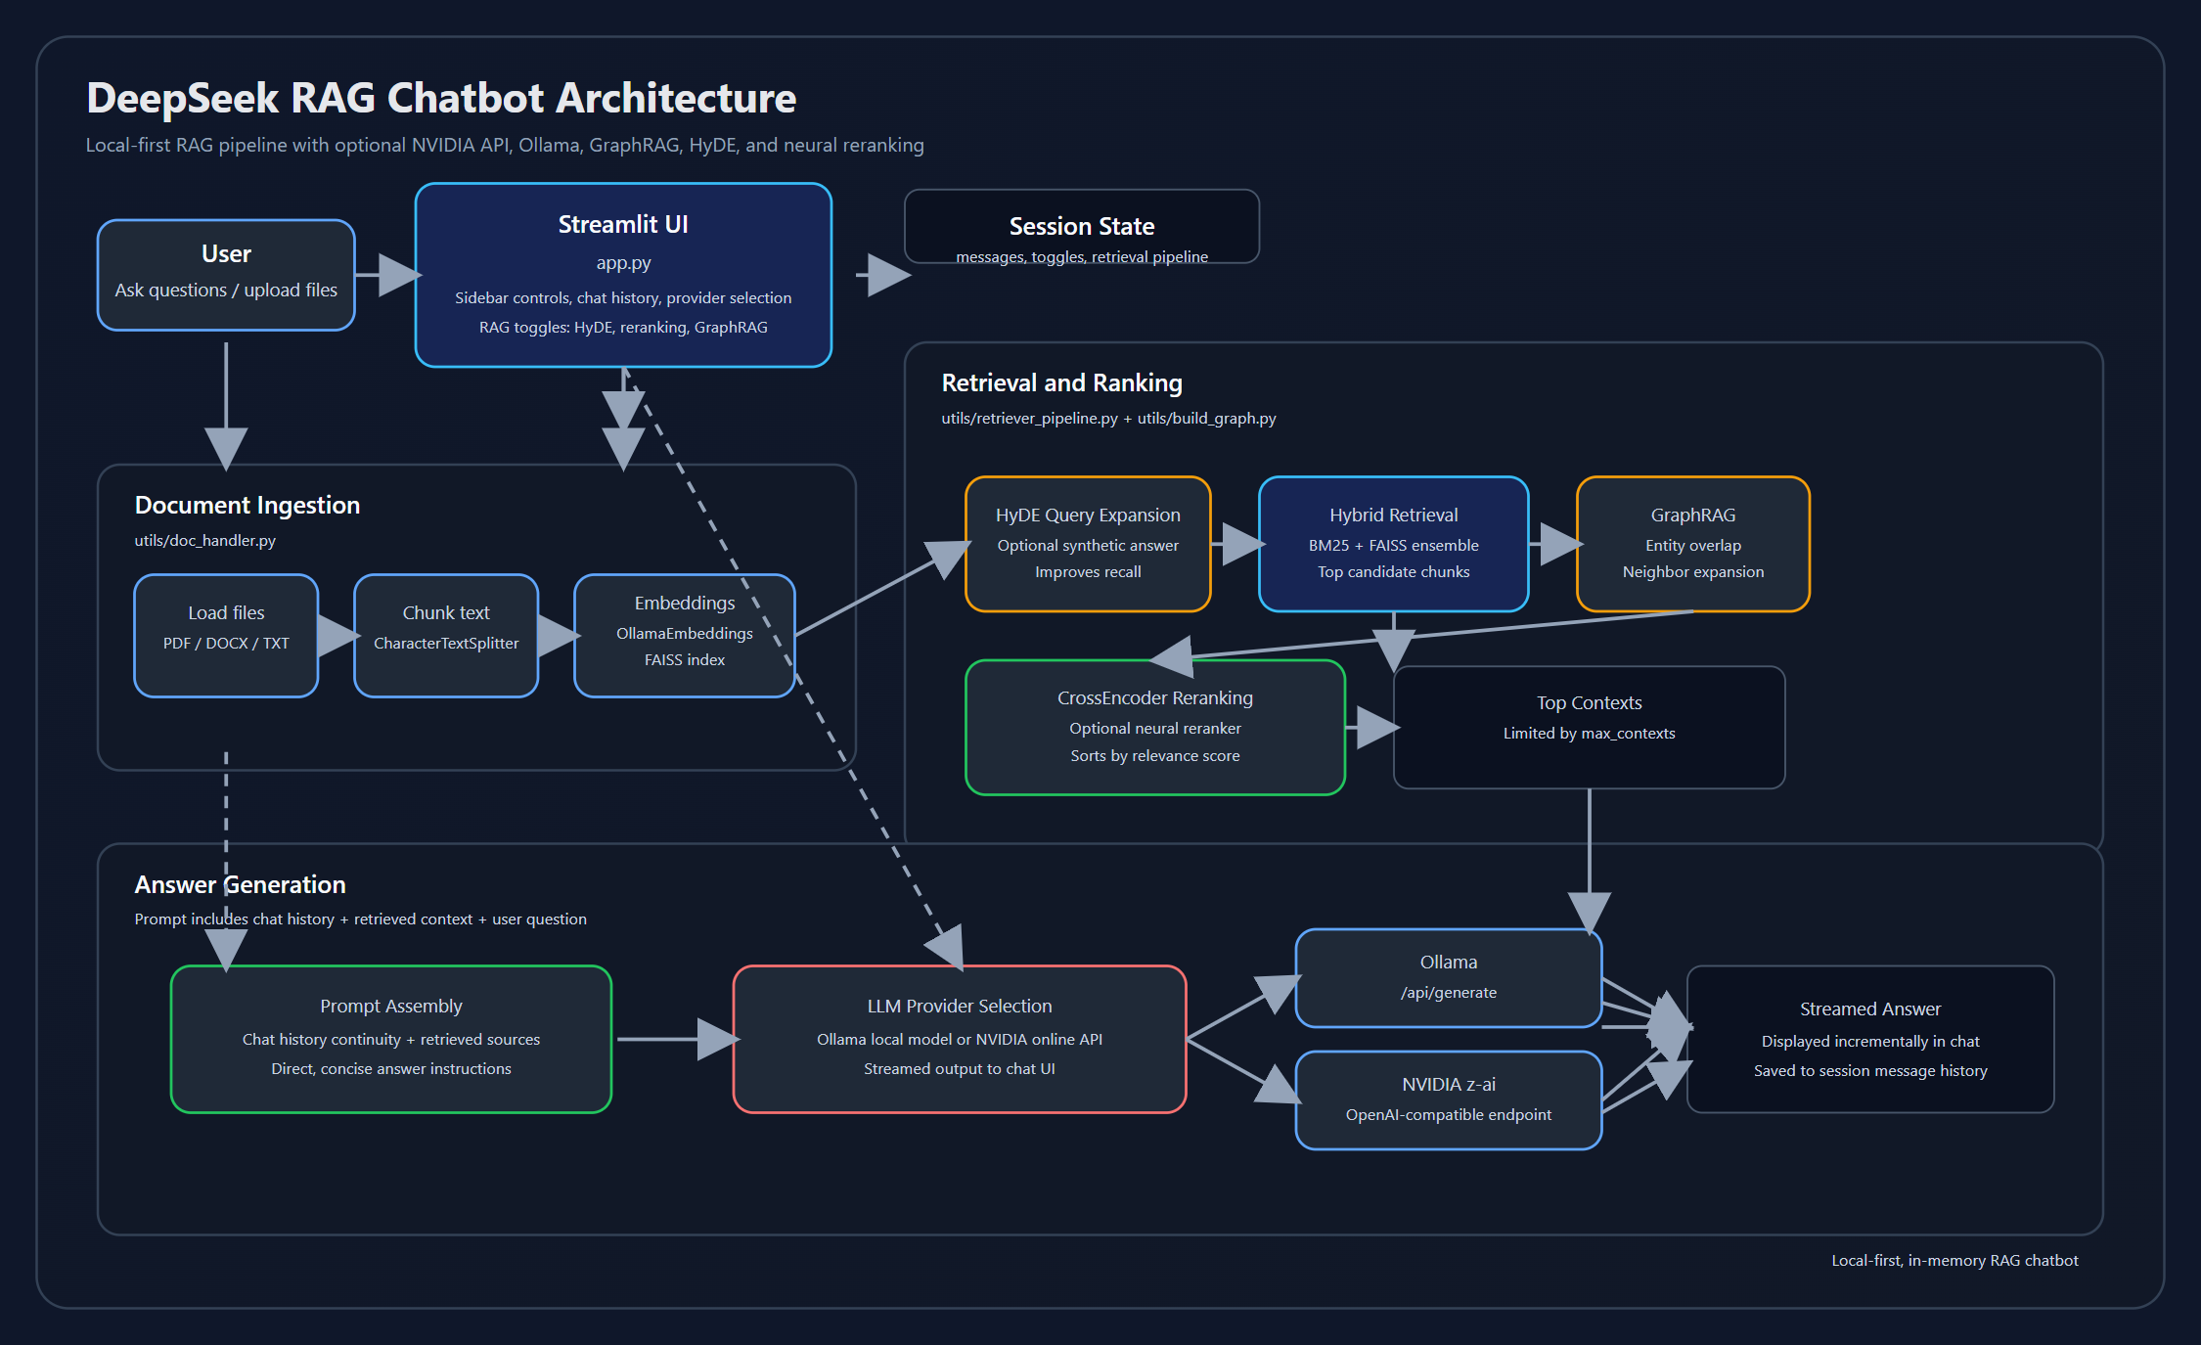
System Architecture
Generated from the repository implementation (Streamlit UI, Hybrid Retrieval, GraphRAG, and dual LLM providers).

Slide 7
Main Application Layer (app.py)
Handles UI, chat interaction, and runtime controls
Document upload and processing triggers
Toggle switches: RAG, HyDE, GraphRAG, neural reranking
Temperature and context-count controls
Maintains session state
Chat history
Retrieval pipeline object
Selected LLM provider
Streams responses token-by-token to improve UX

Slide 8
Document Ingestion (utils/doc_handler.py)
Parsers/loaders used by file type
PDF: PyPDFLoader
DOCX: Docx2txtLoader
TXT: TextLoader
Chunking strategy
CharacterTextSplitter with chunk_size=1000 and overlap=200
Indexes built
FAISS vector store from embeddings
BM25 lexical retriever
Knowledge graph from extracted entities

Slide 9
Hybrid Retrieval Design
Repository combines two retrieval paradigms
BM25 for lexical precision and keyword-heavy queries
FAISS for semantic similarity search
Ensemble retriever merges both with weighted voting
Configured weights in code: BM25=0.4, FAISS=0.6
Benefit: more robust retrieval across different question styles

Slide 10
GraphRAG Implementation
Knowledge graph built from chunk text in utils/build_graph.py
Detects capitalized entities and creates edges between nearby entities
Filters generic terms via stopword and token heuristics
At query-time
Matches graph nodes by token overlap with query
Returns neighbor nodes as extra context candidates
Goal: capture relational signals that lexical/vector search may miss

Slide 11
HyDE + Neural Reranking
HyDE (Hypothetical Document Embeddings)
Generates a hypothetical answer from the query
Uses that enriched text to improve retrieval recall
Neural reranking
CrossEncoder scores (query, candidate_chunk) pairs
Reorders candidates by relevance before context is sent to LLM
Result: better context quality and usually better final answers

Slide 12
Dual LLM Provider Strategy
Provider options in UI
Ollama local models for privacy/offline usage
NVIDIA API for hosted, scalable inference
Runtime behavior
NVIDIA selected if API key is configured
Fallback/alternative to Ollama available via sidebar switch
Both paths use streamed generation for responsiveness

Slide 13
Prompting and Answer Generation
System prompt enforces direct and concise output style
Includes both conversation memory and retrieved context snippets
If context is insufficient, assistant is instructed to ask follow-up
Generation parameters exposed in UI (temperature, context count)

Slide 14
Configuration and Environment
Core environment variables
OLLAMA_API_URL, MODEL
NVIDIA_API_KEY, NVIDIA_BASE_URL, NVIDIA_MODEL
Reference files
.env.example for template values
SETUP_NVIDIA.md for hosted-provider setup
Dependency manifest: requirements.txt

Slide 15
Deployment Options
Option 1: Local Python + Streamlit
Best for development and direct debugging
Option 2: Docker container for app + host Ollama
docker-compose.yml points app to host.docker.internal:11434
Option 3: NVIDIA API mode (no local LLM required)
Useful when local hardware is constrained

Slide 16
Strengths of Current Design
Good retrieval quality stack for a compact app
Hybrid search + graph augmentation + reranking
Flexible provider choice (local and hosted)
Streamlit UX is easy to operate for quick experimentation
Clear modular structure in utils/ for retrieval concerns

Slide 17
Current Gaps / Risks
No persistent storage layer for long-term indexing
Knowledge graph extraction is heuristic (not ontology-aware)
No automated test suite included in repository snapshot
Limited observability and quality metrics in current UI
Scale/performance can vary with document size and model choice

Slide 18
Recommended Roadmap
Add source citations with chunk-level provenance display
Persist vector index + metadata in durable storage
Introduce evaluation harness (retrieval precision + answer faithfulness)
Add authentication and tenant isolation for multi-user scenarios
Expand graph extraction with NER/relationship models
Implement CI tests for ingestion and retrieval regressions

Slide 19
Use Cases
Internal knowledge assistant for teams and documentation
Policy/procedure Q&A over private enterprise files
Research summarization and cross-document insight extraction
Educational tutor over custom class/course content

Slide 20
Final Summary
This project is a practical, local-first RAG chatbot with modern retrieval layers
It combines lexical, vector, graph, and neural ranking signals
It supports both privacy-focused local inference and cloud-style hosted inference
With testing, persistence, and observability upgrades, it can evolve toward production

