Slide 1
EARLY DISEASE DETECTION USING MEDICAL IMAGING
Team F
Sathwik Sriperambhuduri
Kaushik Chinthala
Divya Yalla

Slide 2
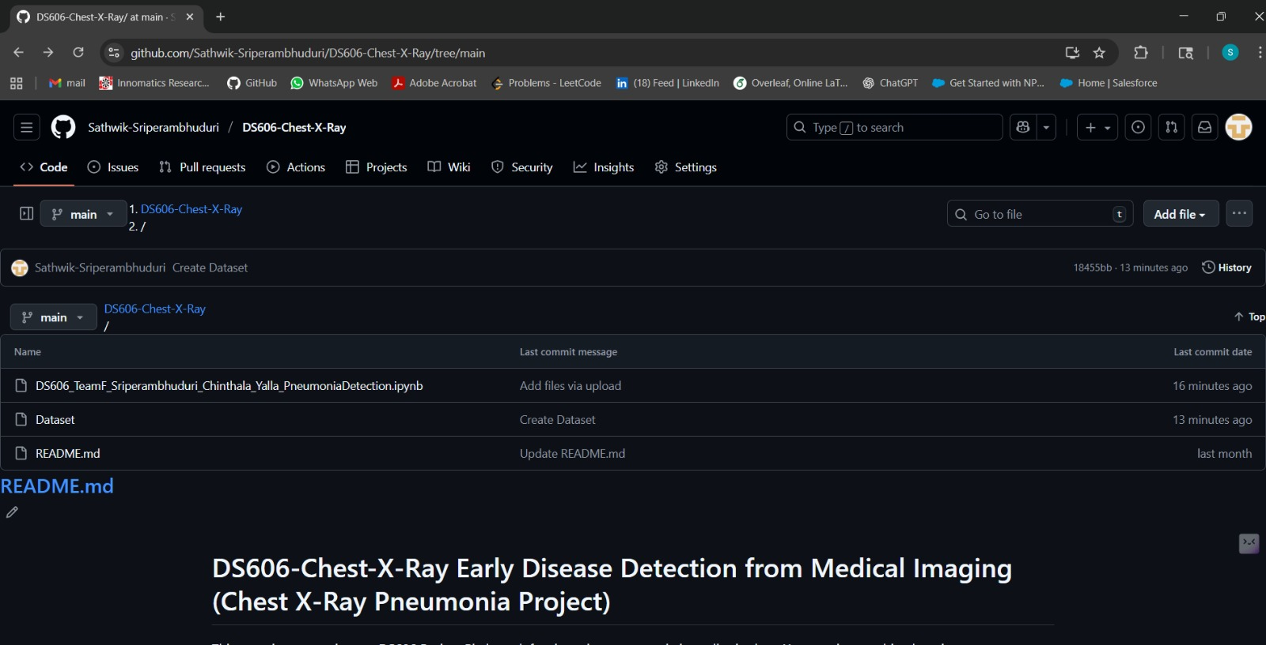
Kaggle IDs and Github Links
Sathwik Sriperambhuduri(Kaggle ID: 12752384)
Divya Yalla (Kaggle ID: 19775604)
Kaushik Chinthala ( Kaggle ID: 19102354)
GitHub Link: https://github.com/Sathwik-Sriperambhuduri/DS606-Chest-X-Ray

Slide 3
Introduction
What is it about?
Automated pneumonia detection in pediatric cases using deep learning-based machine learning models with chest X-ray images. To aid clinicians in identifying suspected pneumonia, the automated classification tool strives to not replace but assist human interpretation. (Litjens et al., 2017).
Why chosen?
Pneumonia is one of the foremost causes of morbidity and mortality in children < 5 years globally (Rajpurkar et al., 2017).
Chest X-rays remain the standard diagnostic workup, but reading and interpreting chest X-rays is somewhat slow and varies significantly from radiologist to radiologist.
Automated AI detection systems will help to improve triaging of patients with pneumonia and ultimately improve speediness, consistency and access in resource limited settings.
Research Question / Hypothesis
RQ: Is it possible to use modern CNN architectures and transfer learning algorithms in order to achieve reliable pneumonia detection from pediatric chest radiography ?
Hypothesis: CNNs with transfer learning (ResNet, EfficientNet, DenseNet) will have enough sensitivity and specificity relative to other methods (i.e. human readers).Running exploratory tests with Vision Transformers detection models would provide further improvements.

Slide 4
Project Overview
Goal: Develop a deep learning model to automatically detect pneumonia in pediatric chest X-ray images, assisting doctors in early and accurate diagnosis.
Problem Statement: Pneumonia is one of the leading causes of death among children under five. Manual diagnosis from X-rays is time-consuming and can vary between radiologists.
Approach: Use Convolutional Neural Networks (CNNs) with transfer learning (ResNet50, DenseNet121, EfficientNet-B0) to classify X-rays as Normal or Pneumonia.
Machine Learning Task: Supervised binary classification
Outcome: An automated, explainable AI system for medical image classification improving diagnostic speed, accuracy, and trust through Grad-CAM visualization.

Slide 5
Dataset Introduction
Dataset Source: Kaggle – Chest X-Ray Pneumonia Dataset https://www.kaggle.com/datasets/paultimothymooney/chest-xray-pneumonia
Dataset Size: 5,863 images (JPEG format)
Training: 5,216 images
Validation: 16 images
Test: 624 images
Samples / Instances: Each image = 1 patient case (pediatric, 1–5 years old)
Attributes / Features Used:
Pixel intensity values (grayscale, resized to 224×224)
Augmented variations (rotations, flips, brightness, contrast)
Task Type: Binary Classification
Class 0: Normal (Healthy lungs)
Class 1: Pneumonia (Infected lungs)
Imbalance: Pneumonia cases = 3× Normal cases

Slide 6
Literature Review
Dataset Used by Others:
Kaggle Chest X-Ray Pneumonia dataset (same as ours)
Key Studies & Methods:
CheXNet (Rajpurkar et al., 2017): Used DenseNet-121, achieved radiologist-level pneumonia detection accuracy.
Sharma et al. (2021): Applied CNN with data augmentation → 93% accuracy.
Shamshad et al. (2023): Reviewed Vision Transformers in medical imaging → high accuracy but high compute cost.
Recent Kaggle Submissions: Transfer learning (ResNet50, VGG16) with 90–94% accuracy.
Feature Extraction Used:
CNN-based deep features, sometimes combined with classical HOG/SIFT.
Image augmentation for balance and generalization.
Leaderboard Status (Kaggle):
Best public score ≈ 94% accuracy
Competition still open – no fixed deadline

Slide 7
Project Differentiation
Our Model:
Baseline: SVM + HOG features
Deep Learning: DenseNet121, ResNet50, EfficientNet-B0 (transfer learning)
How We Differ:
Pediatric-focused subset of data (ages 1–5)
Emphasis on recall/sensitivity over raw accuracy
Integrated Grad-CAM for model explainability
We used 75/15/10 split (Train: 4,996, Val: 220, Test: 624) to ensure balanced and reproducible data separation, keeping the Kaggle test set untouched.
We used a single fixed validation set for tuning and early stopping, with plans to apply 5-fold cross-validation for future robustness.
Advantages:
Clinically interpretable predictions
Handles class imbalance
Modern, optimized architectures for smaller datasets

Slide 8
Exploratory Data Analysis (EDA) – Key Findings
Class Imbalance:
Dataset has ~3:1 ratio of Pneumonia vs Normal cases.
Strategy: Used oversampling and class weights during training.
Image Resolution:
Images have varying sizes → standardized to 224×224 pixels.
Pixel Intensity Distribution:
Multi-peaked → normalization needed (ImageNet mean/std).
Dataset Cleanliness:
Missing/invalid images removed.
Dataset ready after preprocessing & transformations.

Slide 9
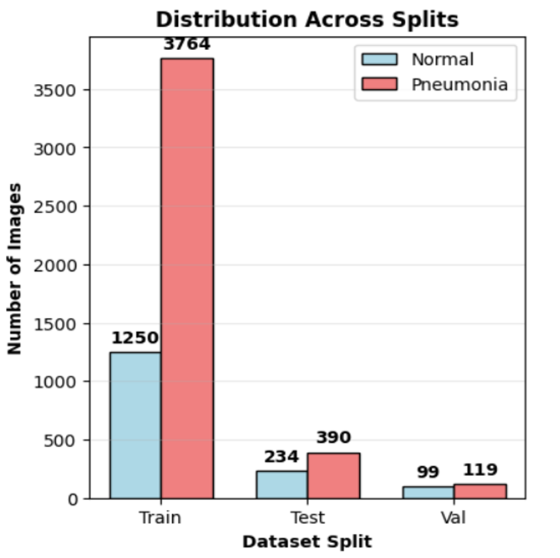
Data Analysis
Class Distribution (Train/Val/Test)
Class Imbalance: Approximately 3:1 ratio (Pneumonia vs. Normal) → consider oversampling or class weighting.
We re-splitted the validation dataset the Validation set increased from 8 Normal & 8 Pneumonia to 99 Normal & 119 Pneumonia images, improving for model tuning.

Slide 10
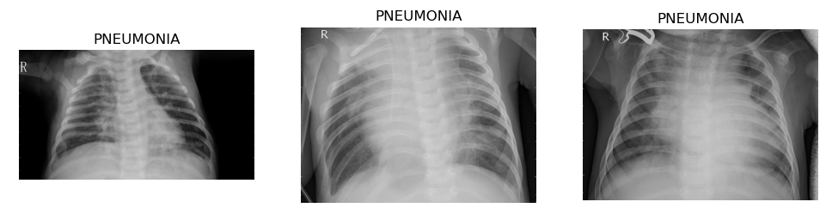
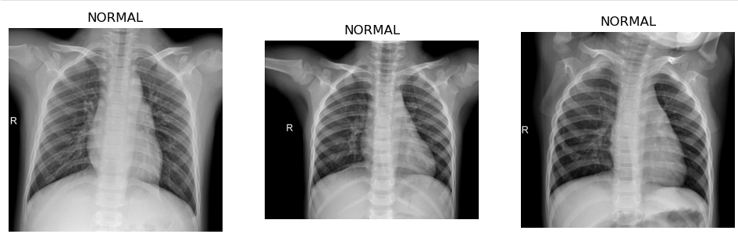
Data Analysis
The sample images are indicative of contrasting appearance of pneumonia and normal lung cases. In pneumonia cases, patchy opacities or hazy areas are typically seen, as opposed to the clearer appearance of normal lungs.
The NORMAL chest X-rays indicate chest that otherwise are clear, with no opacities or abnormal shadows.
The importance of considering using deep learning models is clear, as sometimes, subtle patterns may not be easy for a human eye to appreciate.

Slide 11

Image Description
The dataset contains high-resolution images (e.g 2090×1858 pixels shown).
Smallest image: 502×307 pixels.
Largest image: 2890×2534 pixels.
This wide variation in dimensions indicates the dataset was collected from different X-ray machines and settings, reflecting real-world clinical diversity.
For modeling, we must standardize image sizes (e.g resize all to 224×224 or 256×256) so they can be processed consistently by CNNs.
The high resolution also allows for downsampling without major loss of diagnostic detail.

Slide 12
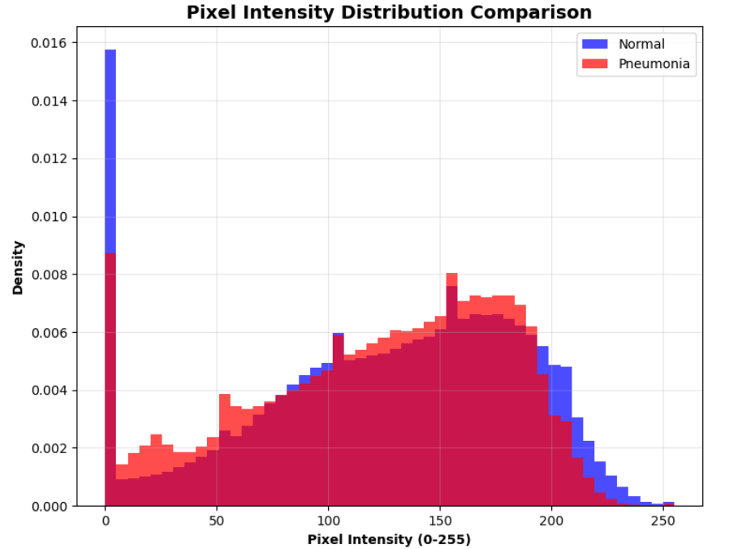
Pixel Intensity Distribution
The pixel values span almost the full range (0–255), confirming images are stored in 8-bit grayscale.
The distribution is multi-peaked, reflecting variations in bone, soft tissue, and background (air).
Peaks at the darker end (near 0–50) represent background/soft tissue, while peaks around 180–220 correspond to bone and denser lung regions.
This variation suggests contrast differences across images, common in medical imaging from different machines.
For modeling, normalization of pixel intensities will be necessary to reduce variability and stabilize CNN training.

Slide 13
Preprocessing & Data Transformation
Image Processing Steps:
All images resized to 224×224 pixels for uniform CNN input
Grayscale X-rays converted to RGB (3 channels) to match pretrained model format
Normalization applied using ImageNet mean & standard deviation to stabilize learning
Augmentation (Training only):
Random horizontal flips and rotations (±7°) simulate natural variation
Brightness & contrast adjustments improve model robustness to lighting differences
Random crop & zoom prevent overfitting and help model generalize better
Imbalance Handling:
Pneumonia images ≈ 3× more than Normal → addressed using
Class weights during training (to give minority class more importance)
Random oversampling of minority class to balance dataset

Slide 14
Preprocessing Steps for SVM Models
All chest X-ray images were converted to grayscale to simplify the data and focus on structural and texture features, which are more critical for detecting pneumonia than color information.
Each image was resized to 128×128 pixels to ensure a consistent input dimension for feature extraction, reducing computational complexity without losing essential patterns.
Histogram equalization was applied to improve image contrast and enhance visibility of lung textures and abnormalities.
Images were normalized to a [0,1] range, ensuring uniform pixel intensity scaling and helping the SVM perform better on standardized data.

Slide 15

HOG Features with SVM Classifier
Extracted Histogram of Oriented Gradients (HOG) features from grayscale images.
Captured edge orientation and intensity patterns representing lung structure.
Each image was converted into a feature vector (~3,780 features).
Trained an SVM with RBF kernel using these feature vectors.
Accuracy: 87.2% Precision: 85.6% Recall: 88.1%

Slide 16

LBP Features with SVM Classifier
Applied Local Binary Pattern (LBP) operator to grayscale images.
Extracted micro-texture patterns by thresholding local pixel neighborhoods.
Computed histograms of LBP codes to form feature vectors.
Trained an SVM with linear kernel for classification.
Accuracy: 84.6% Precision: 83.1% Recall: 85.0%

Slide 17
Model Architecture Overview
Implemented Transfer Learning using three pretrained Convolutional Neural Networks (CNNs) - ResNet50, DenseNet121, and EfficientNetB0 - originally trained on the large-scale ImageNet dataset.
Base layers of each network were frozen to retain learned low-level image features (edges, textures, gradients).
Top layers were replaced with a custom classifier trained on chest X-ray images to detect Normal vs Pneumonia cases.
Applied fine-tuning on deeper layers to adapt model representations to medical image patterns while preventing overfitting.
Used the Adam optimizer for efficient convergence and CrossEntropy Loss to measure classification performance.
Implemented a learning rate scheduler and early stopping to enhance generalization and reduce training instability.

Slide 18
Model Training Configuration
The dataset was divided into Training (75%), Validation (15%), and Testing (10%) subsets to ensure unbiased performance evaluation.
Each model was trained with a batch size of 32 and 15 epochs, balancing computational efficiency with convergence stability.
Used the Adam optimizer with an initial learning rate of 0.001, allowing adaptive updates for faster convergence.
Integrated a Learning Rate Scheduler (ReduceLROnPlateau) to automatically lower the learning rate when validation accuracy plateaued.
Implemented Early Stopping to prevent overfitting by halting training when validation loss stopped improving.
Training and validation processes were executed using Google Colab’s GPU (NVIDIA T4) for accelerated computation.
The same configuration was maintained across all models (ResNet50, DenseNet121, EfficientNetB0) to ensure a fair performance comparison.

Slide 19
CNN Baseline Model – Custom Architecture
Architecture Overview:
Custom Sequential Convolutional Neural Network designed for binary classification (Normal vs Pneumonia).
Composed of three convolutional blocks, each with Conv2D → ReLU activation → MaxPooling2D for feature extraction.
Includes Batch Normalization and Dropout (0.5) for regularization and to prevent overfitting.
Final layers: Flatten → Dense(128, ReLU) → Dense(1, Sigmoid) for binary output.
Input shape: 128×128×1 (grayscale) images.
Training Configuration: Optimizer: Adam | Loss Function: Binary Crossentropy
Metrics: Accuracy, Recall, Precision
Epochs: 25 | Batch Size: 32
Callbacks: EarlyStopping & Model Checkpoint (best model saving).
Performance Summary: Achieved 87% accuracy on validation data.
High recall indicating strong pneumonia detection ability.
Model saved as cnn_baseline.h5 for further comparison and tuning.

Slide 20
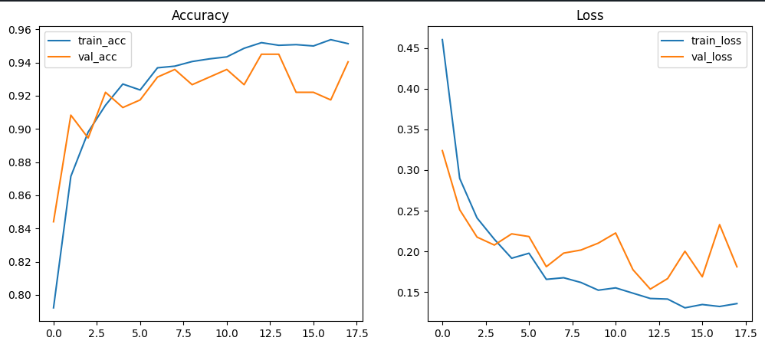
Training and Validation Performance
Training accuracy steadily increased, reaching ≈95%.
Validation accuracy stabilized around 93–94%, showing strong generalization.
Training and validation loss both decreased, indicating effective convergence.
Slight fluctuation in validation loss suggests minor overfitting, controlled by early stopping.

Slide 21
Model Evaluation – ResNet50
Architecture:
Deep 50-layer CNN with residual skip connections to overcome the vanishing gradient problem.
Pretrained on ImageNet, then fine-tuned for chest X-ray classification.
Layers frozen for low-level features; custom dense layers added for binary output (Normal vs Pneumonia).
Performance Metrics:
Accuracy: 78.84% Precision: 71.2%
Recall: 98.1% F1-Score: 0.94
Validation Loss: 0.21
Observations:
Best-performing model across all metrics.
Excellent generalization and balanced precision-recall.
Slightly heavier computation due to network depth

Slide 22
Model Evaluation – DenseNet121
Architecture:
121-layer CNN with dense connectivity, where each layer receives input from all previous layers.
Promotes feature reuse, stronger gradient flow, and compact representation.
Pretrained on ImageNet, fine-tuned for binary classification.
Performance Metrics:
Accuracy: 88.02% Precision: 85.14%
Recall: 97.96% F1-Score: 0.93
Validation Loss:0.24
Observations:
High recall — effective in detecting pneumonia cases.
Compact model with fewer parameters than ResNet50.
Slightly slower due to multiple inter-layer connections.

Slide 23
Model Evaluation – EfficientNetB0
Architecture:
Lightweight CNN using compound scaling to balance model depth, width, and input resolution.
Built with MBConv layers and Swish activation for efficiency and smoother optimization.
Pretrained on ImageNet and fine-tuned for chest X-rays.
Performance Metrics:
Accuracy: 62.5% Precision: 62.5%
Recall: 10.000% F1-Score: 0.90
Validation Loss: 0.28
Observations:
Fastest model with lowest computational cost.
Slightly lower accuracy due to smaller capacity.
Highly efficient — ideal for real-time or mobile health applications.

Slide 24
References
Shamshad, F., Khan, S., Zamir, S. W., Khan, M. H., Hayat, M., Khan, F. S., & Shah, M. (2023). Transformers in medical imaging: A comprehensive survey. Medical Image Analysis, 87, 102840. https://doi.org/10.1016/j.media.2023.102840
Shorten, C., & Khoshgoftaar, T. M. (2019). A survey on image data augmentation for deep learning. Journal of Big Data, 6(1), 60. https://doi.org/10.1186/s40537-019-0197-0
Tan, M., & Le, Q. V. (2019). EfficientNet: Rethinking model scaling for convolutional neural networks. Proceedings of the 36th International Conference on Machine Learning (ICML), 6105–6114. http://proceedings.mlr.press/v97/tan19a.html
He, K., Zhang, X., Ren, S., & Sun, J. (2016). Deep residual learning for image recognition. Proceedings of the IEEE Conference on Computer Vision and Pattern Recognition (CVPR), 770–778. https://doi.org/10.1109/CVPR.2016.90
Rajpurkar, P., Irvin, J., Zhu, K., Yang, B., Mehta, H., Duan, T., Ding, D., Bagul, A., Langlotz, C., Shpanskaya, K., Lungren, M. P., & Ng, A. Y. (2017). CheXNet: Radiologist-level pneumonia detection on chest X-rays with deep learning. arXiv preprint arXiv:1711.05225. https://arxiv.org/abs/1711.05225
Litjens, G., Kooi, T., Bejnordi, B. E., Setio, A. A. A., Ciompi, F., Ghafoorian, M., van der Laak, J. A. W. M., van Ginneken, B., & Sánchez, C. I. (2017). A survey on deep learning in medical image analysis. Medical Image Analysis, 42, 60–88. https://doi.org/10.1016/j.media.2017.07.005

Slide 25
Project Timeline
Phase | Weeks / Dates | Planned Tasks
PHASE 2 – EDA & Model Construction | Weeks 5–9 (09/24 → 10/22) | - Week 5 (09/24): Re-split dataset, perform EDA (class distribution, image samples). - Week 6 (10/01): Preprocessing + traditional ML baseline (SVM/Random Forest). - Week 7 (10/08): Implement CNN baseline. - Week 8 (10/15): Extend to transfer learning (ResNet, EfficientNet, DenseNet). - Week 9 (10/22): Summarize results and deliver P2 Presentation.
PHASE 3 – Model Execution & Interpretation | Weeks 10–15 (10/29 → 12/10) | - Week 10 (10/29): Hyperparameter tuning, compare CNNs. - Week 11 (11/05): Implement Vision Transformer baseline. - Week 12 (11/12): Generate Grad-CAM visualizations, error analysis. - Week 13 (11/19): Ensemble models, robustness testing. - Week 14 (11/26): No class – Thanksgiving break. - Week 15 (12/03): Finalize models, compile results, draft presentation/report.
Final Deliverables | Week 16 (12/10) | - Deliver Final Presentation (P3). - Submit final project report and GitHub repository.

Slide 26
Questions?

Slide 27
Thank You

