Slide 1
EARLY DISEASE DETECTION USING MEDICAL IMAGING
Team F
Sathwik Sriperambhuduri
Kaushik Chinthala
Divya Yalla

Slide 2
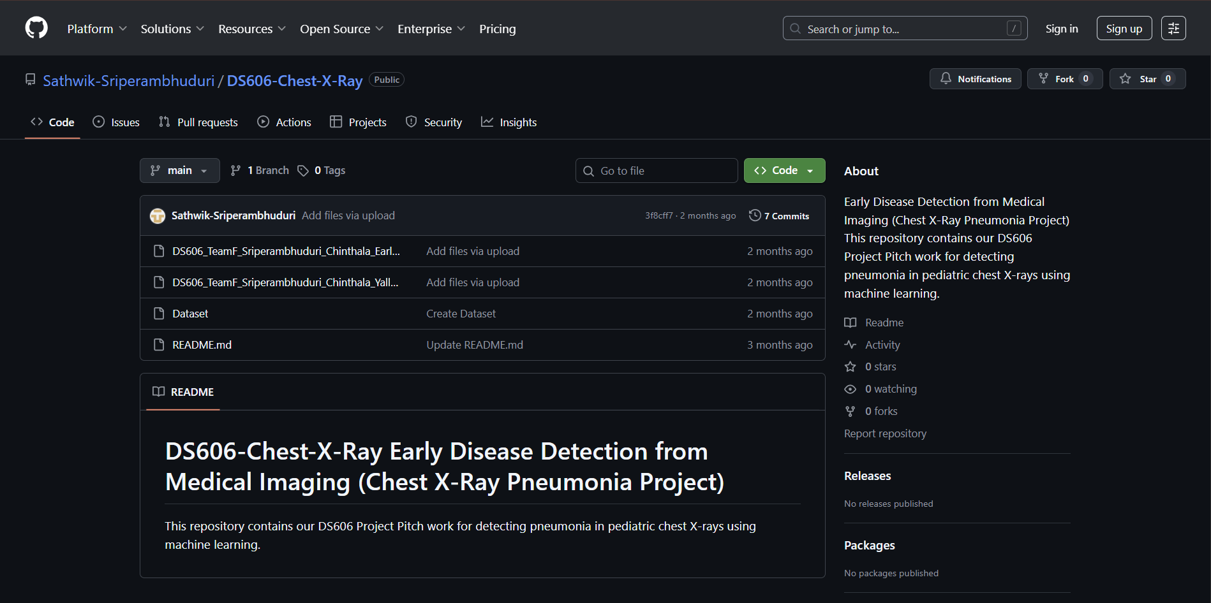
Sathwik Sriperambhuduri(Kaggle ID: 12752384)
Divya Yalla (Kaggle ID: 19775604)
Kaushik Chinthala ( Kaggle ID: 19102354)
GitHub Link: https://github.com/Sathwik-Sriperambhuduri/DS606-Chest-X-Ray
Kaggle IDs and
Github Links

Slide 3
Project Overview
Problem Statement
Pneumonia is one of the leading causes of illness and death in children under five worldwide. Pediatric chest X-rays are difficult to interpret because of overlapping anatomical structures, low contrast, and subtle disease patterns.
Goal
To develop a deep learning model to automatically detect pneumonia in pediatric chest X-ray images, assisting doctors in early and accurate diagnosis.
Approach
We preprocessed and augmented the X-ray images, addressed class imbalance, and created a clean Train/Validation/Test pipeline.
We built both classical ML baselines (HOG/LBP + SVM) and deep learning models including a custom CNN, ResNet50, DenseNet121, and EfficientNet-B0 with fine-tuning.
We evaluated all models using accuracy, precision, recall, confusion matrices, and Grad-CAM explainability to identify the best-performing approach.
Outcome
An automated, explainable AI system for medical image classification improving diagnostic speed, accuracy, and trust through Grad-CAM visualization

Slide 4
Literature review
Dataset Used by Others:
Kaggle Chest X-Ray Pneumonia dataset
Key Studies & Methods:
CheXNet (Rajpurkar et al., 2017): Used DenseNet-121, achieved radiologist-level pneumonia detection accuracy.
Sharma et al. (2021): Applied CNN with data augmentation → 93% accuracy.
Shamshad et al. (2023): Reviewed Vision Transformers in medical imaging → high accuracy but high compute cost.
Recent Kaggle Submissions: Transfer learning (ResNet50, VGG16) with 90–94% accuracy.
Feature Extraction Used:
CNN-based deep features, sometimes combined with classical HOG/SIFT.
Image augmentation for balance and generalization.
Leaderboard Status (Kaggle):
Best public score ≈ 94% accuracy

Slide 5
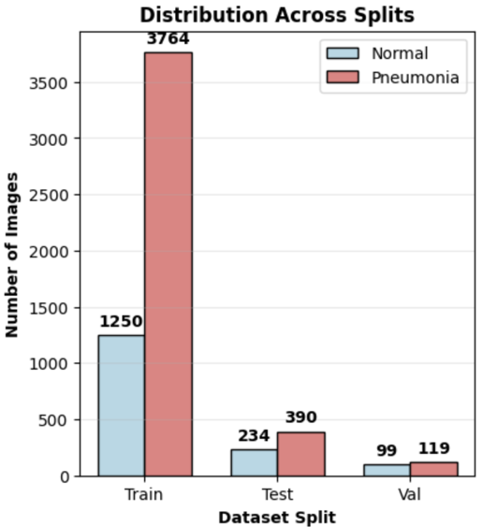
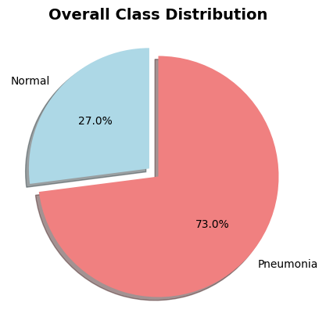
Dataset overview
Source : Kaggle Chest X-ray Pneumonia dataset : https://www.kaggle.com/datasets/paultimothymooney/chest-xray-pneumonia
Dataset Size: 5,863 images
  Training: 5,216 images
  Validation: 220 images
  Test: 624 images
Train/Validation/Test Split: 75% / 15% / 10%
Age Range: Pediatric patients (1–5 years)
Dataset Characteristics
Grayscale X-ray images with varying resolutions
Two classes: Normal & Pneumonia
Imbalance: Total: 5,863 images
Normal: 1,341 | Pneumonia: 4,522
Imbalance ratio ≈ 1 : 2.7 → required class weights + augmentation.

Slide 6
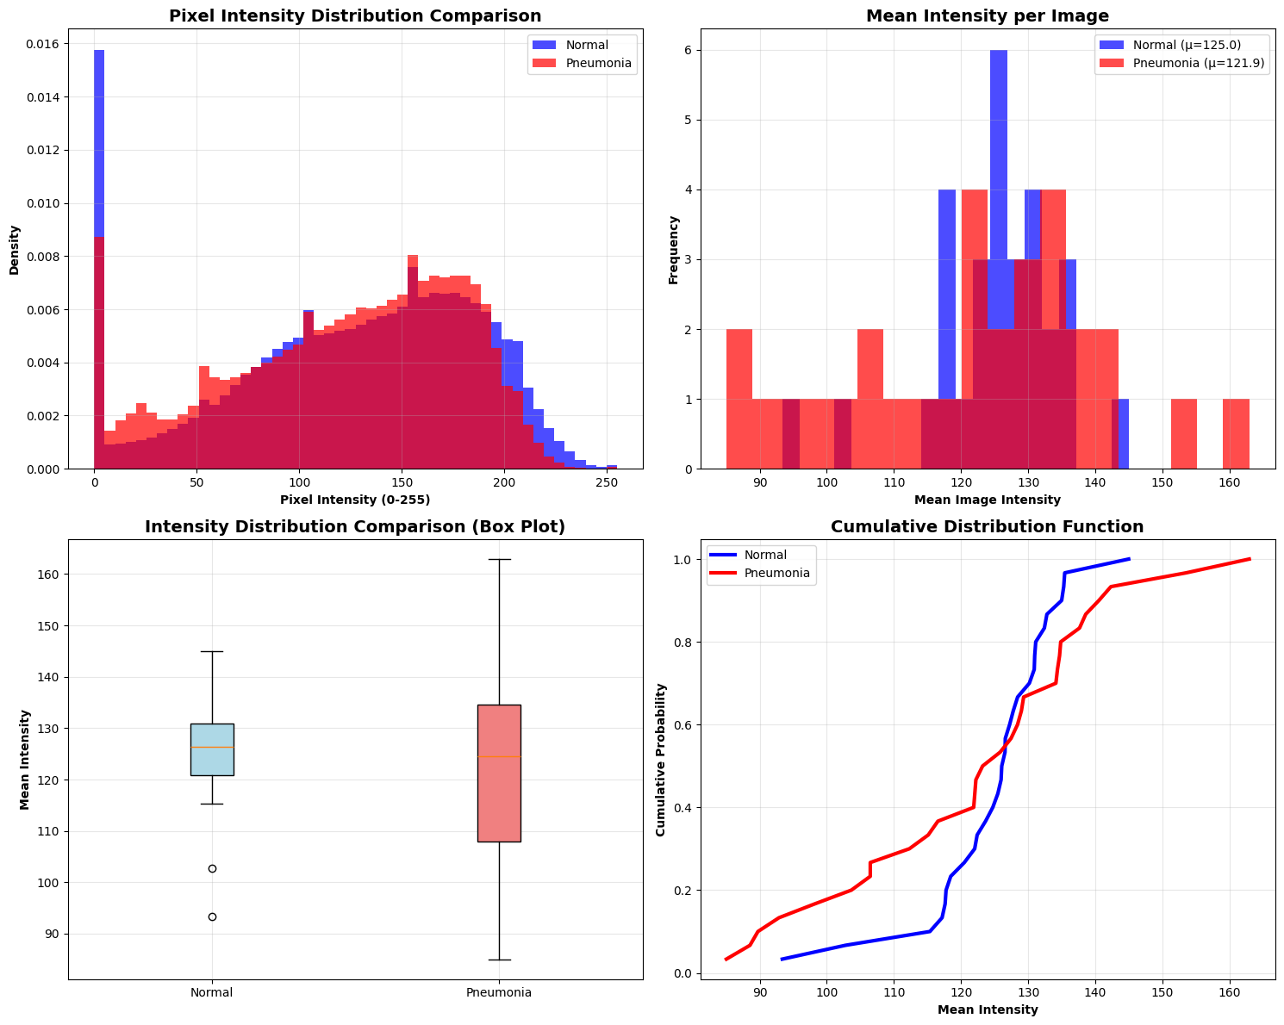
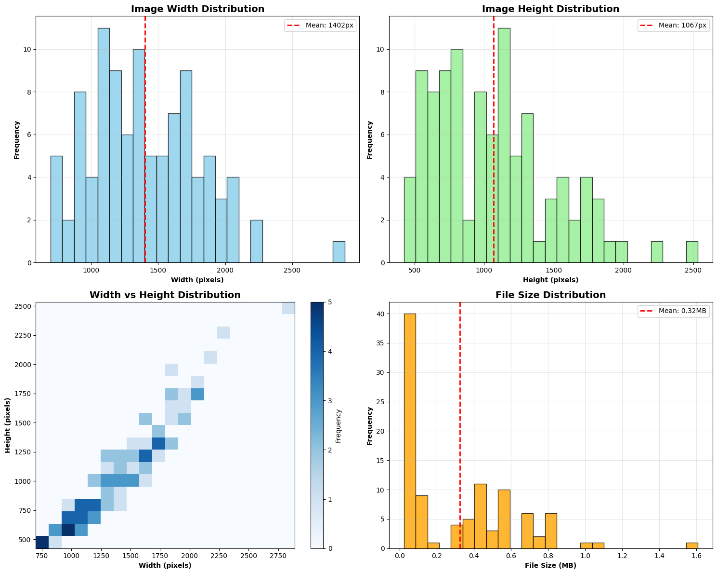
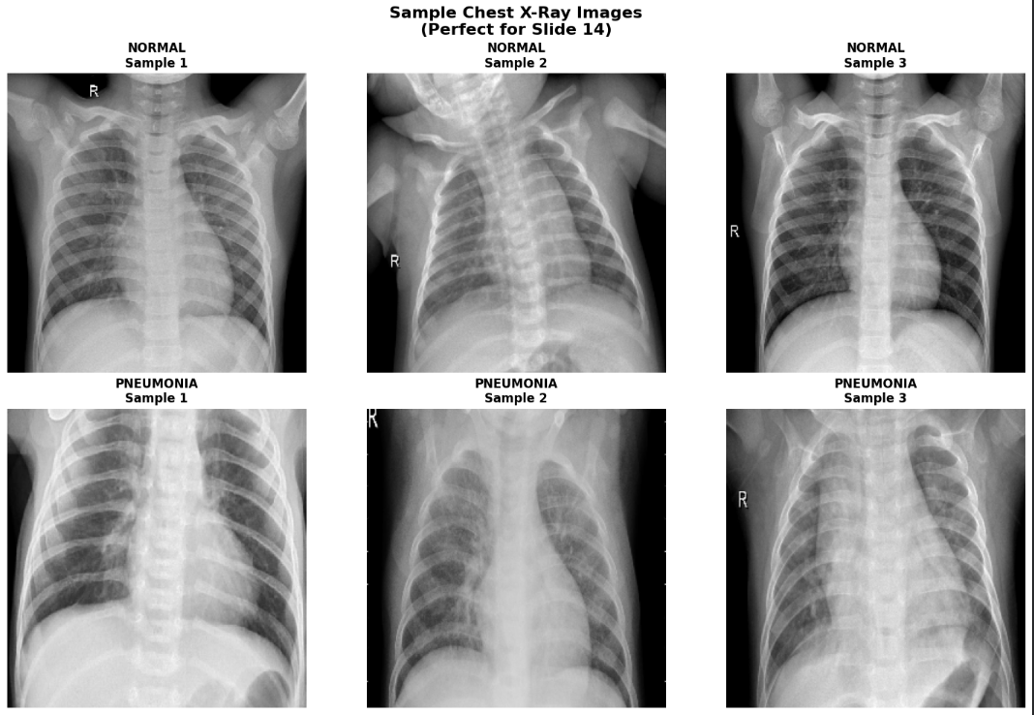
Key EDA Findings
Class Imbalance
Pneumonia: 4,273 images (73%)
Normal: 1,583 images (27%)
Imbalance ratio 1 : 2.7 → Required class weights & augmentation
Image Size Variability
Resolutions range widely from ~500 px to ~2800 px
Average size: 1402 × 1067 px
Pixel Intensity Insights
Pneumonia images show higher mean intensity and broader distribution
Visual Patterns
Splits
Train: 5,014 | Val: 218 | Test: 624

Slide 7
Hypothesis & Interpretation
Hypothesis
“Deep learning models, especially CNNs and transfer learning architectures, can accurately classify chest X-rays into Normal and Pneumonia categories.”
Expected Outcome
Transfer learning models (ResNet/EfficientNet) might outperform a custom CNN.
Pneumonia should be easier to detect due to stronger visual features.
What Actually Happened
The tuned CNN achieved the best performance (86.86% accuracy).
ResNet50 had good recall but lower precision.
EfficientNetB0 struggled due to domain mismatch with grayscale medical images.
Interpretation
Custom CNNs can outperform pretrained models when optimized for medical images.
Performance differences reflect dataset imbalance and domain shift.
Grad-CAM confirms the model focuses on relevant lung regions, supporting the hypothesis.

Slide 8
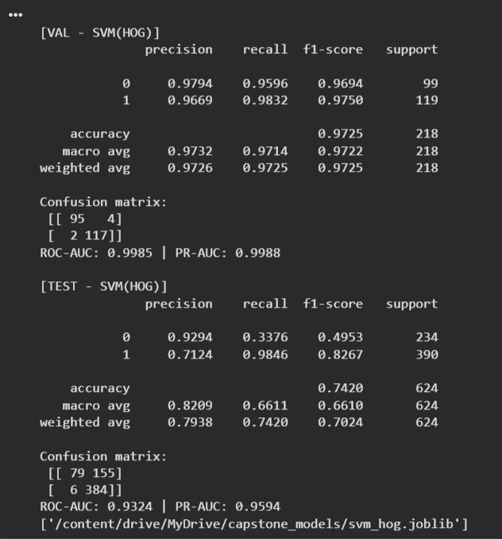
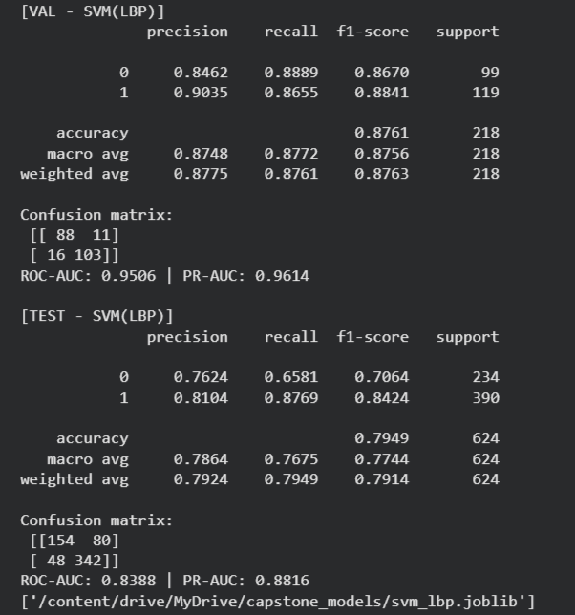
Data Preprocessing
Resize all images to 128×128 pixels and 224×224 pixels.
Normalize pixel values to [0,1] for stable gradient updates.
Applying data augmentation during CNN training:
Rotation, width/height shift, zoom, horizontal flip
Feature representations for Traditional ML baselines:
HOG (edge & gradient structure) : Captures edge and gradient structures that highlight lung shapes and pneumonia-related opacities. Extracted high-dimensional gradient features using HOG.
Trained Linear SVM with class weight = balanced.
Val Accuracy: ~97% & Test Accuracy: ~74% → overfitting.
LBP (local texture patterns) : Extracts local texture patterns that reveal fine-grained abnormalities in lung tissue.
Trained RBF-kernel SVM for non-linear separation.
Val Accuracy: ~88% & Test Accuracy: ~79% → slightly better generalization.

Slide 9
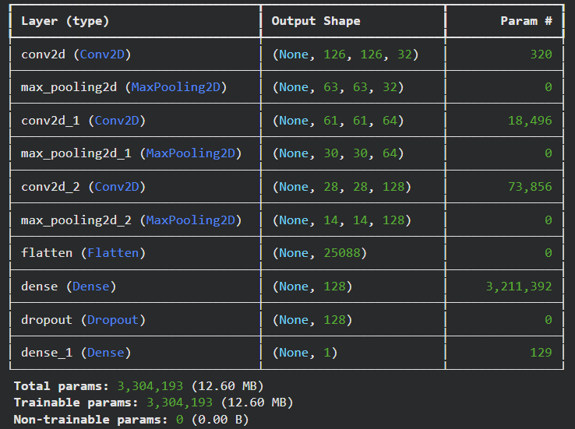
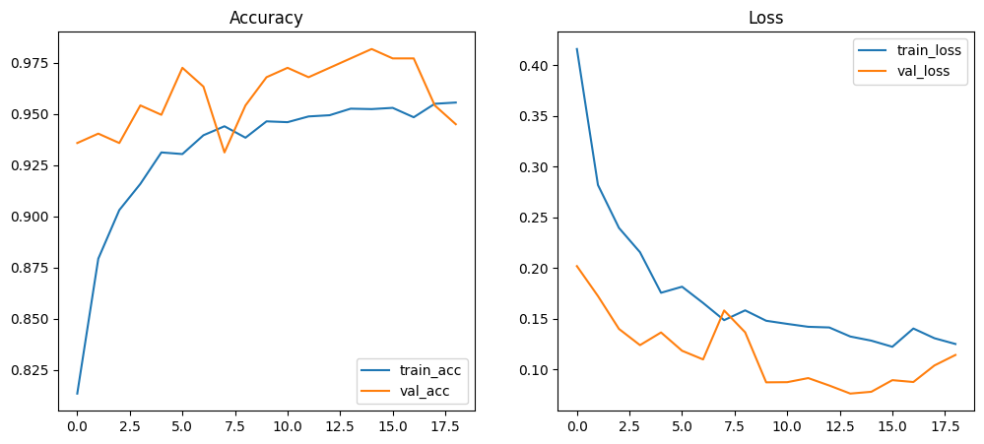
CNN Baseline
Custom CNN with Convolutional blocks
Dense layers with Dropout to reduce overfitting.
Trained on 128×128 grayscale images.
Test Accuracy: 86.5%
Recall (Pneumonia): 0.98
Precision: 0.83
Shows strong feature learning capability despite being a simple model.

Slide 10
Transfer Learning
ResNet50
Deep residual network using skip connections for stable gradient flow.
Pretrained on ImageNet; fine-tuned with custom classifier head.
Test Accuracy: ~75.6%
Strong recall but low precision → over-predicts pneumonia.
Struggled due to domain shift from natural images to grayscale X-rays.
2. EfficientNetB0
Lightweight model using compound scaling to balance depth, width, resolution.
Expected to be efficient and accurate on limited datasets.
Test Accuracy: ~62%
Very high recall but extremely low precision → predicts nearly all images as pneumonia.
Indicates poor adaptation to medical texture and grayscale contrast.

Slide 11
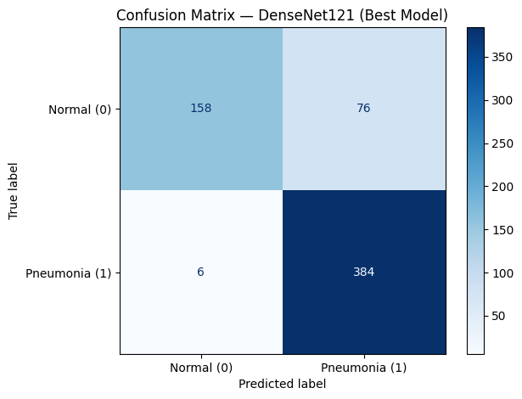
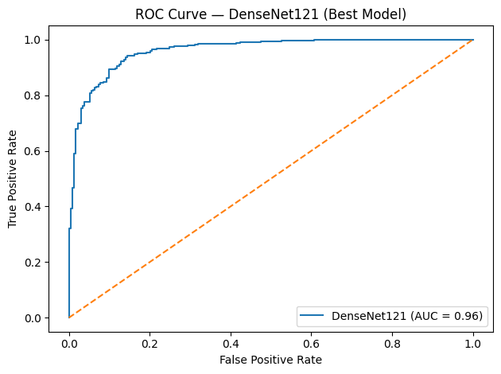
3. DenseNet 50:
Dense connectivity improves gradient flow.
Encourages feature reuse across layers.
Proven strong for medical imaging tasks.
Performance: Test Accuracy: 86.9%
Recall (Pneumonia): 0.9846
Precision: 0.8348
Best balance between false positives & false negatives.
Therefore, Densenet50 has the highest accuracy among the other transfer learning models

Slide 12

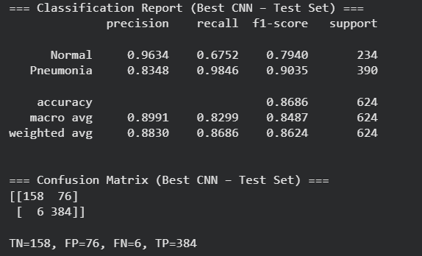
Hyper parameter tuning using Keras
Tuned CNN architecture using KerasTuner Hyperband.
Adjustable parameters:
  Number of convolutional blocks : 2–4
  Filters : 16–64
  Kernel size : 3 or 5
  Dense units : 128–256
  Dropout : 0.3–0.5
  Learning rate : 1e-4 to 1e-3
Best hyperparameters discovered:
  Blocks = 4, Filters = 32, Kernel = 5, Dense = 192, Dropout = 0.5, LR = 1e-4
Best validation accuracy reached: 96.7%

Slide 13
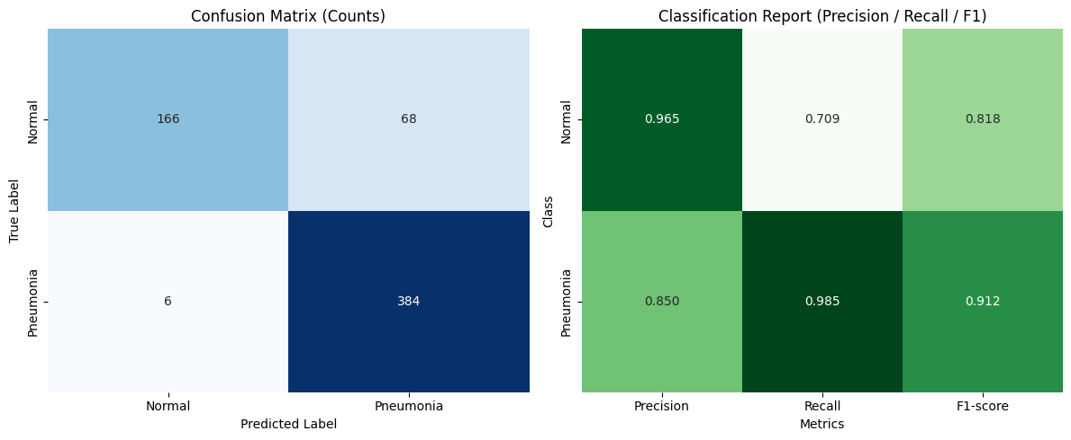
Best CNN Performance (Confusion Matrix + Metrics)
Achieved Test Accuracy: 86.86%
Strong performance detecting Pneumonia
Precision: 0.8348
Recall: 0.9846
F1-score: 0.9035
Normal cases slightly lower recall due to class imbalance.

Slide 14
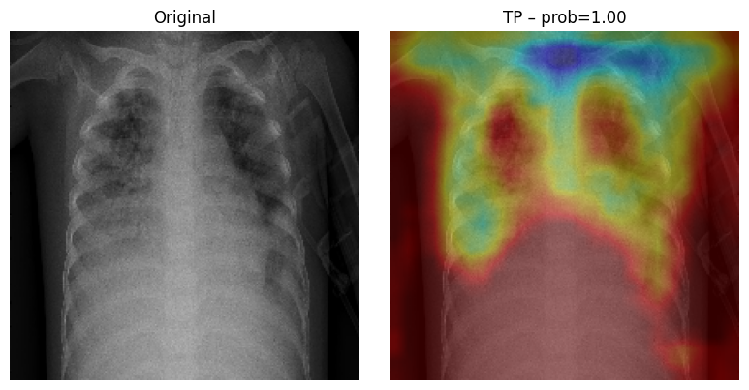
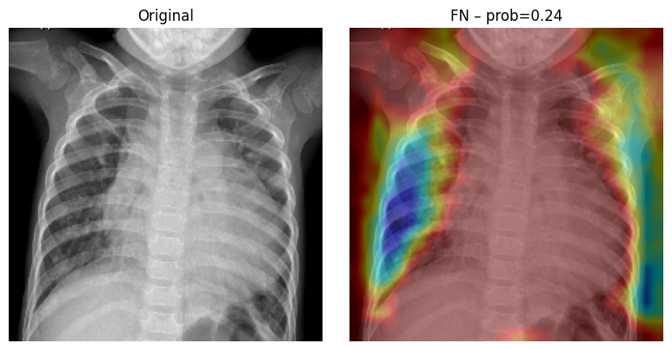
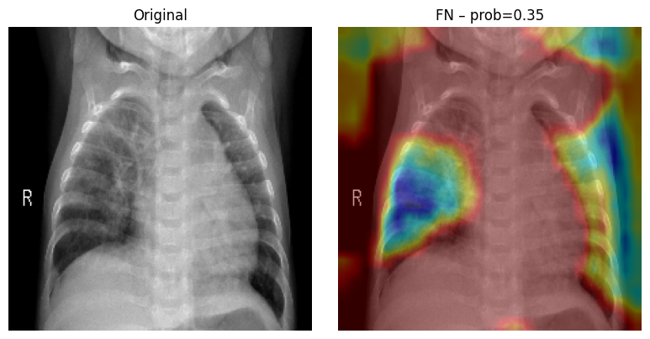
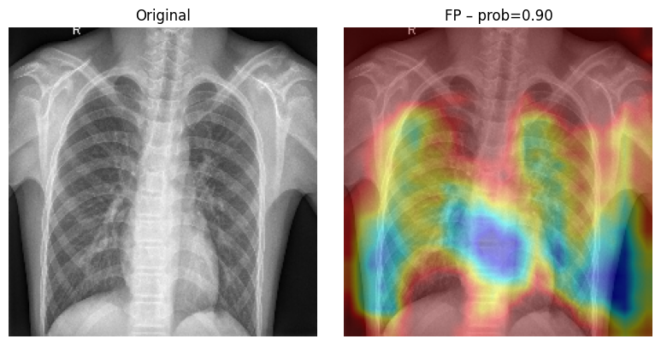
Grad-CAM Explainability
Model Explainability with Grad-CAM
Grad-CAM used to visualize which lung regions influenced predictions.
True Positive examples highlight infiltrates and cloudy regions, as expected.
False Positives often focus on ribs or noisy regions instead of lung tissue.
Helps validate that the model is learning meaningful medical features.

Slide 15
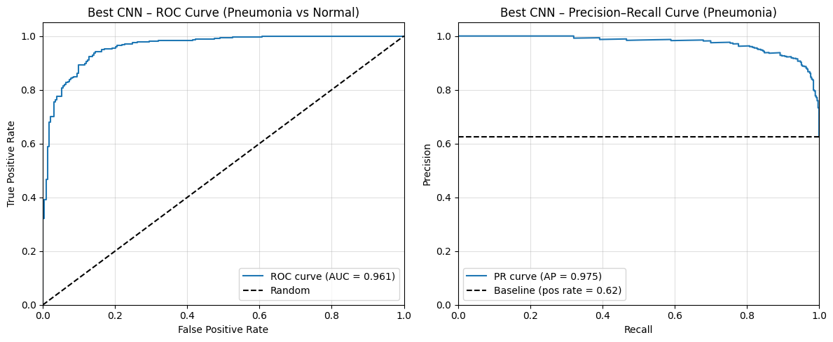
ROC Curve & Precision–Recall Curve
Best CNN – ROC & Precision-Recall Analysis
ROC-AUC = 0.961 → Excellent separability between classes.
Precision–Recall AP = 0.975 → Very strong performance given class imbalance.
PR curve stays high across most recall values → reliable pneumonia detection.

Slide 16
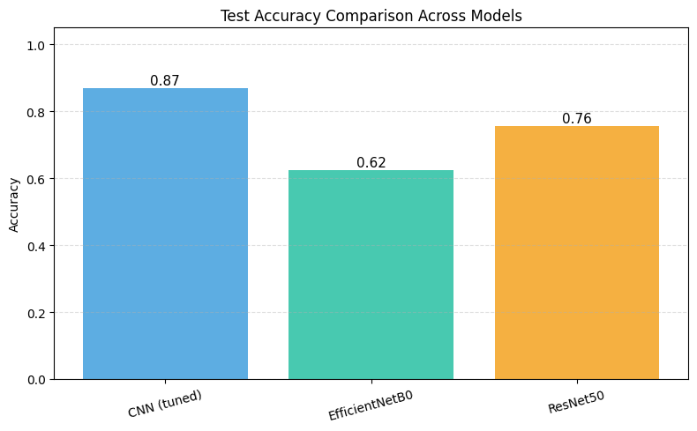
Combined CNN vs EfficientNet vs ResNet Comparison
The tuned CNN outperforms both transfer learning models, achieving the highest accuracy (86.9%).
EfficientNetB0 underperforms despite being modern and efficient likely due to domain mismatch with medical imaging.
ResNet50 performs moderately well, benefiting from deep residual connections, but still below the CNN due to over-generalization from natural images.
Medical images require domain-aware feature extraction, which your tuned CNN handles better than ImageNet-pretrained models.

Slide 17
Limitations
1. Limited Dataset Diversity
The dataset contains only pediatric X-rays, so the model may not work as well on adults.
All images come from one public source, not from multiple hospitals.
2. Transfer Learning Challenges
Models like ResNet and EfficientNet were trained on natural images.
Because X-rays are very different, these models do not transfer perfectly.
3. Missing Clinical Information
We have no patient details like symptoms, medical history.
The model must make decisions only from the image, which limits medical accuracy.
4. Grad-CAM Limitations
Grad-CAM heatmaps show important regions, but they are only an approximation.
They do not outline the exact pneumonia boundary only give a rough idea.

Slide 18
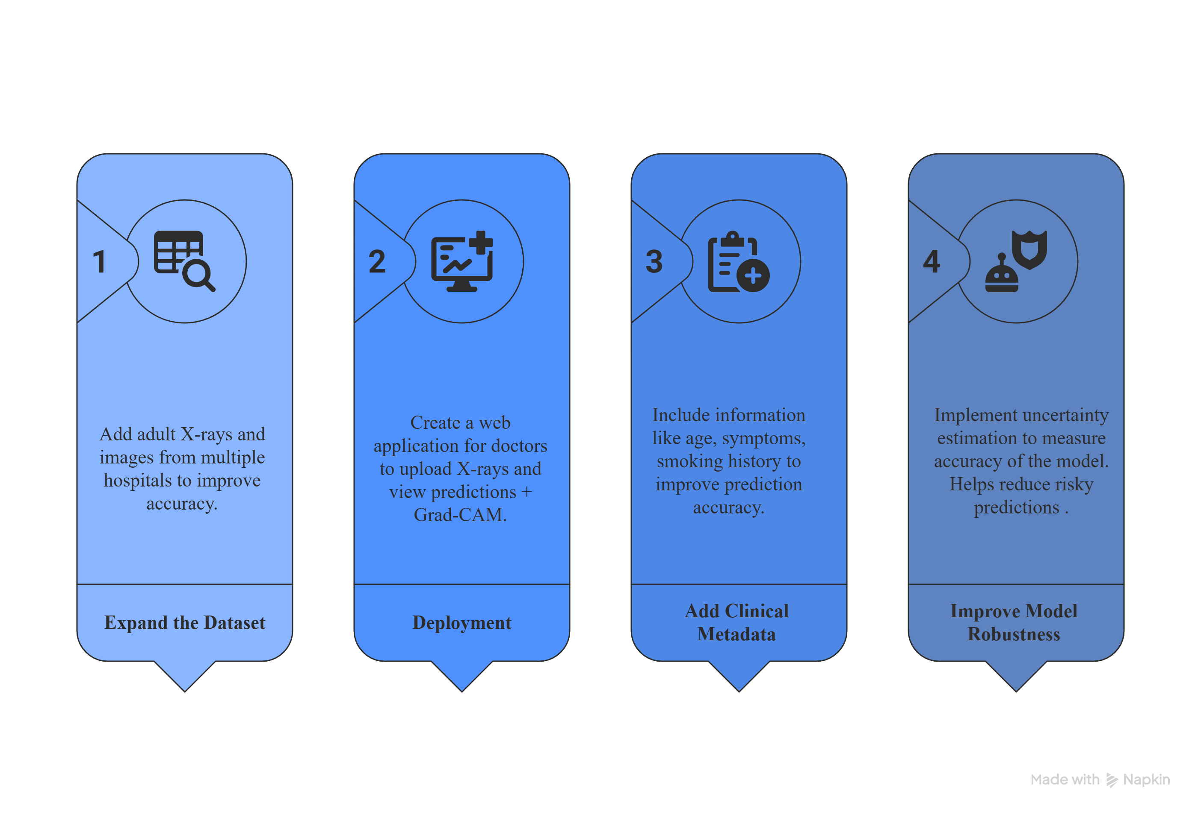
Future Work & Enhancements
What Could Be Done Differently :
Future enhancement of model design
Use segmentation-based preprocessing and test attention-based models like CNN-Attention.
Future change in training
Apply k-fold cross-validation, stronger medical-specific augmentations, and better class-weight tuning.
Future enhancement of data handling
Add more diverse X-ray sources and create a more balanced dataset.

Slide 19
Conclusion
Achieved 86.9% accuracy, AUC = 0.961, and strong pneumonia recall (0.985).
Outperformed transfer learning models like ResNet50 and EfficientNetB0.
Built and compared ML + DL models for pneumonia detection.
Tuned CNN model achieved best accuracy: 86.86%, AUC = 0.961.
Outperformed transfer learning models like ResNet50 and EfficientNetB0.
Grad-CAM confirms model focuses on medically relevant lung regions and Heatmaps confirmed that the model focused on relevant lung regions for its decisions.
Deep learning shows strong potential that AI can support faster, more consistent pneumonia screening.
With better data and further improvements, this system can be developed into a real diagnostic tool.

Slide 20
References
Shamshad, F., Khan, S., Zamir, S. W., Khan, M. H., Hayat, M., Khan, F. S., & Shah, M. (2023). Transformers in medical imaging: A comprehensive survey. Medical Image Analysis, 87, 102840. https://doi.org/10.1016/j.media.2023.102840
Shorten, C., & Khoshgoftaar, T. M. (2019). A survey on image data augmentation for deep learning. Journal of Big Data, 6(1), 60. https://doi.org/10.1186/s40537-019-0197-0
Tan, M., & Le, Q. V. (2019). EfficientNet: Rethinking model scaling for convolutional neural networks. Proceedings of the 36th International Conference on Machine Learning (ICML), 6105–6114. http://proceedings.mlr.press/v97/tan19a.html
He, K., Zhang, X., Ren, S., & Sun, J. (2016). Deep residual learning for image recognition. Proceedings of the IEEE Conference on Computer Vision and Pattern Recognition (CVPR), 770–778. https://doi.org/10.1109/CVPR.2016.90
Rajpurkar, P., Irvin, J., Zhu, K., Yang, B., Mehta, H., Duan, T., Ding, D., Bagul, A., Langlotz, C., Shpanskaya, K., Lungren, M. P., & Ng, A. Y. (2017). CheXNet: Radiologist-level pneumonia detection on chest X-rays with deep learning. arXiv preprint arXiv:1711.05225. https://arxiv.org/abs/1711.05225
Litjens, G., Kooi, T., Bejnordi, B. E., Setio, A. A. A., Ciompi, F., Ghafoorian, M., van der Laak, J. A. W. M., van Ginneken, B., & Sánchez, C. I. (2017). A survey on deep learning in medical image analysis. Medical Image Analysis, 42, 60–88. https://doi.org/10.1016/j.media.2017.07.005

Slide 21
Questions?

Slide 22
Thank You

