Slide 1
Human Birth Data Analysis

Slide 2

Team
G Mohith Krishna 19BCS043
Kola Lokesh 19BCS056
Peluru Goutam 19BCS085
B S Sathwik Goud 19BCS015

Slide 3





CONTENTS
1. Data Collection
2. Data Cleaning
3. Data Analysis
4. Observations
5. Conclusion

Slide 4
Objective
Our main objective is to build a time series model on human birth data.
Analysing the data to find any insights or patterns in data.

Slide 5
Data Collection
We created our own dataset. Our team collected data from multiple sources which include government hospitals and surveys, questionnaires’, form filling etc., Everything is entered into excel file. Our dataset has 5 attributes.
Date of Birth
Time of Birth
Gender
Latitudes
Longitudes

Slide 6
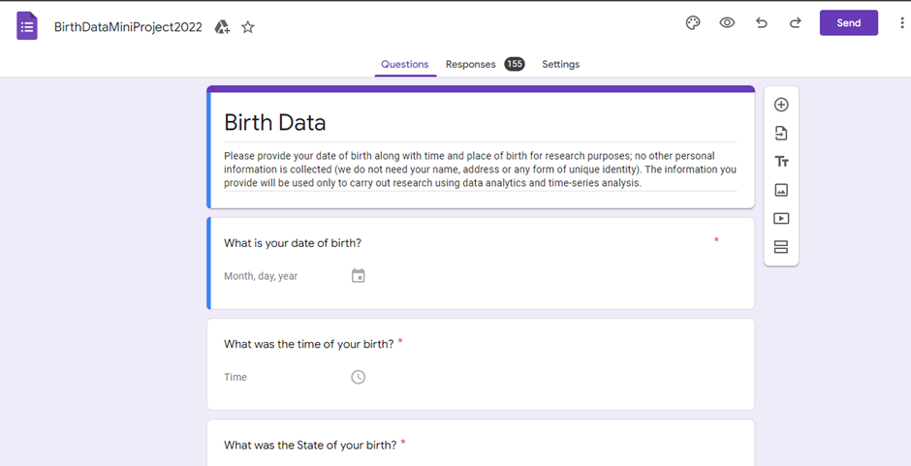
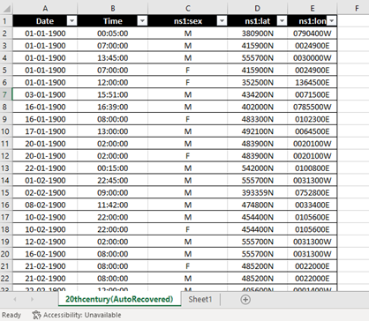
Data Collection

Slide 7
Data Cleaning:
Data Cleaning: - Data cleaning is the process of fixing or removing incorrect, corrupted, incorrectly formatted, duplicate, or incomplete data within a dataset.
Our most cleansing part is done using the best tool available out there that is MS EXCEL.
Initially our raw data contains around 35000 data points. Which consists of irregular data, inconsistent data, data columns with different formats within, wrong location co-ordinates, etc.

Slide 8
WORK FLOW:
Extracting data column attributes
Conversion to similar format
Removal of duplicates
Removal of inaccurate data
Removal of inconsistencies
Finally, we were left with 14898 data points

Slide 9
Data Analytics:
Data Analytics: - Analytics is the systematic computational analysis of data or statistics. It is used for the discovery, interpretation, and communication of meaningful patterns in data.
For this phase we used PYTHON.
We considered few attributes in this process, such as place of birth, date of birth, gender for doing the analysis.

Slide 10
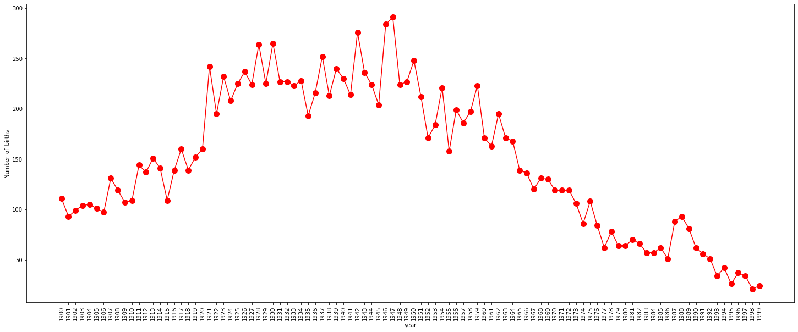
Yearly Births

Slide 11
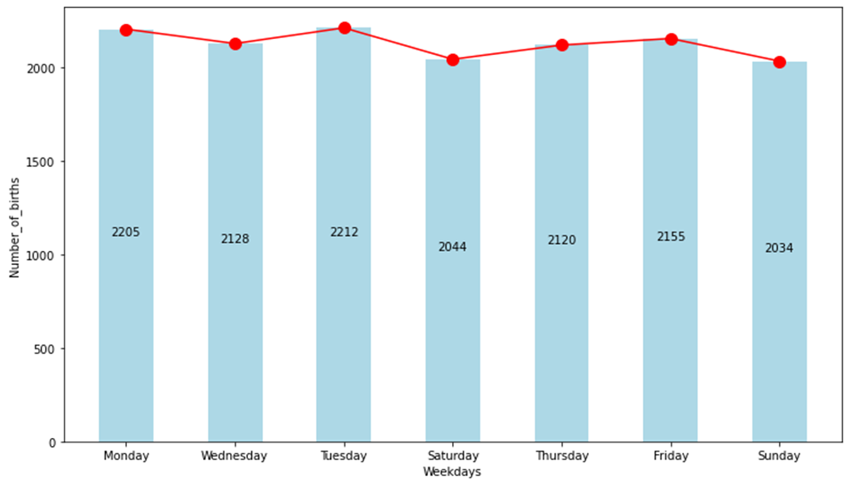
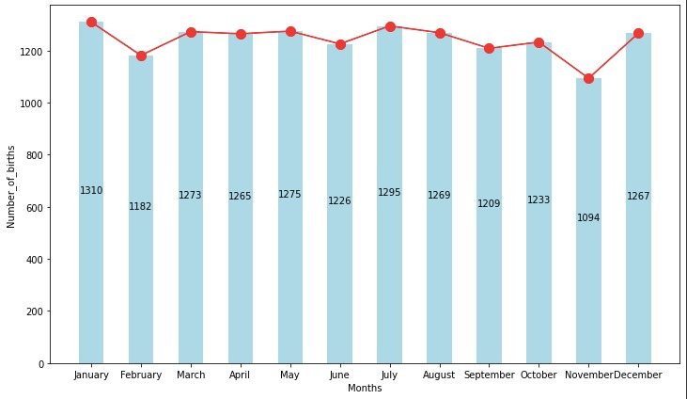
Weekly Births
Monthly Births

Slide 12
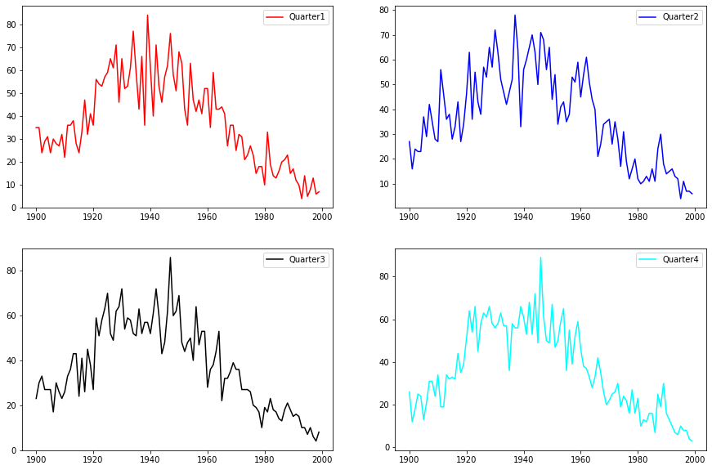
Quarterly Births:

Slide 13
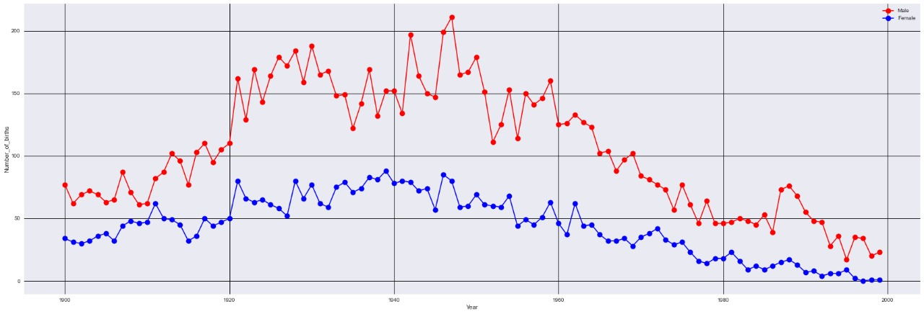
Gender-wise Births:

Slide 14
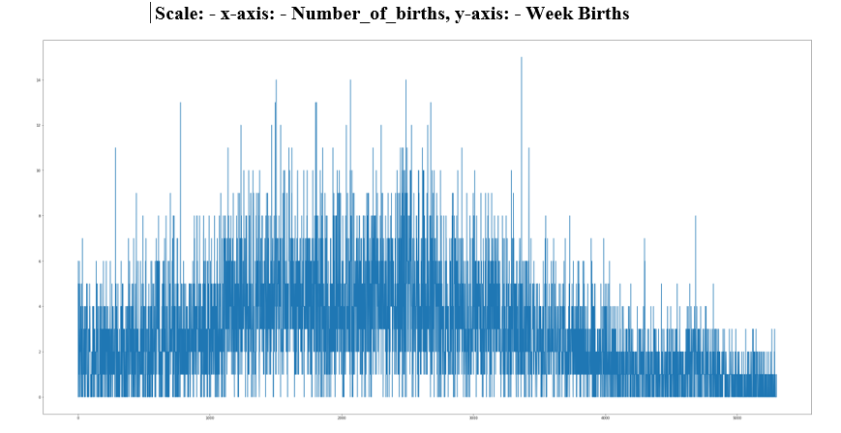

Slide 15
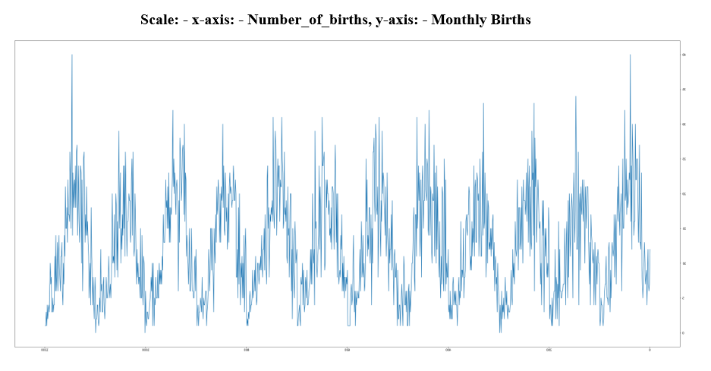

Slide 16
Rolling Mean:
In statistics, a moving average is a calculation to analyze data points by creating a series of averages of different subsets of the full data set.
Rolling Standard Deviation:
It is derived by calculating an ‘n’ time period Simple Moving Average of the data item. It then sums the squares of the difference between the data item and its Moving Average over each of the preceding ‘n’ time periods. Finally, it divides this sum by ‘n’ and calculates the square root of this result.

Slide 17
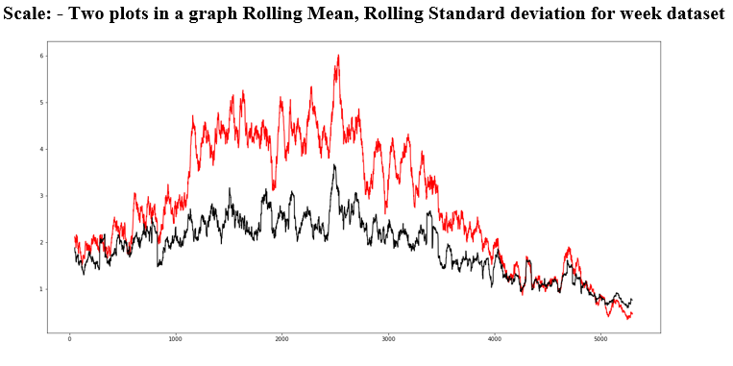

Slide 18
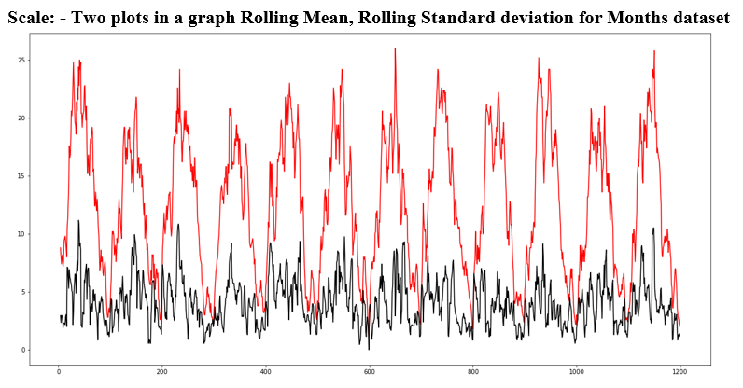

Slide 19
Level: It is the main value that goes on average with time.
Trend: The trend is the value that causes increasing or decreasing patterns in a time series.
Seasonality: This is a cyclic event that occurs in time series for a short time and causes the increasing or decreasing patterns for a short time in a time series.
Noise: These are the random variations in the time series.

Slide 20
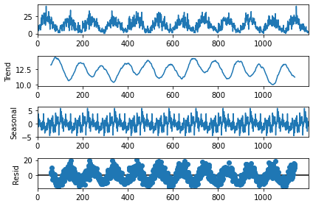

Slide 21
Observation:
Greater number of births were occurred On Tuesdays in this 100-year span.
In yearly births more births were in year 1947.
In monthly births people born in January were more.
In quarter births plots or yearly birth plots we didn’t find any significant observations but we can see roughly the population reached its peak in 1940’s and gradually the population decreased.
In gender births we can obviously observe that the number of female births is less than that of male births.
A fascinating observation was that there is actually a seasonality in the number of births.
Geographically, some places the population density is high, some places there is much scattering (low density).

Slide 22
Conclusion
Major conclusions we can conclude that there is a seasonality in the dataset we collected.
And also, the number of female births is very lower when compared to male births there can e many reasons for that some of them might female infanticide as parents then would have felt that girl is a burden.
More people were born on Tuesdays and Mondays maybe weekend hospitals were closed so they postponed the delivery -just a probabilistic conclusion.

