Slide 1


Exploratory Data Analysis on CRIMES IN INDIA
Name : P Sathwik Reddy
Class : K22UN
REDG NO: 12215930
Roll No : 17

Slide 2
Table of Content
Introduction
Problem Statement
Methodology
Result
Conclusion
References

Slide 3

Introduction
Exploratory Data Analysis (EDA) provides valuable insights into crime trends across regions, time periods, and crime types. By analyzing crime data, we can reveal patterns that highlight areas with higher crime rates or types of offenses, helping to prioritize resources and responses.
EDA is instrumental in identifying anomalies and unusual crime patterns. This allows policymakers and law enforcement to detect emerging threats, seasonal crime surges, or unexpected variations, supporting more targeted crime prevention strategies and community safety efforts.

Slide 4
Problem Statement
Crime prevention and public safety are crucial for a stable society, yet significant challenges remain in reducing crime rates across India. Despite improvements in certain areas, crime distribution remains uneven across regions, with some areas reporting persistently high crime rates. Law enforcement agencies and policymakers often lack clear insights into regional crime trends, potential high-risk areas, and specific factors driving criminal activities.

Slide 5
Abstract
Crime analysis is a critical step toward ensuring public safety and improving crime prevention strategies. In India, despite advancements in law enforcement, the uneven distribution of crime across regions poses significant challenges. High-crime areas often persist due to a lack of actionable insights into crime trends, patterns, and the socio-economic factors influencing criminal activities. This project leverages the "Crimes in India" dataset, which provides detailed information on crime types, state/UT, year, demographics, and the number of reported cases. Through advanced data analytics and machine learning techniques, this study aims to analyze historical trends, identify high-risk areas, and uncover the factors contributing to crime rates. The findings will help policymakers and law enforcement agencies allocate resources more effectively and implement targeted interventions to reduce crime rates.
Dataset Information
The "Crimes in India" dataset comprises the following key features:
Crime Type: Categories such as theft, assault, cybercrime, etc.
State/UT: The geographic region where the crime occurred.
Year: Time-based tracking of crime trends.
Number of Cases Reported: Quantitative data on the occurrence of each crime type.
Demographics: Information such as gender, age group, and population density, where available. The dataset covers crime data from 2000 to 2023, allowing a comprehensive analysis of trends over time and across regions.

Slide 6
Problem Solution
Exploratory Data Analysis (EDA):
Analyze historical crime trends to identify regions with persistently high crime rates.
Visualize crime distribution across states and years using heatmaps and time-series plots.
Feature Engineering:
Derive new insights by combining socio-economic data (e.g., GDP, literacy rate) with crime data.
Create interaction terms between crime categories to understand relationships.
Clustering and Hotspot Detection:
Use clustering algorithms (e.g., K-means, DBSCAN) to group states with similar crime patterns.
Identify high-risk areas by combining clustering results with geographic data.
Predictive Modeling:
Build machine learning models (e.g., Decision Trees, Random Forest) to predict future crime trends based on historical data and socio-economic factors.
Policy Recommendations:
Provide actionable insights, such as high-crime regions and prevalent crime types, to guide resource allocation.
Suggest interventions tailored to specific crime types and regions.
Interactive Dashboards:
Develop dashboards for policymakers to explore trends, identify high-risk areas, and simulate the impact of interventions in real-time.

Slide 7
Methodology
Collect crime data: Gather data on crime counts, crime rates, and crime types across different Indian regions from 2020-2022. Sources could include government crime records, NCRB reports, and public datasets.
Clean the data: Use Python libraries like Pandas to handle missing values, remove duplicates, and standardize data types. For example, `df.dropna()` removes rows with missing data, and `df['column'] = df['column'].astype(int)` ensures consistent data types.
Organize data by categories: Apply `groupby()` in Pandas to categorize data by region, crime type, and time period (e.g., yearly or quarterly), making it easier to analyze patterns and regional hotspots.
Calculate key metrics: Use Pandas methods like `mean()`, `sum()`, and `pct_change()` to find averages, growth rates, and other summary statistics for crime counts and crime rates across regions.
Analyze trends: Use time-series analysis to identify trends in crime rates or crime types. Pandas or Matplotlib can help with `plt.plot()` to visualize trends over time.
Create visualizations: Generate charts with Matplotlib or Seaborn, such as `sns.barplot()` for state-wise crime comparisons or `sns.lineplot()` for tracking changes in crime rates over time.

Slide 8

Results
The Results section provides key insights into crime trends across Indian states, highlighting patterns in crime rates, regional hotspots, and the influence of socio-economic factors. Visualizations showcase notable changes in crime types and highlight high-crime regions, offering valuable insights for targeted crime prevention strategies. Analysis reveals correlations between factors like unemployment rates and crime incidents, guiding more focused interventions and resource allocation.

Slide 9
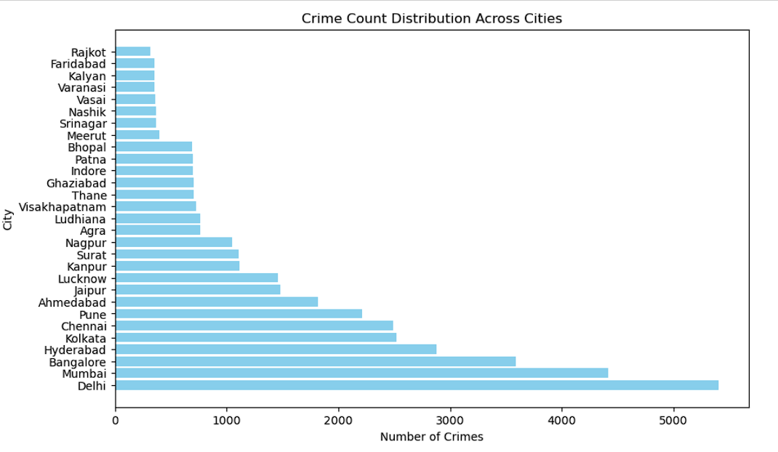
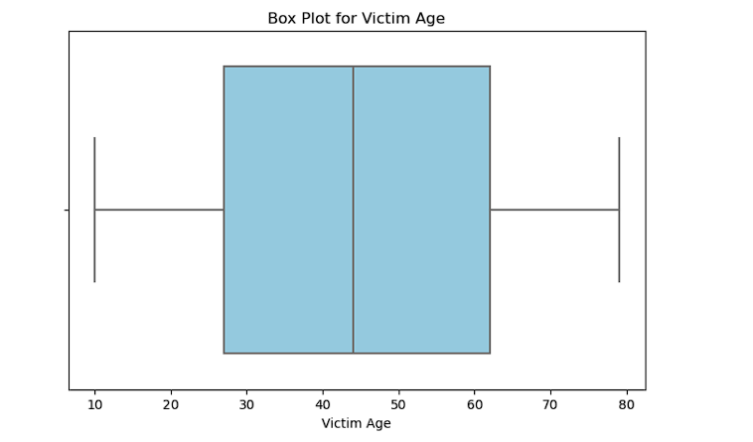
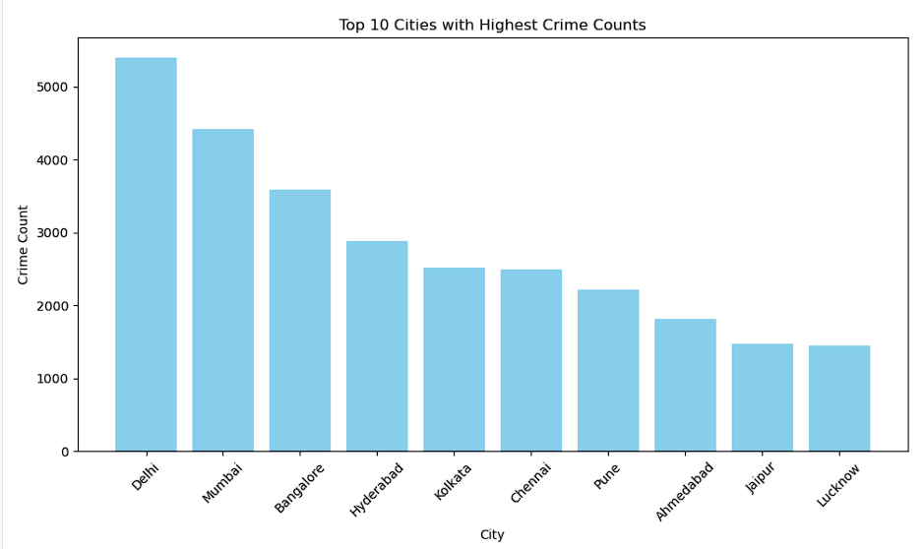
Graphs

Slide 10
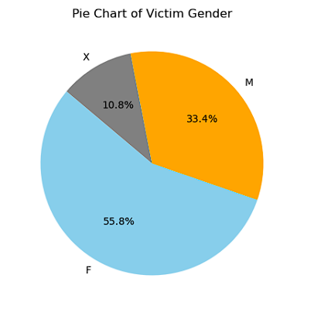
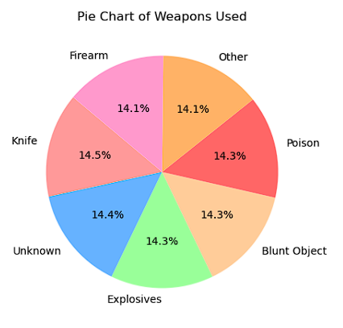
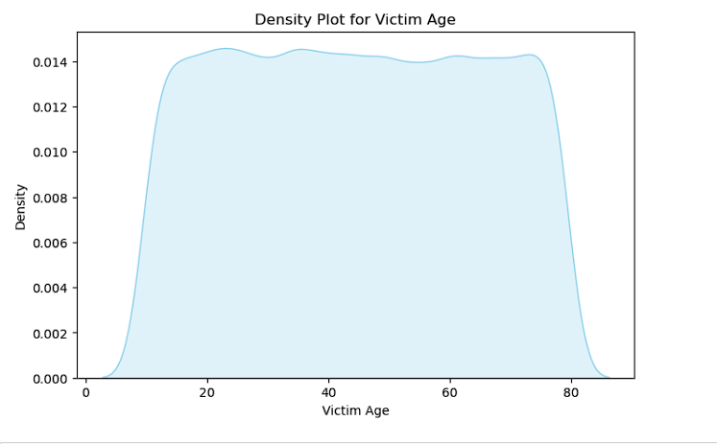

Slide 11
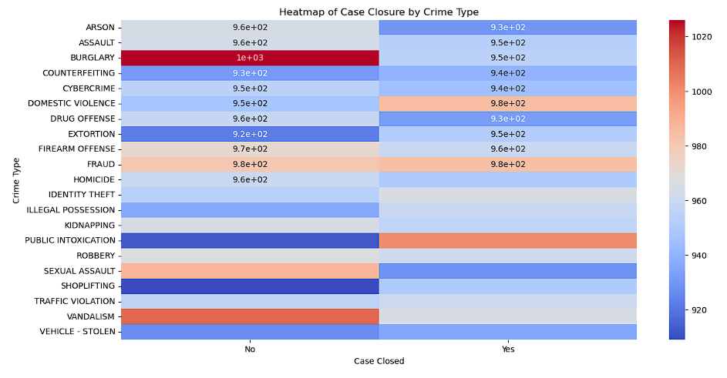
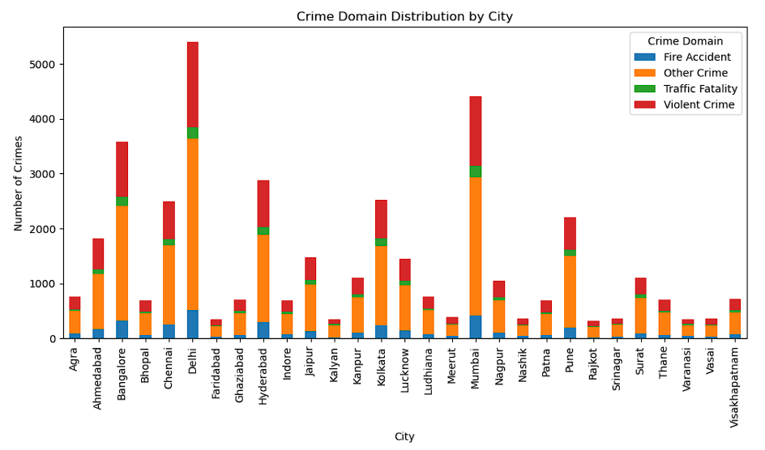
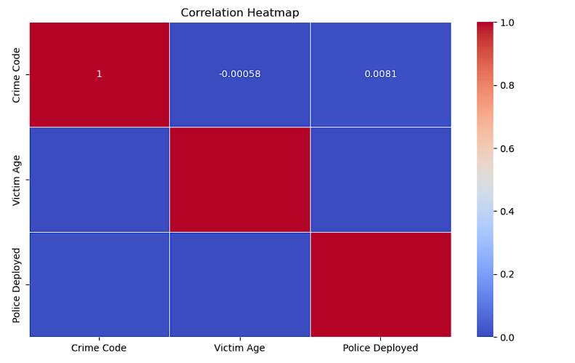
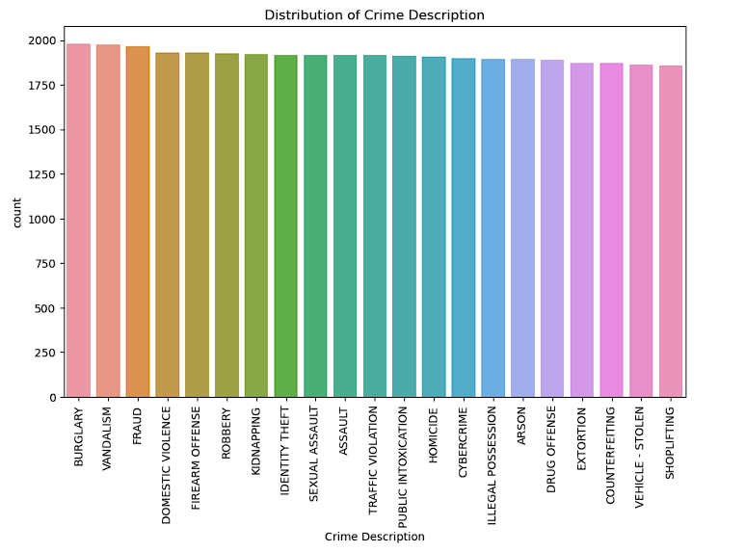

Slide 12
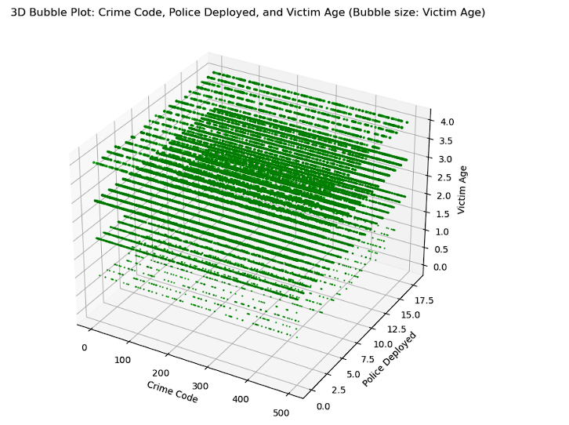
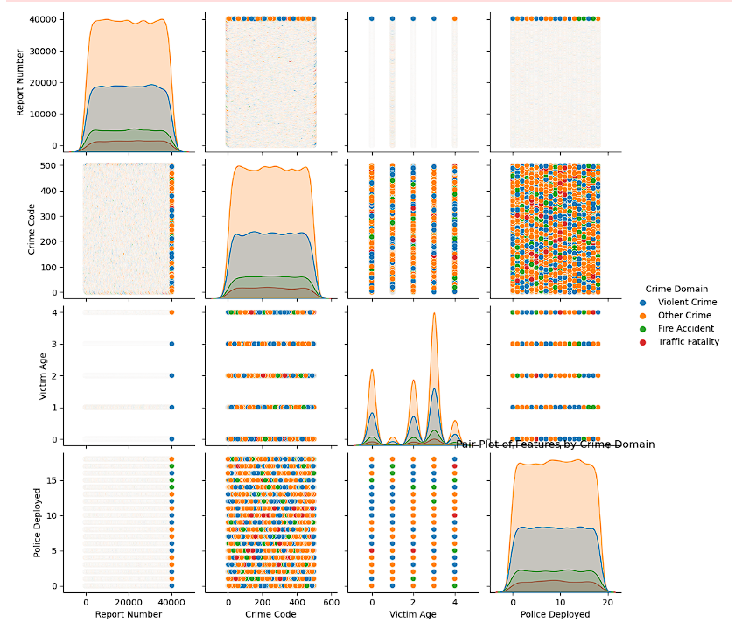
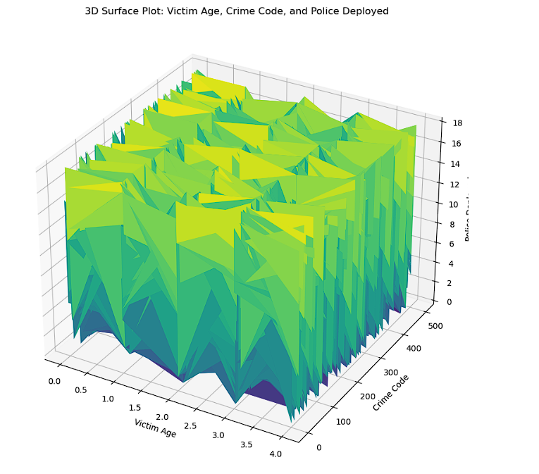

Slide 13
Analysis
Pair Plot Analysis
For your crime analysis project, a pair plot can offer a comparative view of relationships among key crime variables, such as crime rate, population density, socioeconomic indicators, and crime type distribution across regions. This visualization can help reveal correlations, such as whether regions with higher population densities or lower socioeconomic indicators experience higher crime rates. Patterns observed in the pair plot might indicate that areas with lower education or employment rates see more property or violent crimes, and regions with rapid urbanization could show a rise in specific crime types. This insight is crucial for identifying underlying factors driving crime and for informing region-specific interventions.
3D Plot Analysis
The 3D surface and bubble plots provide a multi-dimensional perspective on the relationships between key crime variables, such as crime rate, population density, and socioeconomic indicators. A 3D surface plot can visually represent how crime rate varies with population density and socioeconomic factors, revealing patterns like higher crime rates in areas with dense populations and lower socioeconomic conditions. Meanwhile, a 3D bubble plot adds another layer by incorporating crime types and additional factors such as unemployment or education level, showing how specific crime types correlate with socioeconomic variables across regions. Together, these plots offer valuable insights into how demographic and economic factors shape crime trends, helping to identify high-risk areas and guide targeted, region-specific interventions.

Slide 14
conclusion
In conclusion, the analysis reveals that crime trends in India are influenced by a combination of factors such as population density, socioeconomic conditions, and regional disparities. States like Maharashtra and Delhi show higher crime rates, which can be linked to their dense populations and varying socioeconomic indicators. Meanwhile, regions like Uttarakhand and Himachal Pradesh, which experience significant demographic shifts, show different crime patterns. These insights are crucial for identifying high-risk areas, optimizing law enforcement resources, and implementing targeted interventions based on local conditions. By understanding these patterns, more effective strategies can be developed to reduce crime and promote safety across India’s diverse regions.

Slide 15
REFERENCE :
1. kaggle.com
2. pandas.pydata.org
3. matplotlib.org
4. tensorflow.org

Slide 16

Thank You

