Slide 1
Credit Card Approval Analysis
By Sathwik Devadiga

Slide 2
Introduction
Credit card approval analysis is a vital process for financial institutions to evaluate the likelihood of borrowers defaulting on their credit card payments. By leveraging data-driven techniques, institutions assess creditworthiness, minimize financial losses, and ensure responsible lending practices. This involves collecting extensive applicant data, preprocessing it for accuracy, modeling risk using statistical and machine learning approaches, and making informed decisions based on predictive insights. Effective risk analysis enables institutions to manage credit card portfolios effectively while mitigating potential risks.

Slide 3
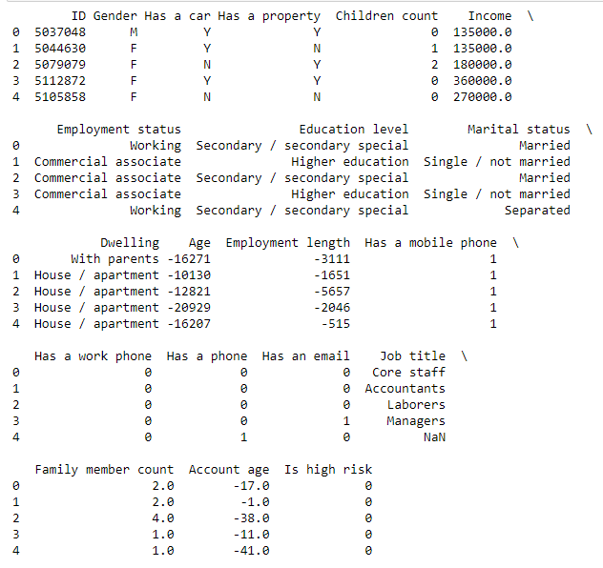
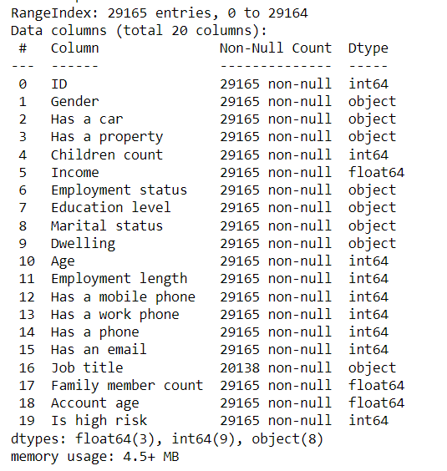
Data Overview

Slide 4
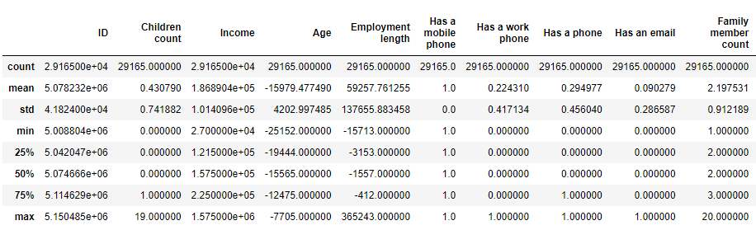
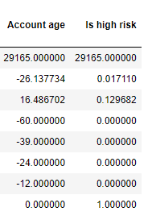
Data Description

Slide 5
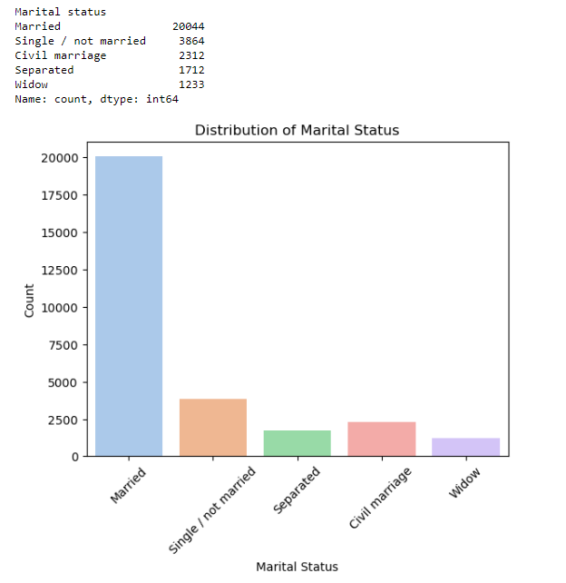
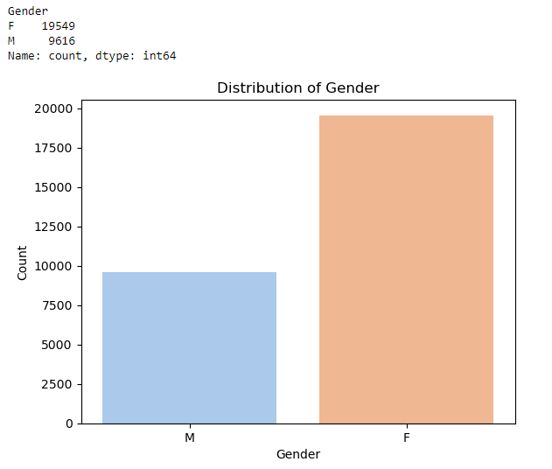
Descriptive Analysis:

Slide 6
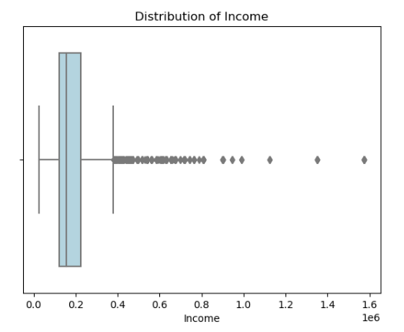
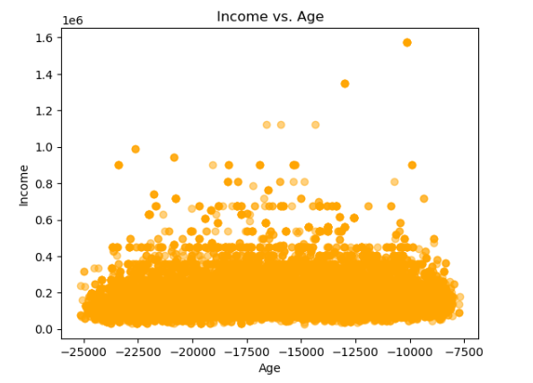

Slide 7
Data Preprocessing:
X_train[:,0] = Labelencoder_x.fit_transform(X_train[:,2])
X_train[:,1] = Labelencoder_x.fit_transform(X_train[:,3])
X_train[:,2] = Labelencoder_x.fit_transform(X_train[:,4])
X_train[:,5] = Labelencoder_x.fit_transform(X_train[:,7])
X_train[:,6] = Labelencoder_x.fit_transform(X_train[:,8])
X_train[:,7] = Labelencoder_x.fit_transform(X_train[:,9])
X_train[:,8] = Labelencoder_x.fit_transform(X_train[:,10])
X_train[:,15] = Labelencoder_x.fit_transform(X_train[:,17])
ss= StandardScaler()
X_train = ss.fit_transform(X_train)
x_test = ss.transform(x_test)

Slide 8
Model Building and Evaluation:
accuracy of random forest clf is 0.9839550191991223
confusion_matrix
[[7175 0]
[ 117 0]]
Accuracy of GaussianNB is 0.9838178826110806
confusion_matrix
[[7174 1]
[ 117 0]]
Accuracy of decision tree clf is 0.867937465715853
confusion_matrix
[[6307 868]
[ 95 22]]
Accuracy of KNeighborsClassifier clf is 0.9834064728469556
confusion_matrix
[[7171 4]
[ 117 0]]

Slide 9
Model Comparison:
GaussianNB, Random Forest, and KNeighborsClassifier show high accuracy scores, suggesting their effectiveness in predicting credit card approval.
Decision Tree classifier has a comparatively lower accuracy score, indicating potential areas for improvement.

Slide 10
Feature Importance Analysis:
Marital status: 0.14697381 Dwelling: 0.14523732
Employment length: 0.11074424 Income: 0.10924689
Job title: 0.10735754 as a property: 0.06626519
Marital Status and Dwelling are among the top features influencing the approval process. This suggests that understanding these factors better could help in refining the approval criteria.
Employment length and Income also play significant roles, indicating the importance of stable employment and income levels in assessing creditworthiness.
Job title seems to have moderate importance, indicating that the nature of employment might also impact credit approval decisions.

Slide 11
Risk Mitigation Strategies
Conduct a detailed analysis of rejected applications to understand the reasons behind rejections, especially focusing on features like marital status, dwelling, employment length, income, and job title. This analysis could reveal biases or inconsistencies in the approval process that need to be addressed.
Implement a more sophisticated ensemble learning approach, combining models like Random Forest and GaussianNB, to improve accuracy further and enhance the robustness of the credit approval system.

