Slide 1
Sales Forecasting for Furniture Store
By Sathwik Devadiga

Slide 2
Introduction
In today's rapidly evolving retail landscape, accurate sales forecasting is crucial for ensuring optimal inventory management, enhancing customer satisfaction, and sustaining business growth. Our project focuses on leveraging advanced analytics techniques to forecast furniture sales for a retail store, enabling proactive decision-making and strategic planning.
For a retail furniture store, predicting future sales is critical to avoiding inventory issues like overstocking or under-stocking. The challenge lies in utilizing time series data from the superstore dataset to forecast furniture sales for the next year accurately. This predictive insight ensures an optimal customer experience, avoids losses, and maintains store sustainability.

Slide 3
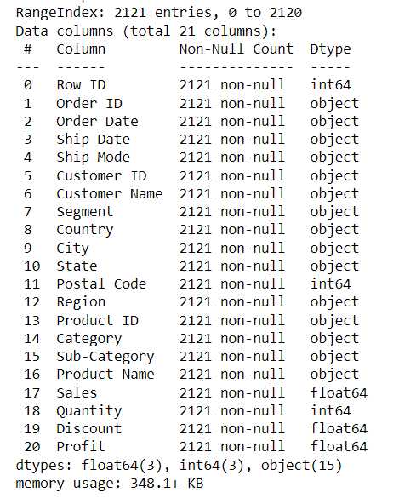
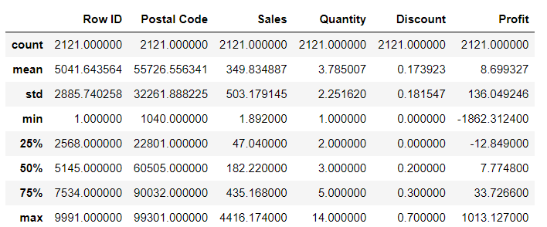
Data Overview

Slide 4
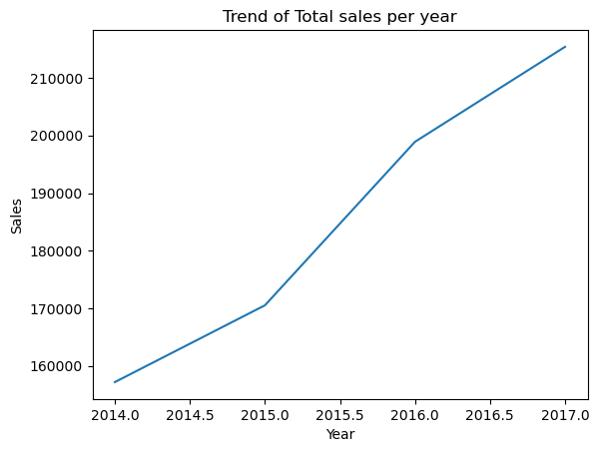
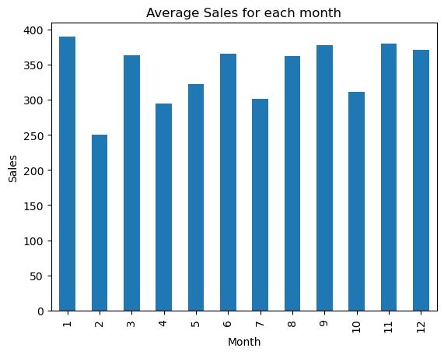
Descriptive Analysis:

Slide 5
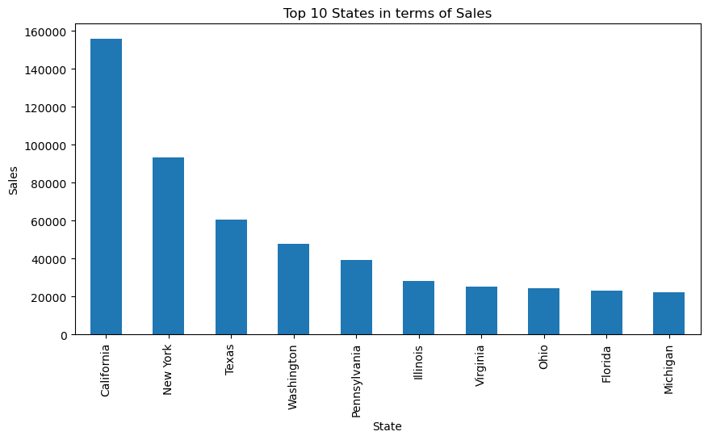
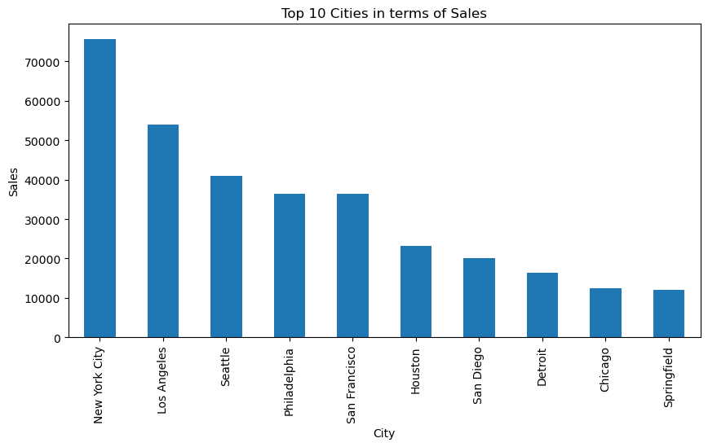

Slide 6
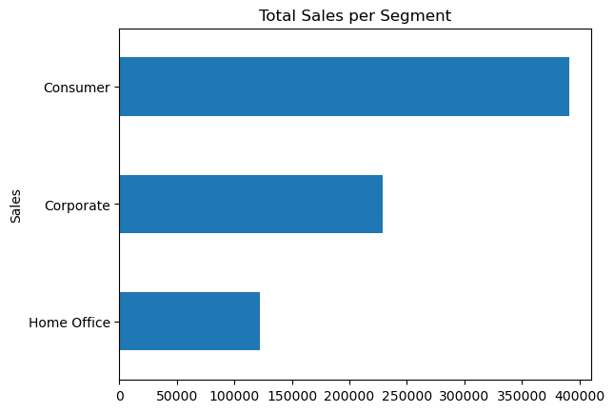
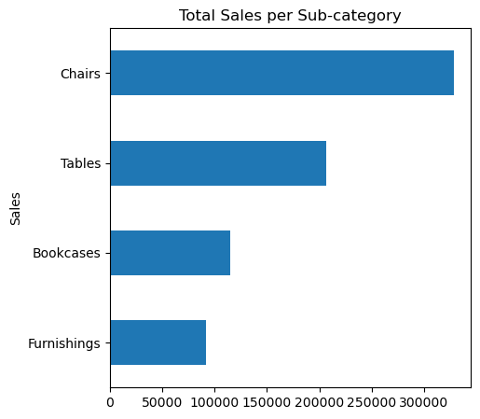

Slide 7
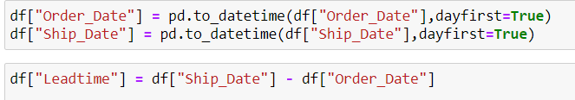
Data Preprocessing:

Slide 8
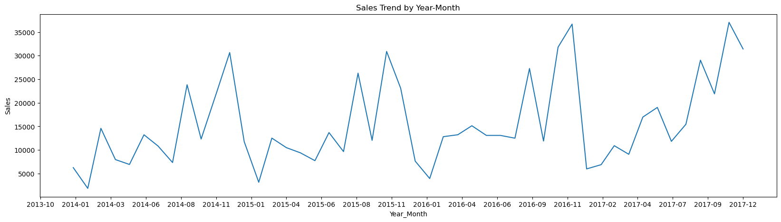
Sales Trend by Year-Month
The plot clearly indicates that the time series has seasonality pattern. The sales are always low at the beginning of the year and high at the end of the year. There is always an upward trend within any single year with a couple of low months in the mid of the year.

Slide 9
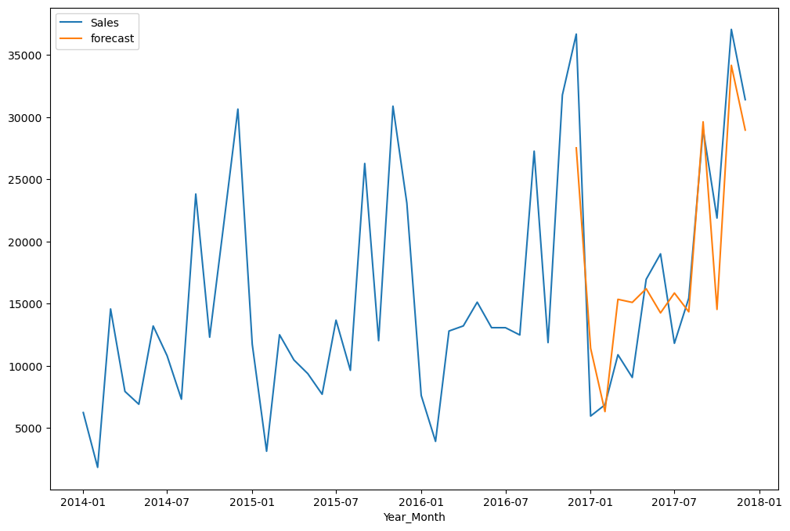
Model fitting:

Slide 10
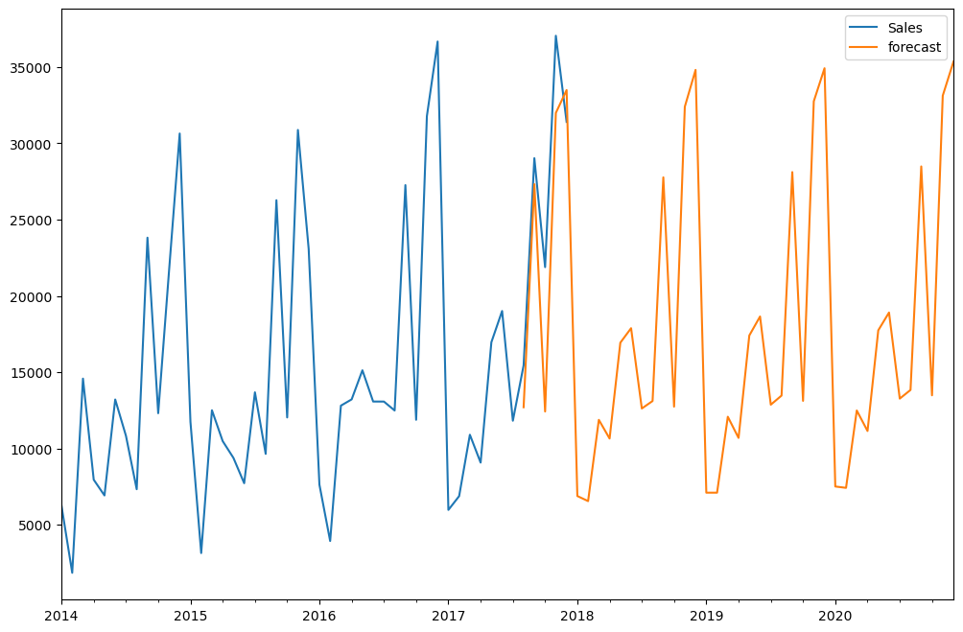
Feature Importance Analysis:

Slide 11
Conclusion
In conclusion, our analysis of the time series data from the dataset has revealed a clear seasonality pattern in furniture sales, with consistently low sales at the beginning of the year and higher sales towards the end. Additionally, we observed an upward trend within each year, punctuated by a few months of lower sales in the middle of the year.
The significance of these findings lies in their direct impact on your business operations. By accurately forecasting future sales, we can help avoid costly inventory issues such as overstocking or under-stocking. This predictive insight ensures that you can maintain optimal inventory levels, thereby enhancing customer satisfaction, minimizing losses, and ensuring the sustainability of your store.

