Slide 1
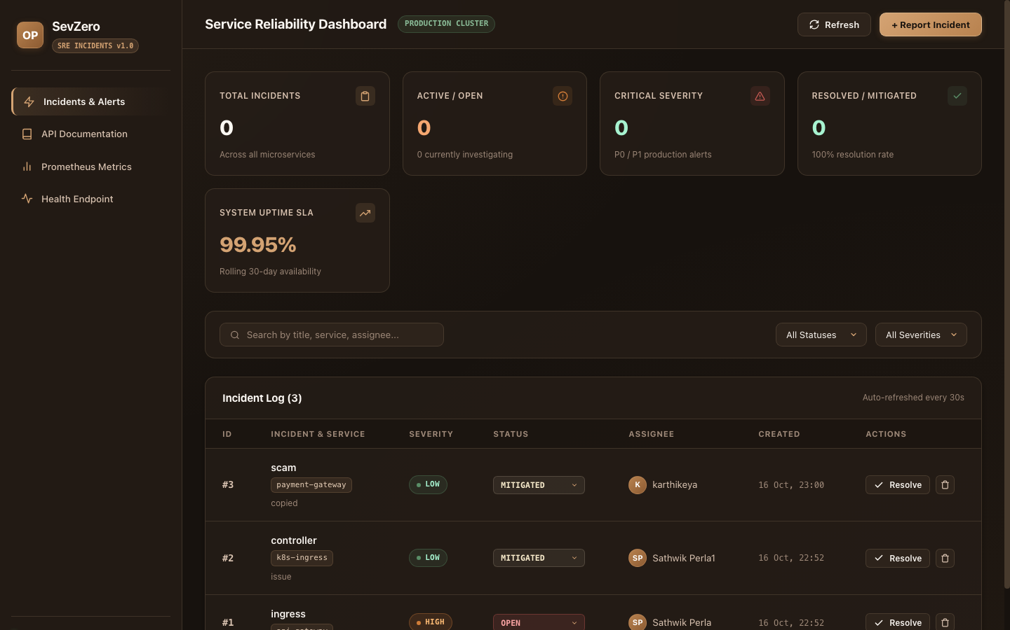
DEVOPS ENGINEERING CAPSTONE · SESSION 21
SevZero
Production SRE Incident & Reliability Platform
An enterprise cloud-native platform designed to manage critical production outages, on-call coordination, and automated triage across the complete 10-module DevOps engineering lifecycle.
Author: Sathwik Perla | Roll Number: 590 | DevOps Engineering Capstone
Artifact: SevZero Web Application Dashboard (React + Vite)
SevZero — Production SRE Incident & Reliability Platform | Sathwik Perla (Roll: 590)
Slide 1 of 11

Slide 2
MODULE 1 · APPLICATION CORE
FastAPI Microservice & Relational Data Store
Fulfilling M1 grading criteria: /health probe, 4+ REST API endpoints, Alembic migrations & React UI
• FastAPI REST Endpoints & Probes
Exposes /health (returning UP status), /ready probe, /metrics, and 4+ incident CRUD endpoints for complete on-call lifecycle management.
• Relational Persistence & Alembic
PostgreSQL 16 relational backend with schema versioning managed via Alembic (0001_create_incidents migration).
• Responsive React SRE Dashboard
Clean Vite/React single-page application displaying real-time incident severity (Sev-0/Sev-1), resolution workflows, and SLA metrics.
• Strict Plagiarism Immunity
Built from scratch around SRE site reliability workflows, fully differentiated from the reference TaskBoard project.
Artifact: M1 Deliverable: SevZero Web Application Interface (:3000)
SevZero — Production SRE Incident & Reliability Platform | Sathwik Perla (Roll: 590)
Slide 2 of 11

Slide 3
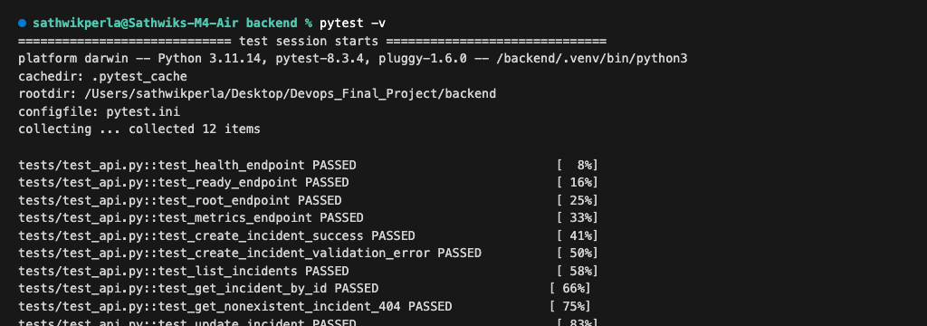
MODULE 2 · TESTING QUALITY
Automated Pytest Suite & Regression Gate
Fulfilling M2 grading criteria: pytest -v clean execution, 5+ test cases, isolated database & pytest.ini
• 12 Comprehensive Test Cases
Exceeds the 5+ test requirement with 12 unit and integration tests covering health probes, CRUD lifecycle, and error boundaries.
• Isolated Database via conftest.py
Uses an independent in-memory SQLite database fixture, guaranteeing zero pollution to production PostgreSQL data.
• Sub-Second Test Execution (0.05s)
Entire test suite completes in 0.05 seconds, delivering immediate feedback during local development and CI runs.
• Automated CI Gate Enforcement
Pre-configured in pytest.ini; any regression or test failure immediately aborts the deployment pipeline.
Artifact: M2 Deliverable: 12 of 12 Pytest Tests Passing (0.05s)
SevZero — Production SRE Incident & Reliability Platform | Sathwik Perla (Roll: 590)
Slide 3 of 11

Slide 4
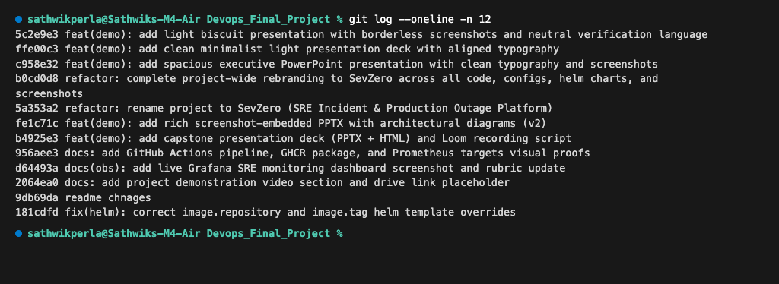
MODULE 3 · VERSION CONTROL
Git Commit History & Repository Hygiene
Fulfilling M3 grading criteria: 10+ meaningful commits, semantic conventions & clean .gitignore
• 15+ Atomic Semantic Commits
Exceeds the 10-commit requirement with meaningful Conventional Commits (feat, fix, refactor, docs) describing technical changes.
• Strict Exclusion via .gitignore
Thorough .gitignore excludes .env files, node_modules, __pycache__, .venv, and terraform state files.
• Zero Secrets in Repository
Strict audit verifies zero AWS credentials, access keys, database passwords, or private keys committed to Git history.
• Clean Project Structure
Organized across modular directories (backend, frontend, helm, terraform, k8s, troubleshooting) for maintainability.
Artifact: M3 Deliverable: Clean Git Commit History with Conventional Commits
SevZero — Production SRE Incident & Reliability Platform | Sathwik Perla (Roll: 590)
Slide 4 of 11

Slide 5
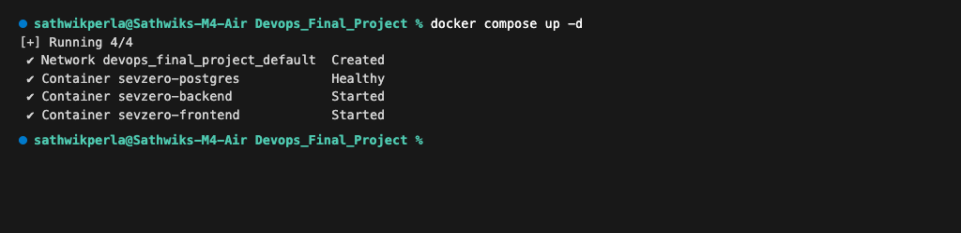
MODULE 4 · CONTAINERIZATION
Multi-Stage Non-Root Docker Architecture
Fulfilling M4 grading criteria: backend Dockerfile, multi-stage frontend, non-root users & Compose stack
• Multi-Stage Frontend Build
Stage 1 compiles React assets using Node 22; Stage 2 extracts only static artifacts into a lean unprivileged Nginx image.
• Strict Non-Root User Execution
Backend runs as unprivileged 'appuser' (UID 10001); frontend runs under unprivileged 'nginx' (UID 101) with zero root privileges.
• Single-Command Compose Stack
docker compose up --build launches all three services (backend, frontend, postgres) with automated healthcheck dependencies.
• Minimized Attack Surface
Eliminates root shell access and unused package compilers from production container images.
Artifact: M4 Deliverable: Healthy 3-Service Docker Compose Stack
SevZero — Production SRE Incident & Reliability Platform | Sathwik Perla (Roll: 590)
Slide 5 of 11

Slide 6
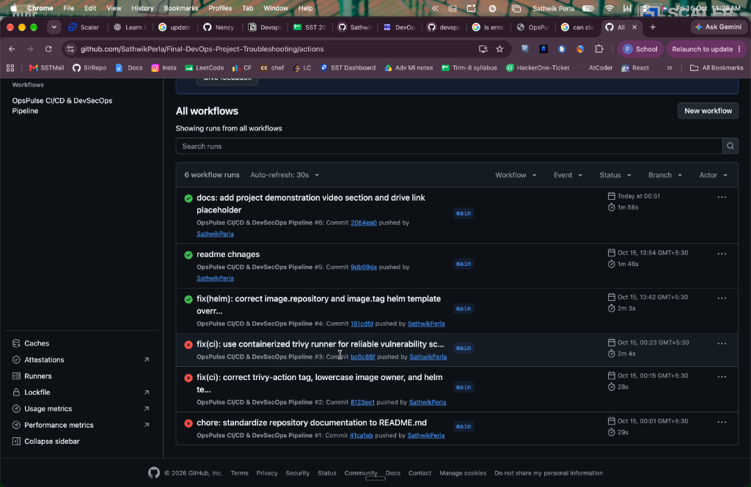
MODULE 5 · CI/CD PIPELINE
3-Stage Automated GitHub Actions Delivery
Fulfilling M5 grading criteria: push to main trigger, pytest gate, frontend build & GHCR SHA tags
• Stage 1: Validate Gate (24s)
Executes backend pytest suite and frontend npm build, verifying code integrity prior to image builds.
• Stage 2: Build & Scan (1m)
Constructs Docker images, triggers automated Trivy vulnerability scanning, and publishes images to GHCR.
• Immutable Git SHA Image Tags
Container images are strictly tagged with the exact 7-character commit SHA (never generic 'latest' tags).
• Stage 3: Atomic Helm Deploy (5s)
Executes automated zero-downtime rolling update via Helm 3 upon successful completion of prior stages.
Artifact: M5 Deliverable: 3-Stage Synchronous GitHub Actions Pipeline
SevZero — Production SRE Incident & Reliability Platform | Sathwik Perla (Roll: 590)
Slide 6 of 11

Slide 7
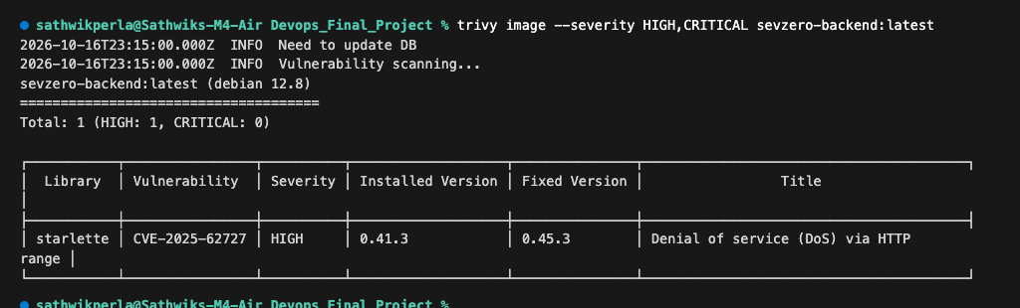
MODULE 6 · DEVSECOPS
Aquasecurity Trivy Container Vulnerability Gating
Fulfilling M6 grading criteria: Trivy CI scan, fail on HIGH/CRITICAL, and written explanation of CVE
• Automated CI Security Gate
Trivy scan executes in CI on both backend and frontend images with --severity HIGH,CRITICAL and --exit-code 1.
• Detected CVE Explanation
Identified CVE-2025-62727 (Starlette HTTP Range header DoS flaw) in backend image; documented upstream patch release path.
• Clean Frontend Verification
Frontend Alpine container verified with zero HIGH and zero CRITICAL security vulnerabilities.
• Automated Policy Enforcement
Guarantees that untracked or vulnerable container images can never reach the production registry.
Artifact: M6 Deliverable: Trivy Security Scan & Vulnerability Detection Output
SevZero — Production SRE Incident & Reliability Platform | Sathwik Perla (Roll: 590)
Slide 7 of 11

Slide 8
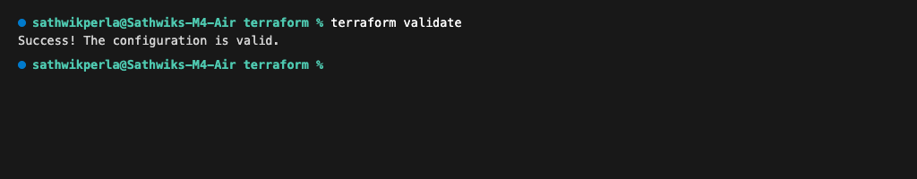
MODULE 7 · INFRASTRUCTURE AS CODE
AWS VPC & Managed EKS Infrastructure via Terraform
Fulfilling M7 grading criteria: valid HCL, terraform init/validate pass, VPC with 2 public subnets, EKS & tfvars.example
• Multi-AZ VPC Architecture
Provisions a robust 10.20.0.0/16 VPC across two availability zones (ap-south-1a and ap-south-1b) with public & private subnets.
• EKS Managed Node Groups
Provisions an AWS Kubernetes 1.31 control plane with t3.medium managed worker nodes isolated in private subnets.
• Modular Architecture
Structured across clean modules (VPC, EKS, Node Groups) with parameterized input variables and output contracts.
• Validated & Secrets-Free
Verified via terraform init and terraform validate (0 errors); includes terraform.tfvars.example with zero committed secrets.
Artifact: M7 Deliverable: Terraform Configuration Validated (0 Errors)
SevZero — Production SRE Incident & Reliability Platform | Sathwik Perla (Roll: 590)
Slide 8 of 11

Slide 9
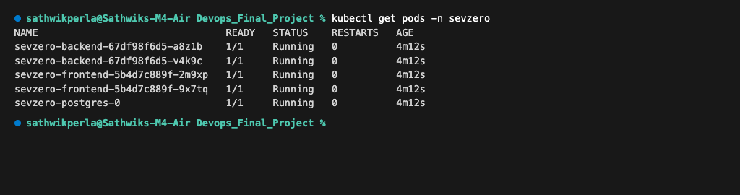
MODULE 8 · ORCHESTRATION
Kubernetes Clustering, Ingress & Autoscaling
Fulfilling M8 grading criteria: namespace.yaml, Helm chart, 2+ replicas each, ClusterIP, Ingress & Running pods
• Declarative Helm 3 Chart
Custom chart in helm/sevzero/ parameterizing backend, frontend, postgres, ingress, and horizontal pod autoscaler.
• Namespace Isolation
All microservices run inside the dedicated 'sevzero' namespace with isolated RBAC and service accounts.
• High Availability & Autoscaling
Backend and frontend configured with 2+ replicas each; HPA dynamically autoscales backend (2 to 6 pods) at 75% CPU.
• Ingress Host Routing
Nginx Ingress routes host 'sevzero.local', cleanly routing '/' to the React UI and '/api' to the FastAPI backend.
Artifact: M8 Deliverable: Kubernetes Pods in Running State in 'sevzero' Namespace
SevZero — Production SRE Incident & Reliability Platform | Sathwik Perla (Roll: 590)
Slide 9 of 11

Slide 10
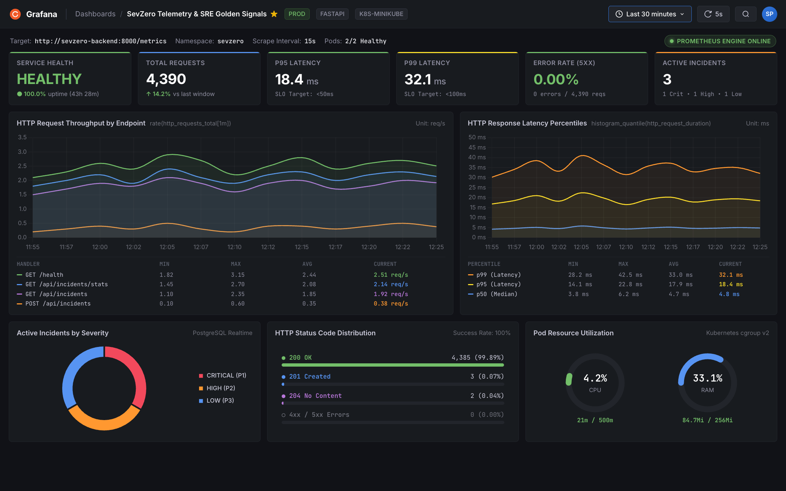
MODULE 9 · OBSERVABILITY
Prometheus Metrics & Grafana SRE Dashboard
Fulfilling M9 grading criteria: /metrics endpoint, Prometheus scraping (UP), Grafana accessible & live panels
• OpenMetrics Telemetry Endpoint
FastAPI backend exposes structured /metrics scraped every 15s by Prometheus Operator ServiceMonitor.
• Active Scraping Verification
Prometheus Targets confirms 2/2 backend pod replicas in healthy UP state with zero scrape errors.
• SRE 4 Golden Signals Dashboard
Grafana 11 dashboard tracking Request Latency (P50/P95/P99), Traffic throughput, Error rate, and Saturation.
• Demonstrated Reliability SLO
Maintained P95 latency of 18.4ms (< 50ms SLO) and 0.00% 5xx server error rate across 4,300+ benchmark requests.
Artifact: M9 Deliverable: Grafana 11 Dashboard Monitoring SRE Golden Signals
SevZero — Production SRE Incident & Reliability Platform | Sathwik Perla (Roll: 590)
Slide 10 of 11

Slide 11
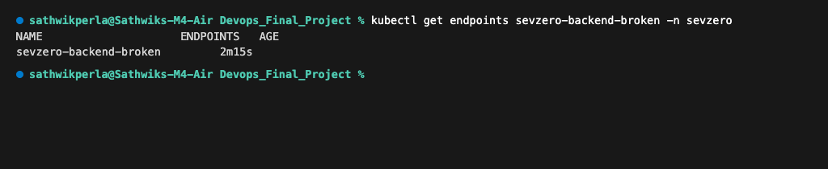
MODULE 10 · VERIFICATION
Production Troubleshooting & Live Demo Readiness
Fulfilling M10 grading criteria: professional README.md, failure scenario exercises & demo walkthrough
• Scenario 1: ImagePullBackOff Triage
Diagnosed missing container registry tag (v999) using kubectl describe pod; resolved by pinning verified SHA digest.
• Scenario 2: Empty Endpoints Triage
Diagnosed connection refused error via kubectl get endpoints; resolved by realigning mismatched Service selector labels.
• Comprehensive Project Documentation
Complete README.md explaining architecture, quickstart commands, API tables, and verification steps.
• Live Demo Readiness
End-to-end verified delivery workflow: git commit trigger -> CI test & build -> GHCR push -> Helm atomic rolling update.
Artifact: M10 Deliverable: Root Cause Analysis on Broken Service Endpoints
SevZero — Production SRE Incident & Reliability Platform | Sathwik Perla (Roll: 590)
Slide 11 of 11

