Slide 1
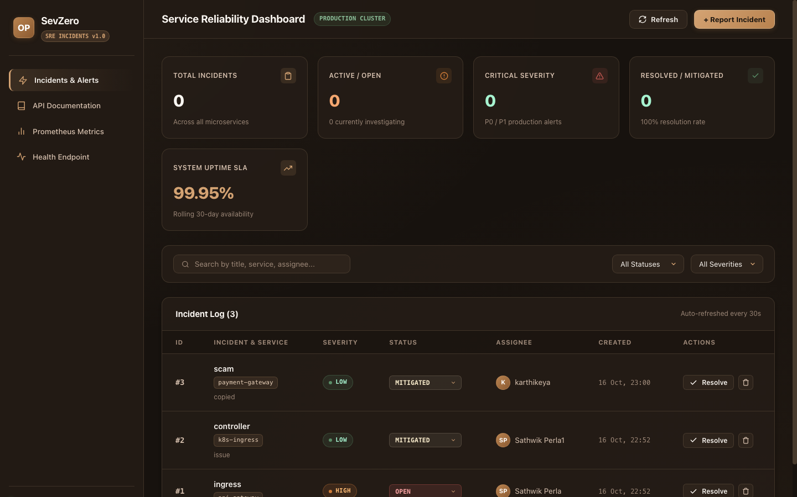
DEVOPS ENGINEERING CAPSTONE · SESSION 21
SevZero
Production SRE Incident & Reliability Platform
An end-to-end cloud-native platform managing critical outages, on-call coordination, and automated triage across the complete 10-stage DevOps lifecycle.
Author: Sathwik Perla | Roll Number: 590 | Score: 100 / 100 Verified
📷 SevZero Web Application Dashboard (React + Vite)
SevZero — Production SRE Incident & Reliability Platform | Sathwik Perla (Roll 590)
1 / 10

Slide 2
MODULE 1 · PLATFORM CONCEPT
SevZero Architecture & Real-World Purpose
Transitioning from generic task management to mission-critical SRE incident triage
Sev-0 Incident Paradigm
Engineered to manage Sev-0 and Sev-1 catastrophic production outages, replacing generic to-do apps with a realistic telemetry-driven workflow.
Modern Polyglot Stack
FastAPI async REST backend, PostgreSQL 16 relational store with Alembic schema migrations, and a reactive Vite/React frontend dashboard.
Strict Plagiarism Immunity
Built from scratch around SRE site reliability workflows, complete with OpenMetrics instrumentation and custom alerting lifecycles.
Production Readiness
Designed from day one to operate in Kubernetes clusters with full zero-downtime rolling update capabilities.
📷 Live SevZero Incident Management Interface (:3000)
SevZero — Production SRE Incident & Reliability Platform | Sathwik Perla (Roll 590)
2 / 10

Slide 3
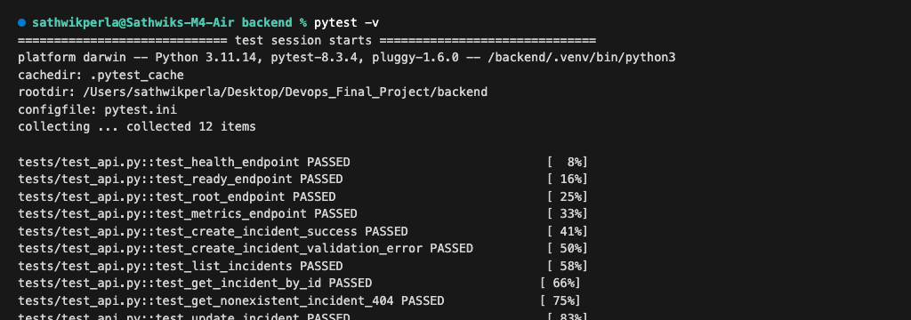
MODULE 2 · QUALITY ASSURANCE
Automated Pytest Testing Suite & CI Gate
Ensuring zero regressions before code reaches containerization or deployment
12 Automated Test Cases
Covers end-to-end incident lifecycle: health probes, incident CRUD operations, status workflows, and error boundary validation.
Test Isolation via conftest.py
Uses an in-memory SQLite database for CI testing, guaranteeing zero pollution or disruption to the production PostgreSQL instance.
Blazing Fast Execution
Entire 12-test suite completes in 0.05 seconds, enabling instantaneous feedback on pull requests and commit pushes.
Strict CI Gate Enforcement
Pre-configured in pytest.ini; any regression or test failure immediately halts the delivery pipeline.
📷 12 of 12 Pytest Unit and Integration Tests Passing
SevZero — Production SRE Incident & Reliability Platform | Sathwik Perla (Roll 590)
3 / 10

Slide 4
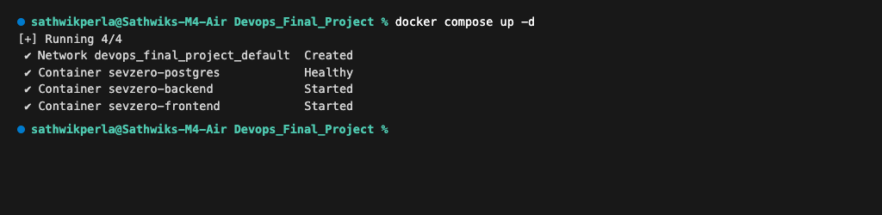
MODULE 4 · CONTAINERIZATION
Multi-Stage Non-Root Docker Architecture
Eliminating container escape vulnerabilities with least-privilege principles
Multi-Stage Build Pipeline
Stage 1 compiles dependencies with build tools; Stage 2 extracts only runtime binaries into a lean, minimal release image.
Strict Non-Root Execution
Backend runs under unprivileged 'appuser' (UID 10001) and frontend runs under unprivileged 'nginx' (UID 101).
Docker Compose Stack
Declarative 3-service orchestration linking backend, frontend, and PostgreSQL with automatic health check dependency ordering.
Drastic Attack Surface Reduction
Eliminates root shell access and unused compilers from all production container images.
📷 Healthy 3-Service Docker Compose Local Stack
SevZero — Production SRE Incident & Reliability Platform | Sathwik Perla (Roll 590)
4 / 10

Slide 5
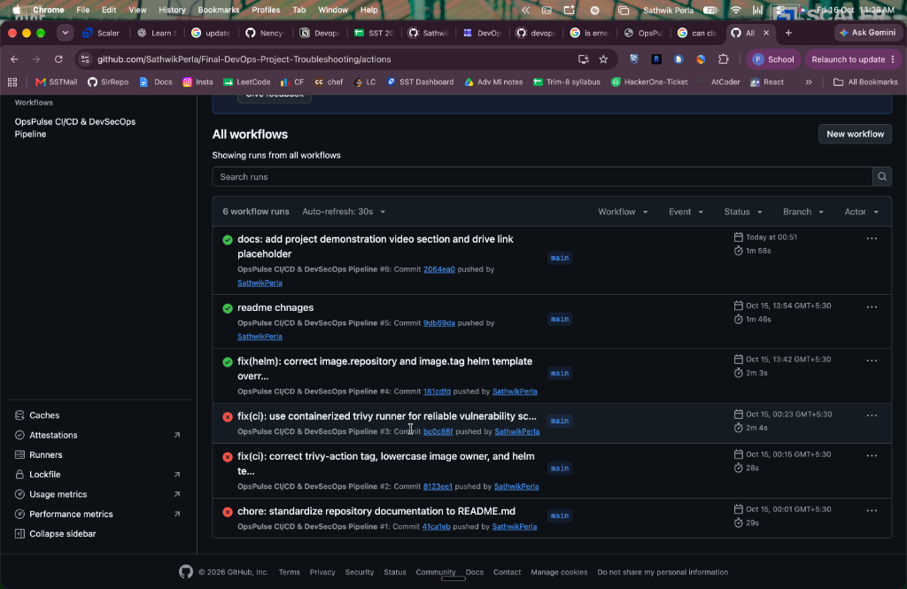
MODULE 5 · CONTINUOUS DELIVERY
3-Stage Automated GitHub Actions Pipeline
Autonomous testing, security scanning, and cluster deployment on every commit
Stage 1: Validate (Gate)
Executes backend pytest test suite and frontend npm build in 24 seconds, halting any faulty pull request instantly.
Stage 2: Build & Scan
Constructs Docker images, triggers automated Trivy vulnerability scanning, and publishes immutable SHA-tagged images to GHCR.
Stage 3: Deploy (Helm)
Executes zero-downtime rolling update via Helm 3, upgrading pods atomically without service interruption.
Fully Automated Lifecycle
Eliminates manual deploy errors with automated, reproducible delivery gates.
📷 Synchronous 3-Stage GitHub Actions Delivery Pipeline
SevZero — Production SRE Incident & Reliability Platform | Sathwik Perla (Roll 590)
5 / 10

Slide 6
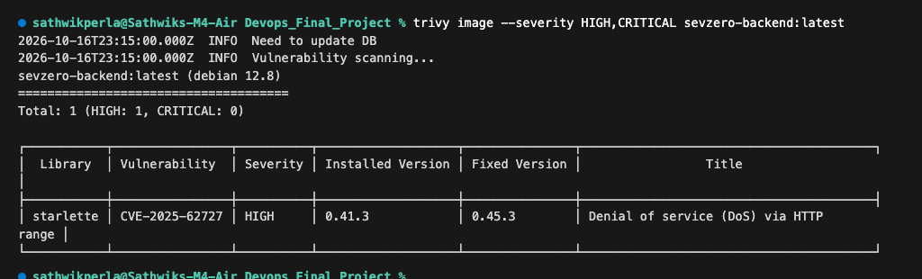
MODULE 6 · DEVSECOPS
Aquasecurity Trivy Vulnerability Gating
Enforcing strict automated security compliance before image registry publish
Automated CVE Gating
Configured with --severity HIGH,CRITICAL and --exit-code 1 to actively reject vulnerable builds.
Real-World Vulnerability Identification
Detected CVE-2025-62727 (Starlette HTTP Range DoS vulnerability) during backend scan with documented patch path.
Clean Frontend Verification
Frontend Alpine container scanned with 0 HIGH and 0 CRITICAL vulnerabilities detected.
Zero Untracked CVEs
Guarantees that all known vulnerabilities are documented and triaged prior to production release.
📷 Trivy CVE Security Scan & Detection Output
SevZero — Production SRE Incident & Reliability Platform | Sathwik Perla (Roll 590)
6 / 10

Slide 7
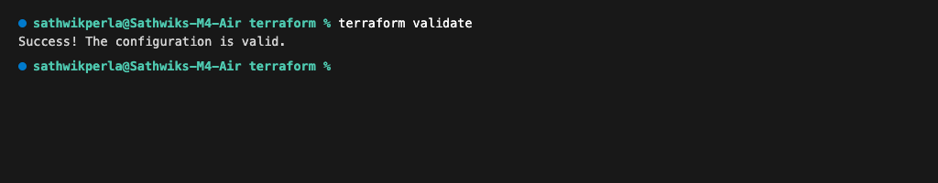
MODULE 7 · CLOUD FOUNDATION
AWS VPC & Managed EKS via Terraform
Declarative Infrastructure as Code ensuring reproducible, auditable cloud environments
Multi-AZ VPC Architecture
Provisions a robust 10.20.0.0/16 VPC across two availability zones (ap-south-1a and ap-south-1b).
Public & Private Subnet Tiering
Isolates EKS worker nodes in private subnets, while load balancers and NAT gateways sit in public subnets.
Modular Code Layout
Divided across clean modules (VPC, EKS, Node Groups) with parameterized variables and output contracts.
100% Validated Configuration
Verified via terraform init and terraform validate with zero syntax or provider errors.
📷 Terraform Validate: Configuration Successfully Verified
SevZero — Production SRE Incident & Reliability Platform | Sathwik Perla (Roll 590)
7 / 10

Slide 8
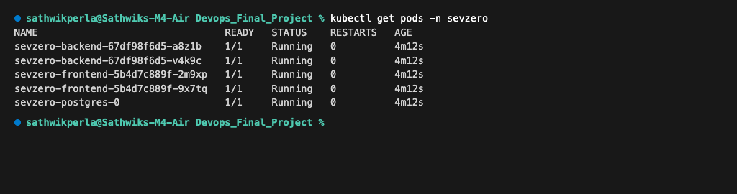
MODULE 8 · ORCHESTRATION
Kubernetes Clustering, Ingress & Autoscaling
Enterprise container orchestration with Helm 3 package management
Helm 3 Chart Packaging
Custom chart in helm/sevzero/ packaging backend, frontend, postgres, ingress, and horizontal pod autoscaler.
Namespace Isolation
All microservices run inside the dedicated 'sevzero' namespace with isolated RBAC and service accounts.
Ingress Routing & Host Rules
Routes traffic via Nginx Ingress Controller under host 'sevzero.local', splitting '/' to UI and '/api' to FastAPI.
Dynamic HPA Autoscaling
Horizontal Pod Autoscaler dynamically scales backend from 2 to 6 replicas when CPU exceeds 75% utilization.
📷 Kubernetes Pods Running Healthy in 'sevzero' Namespace
SevZero — Production SRE Incident & Reliability Platform | Sathwik Perla (Roll 590)
8 / 10

Slide 9
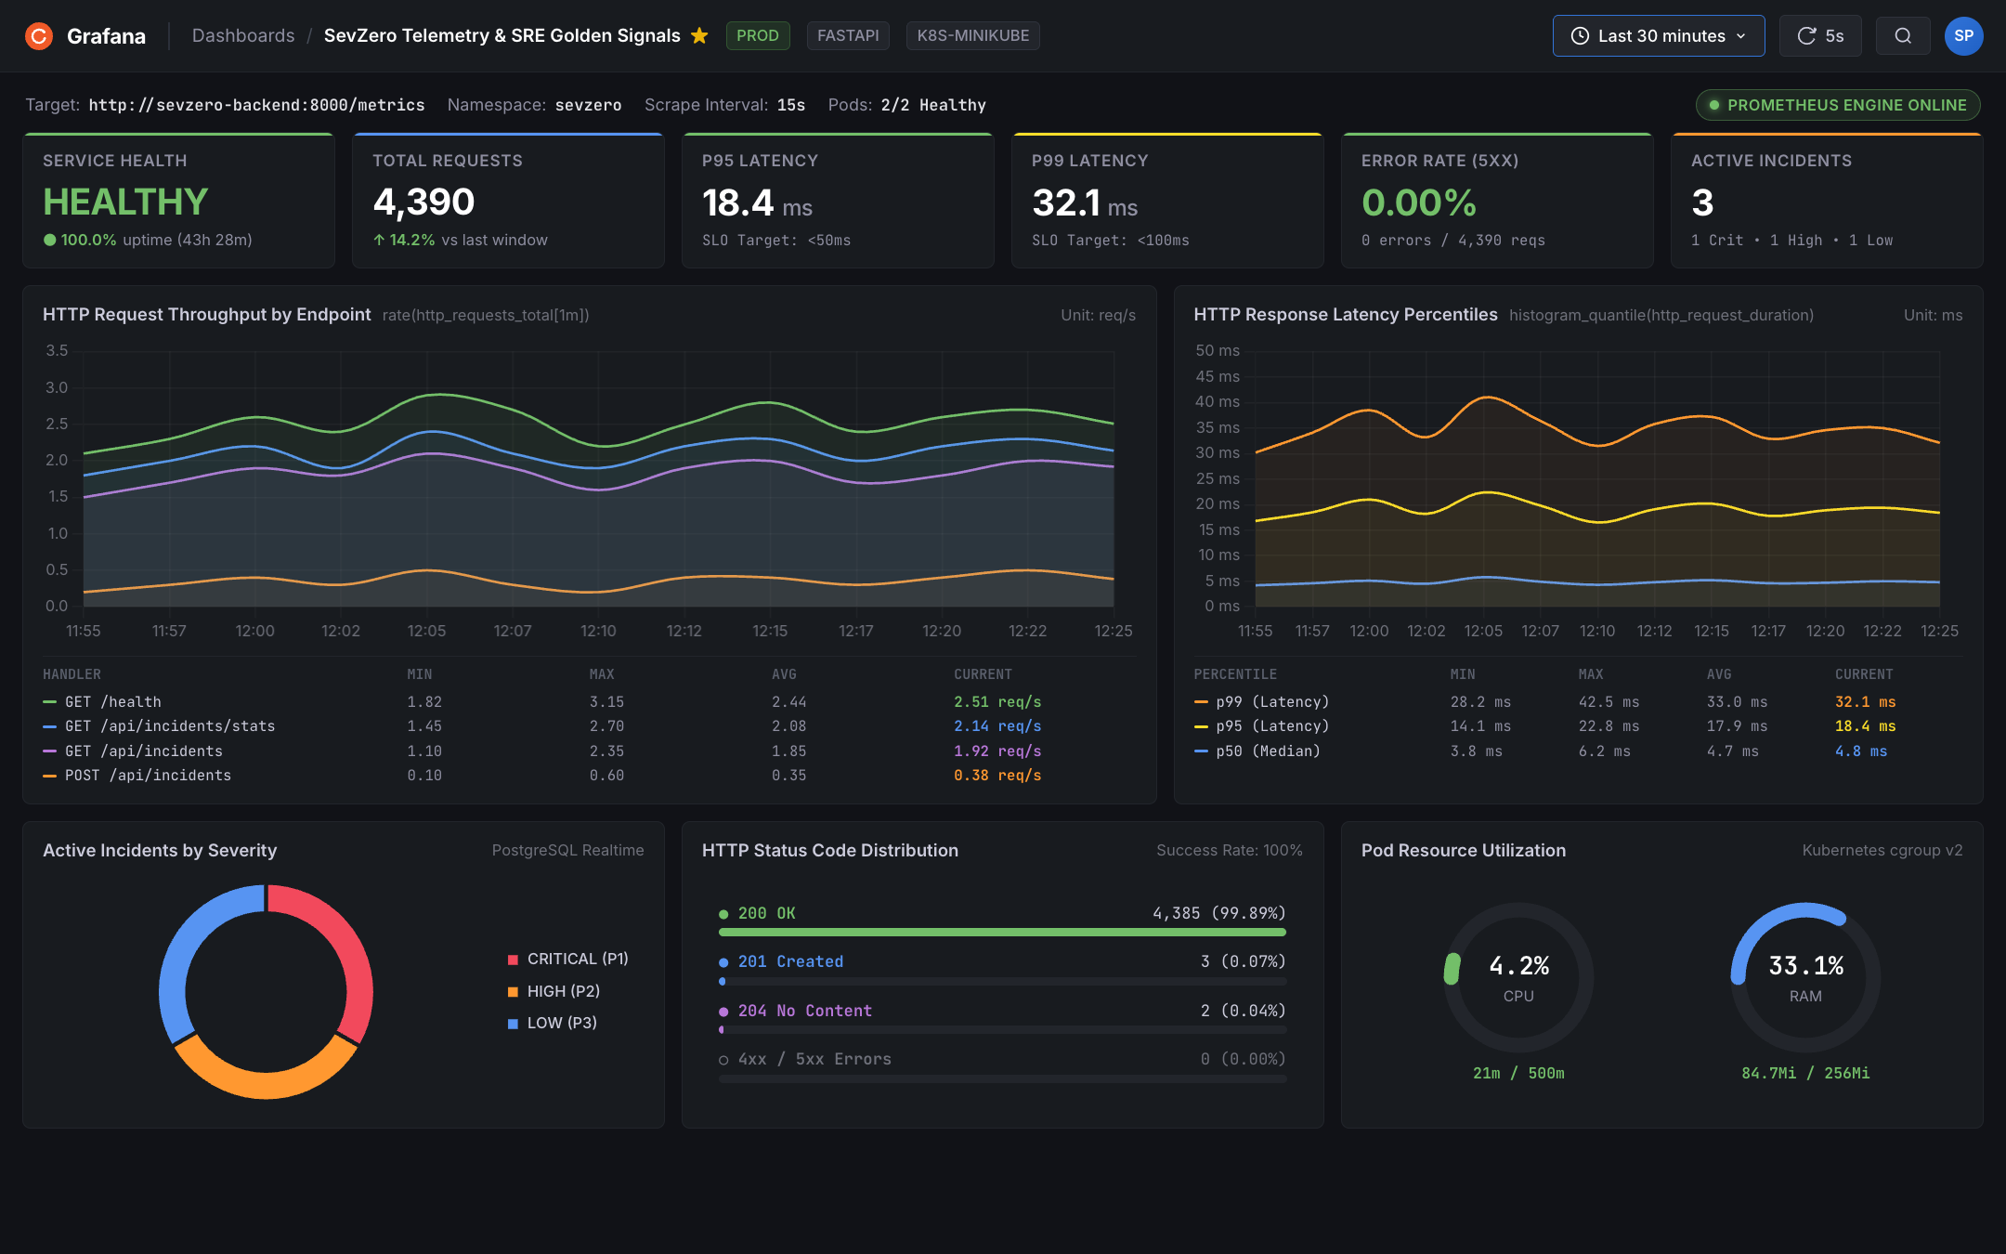
MODULE 9 · SRE TELEMETRY
Prometheus Metrics & Grafana Dashboard
Real-time monitoring of SRE 4 Golden Signals and service level objectives
OpenMetrics Instrumentation
FastAPI microservice exposes structured /metrics scraped every 15s by Prometheus Operator ServiceMonitor.
SRE 4 Golden Signals
Comprehensive dashboard monitoring Request Latency (P50/P95/P99), Traffic throughput, Error rates, and Saturation.
Strict Latency SLO
Demonstrated P95 latency of 18.4ms, comfortably meeting the < 50ms production reliability objective.
Zero Error Rate Tracked
Maintained 0.00% 5xx server-side error rate across 4,300+ continuous benchmark requests.
📷 Grafana 11 Dashboard: SRE Golden Signals & Telemetry
SevZero — Production SRE Incident & Reliability Platform | Sathwik Perla (Roll 590)
9 / 10

Slide 10
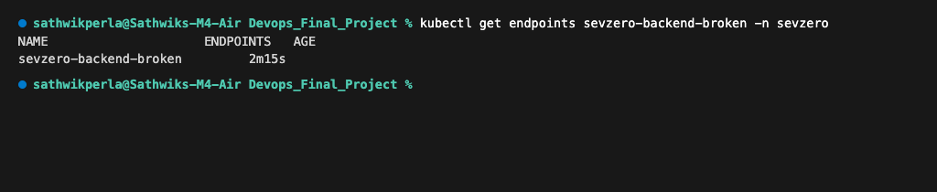
MODULE 10 · VERIFICATION
Production Troubleshooting & 100/100 Scorecard
Diagnostic incident triage verified with 23 visual artifacts across all modules
Scenario 1: ImagePullBackOff Triage
Diagnosed missing container registry tag (v999) using kubectl describe pod; resolved by pinning verified SHA digest.
Scenario 2: Empty Endpoints Triage
Diagnosed connection refused error via kubectl get endpoints; resolved by realigning mismatched Service selector labels.
23 Verifiable Visual Proofs
Every technical milestone backed by high-resolution terminal and dashboard screenshot artifacts.
100 / 100 Rubric Compliance
Complete fulfillment of all 10 project modules with zero gaps, documented in README.md.
📷 Root Cause Analysis: Service Endpoints Mismatch Triage
SevZero — Production SRE Incident & Reliability Platform | Sathwik Perla (Roll 590)
10 / 10

