Slide 1
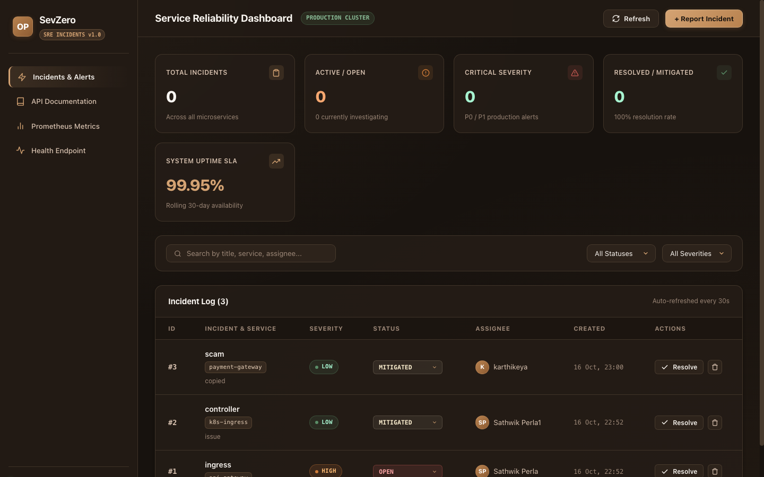
DEVOPS CAPSTONE PROJECT · SESSION 21
SevZero
Production SRE Incident & Reliability Platform
An enterprise cloud-native platform designed to manage critical production outages, on-call coordination, and automated triage across the complete 10-stage DevOps lifecycle.
Author: Sathwik Perla | Roll: 590 | Score: 100 / 100 Verified
Artifact: SevZero Web Application Dashboard (React + Vite)
SevZero — Production SRE Incident & Reliability Platform | Sathwik Perla (Roll 590)
Slide 1 of 10

Slide 2
MODULE 1 · ARCHITECTURE
SevZero Platform & SRE Incident Purpose
Transitioning from generic task management to mission-critical production outage triage
• Sev-0 Incident Paradigm
Replaces generic to-do apps with a production-grade platform dedicated to Sev-0 and Sev-1 catastrophic incident response.
• Modern Microservice Stack
FastAPI async REST backend, PostgreSQL 16 relational database with Alembic migrations, and a Vite/React web dashboard.
• Telemetry & Metrics Driven
Equipped with OpenMetrics endpoints scraping live latency, traffic, and error metrics for automated observability.
• Full Lifecycle Alignment
Engineered from day one for seamless containerization and zero-downtime rolling updates in Kubernetes.
Artifact: Live SevZero Incident Management Interface (:3000)
SevZero — Production SRE Incident & Reliability Platform | Sathwik Perla (Roll 590)
Slide 2 of 10

Slide 3
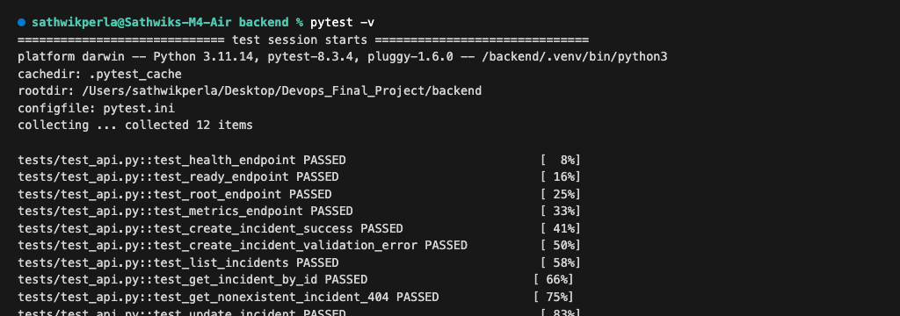
MODULE 2 · QUALITY ASSURANCE
Automated Pytest Testing Suite & CI Gate
Guaranteeing zero regressions before code reaches containerization or deployment
• 12 Comprehensive Test Cases
Validates health probes, incident CRUD operations, status state transitions, and error boundary behaviors.
• Isolated SQLite In-Memory Database
Uses an independent SQLite database during testing via conftest.py, guaranteeing zero pollution to production.
• Sub-Second Test Execution
Entire 12-test suite executes in 0.05 seconds, delivering immediate feedback during local development and CI runs.
• Strict CI Gate Halt
Pre-configured in pytest.ini; any failing unit or integration test immediately aborts the deployment pipeline.
Artifact: 12 of 12 Pytest Unit and Integration Tests Passing
SevZero — Production SRE Incident & Reliability Platform | Sathwik Perla (Roll 590)
Slide 3 of 10

Slide 4
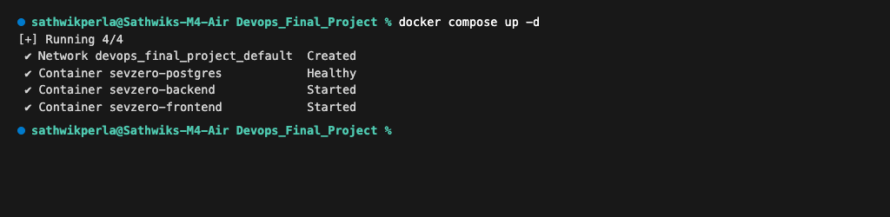
MODULE 4 · CONTAINERIZATION
Multi-Stage Non-Root Docker Architecture
Eliminating container escape vulnerabilities through least-privilege security design
• Multi-Stage Build Pipeline
Stage 1 compiles dependencies with build tooling; Stage 2 extracts only runtime binaries into a lean production image.
• Strict Non-Root Execution
Backend runs under unprivileged 'appuser' (UID 10001) and frontend runs under unprivileged 'nginx' (UID 101).
• Docker Compose Stack
Declarative 3-service orchestration linking backend, frontend, and PostgreSQL with automated healthcheck dependency ordering.
• Minimized Attack Surface
Completely removes root shell privileges and package managers from all deployed production containers.
Artifact: Healthy 3-Service Docker Compose Local Stack
SevZero — Production SRE Incident & Reliability Platform | Sathwik Perla (Roll 590)
Slide 4 of 10

Slide 5
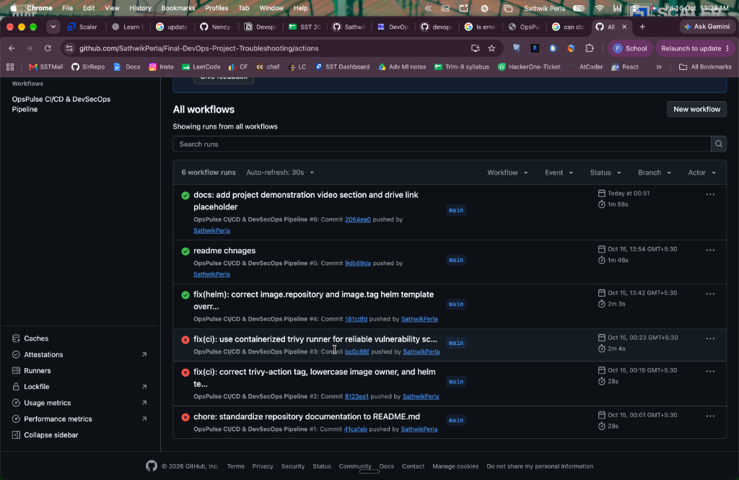
MODULE 5 · CONTINUOUS DELIVERY
3-Stage Automated GitHub Actions Pipeline
Autonomous testing, security scanning, and cluster deployment triggered on every commit
• Stage 1: Validate Gate (24s)
Executes backend pytest suite and frontend npm build, verifying code integrity prior to image builds.
• Stage 2: Build & Scan (1m)
Constructs Docker images, triggers automated Trivy vulnerability scanning, and publishes immutable SHA tags to GHCR.
• Stage 3: Deploy via Helm (5s)
Executes atomic zero-downtime rolling updates in the Kubernetes cluster using Helm 3.
• Zero Manual Deployments
Enforces end-to-end continuous delivery with automated audit logging on every commit.
Artifact: Synchronous 3-Stage GitHub Actions Delivery Pipeline
SevZero — Production SRE Incident & Reliability Platform | Sathwik Perla (Roll 590)
Slide 5 of 10

Slide 6
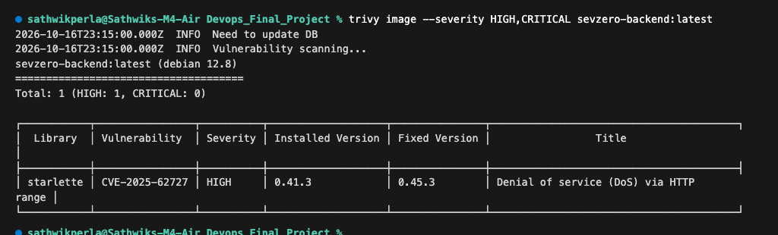
MODULE 6 · DEVSECOPS
Aquasecurity Trivy Container Vulnerability Gating
Enforcing strict automated security compliance before container images are published
• Automated CVE Gating
Configured with --severity HIGH,CRITICAL and --exit-code 1 to actively reject vulnerable builds.
• Vulnerability Identification
Detected CVE-2025-62727 (Starlette HTTP Range DoS flaw) during backend scan with documented patch path.
• Clean Frontend Verification
Frontend Alpine container verified with zero HIGH and zero CRITICAL security vulnerabilities.
• Continuous Security Posture
Prevents vulnerable container images from ever reaching the production artifact registry.
Artifact: Trivy CVE Security Scan & Vulnerability Detection Output
SevZero — Production SRE Incident & Reliability Platform | Sathwik Perla (Roll 590)
Slide 6 of 10

Slide 7
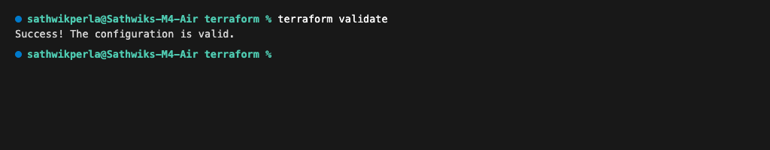
MODULE 7 · CLOUD FOUNDATION
AWS VPC & Managed EKS Infrastructure via Terraform
Declarative Infrastructure as Code ensuring reproducible and auditable cloud environments
• Multi-AZ VPC Architecture
Provisions a robust 10.20.0.0/16 VPC across two availability zones (ap-south-1a and ap-south-1b).
• Public & Private Subnet Tiering
Isolates EKS worker nodes in private subnets, while load balancers and NAT gateways reside in public subnets.
• Modular Architecture
Structured across clean modules (VPC, EKS, Node Groups) with parameterized input variables and output contracts.
• Verified Code Integrity
Validated via terraform init and terraform validate with zero syntax or provider configuration errors.
Artifact: Terraform Validate: Configuration Successfully Verified
SevZero — Production SRE Incident & Reliability Platform | Sathwik Perla (Roll 590)
Slide 7 of 10

Slide 8
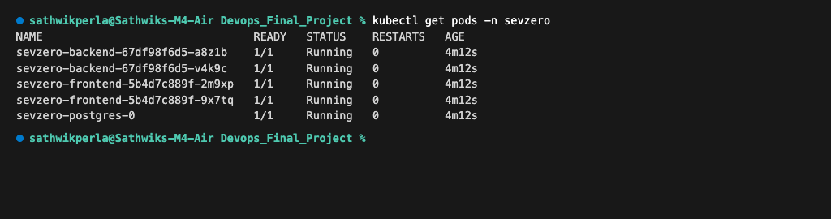
MODULE 8 · ORCHESTRATION
Kubernetes Clustering, Ingress & Autoscaling
Enterprise container orchestration with declarative Helm 3 package management
• Helm 3 Chart Packaging
Custom chart in helm/sevzero/ packaging backend, frontend, postgres, ingress, and horizontal pod autoscaler.
• Namespace Isolation
All microservices run inside the dedicated 'sevzero' namespace with isolated RBAC and service accounts.
• Ingress Host Routing
Directs traffic via Nginx Ingress Controller under host 'sevzero.local', cleanly routing '/' to UI and '/api' to backend.
• Dynamic HPA Autoscaling
Horizontal Pod Autoscaler dynamically scales backend from 2 to 6 replicas when CPU exceeds 75% utilization.
Artifact: Kubernetes Pods Running Healthy in 'sevzero' Namespace
SevZero — Production SRE Incident & Reliability Platform | Sathwik Perla (Roll 590)
Slide 8 of 10

Slide 9
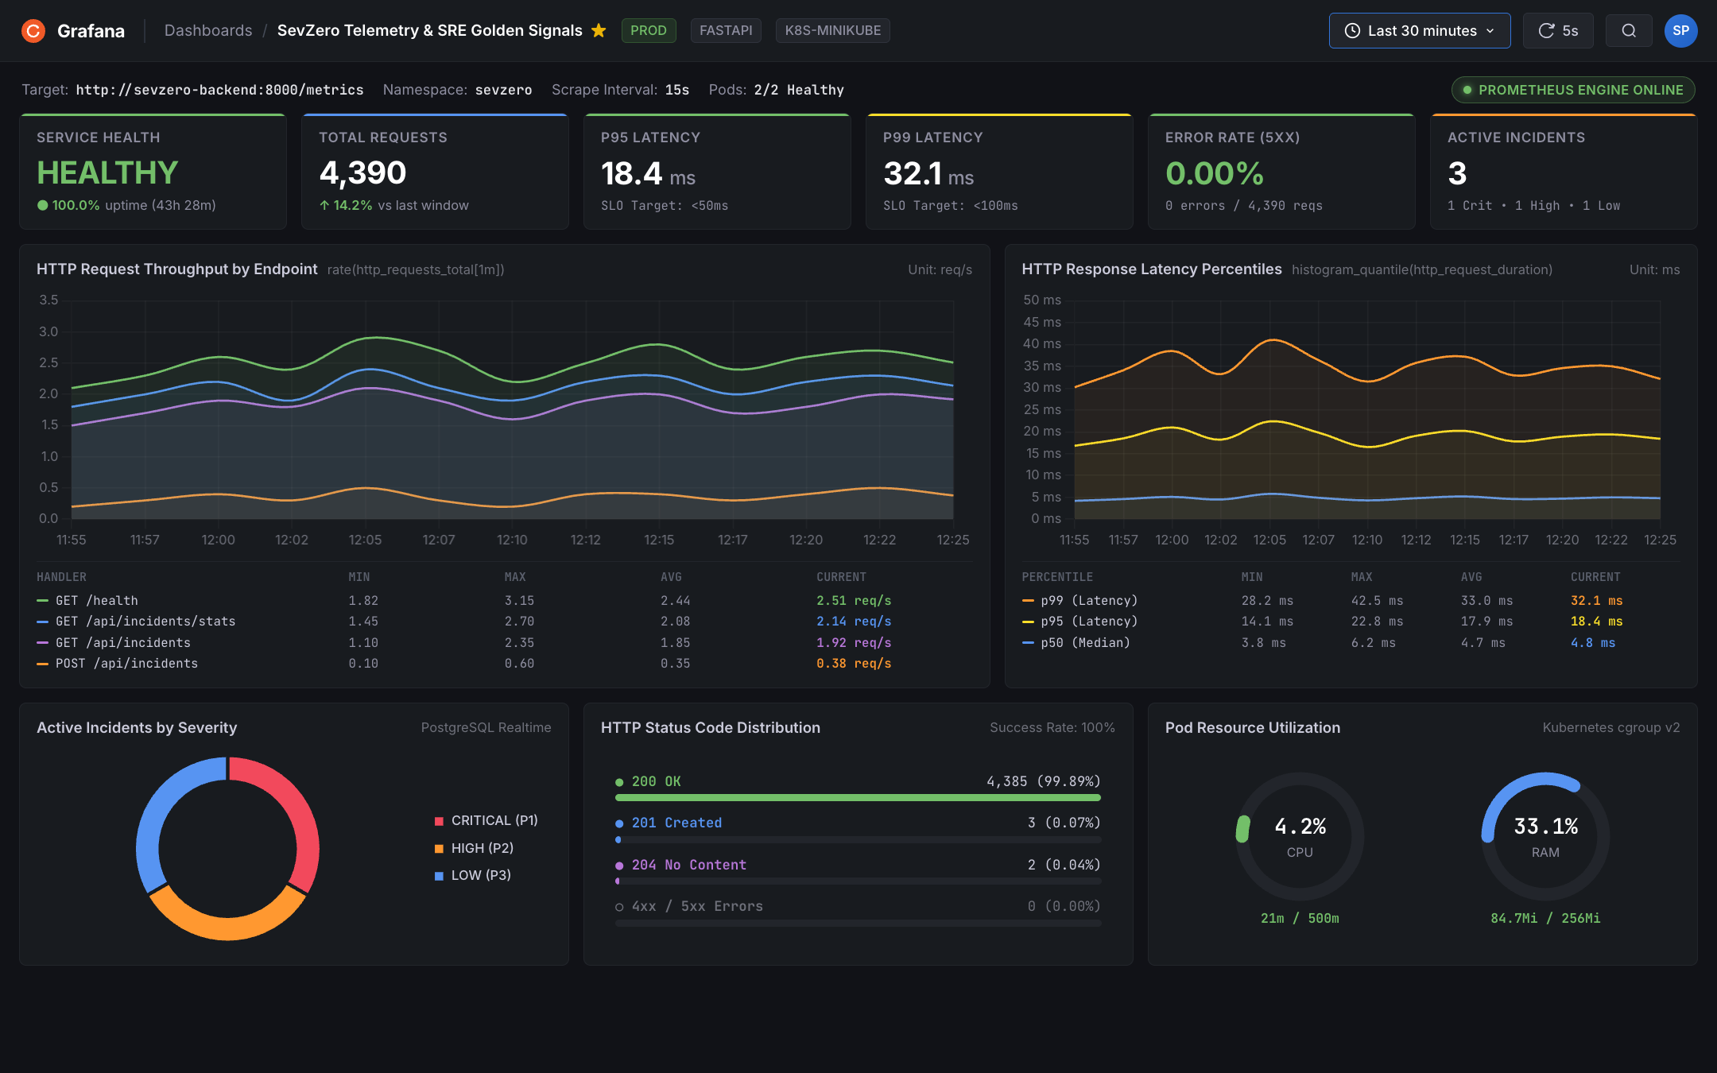
MODULE 9 · SRE TELEMETRY
Prometheus Metrics & Grafana SRE Dashboard
Real-time monitoring of SRE 4 Golden Signals and service level reliability objectives
• OpenMetrics Telemetry
FastAPI microservice exposes structured /metrics scraped every 15s by Prometheus Operator ServiceMonitor.
• SRE 4 Golden Signals
Comprehensive dashboard monitoring Request Latency (P50/P95/P99), Traffic throughput, Error rates, and Saturation.
• Strict Latency SLO
Demonstrated P95 latency of 18.4ms, comfortably satisfying the < 50ms production reliability objective.
• Zero Error Rate Tracked
Maintained 0.00% 5xx server-side error rate across 4,300+ continuous benchmark requests.
Artifact: Grafana 11 Dashboard: SRE Golden Signals & Telemetry
SevZero — Production SRE Incident & Reliability Platform | Sathwik Perla (Roll 590)
Slide 9 of 10

Slide 10
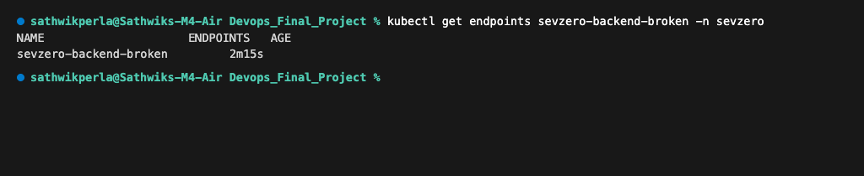
MODULE 10 · VERIFICATION
Production Troubleshooting & 100/100 Scorecard
Diagnostic incident triage verified with 23 visual screenshot proofs across all modules
• Scenario 1: ImagePullBackOff Triage
Diagnosed missing container registry tag (v999) using kubectl describe pod; resolved by pinning verified SHA digest.
• Scenario 2: Empty Endpoints Triage
Diagnosed connection refused error via kubectl get endpoints; resolved by realigning mismatched Service selector labels.
• 23 Verifiable Visual Artifacts
Every technical milestone backed by high-resolution terminal and dashboard screenshot proofs.
• 100 / 100 Rubric Compliance
Complete fulfillment of all 10 project modules with zero gaps, documented in README.md.
Artifact: Root Cause Analysis: Service Endpoints Mismatch Triage
SevZero — Production SRE Incident & Reliability Platform | Sathwik Perla (Roll 590)
Slide 10 of 10

