Slide 1
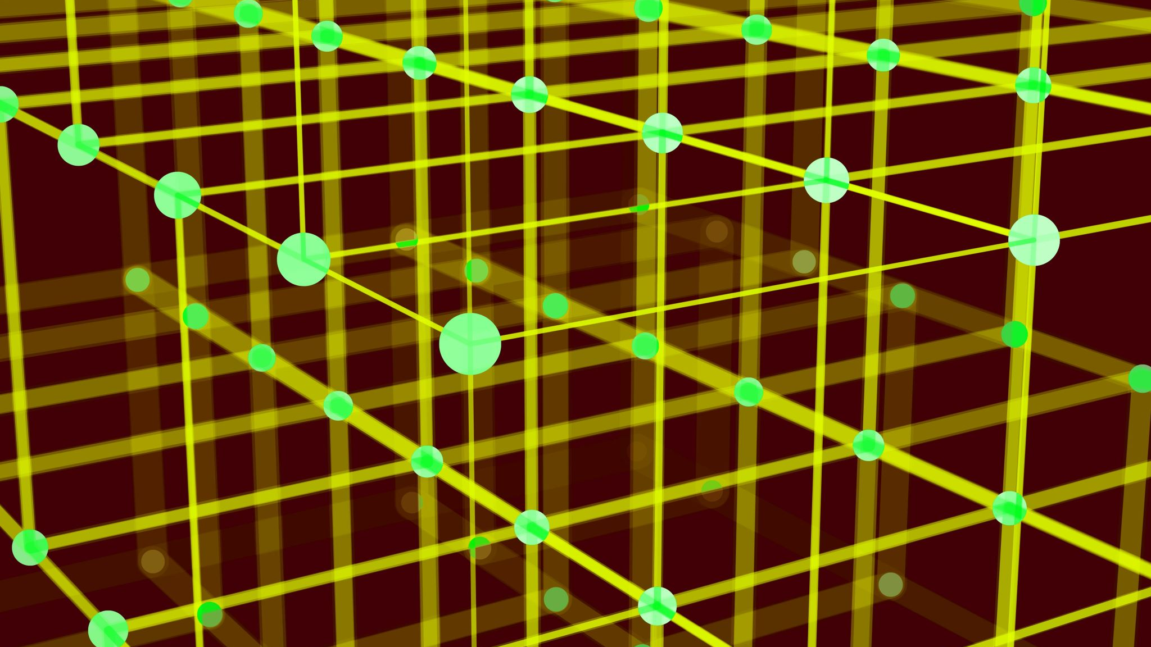
Generative AI
Assignment 7 Sathwik Reddy Chelemela

Slide 2
Problem
Task
Task Definition: Train two models on the MNIST dataset:
Vanilla Autoencoder (AE)
Variational Autoencoder (VAE)
Detach
Objective: Detach the decoder from each trained model.
Generate
Generate images by feeding latent vectors into the decoders.
Goal
Goal: Compare the quality and characteristics of images produced by each decoder.

Slide 3
Data and Prep
Dataset: MNIST dataset containing handwritten digits.
Data Preprocessing: Normalize pixel values (typically to the range [0, 1]).
Reshape images as needed for model input.
Data Splitting: Divide into training, validation (and possibly test) sets.

Slide 4
Approach
Vanilla Autoencoder Architecture: Standard encoder-decoder structure.
Loss Function: Mean Squared Error (MSE) to minimize reconstruction error.
Variational Autoencoder Architecture: Encoder that maps to a latent distribution, decoder reconstructs from samples.
Loss Components:
Reconstruction loss (e.g., MSE)
KL Divergence for latent regularization.
Decoder Detachment: Isolate the decoder from each model after training.
Generate images by inputting latent vectors into the decoders.
Training Details: Optimizer choice, learning rate, number of epochs, etc.

Slide 5
Evaluation
Evaluation Metrics: Visual inspection of reconstructed and generated images.
Comparison:
Latent Space Properties:
VAE: Enforced continuity and smooth interpolation.
Vanilla AE: Possibly more precise reconstructions but less controlled latent space.
Observations: VAE decoders may produce more diverse and continuous variations.
Vanilla AE decoders might yield sharper, more precise images.

Slide 6
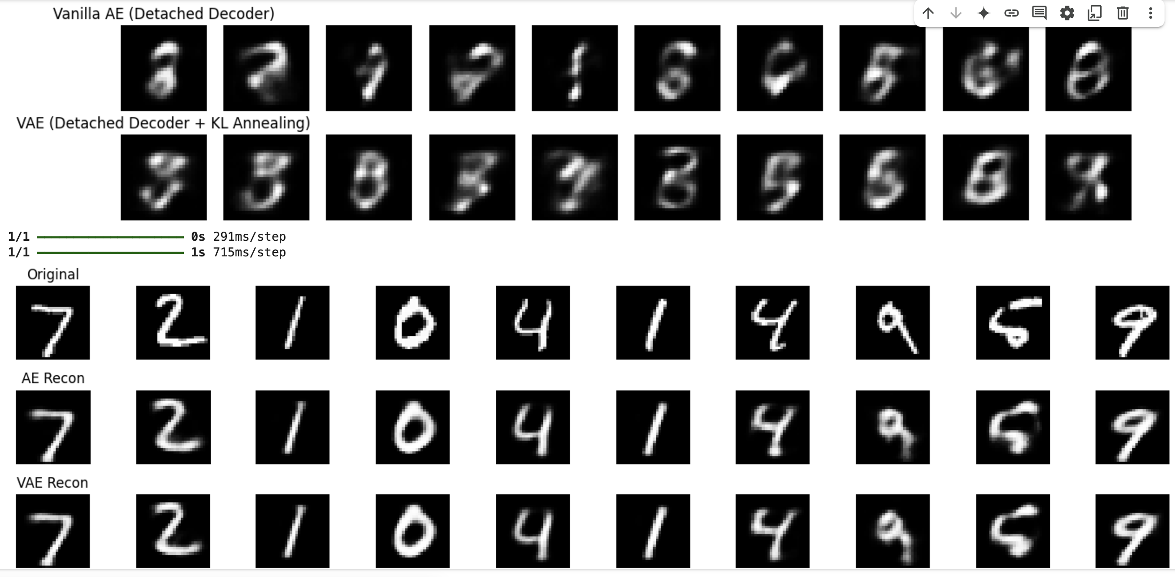
Results

Slide 7
Conclusion
Summary of Findings: Both models can reconstruct MNIST digits effectively.
VAEs provide a well-structured latent space facilitating smooth interpolation, while vanilla AEs excel in exact reconstruction fidelity.
Key Takeaways: Trade-off between reconstruction accuracy (vanilla AE) and latent space regularity (VAE).
Future Directions: Extend experiments to more complex datasets.
Explore hybrid approaches or additional regularization techniques.
Applications: Generative modeling, image synthesis, data augmentation, and anomaly detection.

