Slide 1

Fine-Tuning Large Language Models for SQL Query Generation
A Comparative Analysis
between DeepSeek R1 and Llama 3.2
Sathwik Reddy Chelemela

Slide 2

Objective:
To automate SQL query generation from natural language queries using advanced LLMs.
To evaluate and compare the performance of DeepSeek R1 and Llama 3.2 models.
Goals:
Enhance database query efficiency and accuracy.
Provide intuitive interactions with databases for non-technical users.

Slide 3
Approach
Chosen Models:
DeepSeek: Efficient model known for its robustness and capability in understanding structured data.
Llama 3.2: Known for performance, computational efficiency, and flexibility in fine-tuning.
Techniques Used:
LoRA (Low-Rank Adaptation)
GPU: T4
Quantization (8-bit)
Prompt Engineering for better context and accuracy.

Slide 4
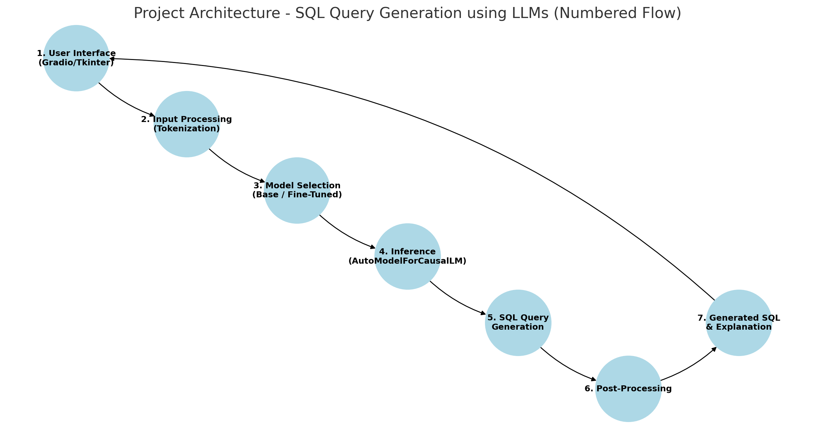

Slide 5

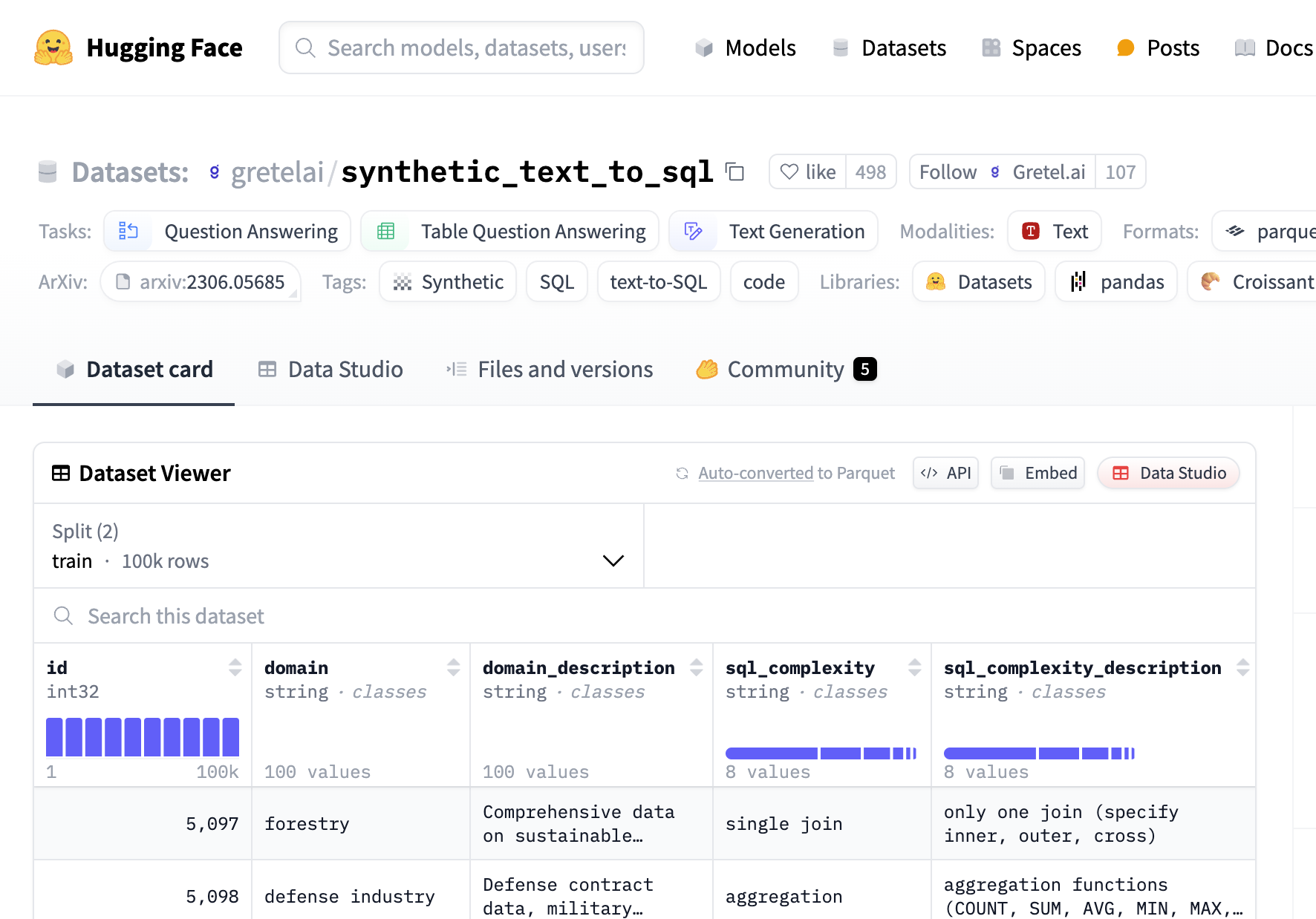
Dataset and Schema
Domain: Automobile sales data.
Example schema used: CREATE TABLE CarSales ( Manufacturer VARCHAR(50), Model VARCHAR(50), CarsSold INT, Year INT );
Sample Data:
('Toyota', 'Camry', 450000, 2023),
('Ford', 'F-150', 800000, 2023),
('BMW', '3 Series’,300000, 2023)

Slide 6
Data Preparation
Steps Taken:
Loading datasets into a structured format compatible with Hugging Face datasets library.
Normalization of queries and schema representations.
Creating training prompts that clearly define user intent and expected SQL outcomes.

Slide 7
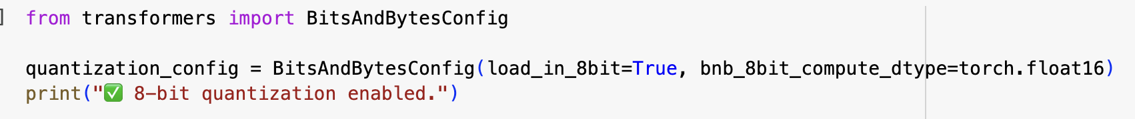
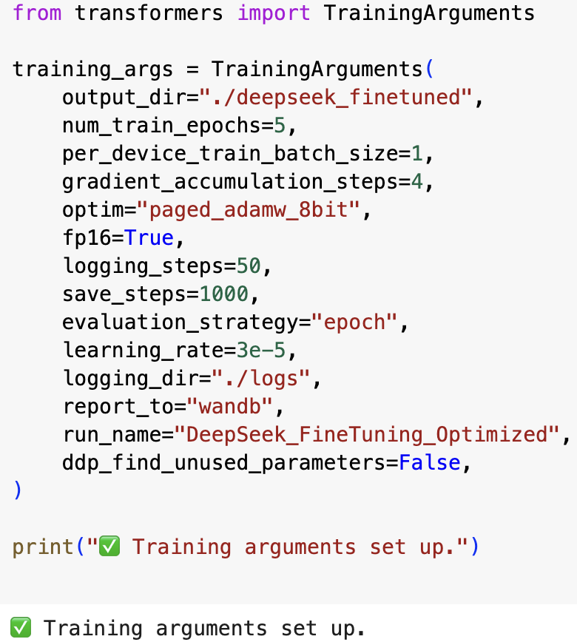
Model Fine-Tuning Process
Configuration:
Quantization for efficient inference (8-bit computations).
LoRA for parameter-efficient fine-tuning, reducing computational costs significantly.
Hyperparameters: Temperature: 0.7, Top_p: 0.95, Repetition Penalty: 1.0
Tools Used: Hugging Face Transformers, PEFT, WandB (Weights & Biases) for monitoring and logging training performance.

Slide 8
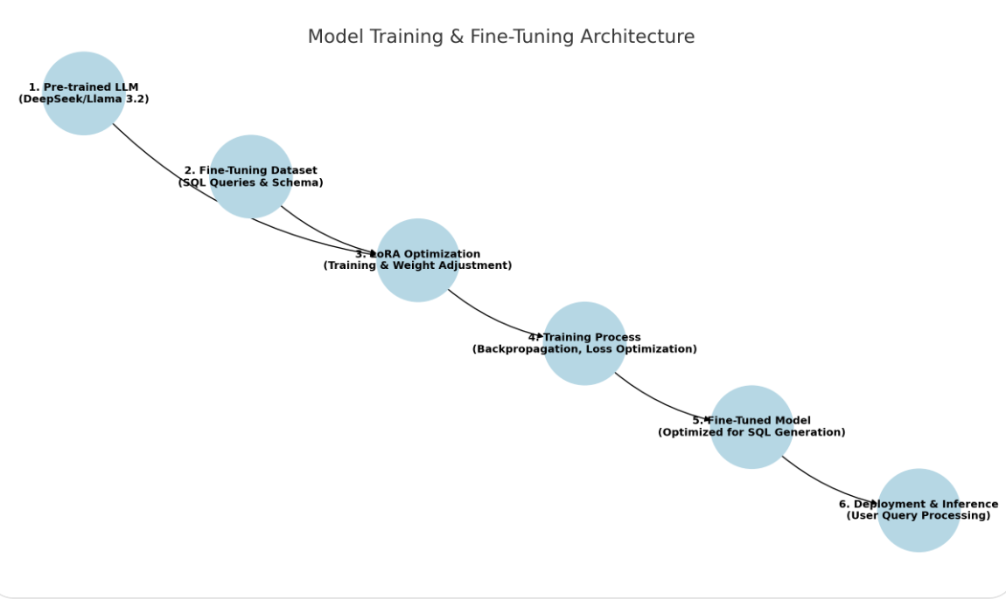

Slide 9

Evaluation Metrics
Metrics Selected:
Rouge_score (measures relevance and completeness).
BLEU Scores for measuring similarity between generated and target queries.
Sqlite3 for executing and comparing sql queries of each model and checking whether they produce same output or not.
Semantic Similarity: measures the degree of similarity between pieces of text based on their meaning, rather than just the words used.
Accuracy Test with Ground Truth
Time to measure execution time for each model
Why these metrics matter?
Ensures queries are correct, efficient, and relevant.
Helps gauge practical utility in real-world scenarios.

Slide 10

User Interface Implementation
Provides easy input fields for user queries.
Allows selection between Base and Fine-Tuned models.
Generates SQL queries in real-time with explanations

Slide 11
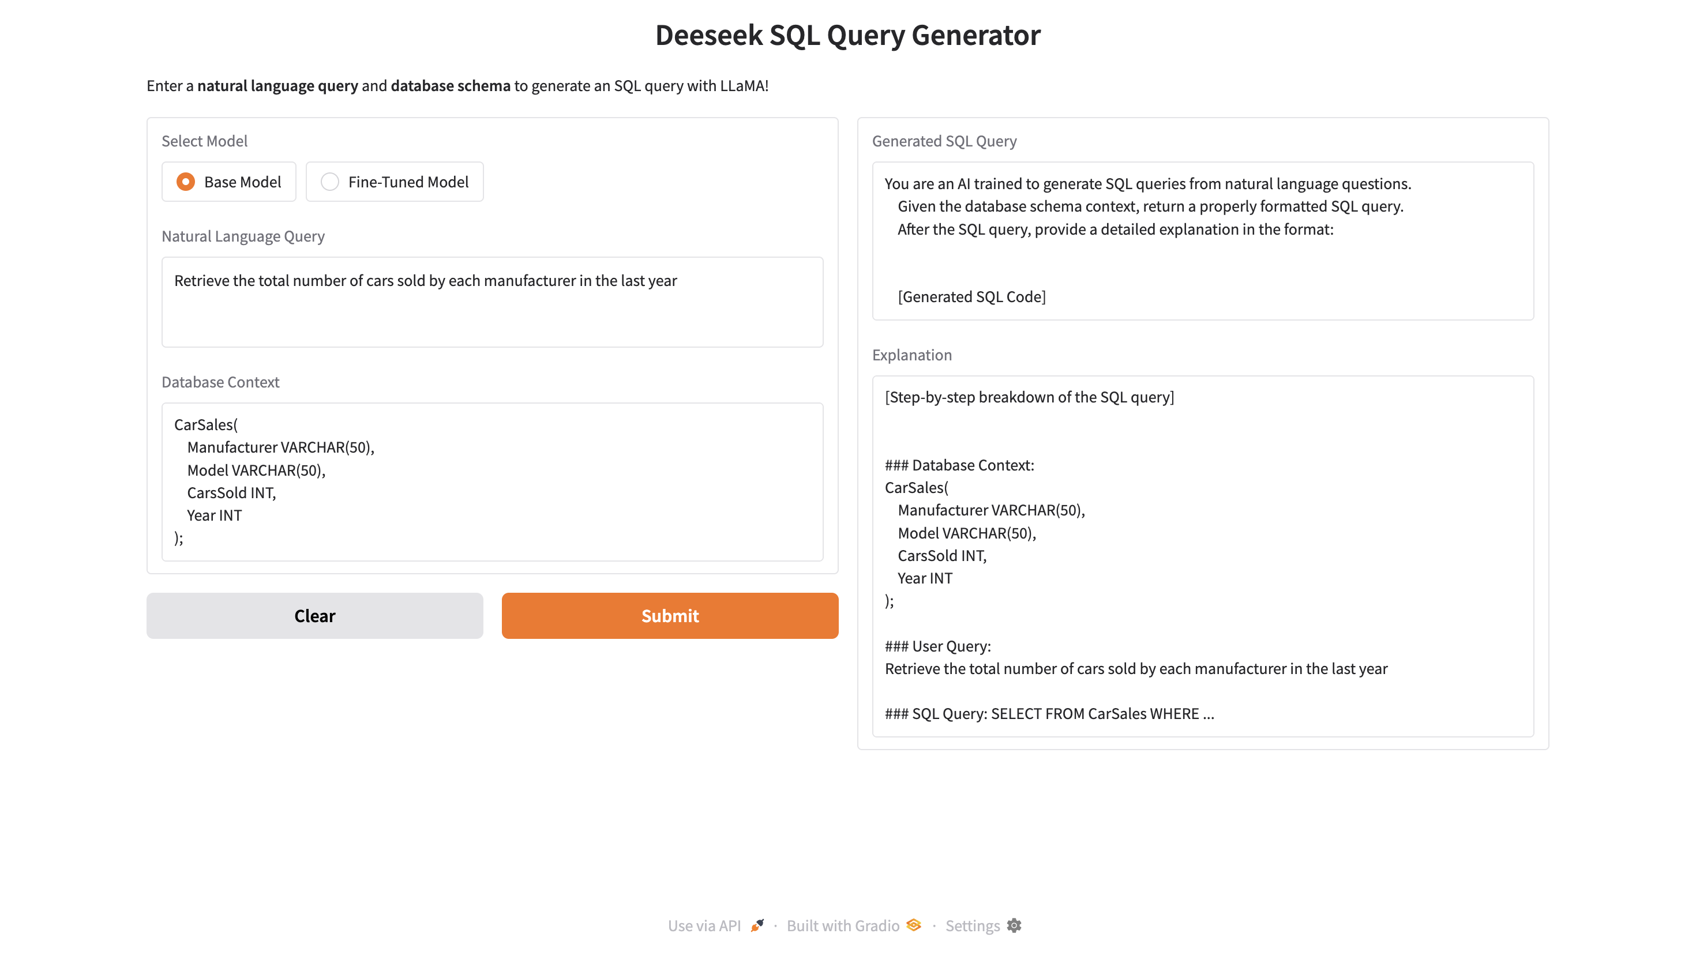
RESULTS

Slide 12
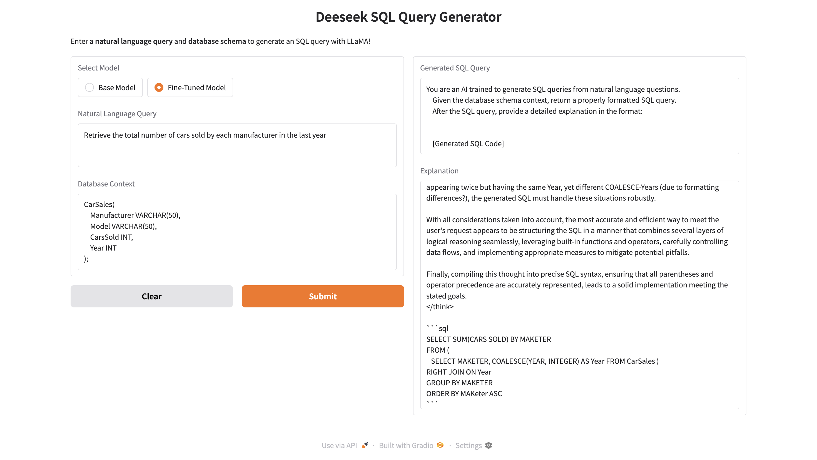
RESULTS

Slide 13
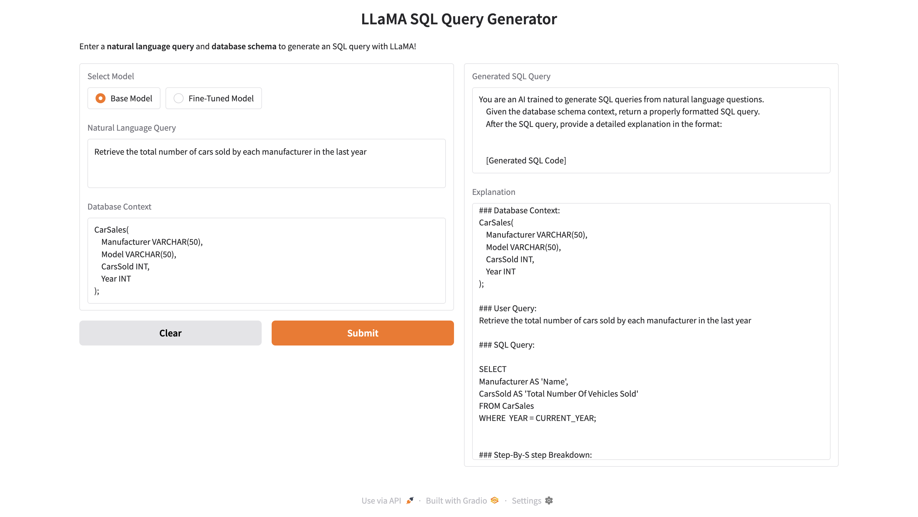
RESULTS

Slide 14
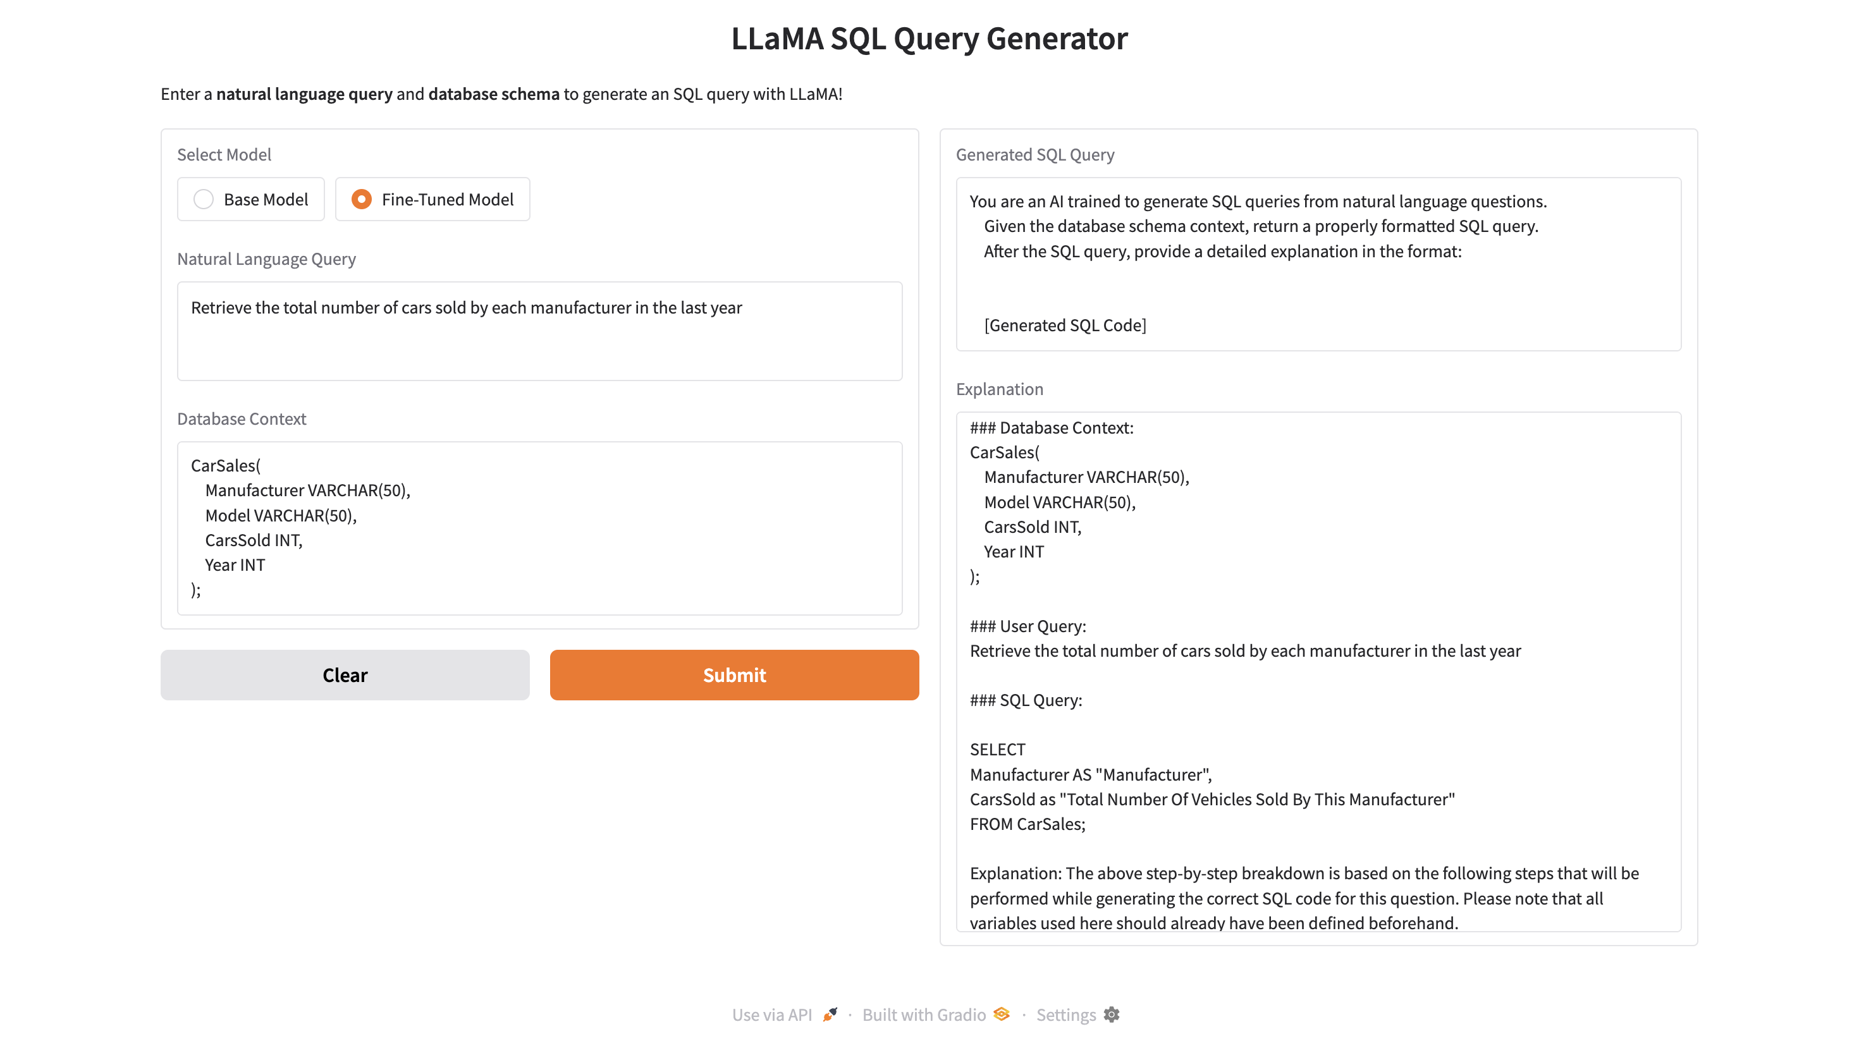
RESULTS

Slide 15
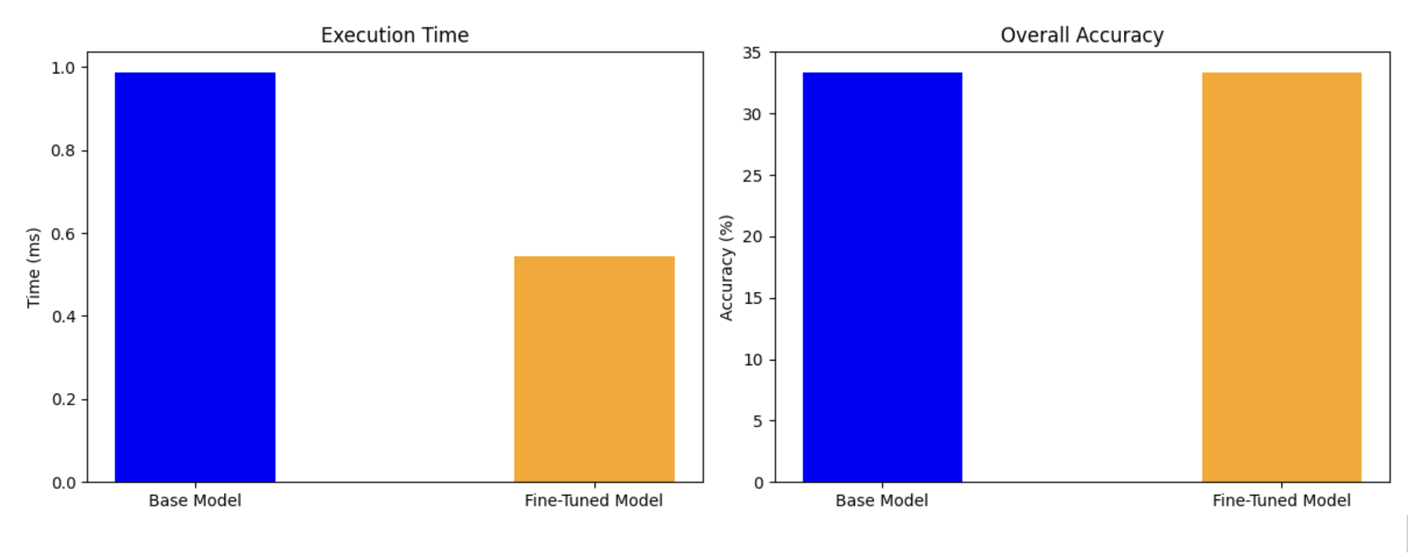
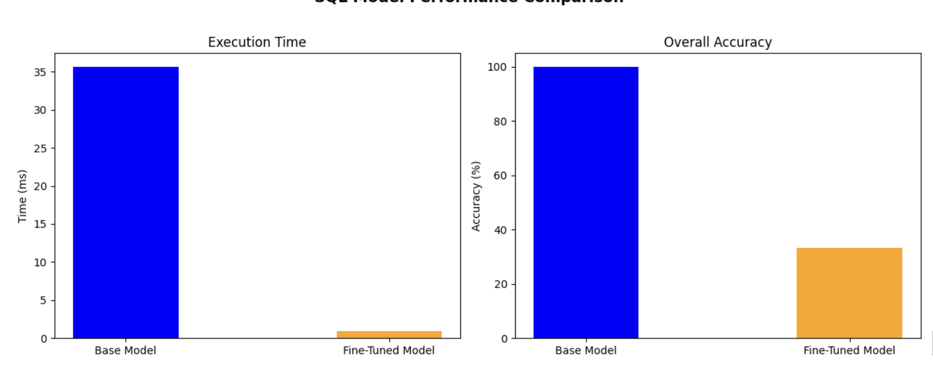
Results Interpretation
Llama 3.2
DeepSeek R1

Slide 16
Results Interpretation
Key Insights:
DeepSeek is highly effective for structured and clear-cut tasks.
Llama 3.2 shows more flexibility for varied, nuanced queries.
Observations:
Fine-tuning significantly improves domain-specific performance.
Prompt clarity substantially influences result accuracy.

Slide 17

Conclusion
Key Achievements:
Successfully fine-tuned DeepSeek and Llama 3.2 for SQL query generation.
Developed a user-friendly Gradio UI for real-time natural language to SQL conversion.
Improved the efficiency and accuracy of generating structured queries from text.
Key Learnings:
High-quality training data is crucial for model performance.
Effective prompt engineering significantly impacts the accuracy of generated SQL.
Fine-tuning enhances domain-specific performance, making models more reliable in structured tasks.

