Slide 1

Generative AI Assignment -3
Name - Sathwik Reddy Chelemela
NUID- 002873268

Slide 2
Problems and Challenges
(A) LangChain with RAG
Retrieval-Augmented Generation (RAG) enhances LLMs by retrieving external knowledge.
This project explores how LangChain uses FAISS for vector storage and retrieval.
Focus areas: Input/output parsing, retrieval mechanisms, and response formatting.
(B) CIFAR-10 CNN Performance Analysis
CIFAR-10 is a 10-class image classification dataset.
We investigate CNN performance by varying:
Batch Normalization & Dropout
Number of convolutional & pooling layers
Activation functions (ReLU, Tanh, Softmax)

Slide 3
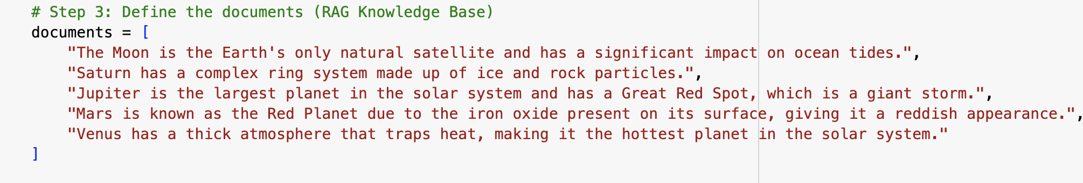
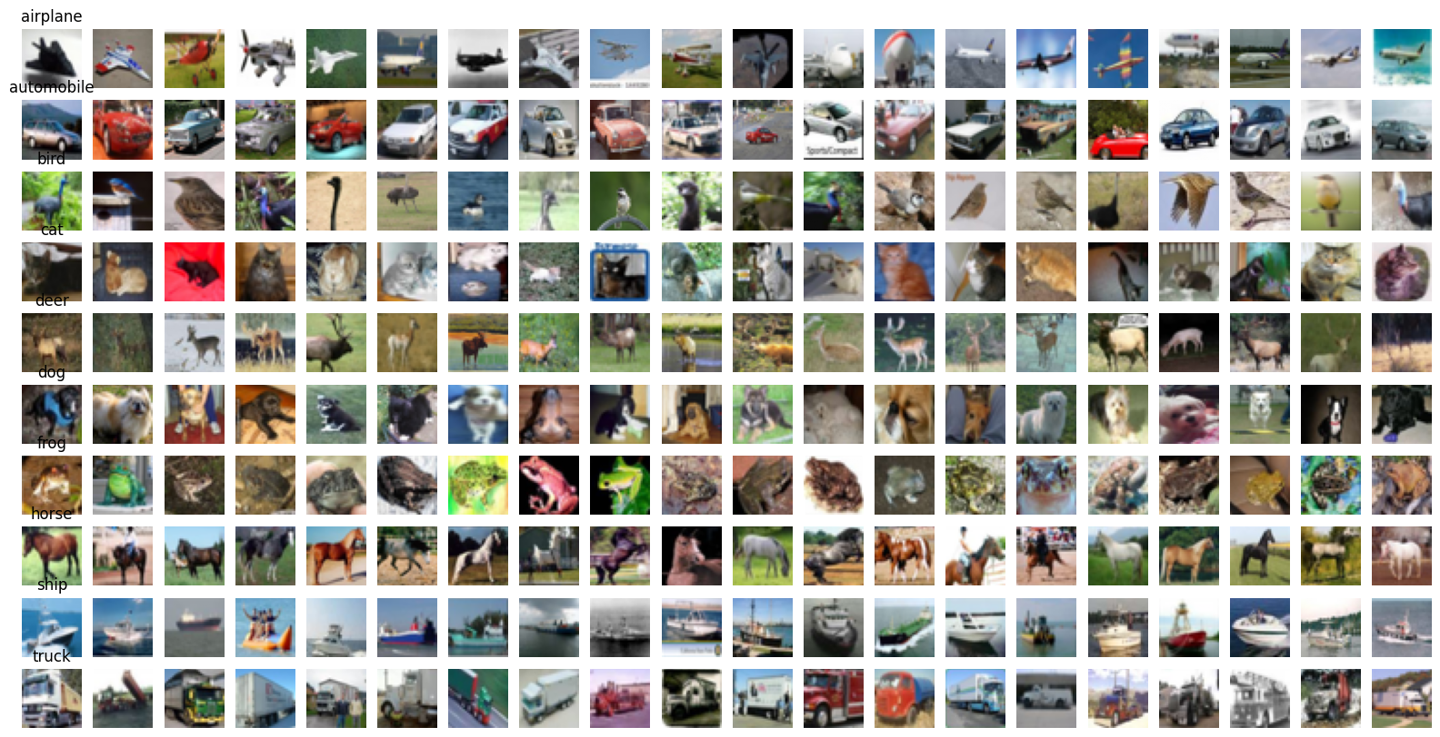
Data and preparation
(A) LangChain RAG Data
Text documents about planets are embedded using SentenceTransformer.
FAISS is used as a vector database for efficient retrieval.
Queries retrieve the most relevant documents before generating an answer.
(B) CIFAR-10 Dataset
60,000 images (10 classes, 32x32 pixels, RGB).
Preprocessing includes:
Normalization of pixel values.
One-hot encoding of labels.
Data augmentation (flipping, rotation) to improve generalization.

Slide 4
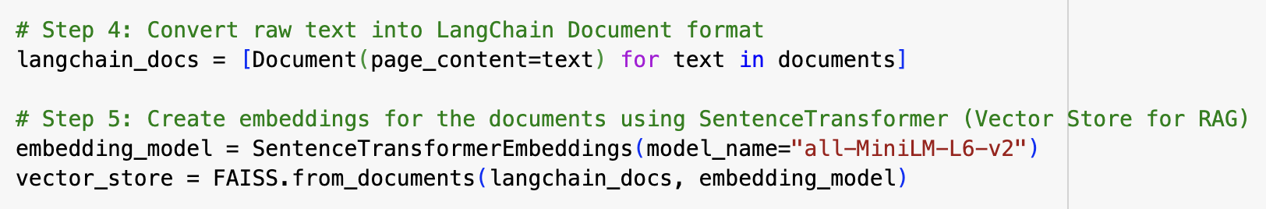
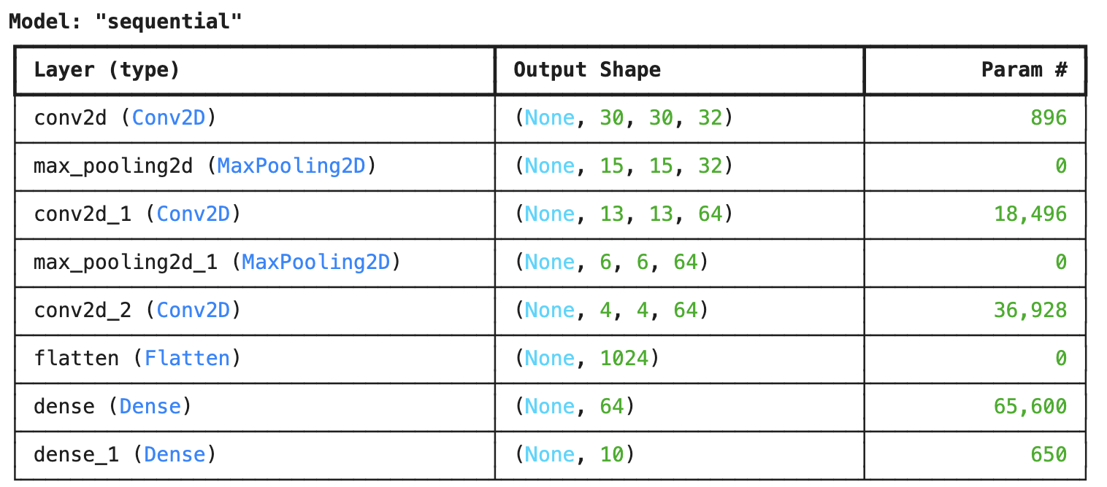
Approach
A) LangChain RAG Implementation
OpenAI GPT-3.5 Turbo is used as the LLM.
FAISS retrieves top matching documents.
Structured prompting and output formatting improve answer readability.
(B) CNN Model Variations
Baseline: 3 Conv layers + ReLU + MaxPooling.
Variations:
Batch Normalization for faster convergence.
Dropout to reduce overfitting.
Different activation functions and layer depths to evaluate accuracy trends.

Slide 5
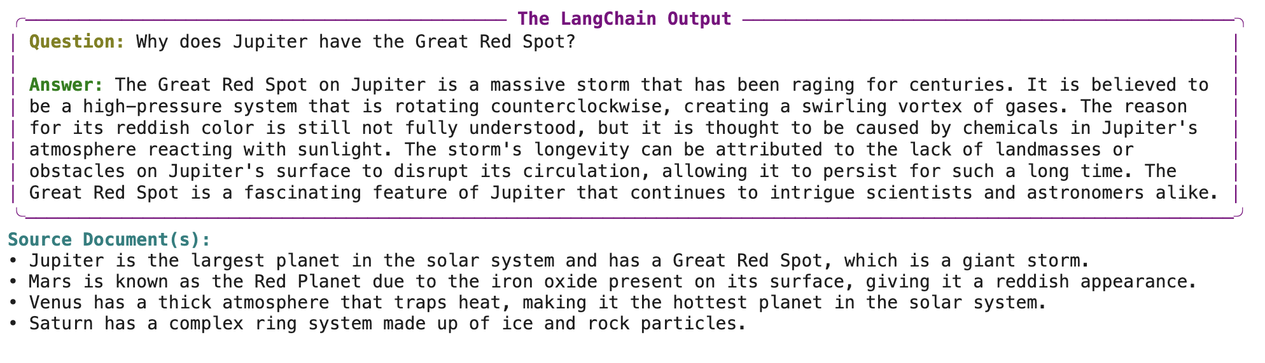
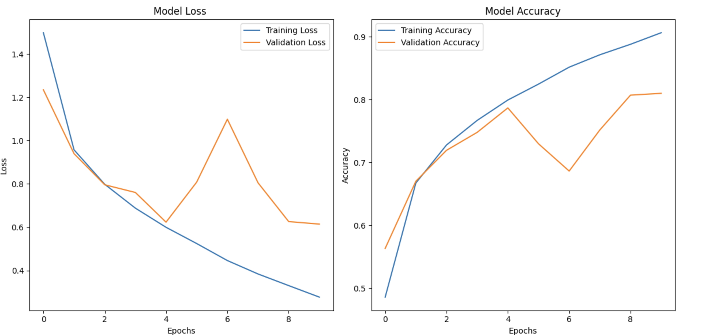
Evaluate
LangChain RAG Results:
FAISS improves retrieval efficiency.
Context-aware responses are more factual.
Proper prompt engineering enhances clarity.
CNN Performance Comparison:
Batch Normalization: Faster training, better accuracy.
Dropout: Helps generalization, reduces overfitting.
Activation Functions:
ReLU → Best performance.
Tanh & Sigmoid → Slower, vanishing gradient issues.

Slide 6
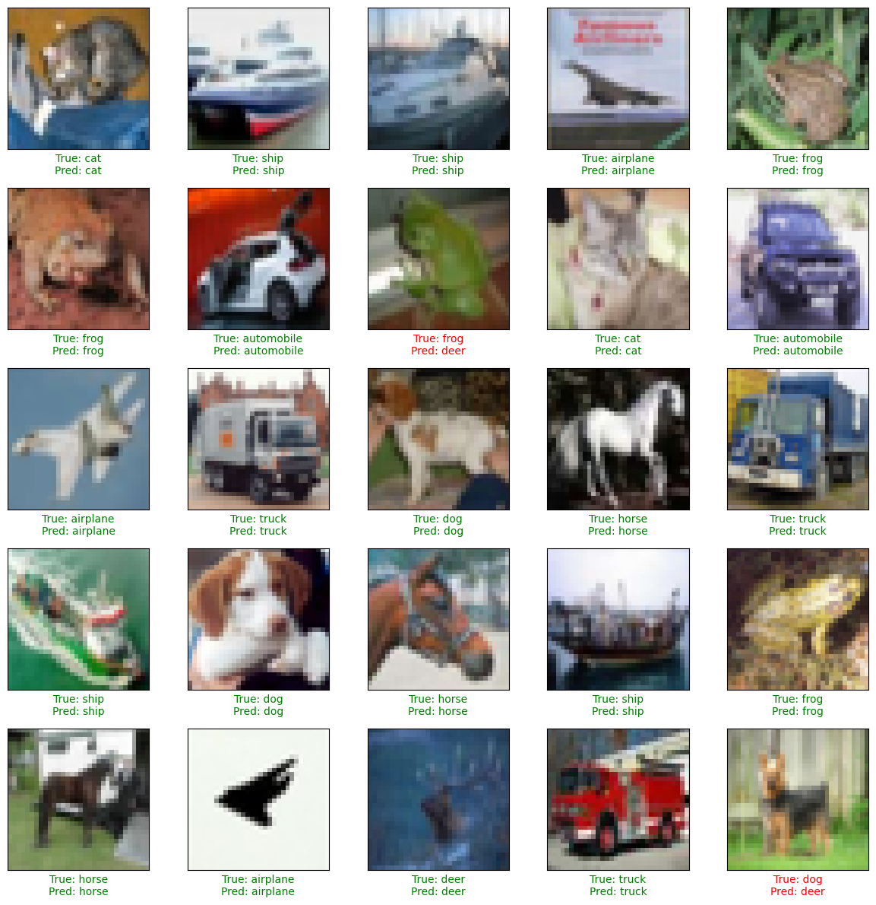
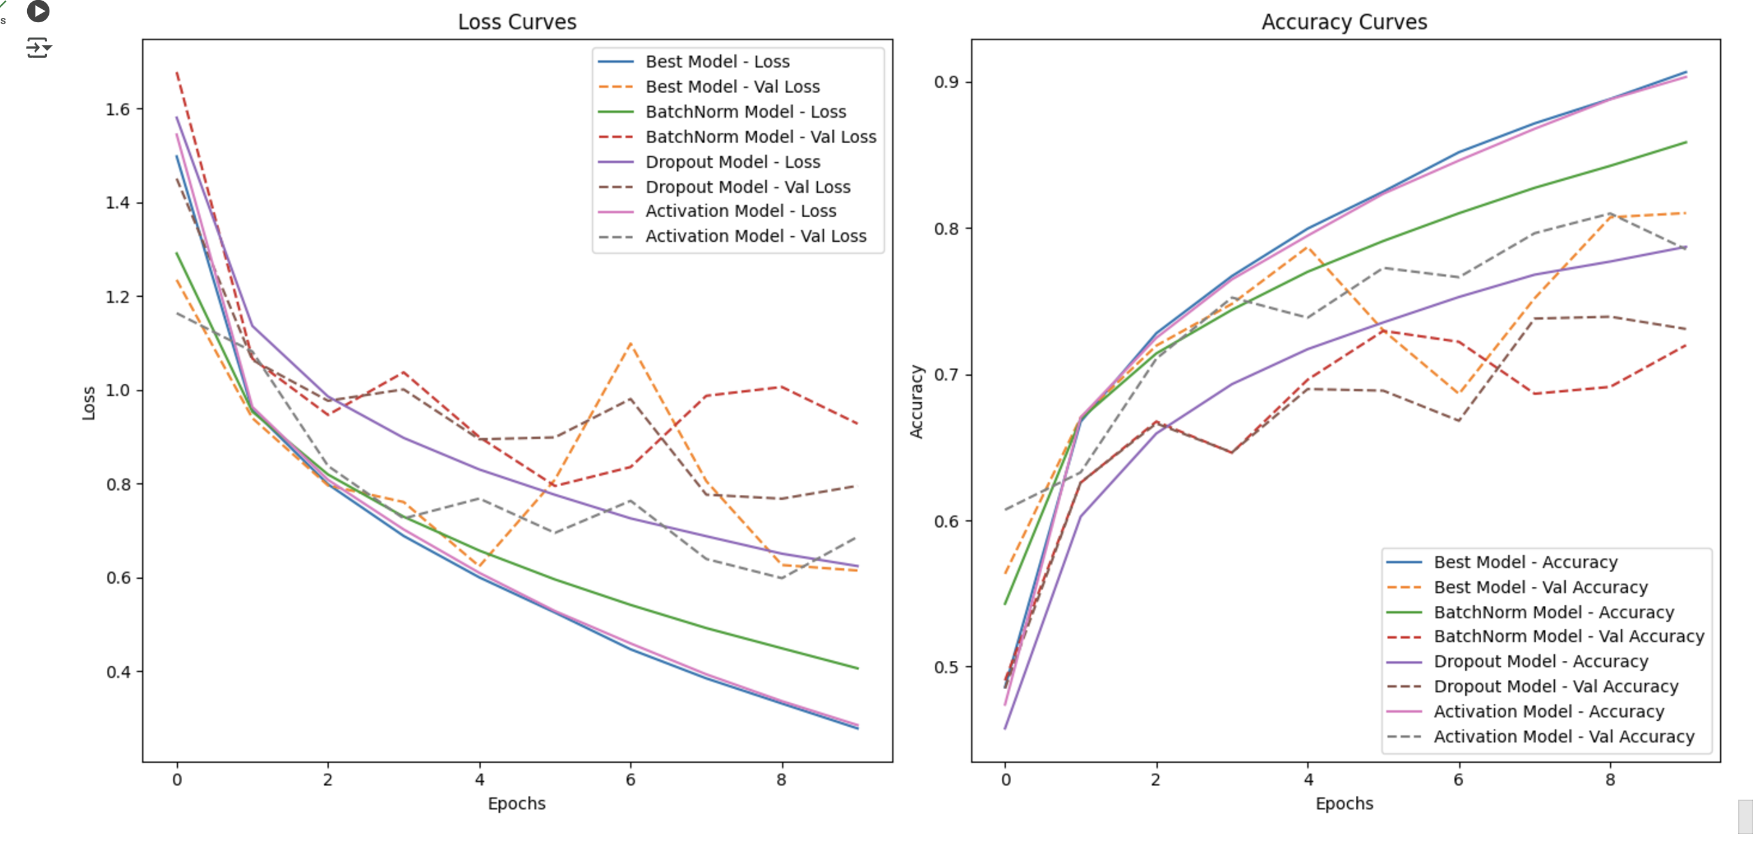
Conclusion
LangChain RAG Insights:
RAG boosts response relevance & accuracy.
High-quality embeddings are key for retrieval.
CIFAR-10 CNN Takeaways:
Best Setup: Batch Normalization + Dropout + ReLU.
More layers improved accuracy slightly.
Regularization techniques (BatchNorm & Dropout) are crucial.

