Slide 1
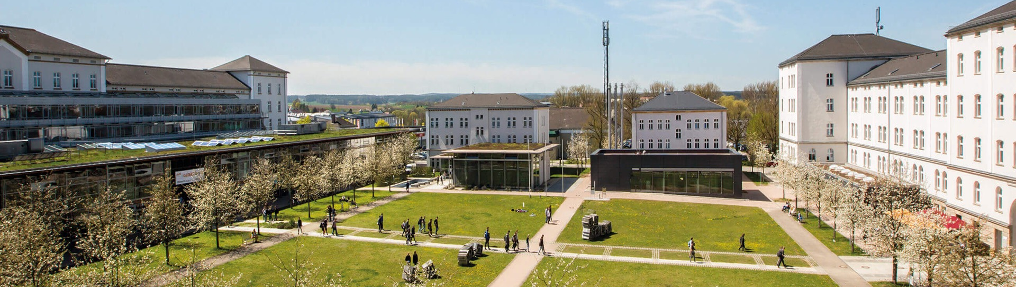
Analysis of Electric Vehicle Charging Stations
WISE 2025 PRS Project
SAI SURYA ALLA, SATHWIK NAGASUNDARA SHARMA
© 2025 OTH Amberg-Weiden

Slide 2
PRESENTATION OUTLINE
1
Introduction
4
Results & Findings
2
Questions
5
Conclusion
3
Applied Method

Slide 3
Questions
Questions:
Which of the German states has the most charging stations?
Which city has the most charging stations in Germany (besides Berlin, Hamburg, Munich and Cologne)? In total, how many charging stations does the city of Amberg have and how much energy can be charged at max?
What are the 5 most prominent charging station operators in Germany and how many electric vehicles can each of them charge at once?
3rd December 2024
3

Slide 4
Applied Method
Already loaded dataset and checked Null or Duplicate.
Calculated number of charging stations in each German state.
Performed calculations for finding charging stations .
Visualized trends using Bar plot and choropleth map.

Slide 5
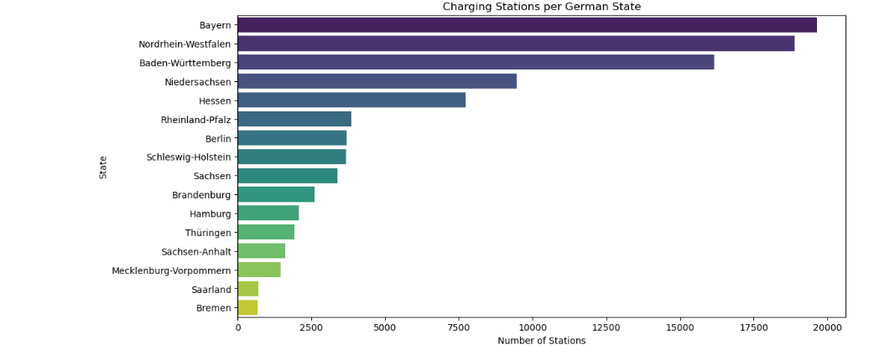
Charging stations per German State
The Bar plot provides us information regarding Bavarian region for charging stations about 19650 and is highest among all German States.
Lowest counts are found in Bremen with 687 stations and Saarland with 692 charging stations.

Slide 6
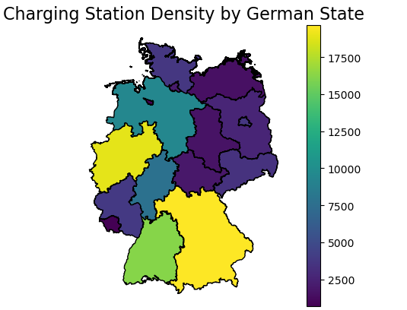
Choropleth map
Choropleth map helps us to identify the geographical data with calculated station counts by using Geospatial mapping which fetches the GeoJSON file with boundaries of all German states.
Darker colours on the map indicates Lower concentration of charging stations, providing a clear visual representation of EV infrastructure density..

Slide 7
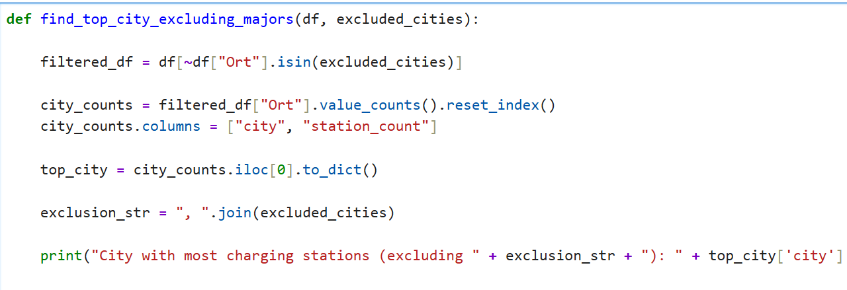
Top City Analysis (Excluding Majors)
Finding the top city with excluding the major metropolitan areas specifically Berlin, Hamburg, Munich, and Cologne.
The city with most charging stations excluding big cities is Stuttgart consists of 2116 stations

Slide 8
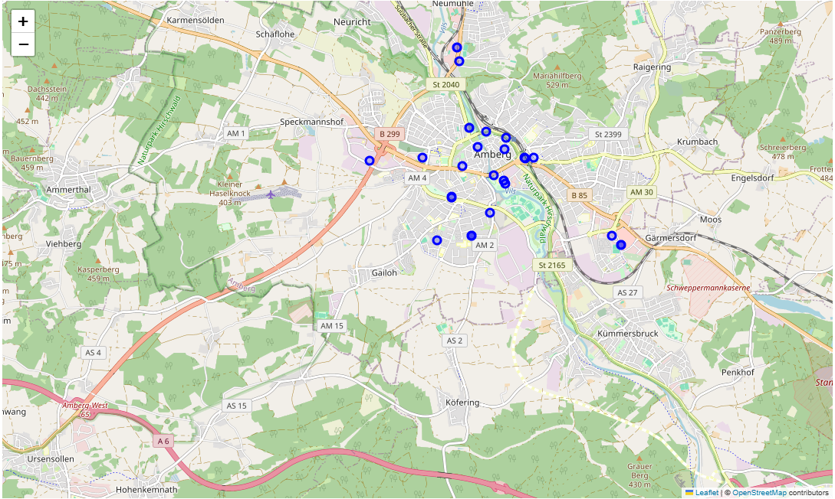
Charging stations in city of Amberg
The city of Amberg contains total 34 charging stations.
Each charging station in Amberg has total maximum charging power capacity of 2576 KW.

Slide 9
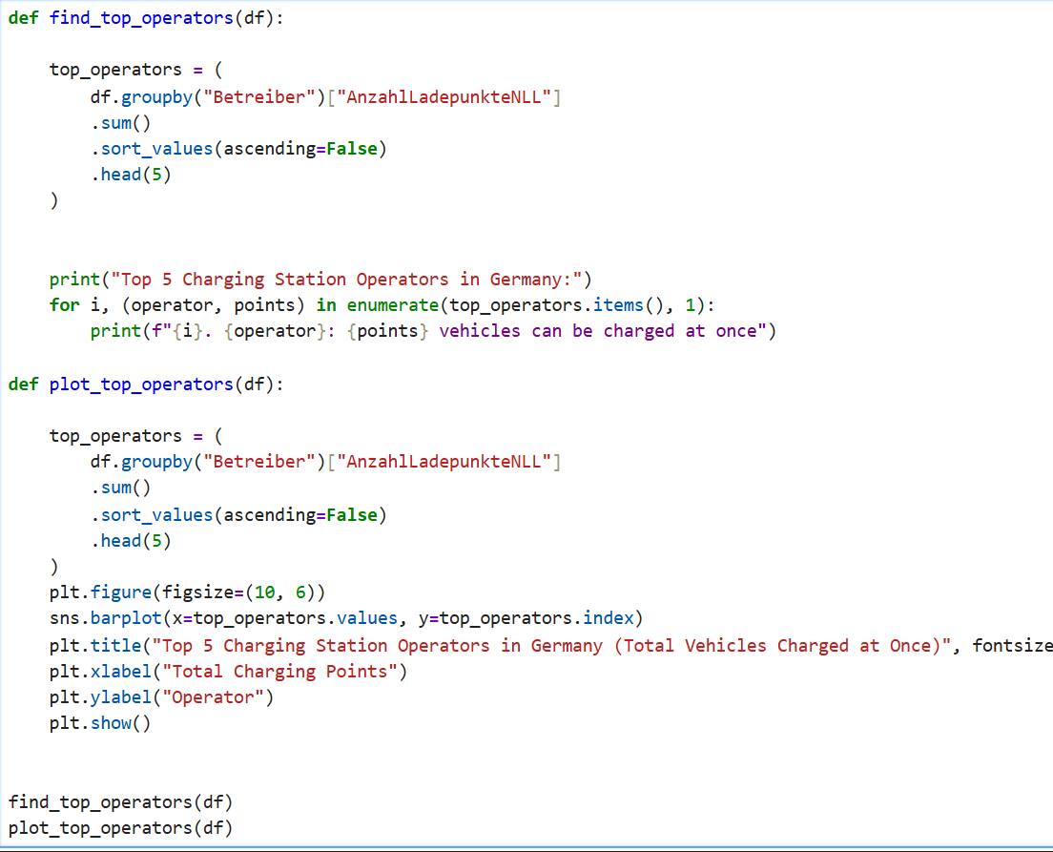
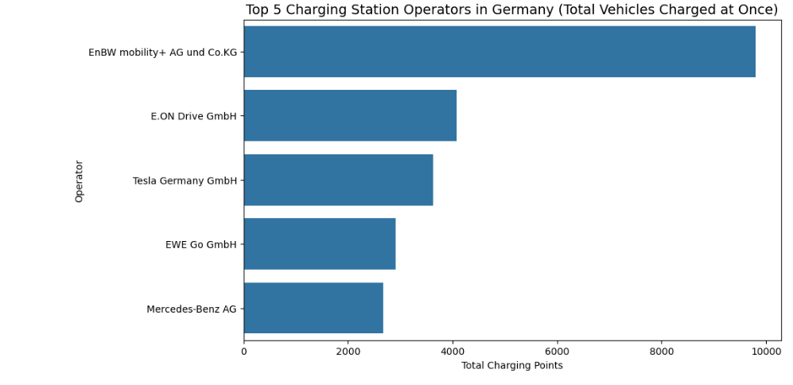
Top 5 charging stations in Germany

Slide 10
Key Findings
  Regional Dominance: Our analysis concludes that Bayern is the state with the highest number of charging stations (19,650). Nordrhein-Westfalen holds second place with 18,896 stations, followed by Baden-Württemberg with 16,171. These three states form the industrial and infrastructure core of the German charging network.
  City-Specific Infrastructure: Excluding major hubs (Berlin, Hamburg, Munich, and Cologne), Wolfsburg emerged as the city with the most charging stations. Specifically regarding Amberg, our analysis concludes the city has 52 charging stations, with a higher density in the central district. The maximum combined energy output of these stations totals 2246.6 kW.
  Leading Operators: The top five prominent operators identified are:
    EnBW Mobility+ AG & Co. KG
    E.ON Drive GmbH
    Tesla Germany GmbH
    EWE Go GmbH

Slide 11
Lessons learned
We built reusable data-cleaning and visualization functions with pandas, seaborn, geopandas, and folium, enabling easy updates and interactive mapping of Amberg’s 52 stations.
The system was tested locally with variant datasets to ensure robustness against future Federal Network Agency updates.
Effective GitHub collaboration, continuous communication with lecturers, and independent ownership of research topics drove the project’s success.

