Slide 1
Multi-Class Customer Category Prediction
Predicting customer category from purchase behavior using machine learning

Slide 2
Abstract
Businesses often treat all customers alike and miss chances to personalize offers. This project builds a multi-class classification model that predicts a customer's category from behavioral data: age, previous purchases, review rating, purchase frequency and subscription status. After exploratory data analysis, categorical features are encoded and numeric features scaled, then Logistic Regression, Decision Tree, Random Forest and Gradient Boosting are compared using cross-validation and macro F1. The best model is deployed in a Streamlit web app so non-technical teams can get instant predictions for targeted marketing and retention.

Slide 3
Problem & Objective
Businesses treat all customers alike, missing chances to personalize offers
Goal: classify each customer into one of several categories from behavioral data
Enables targeted marketing, retention strategies and better recommendations
Deliverable: a trained multi-class model served through an interactive web app

Slide 4
Input Features
Age
Customer age in years
Previous Purchases
Count of past orders
Review Rating
Average rating given (numeric)
Frequency of Purchases
Categorical: e.g. Weekly, Fortnightly, Monthly
Subscription Status
Categorical: Yes / No

Slide 5
Exploratory Data Analysis (EDA)
Data Quality
Checked missing values, duplicates and data types
Numeric Features
Age, purchases, rating: distributions and outliers
Categorical Features
Frequency and subscription: category counts
Target Distribution
Class balance across customer categories
Feature vs Target
Box plots, grouped bars and correlation heatmap

Slide 6
Modeling Pipeline
Data Collection
Preprocessing
Model Training
Evaluation
Deployment
Encode categorical features, scale numeric features, split into train/test sets, then compare classifiers.

Slide 7
Multi-Class Classification Approach
Target has 3+ classes, so models output a probability for every category
Candidate models: Logistic Regression, Decision Tree, Random Forest, Gradient Boosting
Metrics: accuracy, macro precision / recall / F1, confusion matrix
Cross-validation to guard against overfitting; pick best by macro F1

Slide 8
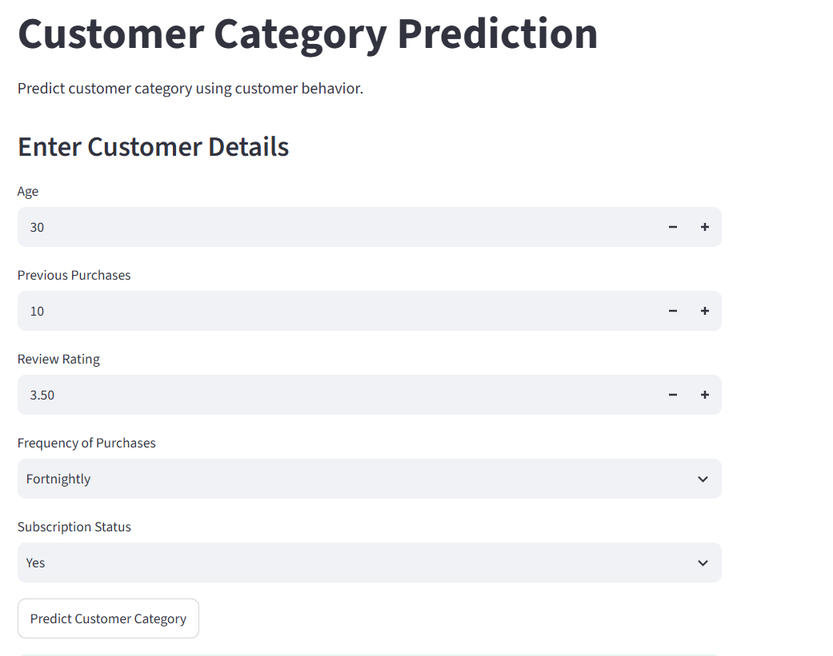
Web App Demo (Streamlit)
User enters age, purchases, rating, frequency and subscription
One click on "Predict Customer Category"
Model returns the predicted category instantly

Slide 9
Conclusion & Next Steps
Behavioral features can segment customers into actionable categories
The Streamlit app makes the model usable by non-technical teams
Next: add more features (spend, product type), tune hyperparameters, monitor drift
Next: connect predictions to marketing campaigns and measure uplift

