Slide 1

A Machine Learning Model for Agriculture CO2 Emissions Prediction
N.Sathwika:AIE23119
V.Pavan Kumar:AIE23134
S.Manivardhan:AIE23158
Department of Computer Science & Engineering,
Amrita School of Engineering, Bengaluru

Slide 2
Agenda
Problem Statement
Data Description
Technical Description
Implementation
Results and Analysis
Conclusion

Slide 3
Introduction
Problem Statement
The agricultural and food production sectors are major contributors to global greenhouse gas emissions, particularly carbon dioxide (CO₂). Understanding and accurately forecasting these emissions is essential for developing effective policies and strategies to mitigate climate change. However, the complexity and variability of emission sources—ranging from crop residues and manure management to energy usage and food transport—pose significant challenges in quantifying and predicting
total emissions

Slide 4
Data Description
Dataset Overview The dataset contains historical data on various emission sources in the agro-food sector. It includes both numerical and categorical features relevant to agricultural practices and their environmental impact.
Target Variable The primary target variable is total_emission, representing the total CO₂ emissions in a given context. This variable is used as the output in machine learning models for prediction.
Feature Attributes Features include emission sources such as Crop Residues, Manure Management, Forest Fires, On-farm energy use, and Food Transport. Some of these features exhibit skewed distributions and are log-transformed during preprocessing.
Categorical Information The only categorical column in the dataset is Area, representing geographic regions or countries. It is one-hot encoded to be usable in machine learning pipelines.
Missing and Skewed Data Handling Rows with missing target values are removed to maintain model integrity. Numeric features are imputed using the median, and skewed columns are log-transformed to normalize their distributions.

Slide 5
Technical Description
Model | Key Libraries Used | Key Actions Performed | Notable Points
XG boost Regression | Pandas, numpy, scikit-learn, xgboost, matplotlib, seaborn, joblib | Trained a full machine learning pipeline on emissions data . | The model is evaluated using RMSE, MAE, and R² score, and a scatter plot is used to visualize actual vs predicted emissions
Ensemble Regression | pandas, numpy, scikit-learn, xgboost, joblib | Trained an ensemble model pipeline | Evaluated using standard regression metrics (RMSE, MAE, R²) for performance comparison.
Random Forest Regression | Sklearn, matplotlib, seaborn, joblib | Model training and evalution metrics | RMSE ,MAE –lower,R-square(high)
CatBoostRegressor | pandas, numpy,catboost, joblib | Model interpretation and model saving | RMSE,MAE-lower,R-square(higher)
MLP Regressor Sklearn, matplotlib, seaborn, joblib Model training and evalution RMSE,MAE-varied,R- square(moderate)

Slide 6
Implementation
1. XGBoost Regression Model
Implemented using XGBRegressor from xgboost
Combined with a preprocessing pipeline that includes median imputation, standard scaling, and one-hot encoding for categorical data.
Log transformation applied to skewed emission features like Crop Residues and Forest fires to normalize data distribution.
Model evaluation included RMSE, MAE, R² score, actual vs predicted plots
2. Ensemble Regression Model
Implemented using VotingRegressor from sklearn.ensemble, combining XGBoost, Random Forest, Gradient Boosting, and Ridge Regressor.
Preprocessing pipeline is identical to the XGBoost model, ensuring consistent data handling before training.
Evaluated using RMSE, MAE, and R², and the trained ensemble model was saved as a .pkl file for deployment.

Slide 7
Implementation
3. Random Forest:
Implemented using RandomForestRegressor with 200 estimators and max depth of 25.
Integrated into a pipeline with median imputation, standard scaling, and one-hot encoding.
Evaluated using RMSE, MAE, R² score, along with actual vs predicted plots and top 15 feature importance visualization.
4. CatBoost :
Implemented using CatBoostRegressor with 500 iterations, depth 6, and learning rate 0.1.
Automatically handled categorical variables (like Area) via cat_features without explicit encoding.
Skewed emission features were log-transformed for better model performance.

Slide 8
MLP Regressor:
Implemented using MLPRegressor with 3 hidden layers (128, 64, 32), ReLU activation, and adaptive learning rate.
Used a pipeline with median imputation, standard scaling, and one-hot encoding for preprocessing.
Included log transformation for skewed emission-related features.
Assessed using RMSE, MAE, R² score, cross-validated R² scores, actual vs predicted scatter plot, and permutation-based feature importance.

Slide 9
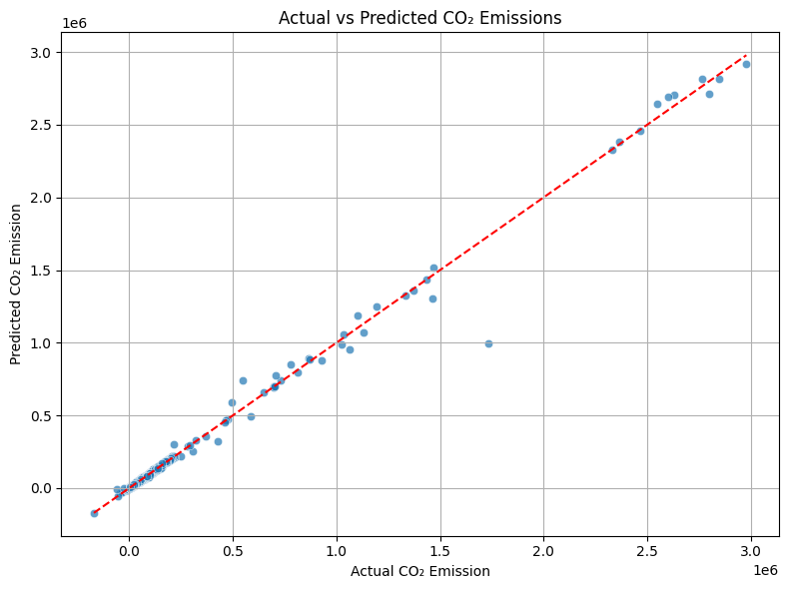
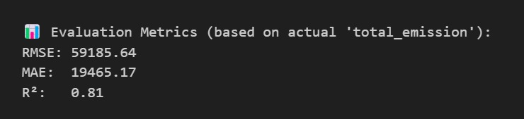
Results and Analysis
XGBoost Regressor

Slide 10
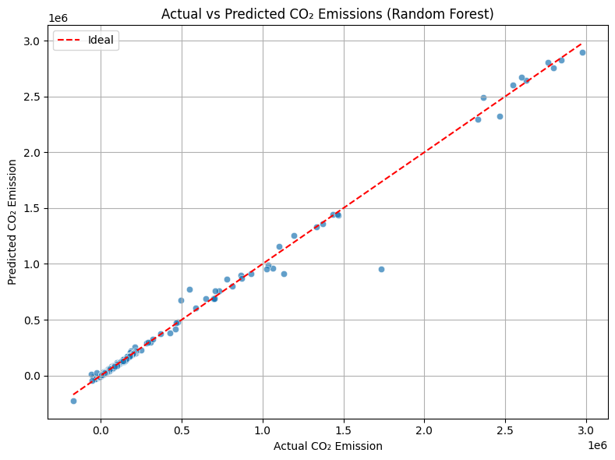
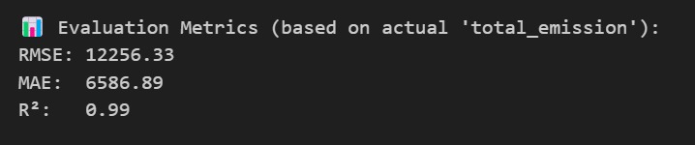
Random Forest Regression

Slide 11
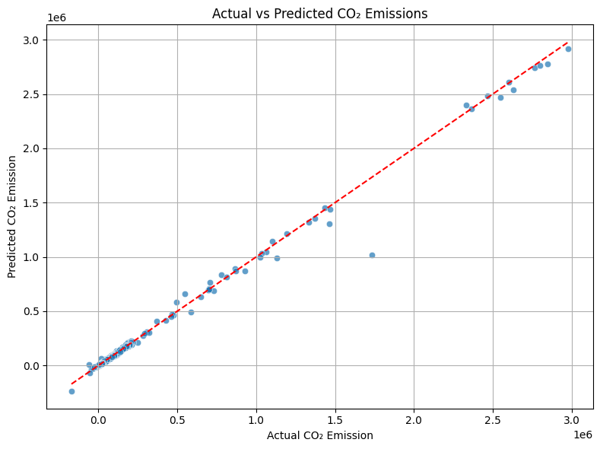
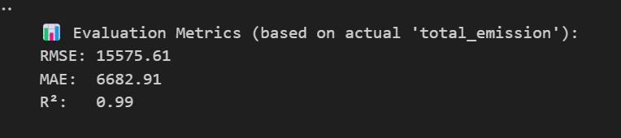
Cat Boost Regressor

Slide 12

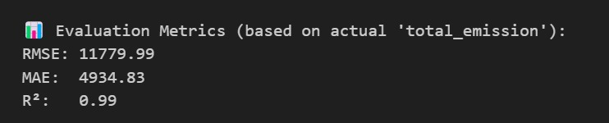
Ensemble Regression

Slide 13
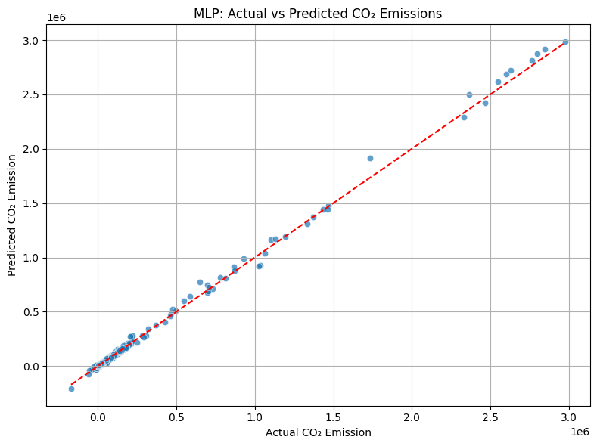
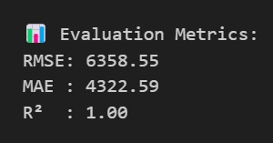
MLP Regressor

Slide 14
Literature survey
Sno. | Author | title | year | Inference
1 | Toby A. Adjuik, Sarah C. Davis | Machine Learning Approach to Simulate Soil CO₂ Fluxes under Cropping Systems | 2024 | The study applied ML models (GB, RF, SVR, KNN) to predict CO₂ fluxes using GRACEnet data. Gradient Boosted and Random Forest models showed strong performance, though they don't model biogeochemical processes
2 | Eko Priyono, Ispandi, Rusdi | Evaluating the Impact of Agricultural Technology on Greenhouse Gas Emissions Using Machine Learning | 2023 | Using XGBoost and SVM, the study assessed how agricultural tech affects GHG emissions. XGBoost achieved 99.6% accuracy, proving effective for climate-related agricultural planning.
3 | Muhammad Hassan, Khabat Khosravi, et al. | Prediction of Carbon Dioxide Emissions from Atlantic Canadian Potato Fields Using Advanced Hybridized Machine Learning Algorithms | 2023 | Three hybrid ML models were tested on soil and climate data to predict CO₂ emissions in Canada. ICO-AR-RF model gave the best results, especially in sensitivity to climatic variables over soil properties
4 | Endre Harsányi, Morad Mirzaei, et al. | Assessment of Advanced Machine and Deep Learning Approaches for Predicting CO₂ Emissions from Agricultural Lands | 2024 | ML (GBR, SVR) and DL (FNN, CNN) models were evaluated for CO₂ prediction in two agroclimatic zones. FNN performed best overall, offering guidance for climate-smart agriculture planning.
5 | Pawan Kumar Singh, Alok Kumar Pandey, et al | Multiple Forecasting Approach: A Prediction of CO₂ Emission from the Paddy Crop in India | 2021 | Four forecasting models were compared for predicting CO₂ from Indian paddy fields. Holt-Winters and SVR showed the lowest errors, making them suitable for policy-making and future projections.
6 | Nisha Chauhan | Predicting CO₂ Emission per Crop-Type Using Machine Learning and Neural Network Algorithms | 2022 | This study predicts CO₂ emission per crop using ANN and ML on FAO data across 200 countries. Random Forest performed best (RMSE 0.032), highlighting its utility in crop-specific emission profiling.

Slide 15
Conclusion:
This project effectively addresses the challenge of forecasting total CO₂ emissions from the agricultural and food production sectors using machine learning. By incorporating diverse emission sources—such as crop residues, manure management, forest and savanna fires, on-farm energy use, and food transport—our models can capture the complexity of agricultural emission dynamics. The XGBoost model, with its ability to handle non-linear patterns and feature importance evaluation, provided strong baseline predictions. Additionally, the ensemble model further enhanced robustness by combining multiple regression algorithms (XGBoost, Random Forest) leading to improved generalization and accuracy..

Slide 16

Thank you !!!!!

