Slide 1
HIDING DATA IN THE PHOTO
STEGANOGRAPHY
Presented By: Mateti Sathwika
Student Name : Mateti Sathwika
College Name & Department : Kakatiya Institute Of Technology And Science Warangal & Computer Science Engeneering

Slide 2
OUTLINE
Problem Statement
Technology used
Wow factor
End users
Result
Conclusion
Git-hub Link
Future scope

Slide 3
PROBLEM STATEMENT
To hide the data from unauthorised persons it is very difficult to hide.
The unauthorised persons can easily identify where the data is stored.
So that it is easy to authorise.
Due to this we are doing this project called hiding the message in the photo using STEGANOGRAPHY.
So that the unauthorised persons can't able to identify easily.

Slide 4
TECHNOLOGY USED
The hardware requirements are:-
Operating system:- Mac OS, Windows, Linux.
Memory:- 128GB
RAM:- 8GB/16GB
The Software requirements are:-
Python platform
GitHub
Python libraries (cv2, string, image)

Slide 5
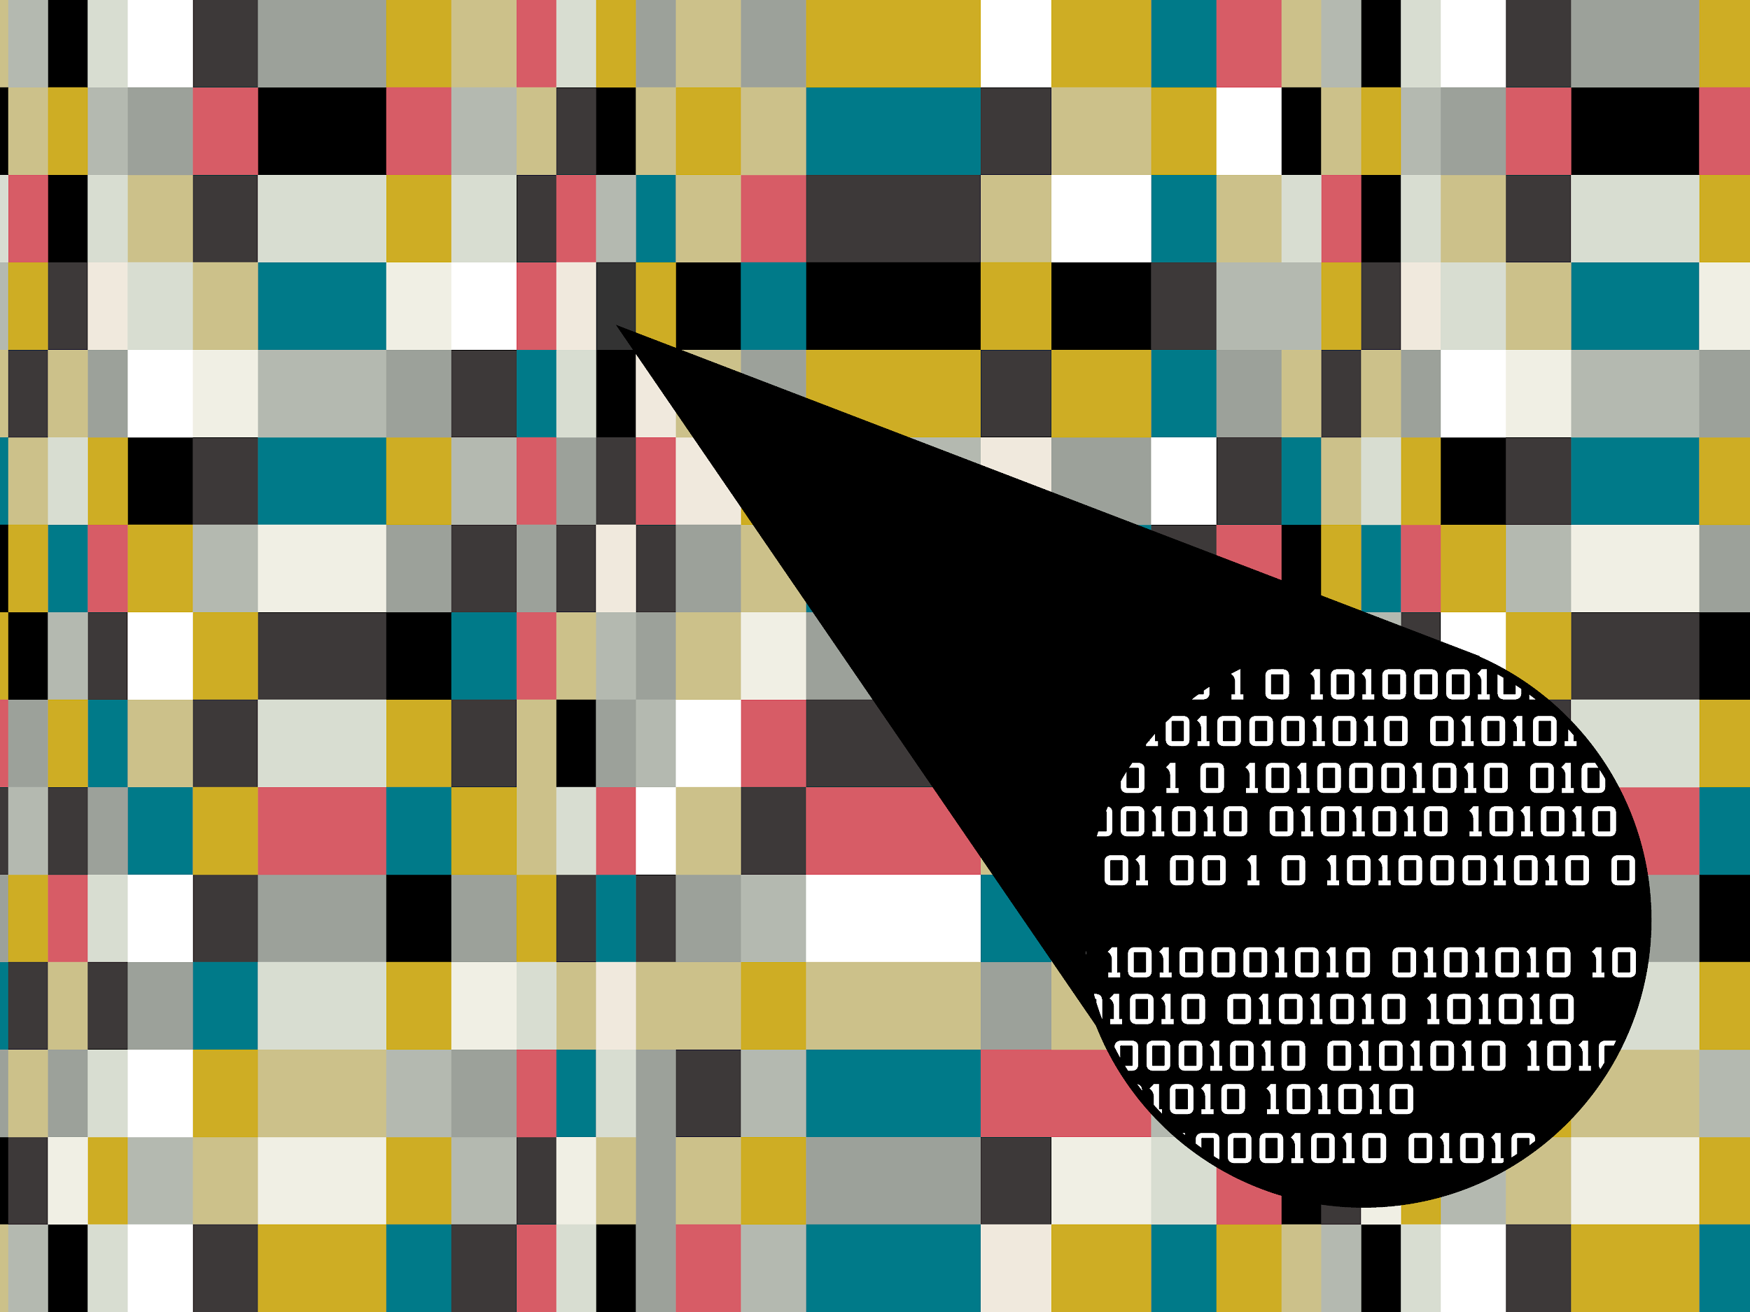
WOW FACTORS
The main feature is to hide
the message in the photo
in the encrypted form and
protecting them with the
password.
When we try to decrypt
then password is needed
to decrypt.
And the photo which is
encrypted should also known
to the user who is going to
decrypt.

Slide 6
END USERS
The end users are:-
Business
Offices.
Colleges.
Milatary.
People who want to hide the message from other users

Slide 7
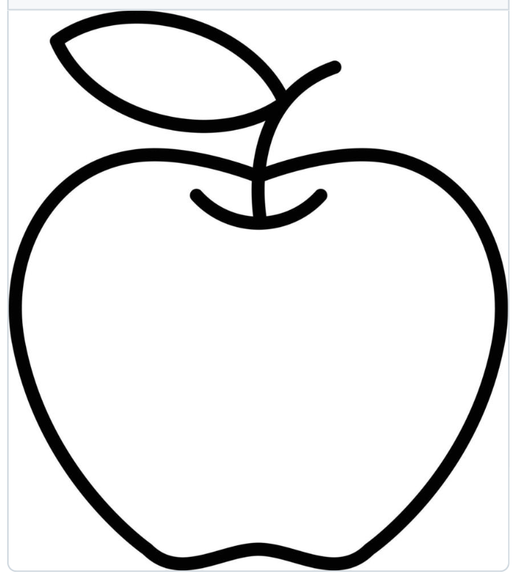
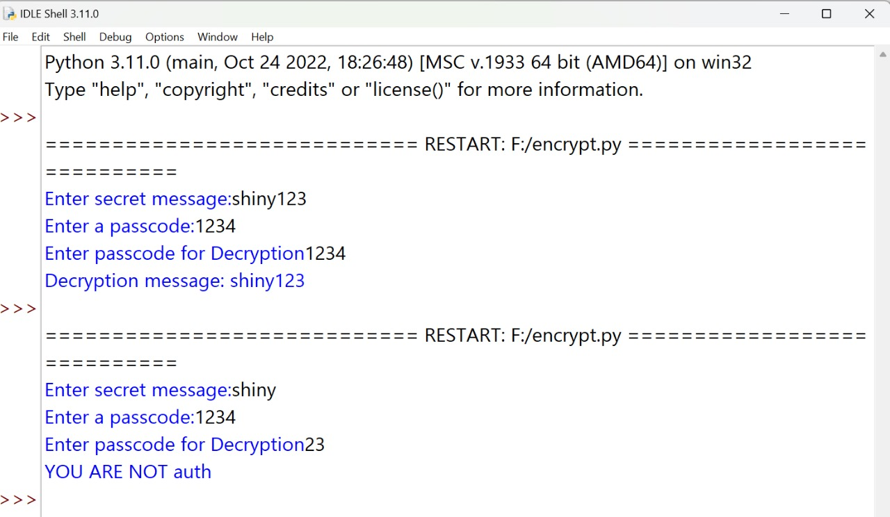
RESULTS
Screenshots of the outcome (min 3)

Slide 8
CONCLUSION
Steganography is a method of hiding secret information in ordinary files. It can be used for both beneficial and malicious purposes.
Steganography is a useful tool for cybersecurity, but it can also be used by cybercriminals.
Steganography is used to project copywrite works, prevent surveillance and more.

Slide 9
GITHUB LINK
https://github.com/Sathwika0408/Encrypt.git

Slide 10
THANK YOU

