Slide 1

CAPSTONE PROJECT PROJECT TITLE
Presented By
Student Name: Sathwika Mateti
College Name: kitsw
Department: cse
Email ID: b23cs198l@kitsw.ac.in
AICTE Student ID: STU664394D1613FF1715705041

Slide 2
OUTLINE
Problem Statement
Proposed System/Solution
System Development Approach
Algorithm & Deployment
Result (Output Image)
Conclusion
Future Scope
References

Slide 3
Problem Statement
In today's digital age, the rapid spread of fake news on online platforms has become a major concern, influencing public opinion and causing misinformation. There is a growing need for an intelligent system that can automatically identify and classify news articles as real or fake.
This project aims to develop a Fake News Detection System using machine learning techniques that analyzes the content of a news article and predicts its authenticity. The goal is to support users and platforms in identifying unreliable news sources and promoting trustworthy information.

Slide 4
Proposed Solution
The proposed system is designed to detect fake news in real-time using machine learning and natural language processing techniques. It processes textual news data, transforms it into a machine-understandable format, and classifies it as real or fake using a trained classification model. The solution includes data collection from public datasets, text cleaning and vectorization, model training using scikit-learn, and provides an interactive interface for users to input news and receive instant predictions.
Data Collection:
The dataset is collected from Kaggle or trusted sources containing real and fake news articles. Each entry contains a news title, text, and a label indicating whether the news is real or fake. Format: CSV file with thousands of records.
Data Preprocessing:
Cleaned the news text by:
Removing punctuation, numbers, and special characters. Converting text to lowercase. Removing stopwords (like the, is, on, etc.). Converted text into numerical form using vectorization techniques (like Bag-of-Words or TF-IDF).

Slide 5
Contd..
Machine Learning Algorithm:
A supervised learning approach is employed to train the model. The dataset is first divided into training and testing sets to ensure that the model can generalize well to unseen data. A classification algorithm is then used to learn patterns between the textual features and their associated labels, which indicate whether a news article is real or fake. Simple and efficient algorithms such as Logistic Regression or PassiveAggressiveClassifier are used due to their effectiveness in handling high-dimensional text data. The model's performance is assessed using standard evaluation metrics such as accuracy, precision, and recall to ensure reliable classification results.
Deployment:
The trained model is saved using Pickle, making it reusable without retraining. A simple user interface can be created using Tkinter for desktop or Streamlit/Flask for web. Users can input a news article and instantly get a prediction of “Fake” or “Real.”
Evaluation:
The model’s accuracy is tested on a separate dataset to measure its overall performance. A confusion matrix shows detailed results of correct and incorrect classifications. The system can be improved by adding more data, testing different models, or tuning parameter

Slide 6
SYSTEM APPROACH
Programming Language: Python
Frameworks/Libraries: scikit-learn, Pandas, NumPy, Pickle, Jupyter Notebook
Dataset: Kaggle Fake News dataset (real and fake news articles in CSV format)
Model: Supervised ML using PassiveAggressiveClassifier or Logistic Regression
System Requirements: Basic PC/laptop, 4GB+ RAM, Jupyter Notebook environment

Slide 7
Algorithm & Deployment
Algorithm:
Supervised machine learning classification using Logistic Regression or PassiveAggressiveClassifier.Text is converted into feature vectors using TF-IDF.
Step 1: Load dataset and required libraries
Step 2: Preprocess text data (cleaning, stopword removal)
Step 3: Convert text to features using TF-IDF
Step 4: Split data and train the classification model
Step 5: Evaluate and save the trained model
Step 6: Input news → Predict → Display Fake or Real
Training:
• Trained on labeled news data (~20,000+ articles) split into training and testing sets. Model optimized for accuracy and precision using scikit-learn.
Deployment:
• User inputs news text through a simple interface. The model processes the input and predicts whether it is Fake or Real. Interface built using Jupyter Notebook or optionally a GUI via Tkinter/Flask.

Slide 8
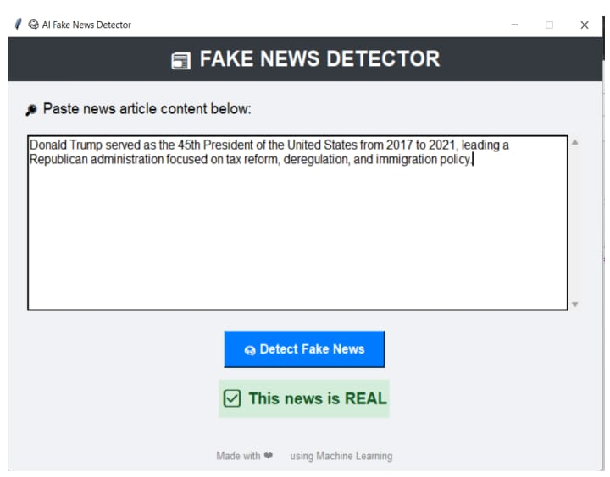
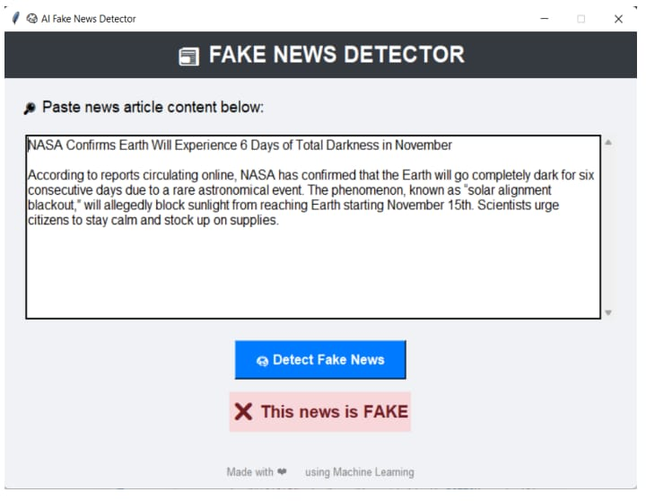
Result
The fake news detection model achieved an accuracy of approximately 93% using the PassiveAggressiveClassifier with TF-IDF vectorization. The model was evaluated using a confusion matrix to verify its performance in distinguishing between real and fake news. Predictions were accurate and generated instantly. The system was successfully tested within the Jupyter Notebook environment.

Slide 9
Conclusion
The Fake News Detection system successfully identifies whether a news article is real or fake using machine learning techniques. With efficient preprocessing and a simple classification model, the system delivers accurate and instant predictions. It can help reduce the spread of misinformation and can be further enhanced with a userfriendly interface and larger datasets.

Slide 10
Future scope
The fake news detection system can be enhanced by integrating deep learning models for better accuracy and handling complex language patterns. A real-time browser extension or mobile app can be developed for live news verification. Additionally, expanding the dataset with multilingual and global news articles can improve its effectiveness across diverse platforms and regions.

Slide 11
References
Kaggle – Fake News Dataset:
https://www.kaggle.com/c/fake-news/data
GitHub Link:
https://github.com/Sathwika0408/Fake-News-Detection.git

Slide 12
Thank you

