Slide 1
Blockchain Technology
By:
Sathwika Bachu - 22071A6769

Slide 2
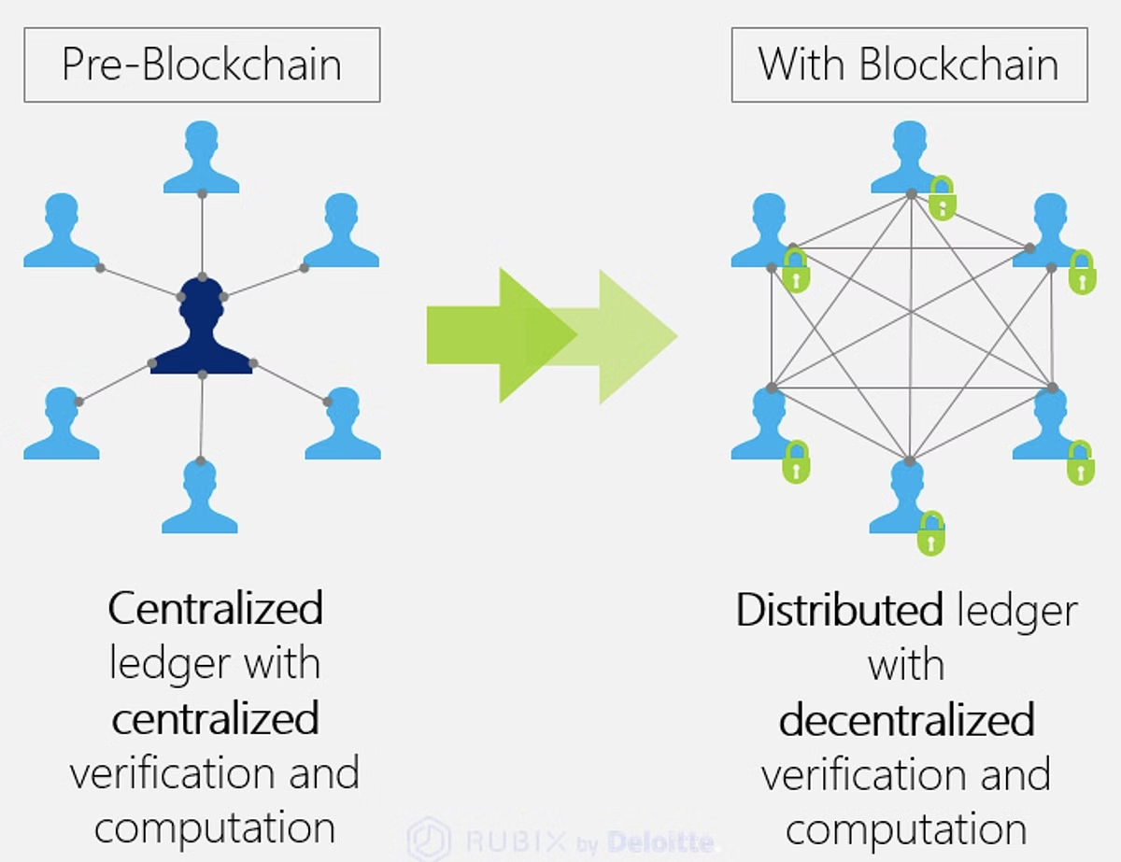
What is Blockchain?
Blockchain is a distributed ledger technology (DLT) that records transactions across a network of computers (or nodes) in a way that ensures security, transparency, and integrity. Once a transaction is added to the blockchain, it becomes virtually immutable
Key Components:
Ledger: A digital record of all transactions that are verified and stored.
Blocks: Each block contains a list of transactions, a timestamp, and a cryptographic hash of the previous block, forming a secure chain.
Decentralized Network: Unlike traditional systems (e.g., banks or central authorities), blockchain relies on a peer-to-peer network where no single entity has control over the entire system.
.

Slide 3
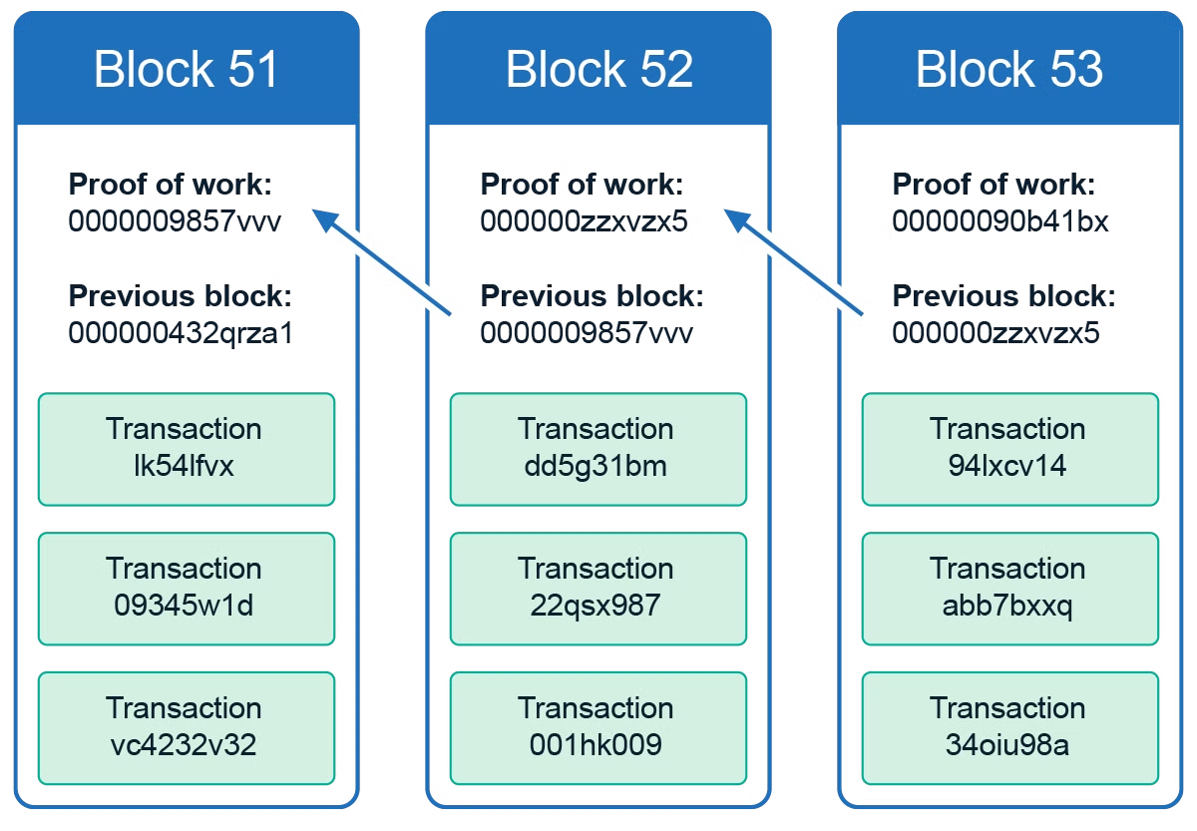
How Blockchain Works
Step 1: Transaction Initiation A user creates a transaction (e.g., sending cryptocurrency) and broadcasts it to the network.
Step 2: Validation Nodes (computers) in the network validate the transaction using consensus mechanisms like Proof of Work or Proof of Stake.
Step 3: Block Creation Validated transactions are bundled into a block. Each block contains transaction data, a timestamp, and a reference (hash) to the previous block.
Step 4: Block Added to Chain Once verified, the block is added to the blockchain, forming a secure, immutable chain of records.
Step 5: Decentralization The blockchain is distributed across all nodes in the network, ensuring transparency and security without central control.

Slide 4
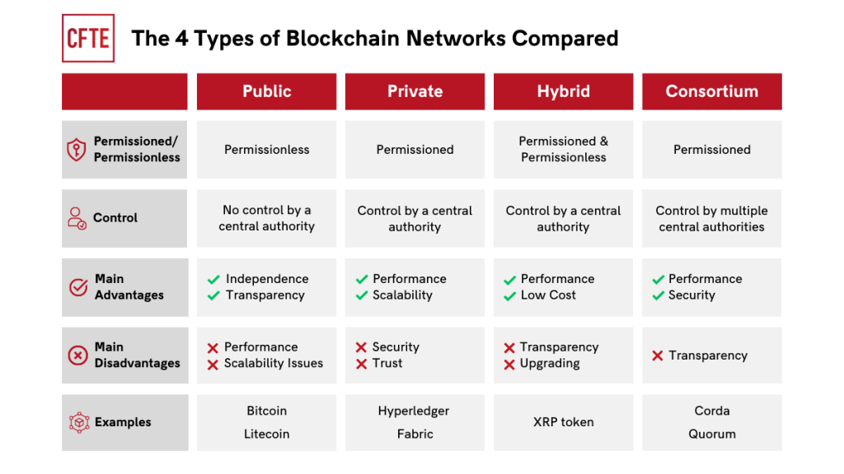
Types of Blockchain
Public Blockchain Open to anyone to participate, fully decentralized (e.g., Bitcoin, Ethereum).
Private Blockchain Restricted access, typically used within organizations; centrally controlled (e.g., Hyperledger).
Consortium Blockchain Controlled by a group of organizations rather than a single entity; semi-decentralized (e.g., R3 Corda).
Hybrid Blockchain Combines features of both public and private blockchains; allows controlled access with public transparency for specific data (e.g., IBM Food Trust).

Slide 5
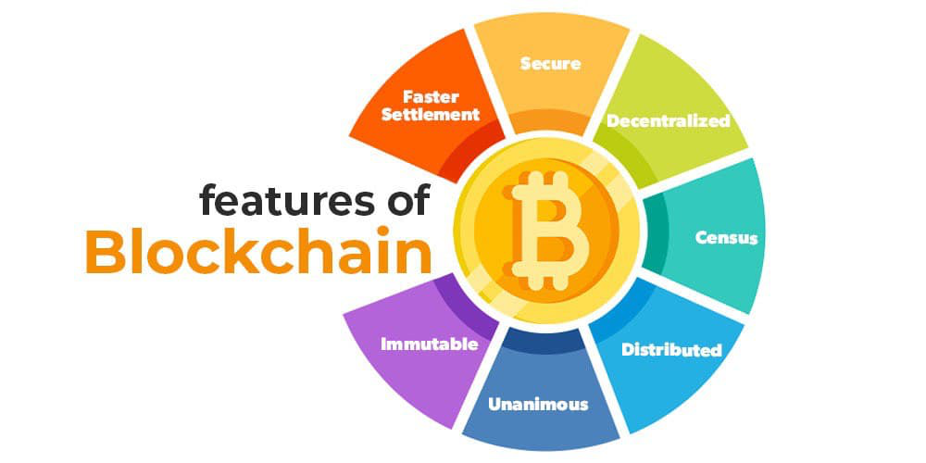
Key Features of Blockchain
Decentralization No single authority controls the network; it’s distributed across nodes.
Transparency All transactions are visible to participants, ensuring accountability.
Security Transactions are secured through cryptographic methods, making data tamper-proof.
Immutability Once a transaction is recorded, it cannot be altered or deleted.
Consensus Mechanisms Nodes agree on the validity of transactions using methods like Proof of Work or Proof of Stake.

Slide 6
Consensus Mechanisms
Proof of Work (PoW) Requires solving complex mathematical puzzles; energy-intensive (e.g., Bitcoin).
Proof of Stake (PoS) Validators are chosen based on the amount of cryptocurrency they hold; more energy-efficient (e.g., Ethereum 2.0).
Delegated Proof of Stake (DPoS) Stakeholders vote for validators, making it more democratic and scalable (e.g., EOS).
Practical Byzantine Fault Tolerance (PBFT) Nodes reach consensus even if some act maliciously, ideal for private blockchains.

Slide 7
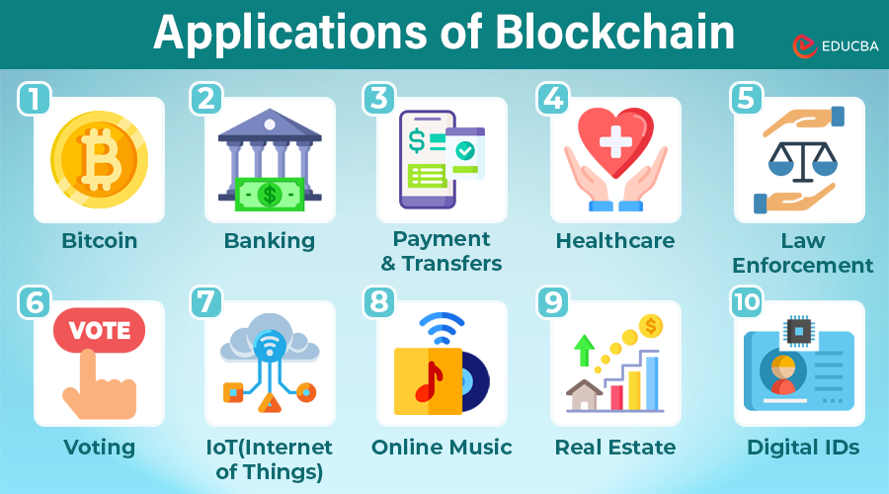
Applications of Blockchain
Cryptocurrency Supports decentralized digital currencies like Bitcoin and Ethereum.
Smart Contracts Self-executing contracts with automated enforcement (e.g., Ethereum).
Supply Chain Management Tracks goods across the supply chain, enhancing transparency and reducing fraud.
Healthcare Secures patient data and improves data sharing between providers.
Voting Systems Enables secure, transparent, and tamper-resistant elections.

Slide 8
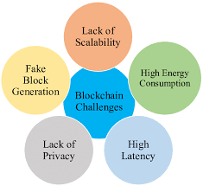
Challenges of Blockchain
Scalability Limited transaction throughput compared to traditional systems.
Energy Consumption Proof of Work blockchains require significant computational power.
Regulation Unclear legal frameworks and evolving regulations in different regions.
Adoption High costs and technical complexity slow down widespread use.
Security Risks Vulnerabilities like 51% attacks in certain blockchain networks.

Slide 9
Future of Blockchain
Integration with Emerging Technologies Blockchain will merge with AI, IoT, and Big Data for smarter, more efficient systems.
Sustainability Focus Move towards eco-friendly consensus mechanisms like Proof of Stake to reduce energy consumption.
Wider Industry Adoption Expansion into sectors like finance, real estate, healthcare, and government.
Interoperability Improved communication between different blockchains to enable seamless transfers of assets and data.
Regulatory Evolution Governments and institutions will establish clearer rules, enabling broader blockchain adoption.

Slide 10
THANK YOU

