Slide 1
Google AppStore Data Analysis
Submitted By Sathwika Chandra

Slide 2
Problem Statement:
Conduct a comprehensive analysis of Google App Store data to uncover trends in user preferences, popular app categories, and user ratings. Explore the correlation between app features and download rates, while identifying opportunities for app optimization and user engagement strategies. The goal is to provide actionable insights for developers to enhance app performance and user satisfaction in a highly competitive marketplace.

Slide 3
Absrtact:
This project involves analyzing Google app Store data. Google Play is a digital distribution service operated and developed by Google Inc. It serves as the official app store for the Android operating system, allowing users to browse and download applications developed with the Android SDK and published through Google. Google Play also serves as a digital media store, offering music, books, movies, and television programs.

Slide 4
Data Set And Implementation
Name : Name of the Application
Category : Category of the app belong to
Rating : Rating of the Application.
Reviews : No. of reviews.
Size : Size of the App.
Installs : no.of installations for the App
Type : Type of App (Paid/ Free)

Slide 5
Price : Price of the App.
Last Updated : Last updated Date
Current Version : Current version of the App.
Minimum Android version : Minimum Android version of the App.
Genres : Genre of the App belong to.

Slide 6
Tools And Languages
Google Colab (Python)
Tableau Public (Data Visualisation)

Slide 7
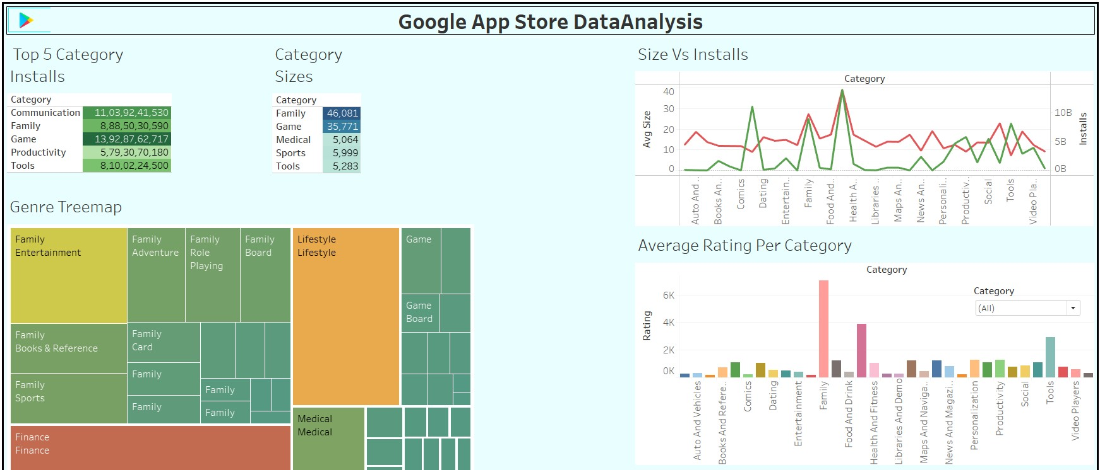
Dashboard:

Slide 8
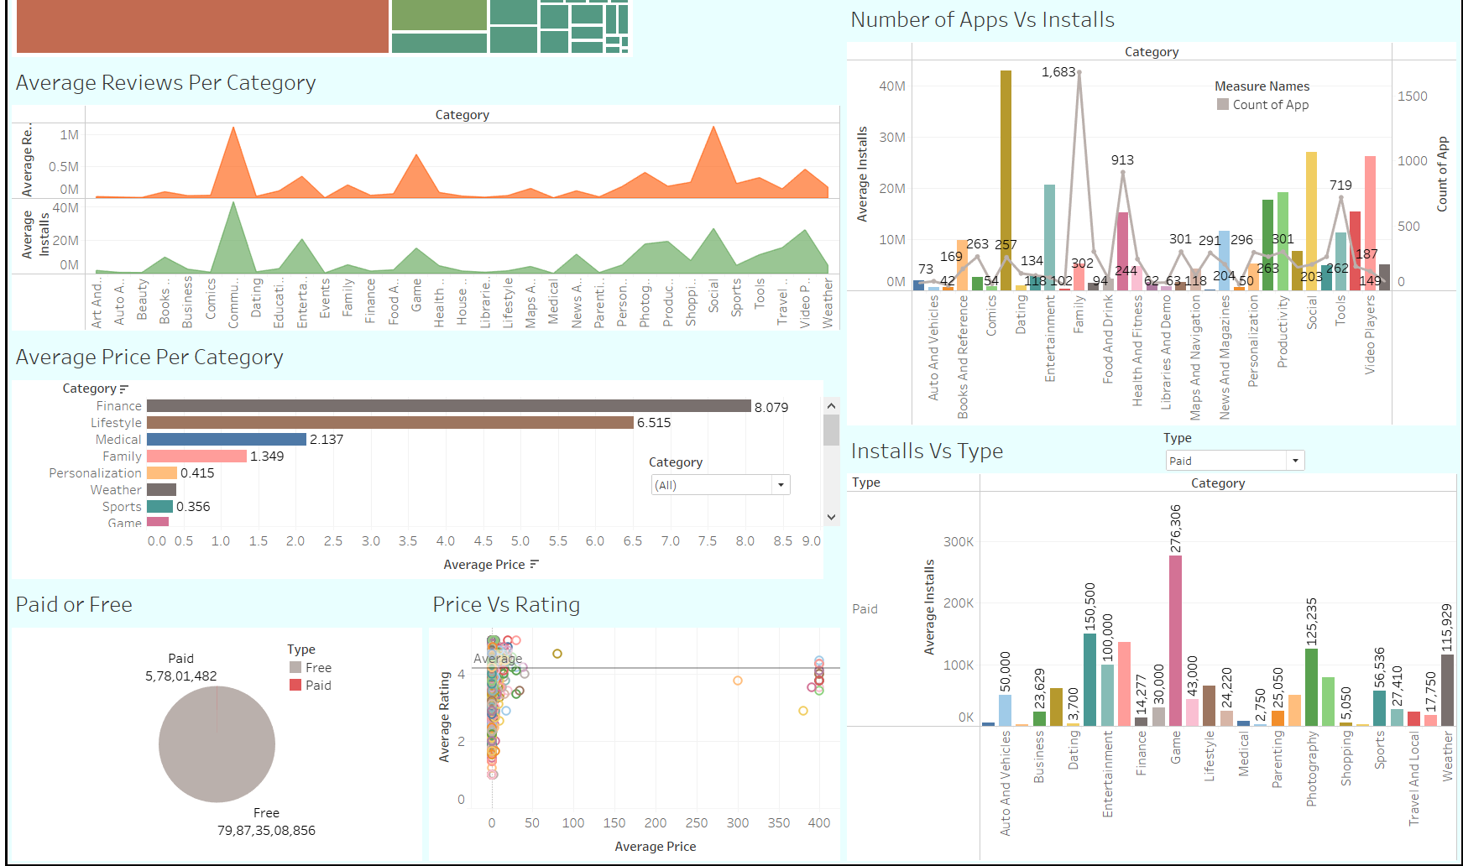

Slide 9
Link for Implementation And Dataset:
Tableau Link
https://public.tableau.com/app/profile/sathwika.chandra.narra/viz/GoogleAppStoreDataAnalysis_16918321842000/Dashboard1?publish=yes
Google Colab Link:
https://colab.research.google.com/drive/1h-CgbOvMj4jm73UrFBngGm3A-Z46dKc9#scrollTo=-OmKqpKUjf4B

Slide 10
Conclusion:
Analysis of Google App Store data has revealed valuable insights into user behavior and app performance.We analysed the top categories Installs and Sizes, Combination between Category and Average Price, Average Reviews, Average Rating, Installs vs Size and Apps, either the app is paid or free etc..
Overall, this analysis provides a foundation for data-driven decisions to improve app success in a competitive marketplace and analyse Appstore data

Slide 11
THANK YOU

