Slide 1
Crop Production Analysis
Submitted by Sathwika Chandra

Slide 2
Problem Statement
The Agriculture business domain, as a vital part of the overall supply chain, is expected to highly evolve in the upcoming years via the developments, which are taking place on the side of the Future Internet.
This paper presents a novel Business-to-Business collaboration platform from the agri-food sector perspective,which aims to facilitate the collaboration of numerous stakeholders belonging to associated business domains, in an effective and flexible manner.

Slide 3
Abstract
This dataset provides a huge amount of information on crop production in Indiaranging from several years. Based on the Information the ultimate goal would be to predict crop production and find important insights highlighting key indicators and metrics that influence crop production.

Slide 4
Data Set and Implementation
State Name : Name of the state
District Name : Name of District
Crop_Year : Year of crop
Season : Season in which crop has grown
Crop : Name of the crop
Area : Area of production
Production : Crop produced

Slide 5
Tools And Languages
Google Colab (Python)
Tableau Public (Data Visualisation)

Slide 6
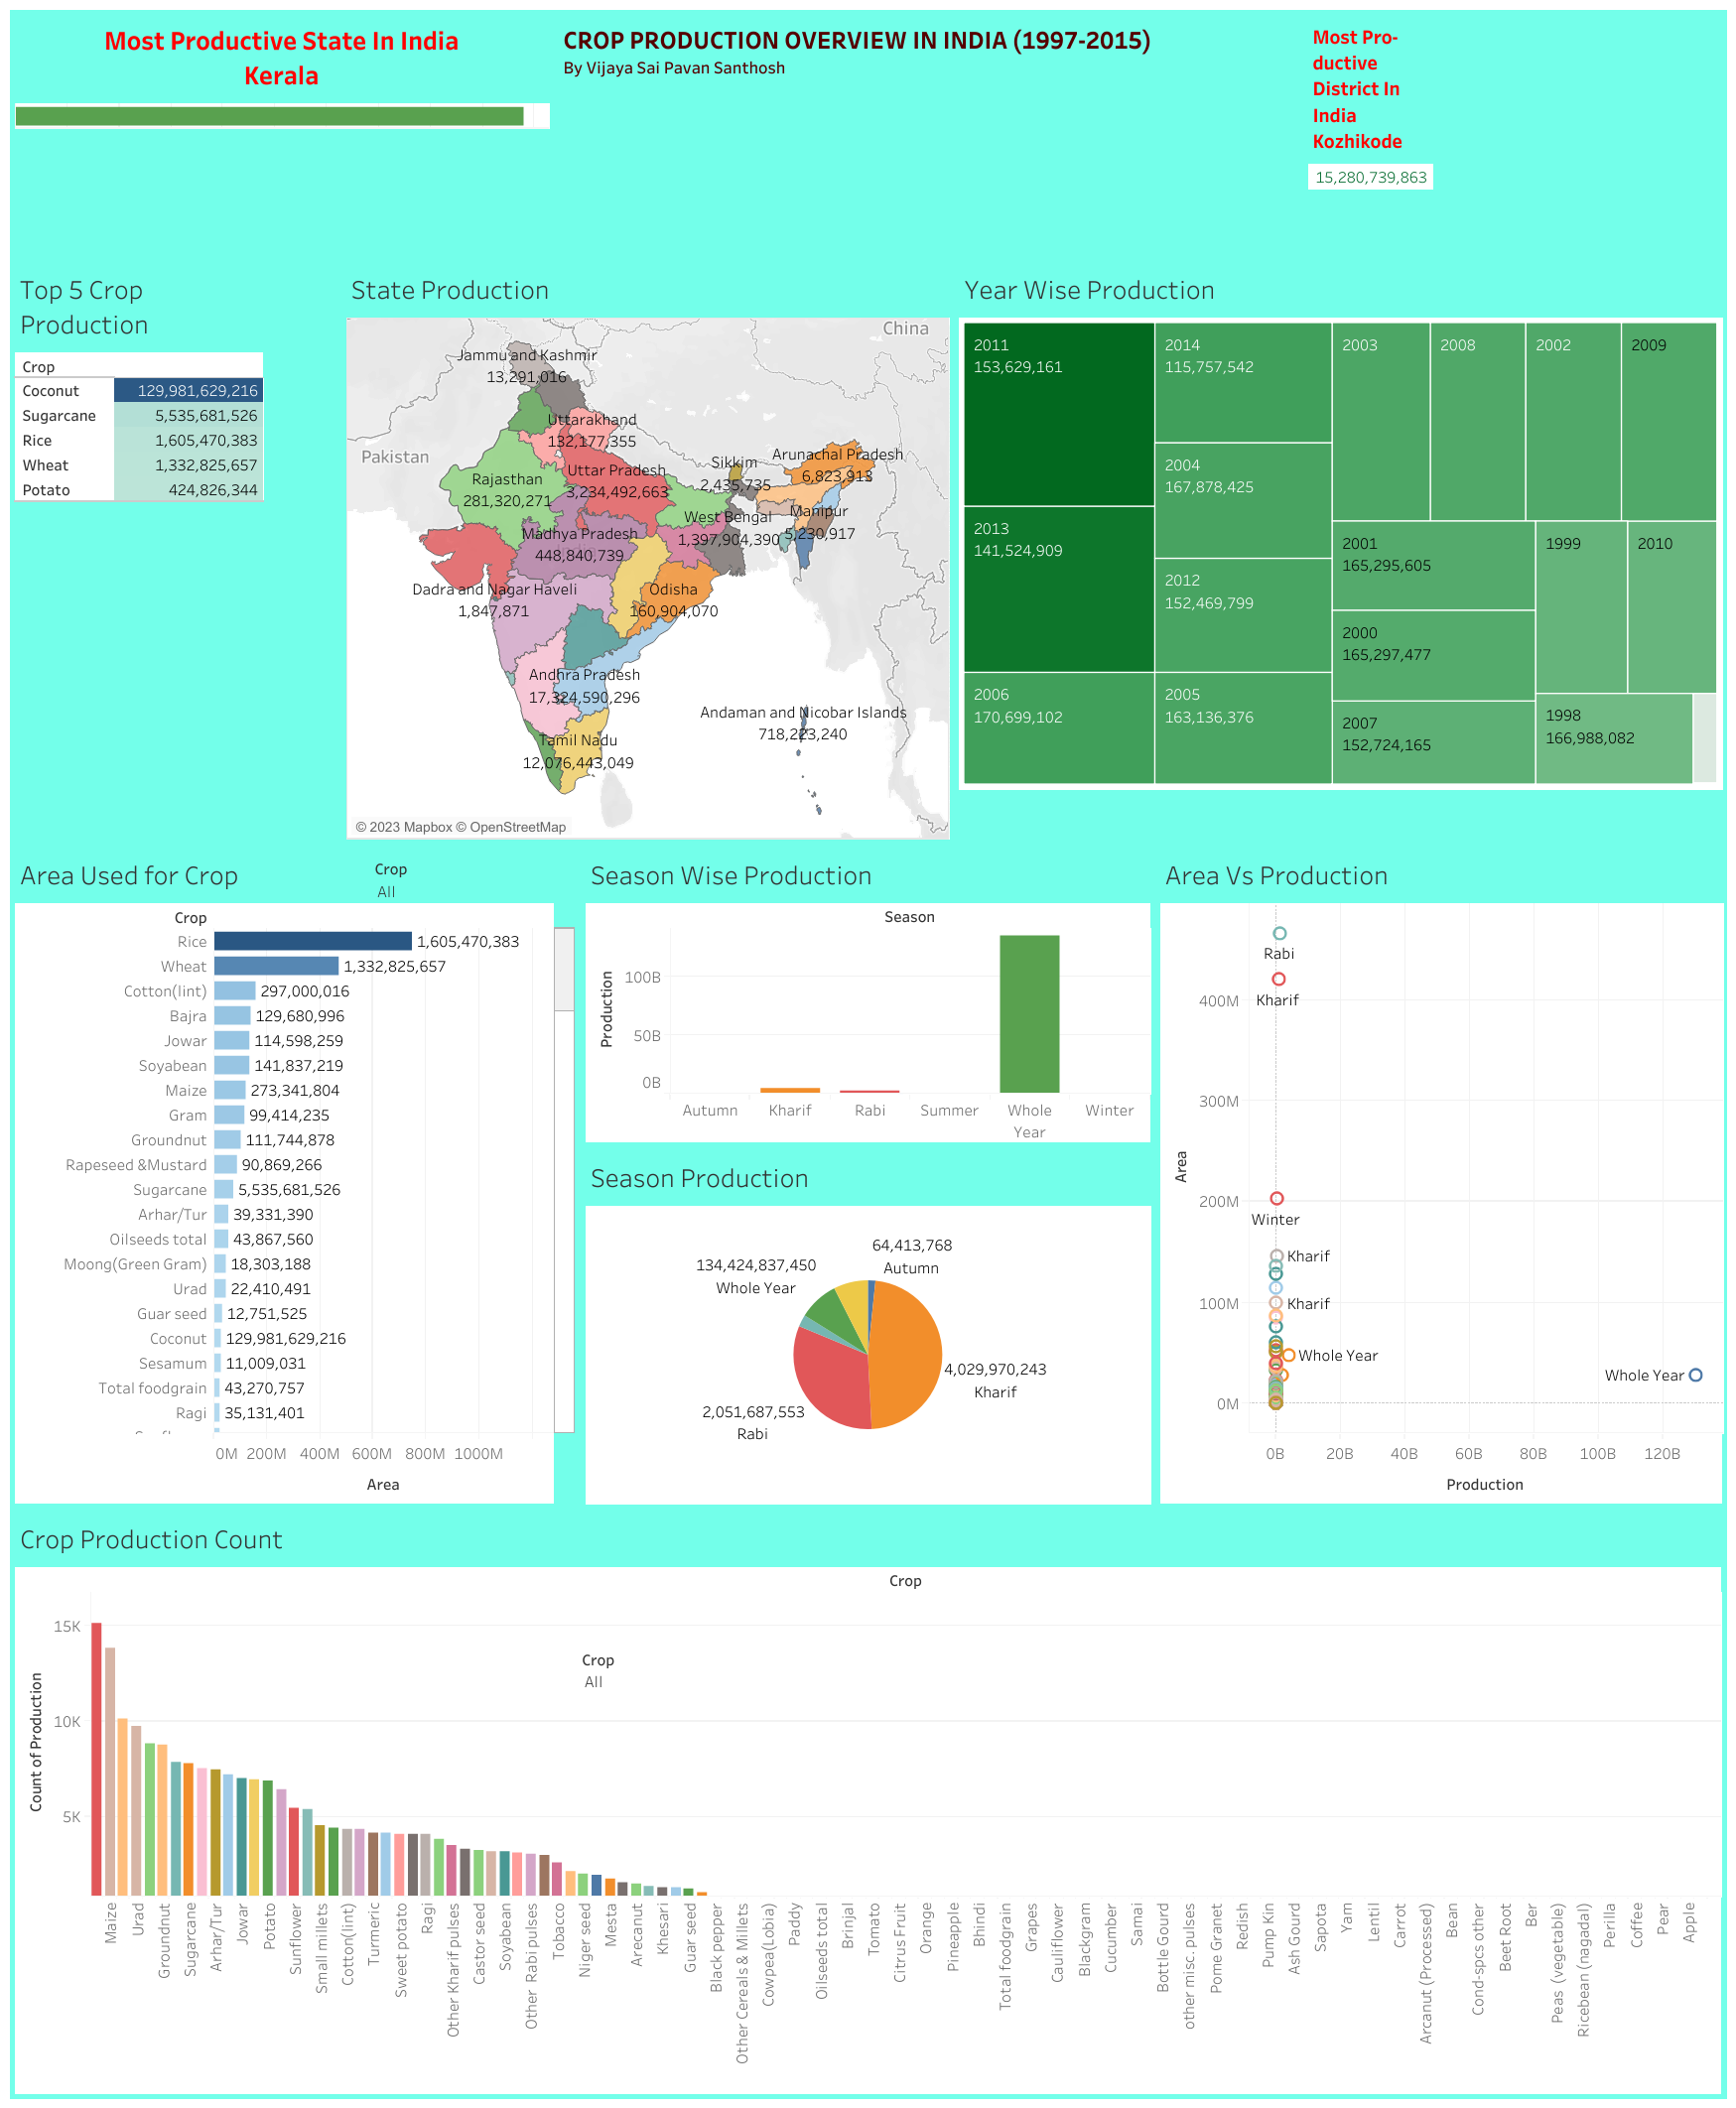
DashBoard

Slide 7
Links
Tableau Link
https://public.tableau.com/app/profile/sathwika.chandra.narra/viz/CropProductionAnalysis_16922915123340/Dashboard1?publish=yes
Google Colab Link
https://colab.research.google.com/drive/1k0jv9yPrfSArEIIk7uKmN88E1_dtVTAu

Slide 8
Conclusion:
This paper has introduced a pioneering Business-to-Business collaboration platform,
approached from the perspective of the agri-food sector.
The platform's primary objective is to enhance and streamline the cooperation of diverse
stakeholders across interconnected business domains. By fostering effective and adaptable collaboration, this platform holds the potential to catalyze innovation, improve resource utilization, and ultimately contribute to the growth and sustainability of the entire agriculture and food supply chain. As technology continues to reshape industries, the proposed collaboration platform stands as a promising solution to meet the evolving demands of the agricultural sector in a rapidly changing business landscape.

