Slide 1
More on MVC and severless Functions
Vennela Cheekoti
Susritha Gade
Sathwika Gone

Slide 2



Sathwika Gone
Susritha Gade
Vennela Cheekoti

Slide 3
MVC – Model View Controller
Model:
represents domain specific data and business logic in MVC architecture.
Model objects retrieve and store model state in the persistence store like a database
View:
View is a user interface.
View displays data from the model to the user and also enables them to modify the data.
Sathwika Gone

Slide 4
Controller:
MVC Controllers are responsible for controlling the flow of the application execution.
When you make a request (means request a page) to MVC application, a controller is responsible for returning the response to that request.
The controller can perform one or more actions.
Sathwika Gone

Slide 5
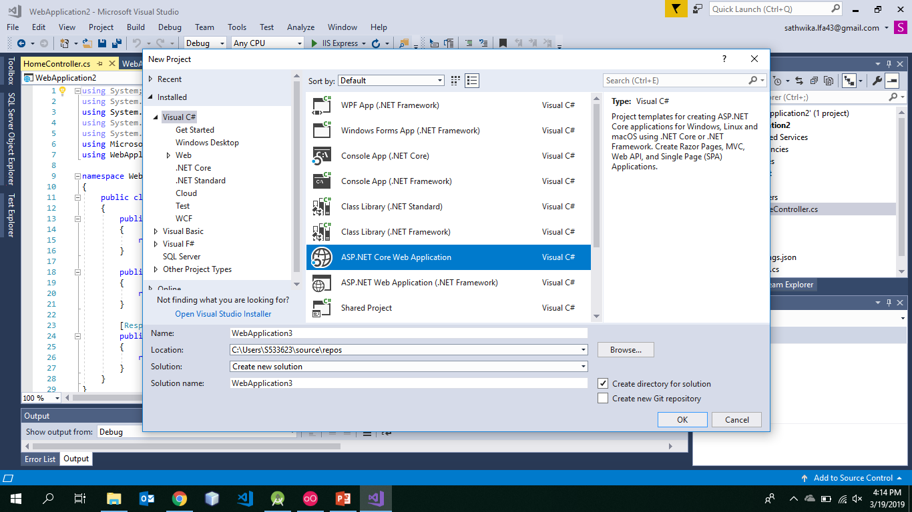
User Authentication in MVC
Sathwika Gone

Slide 6
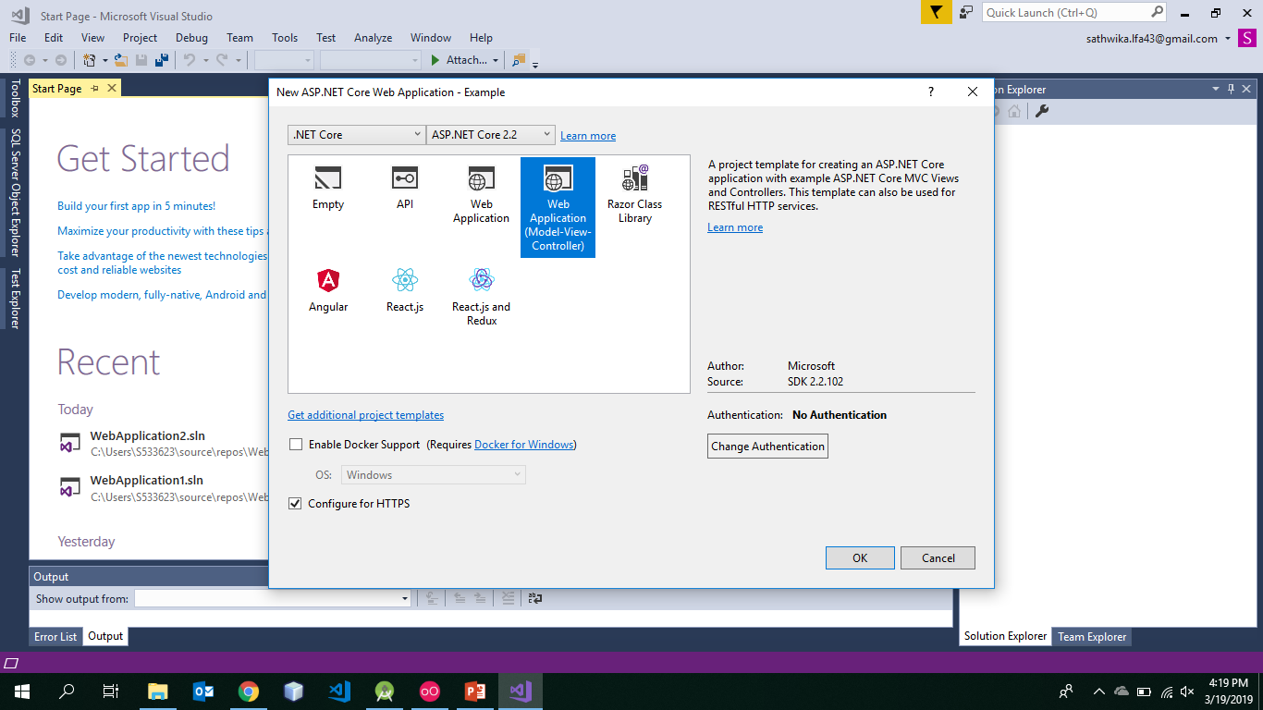
Web Application (Model-View-Controller): A project template for creating ASP .NET core With example MVC Views and Controllers and this is also used for RESTful HTTP services.
Sathwika Gone

Slide 7
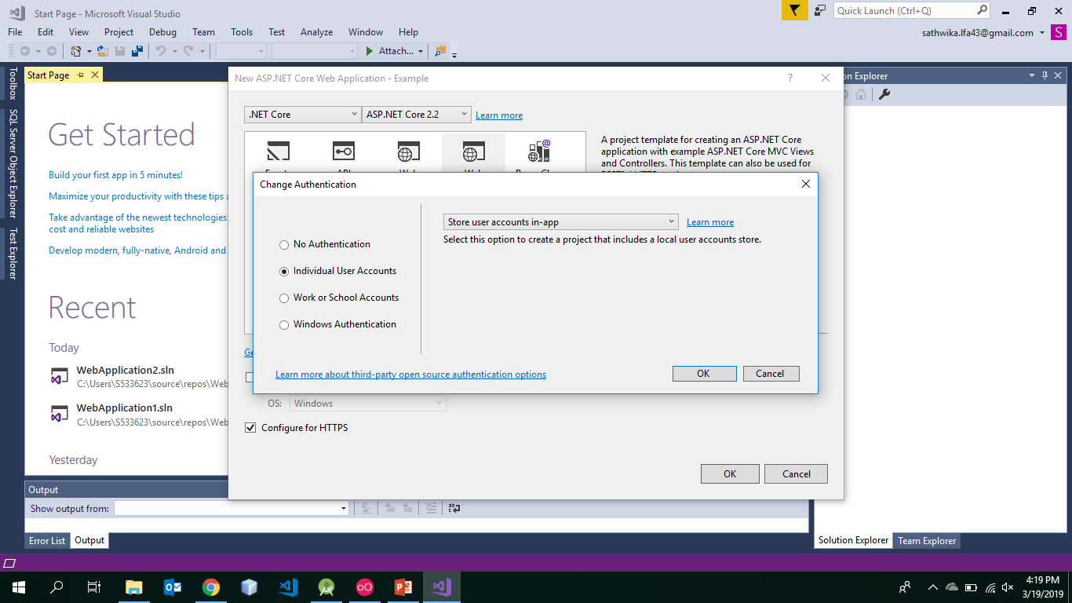
Sathwika Gone

Slide 8
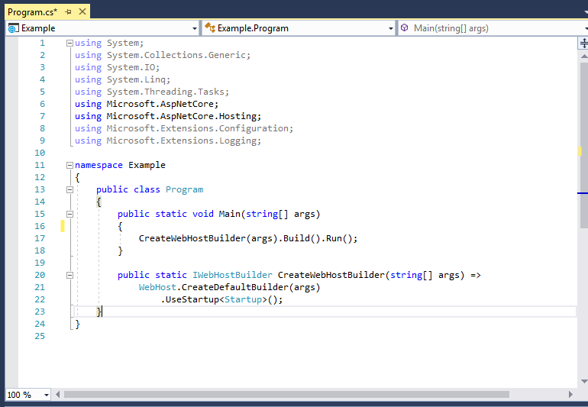
Program.cs
Execution starts In program.cs
It requires services which are in Startup.cs so the Main method calls Startup.cs
Now it build the host by using Build() and run by using Run()
Sathwika Gone

Slide 9
Startup.cs
A service is a reusable component that provides app functionality.It has two methods
1) ConfigureServices: This method gets called at the runtime. This method is used to add services to the container.
Syntax:
public void ConfigureServices(IServiceCollection services)
2) Configure: This method gets called by the runtime. This method is used to configure the HTTP request pipeline.
Syntax:
public void Configure(IApplicationBuilder app, IHostingEnvironment env)
Sathwika Gone

Slide 10
It also provides the default route for the application
app.UseMvc(routes =>
{
routes.MapRoute(
name: "default",
template: "{controller=Home}/{action=Index}/{id?}");
});
This code says that default route is from HomeController with an Action called Index
Sathwika Gone

Slide 11
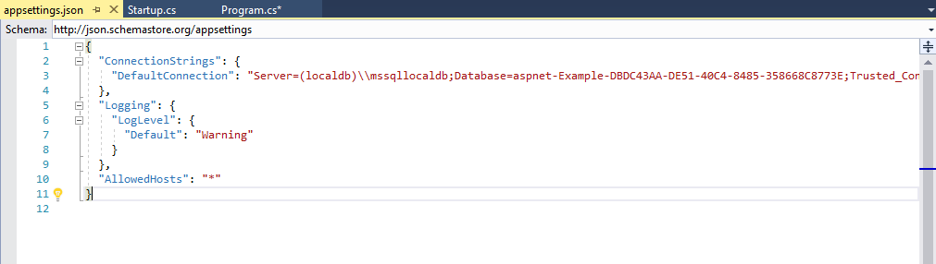
appsettings.json
In ASP.NET Core configuration API provides a way of configuring an app based on a list of name-value pairs that can be read at runtime from multiple sources.
Sathwika Gone

Slide 12
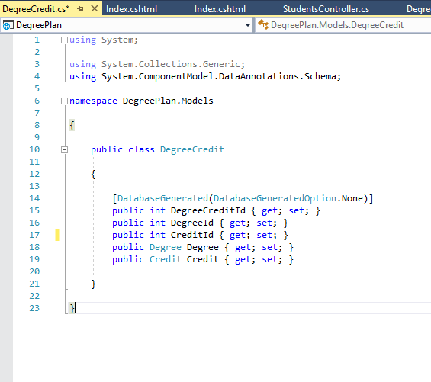
Models
Primary Key:
ID followed by class name will become a primary key.
Foreign Key:
<navigation property name><primary key property name>
Sathwika Gone

Slide 13
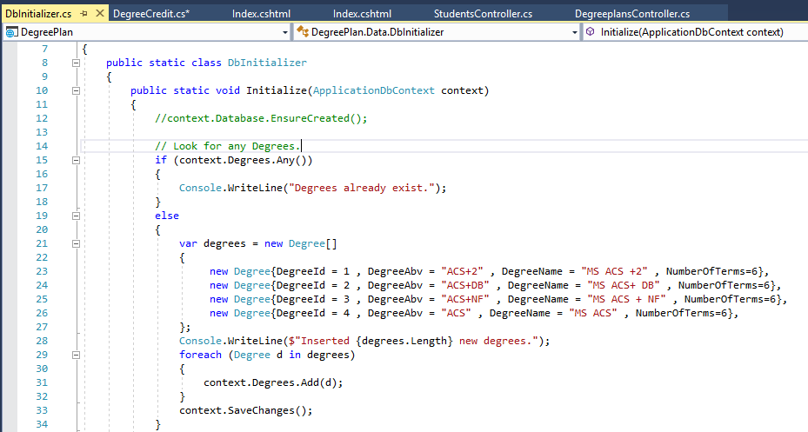
DbInitializer.cs
He Seed method takes the database context object as an input parameter, and the code in the method uses that object to add new entities to the database.
Syntax:
public static void Initialize(ApplicationDbContext context)
Sathwika Gone

Slide 14
Adding migrations
We will create initial migrations by using : dotnet ef migrations add InitialCreate
Once intial migrations were added we will use the following command to update database :dotnet ef database update
Susritha Gade

Slide 15
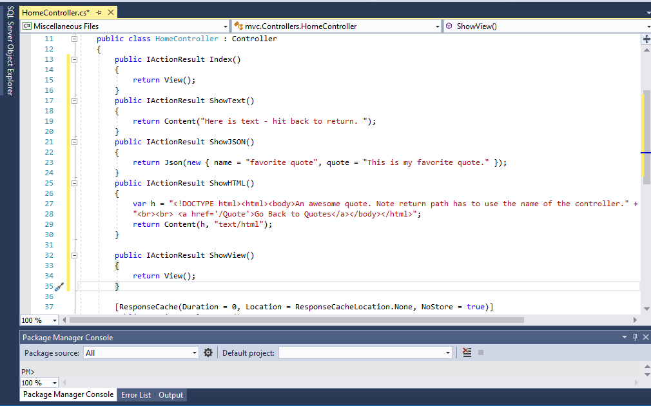
HomeController.cs
In controllers methods can return
Views, json, html and text.
Susritha Gade

Slide 16
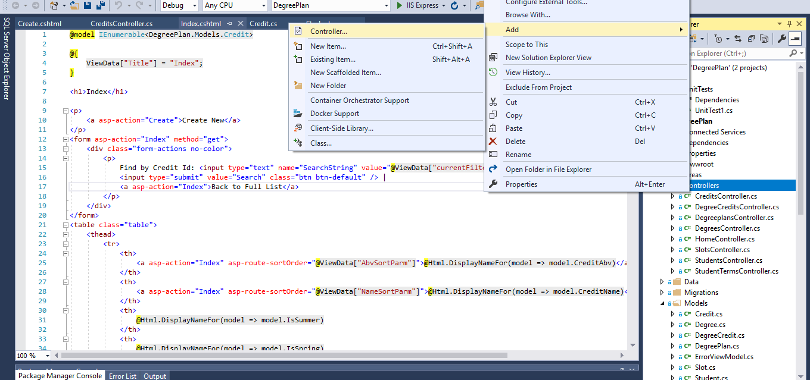
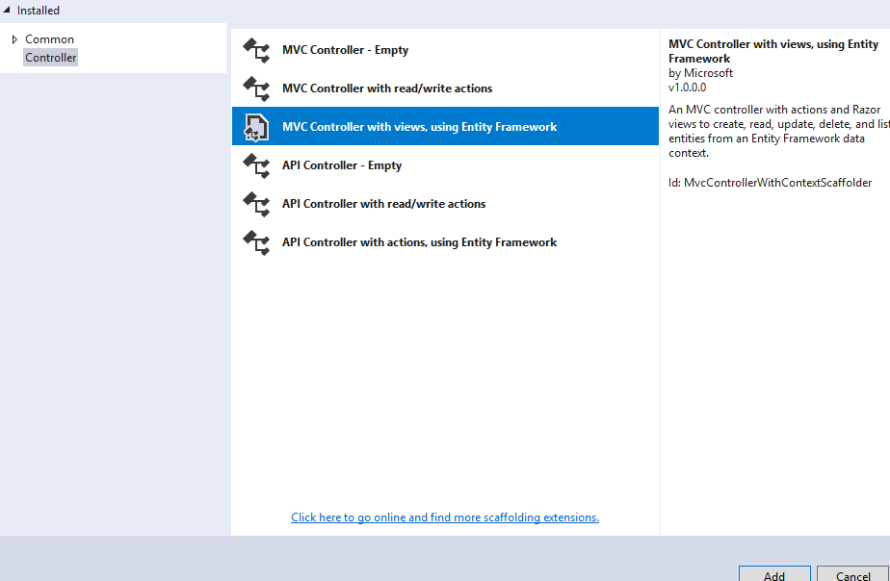
Adding new controller
Susritha Gade

Slide 17
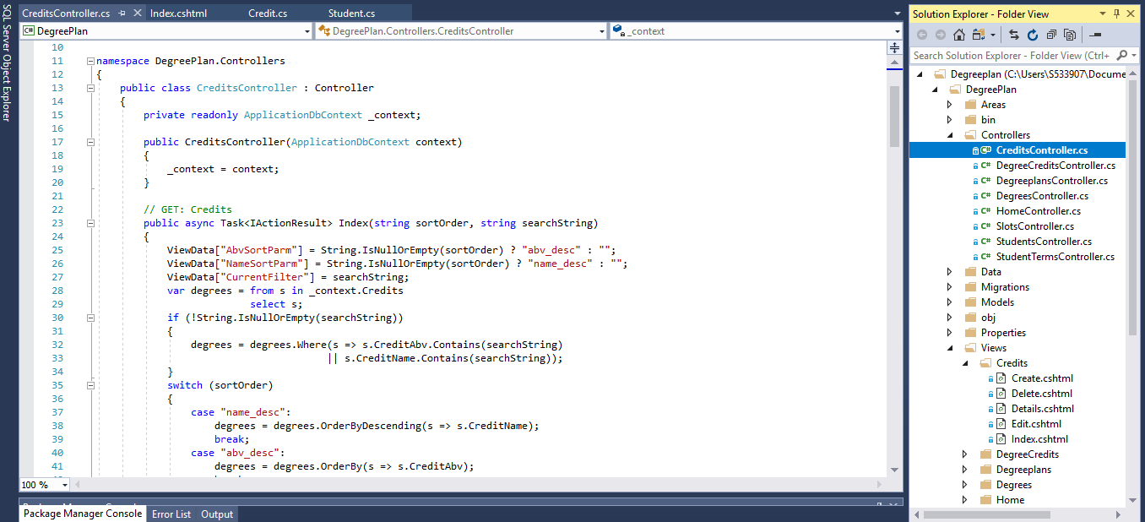
CreditsController.cs
Susritha Gade

Slide 18
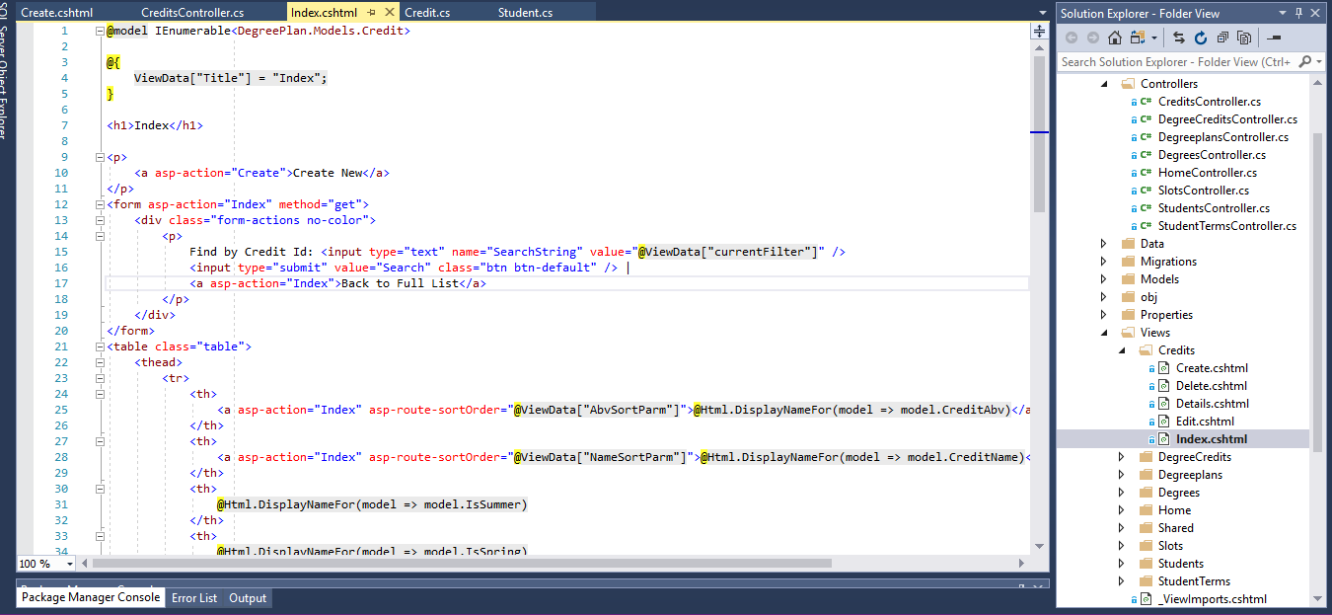
Views
Susritha Gade

Slide 19
Serverless Functions:
The world of cloud computing has been revolutionized by a solution called serverless computing.
Currently, there are various serverless or Function-as-a-Service (FaaS) offerings
two major serverless computing infrastructures support C# and .NET. They are AWS Lambda by Amazon and Azure Functions by Microsoft
Vennela Cheekoti

Slide 20
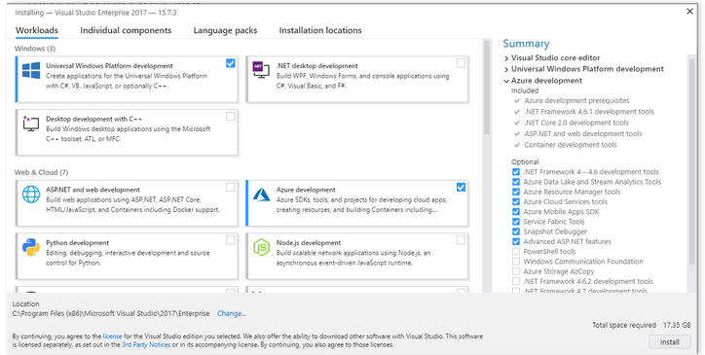
Azure Functions:
Vennela Cheekoti

Slide 21
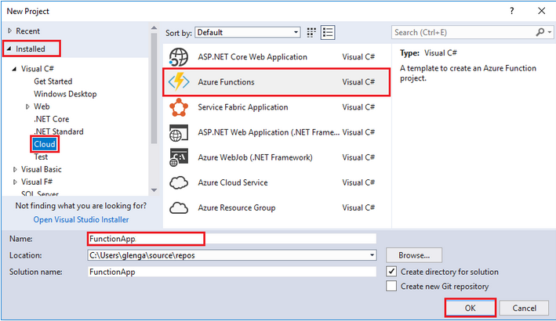
Azure Functions(Cont)
Vennela Cheekoti

Slide 22
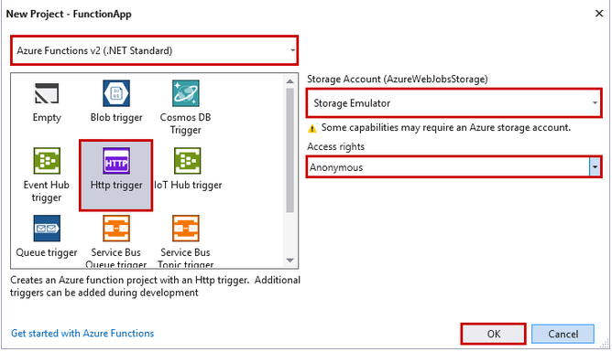
Azure Functions(Cont)
Vennela Cheekoti

Slide 23
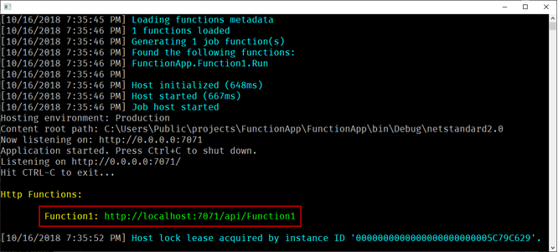
Azure Functions(Cont)
Vennela Cheekoti

Slide 24
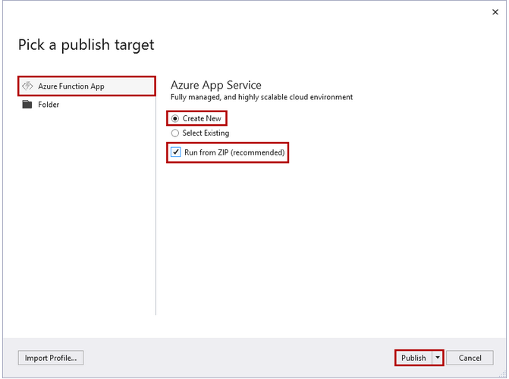
Azure Functions(Cont)
Vennela Cheekoti

Slide 25
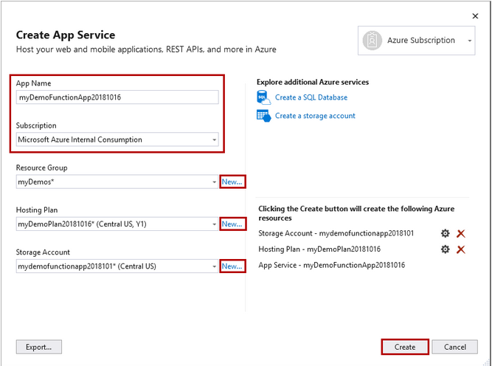
Azure Functions(Cont)
Vennela Cheekoti

Slide 26
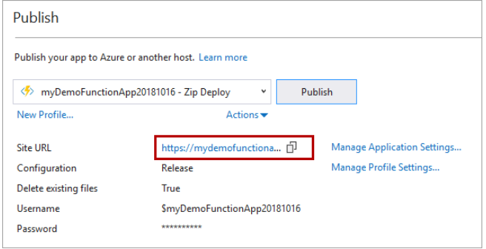
Azure Functions(Cont)
Vennela Cheekoti

Slide 27
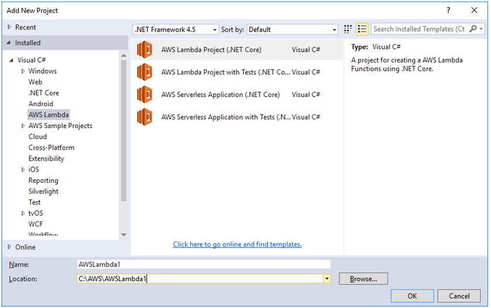
AWS Lambda
Vennela Cheekoti

Slide 28
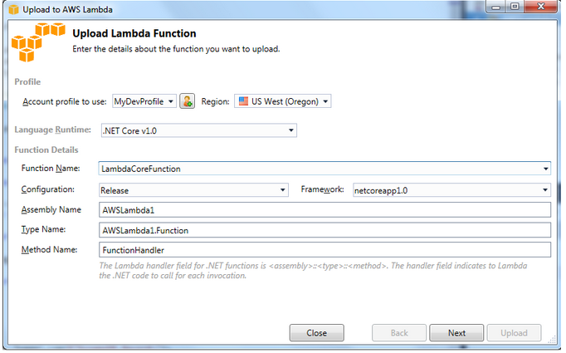
AWS Lambda(Cont)
Vennela Cheekoti

Slide 29
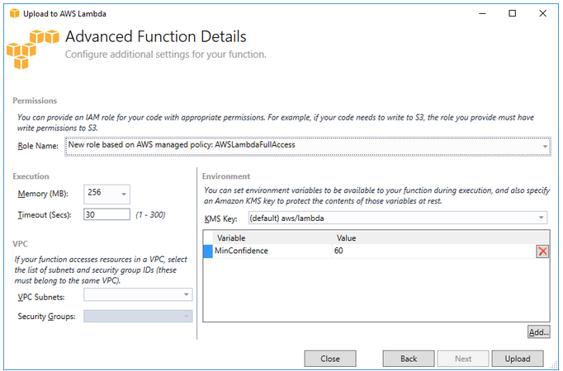
AWS Lambda(Cont)
Vennela Cheekoti

Slide 30
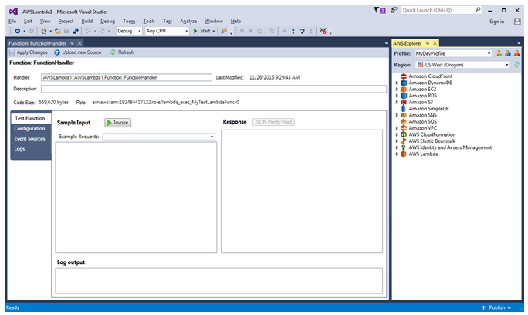
AWS Lambda(Cont)
Vennela Cheekoti

Slide 31
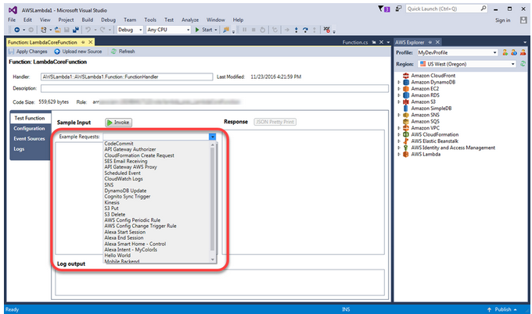
AWS Lambda(Cont)
Vennela Cheekoti

Slide 32
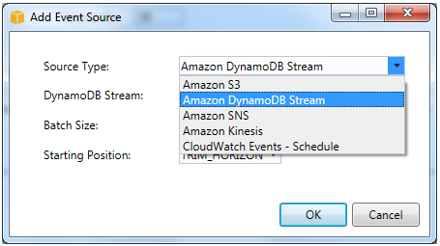
AWS Lambda(Cont)
Vennela Cheekoti

Slide 33
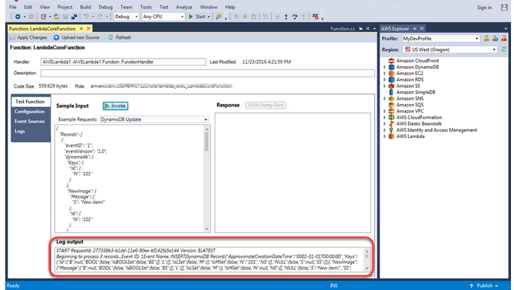
AWS Lambda(Cont)
Vennela Cheekoti

Slide 34


