Slide 1

FASTFOOD ANALYSIS
PRESENTED BY
SATHYANARRAYANAN

Slide 2

OBJECTIVE
Analyze and visualize fast food data to uncover trends in restaurant performance and nutritional composition. The study aims to identify patterns in calories and key nutrients to understand food quality and potential health impact.
Key Deliverables:
A structured visualization of restaurant wise nutritional metrics
Identification of high sodium and high cholesterol food items
Comparative analysis of calorie distribution across restaurants
Insights on nutritional trends and high risk food categories

Slide 3

DATASET OVERVIEW
The dataset consists of detailed information on fast food menu items across multiple restaurants, enabling comparative analysis.
It includes a wide range of nutritional attributes such as calories, total fat, saturated fat, trans fat, sodium, cholesterol, carbohydrates, sugar, protein, and essential vitamins.
Each record represents a single food item, allowing item-level analysis of nutritional composition and variation between restaurants.
The dataset supports identifying high-calorie and high-risk nutritional items, especially focusing on sodium and cholesterol content.
The data is analyzed using Power BI to perform exploratory analysis and visualization, uncovering patterns in food quality and health impact.

Slide 4

KEY PARAMETERS CONSIDERED
Calories: Represents the total energy content of each food item and helps compare overall energy intake across restaurants. High-calorie items may contribute to weight gain and health concerns.
Sodium & Cholesterol: Indicate key health risk factors. High sodium is linked to blood pressure issues, while high cholesterol is associated with cardiovascular diseases.
Protein, Carbohydrates & Fiber: Represent overall nutritional quality. Protein supports body functions, carbohydrates provide energy, and fiber contributes to digestive health.
Focus of Analysis: The study focuses on identifying Top 10 high sodium and high cholesterol food items, along with analyzing calorie distribution across restaurants.
These parameters are selected as they have the highest impact on health risk and overall nutritional quality evaluation.

Slide 5

ANALYSIS APPROACH
The dataset was cleaned and prepared to ensure consistency and accuracy for analysis.
Restaurant-wise comparisons were conducted to analyze average calorie and nutrient variations.
Top 10 analysis was applied to identify food items with the highest sodium and cholesterol levels.
Data visualizations were created using Power BI to present insights clearly and support data-driven conclusions.

Slide 6
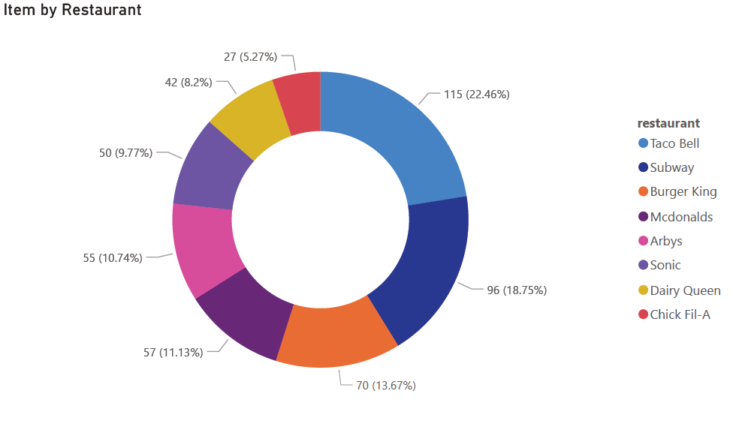
ITEM BY RESTAURANT
Taco Bell has the highest number of items with 115 (22.46%), indicating the largest menu variety.
Subway follows with 96 items (18.75%), showing a strong presence in the dataset.
Burger King contributes 70 items (13.67%), while McDonald’s has 57 items (11.13%), reflecting moderate menu sizes.
Arby’s and Sonic have 55 (10.74%) and 50 (9.77%) items respectively, indicating relatively smaller menus.
Dairy Queen has 42 items (8.2%), and Chick-fil-A
has the lowest with 27 items (5.27%).

Slide 7
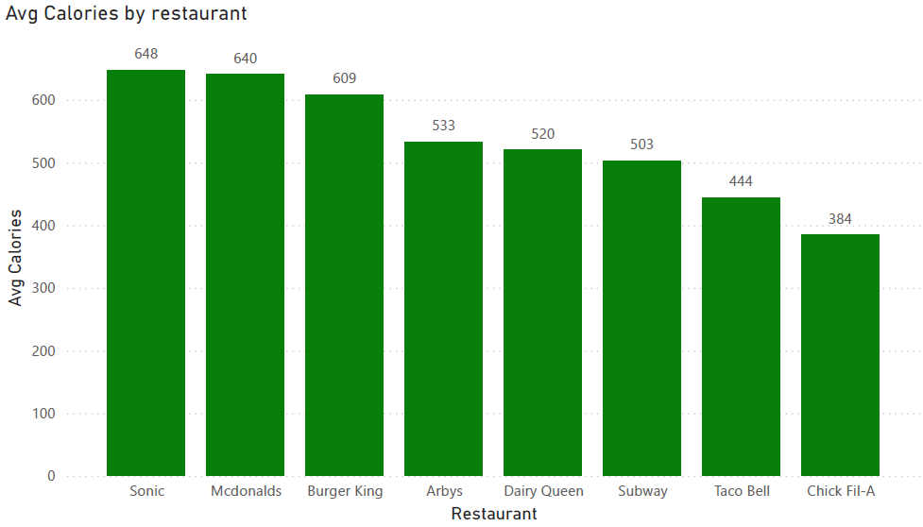
AVG CALORIES BY RESTAURANT
Sonic has the highest average calories at 648, followed closely by McDonald’s (640) and Burger King (609), indicating higher calorie menu items.
Arby’s (533) and Dairy Queen (520) fall in the mid-range, showing moderate calorie levels.
Subway has an average of 503 calories, slightly lower compared to most competitors.
Taco Bell (444) and Chick-fil-A (384) have the lowest average calories, indicating relatively lighter menu options.
There is a significant gap of over 260 calories between the highest (648) and lowest (384) average values, showing strong variation across restaurants.

Slide 8
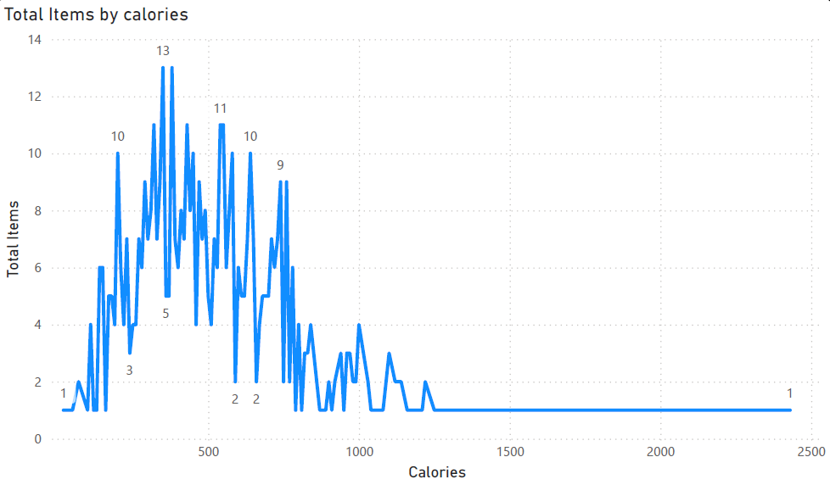
TOTAL ITEMS BY CALORIES
The highest concentration of items falls in the 300 - 600 calorie range, where item counts peak at around 10 to 13 items.
The maximum frequency observed is approximately 13 items, indicating this calorie range is the most common across the dataset.
As calories increase beyond 700, the number of items drops significantly to around 1 - 4 items, showing fewer high-calorie options.
Extremely high-calorie items (above 1000 calories) are very rare, typically with only 1 item per range.
The overall trend shows a declining pattern, where item count decreases as calorie values increase, indicating most menu items are concentrated in mid-calorie ranges.

Slide 9
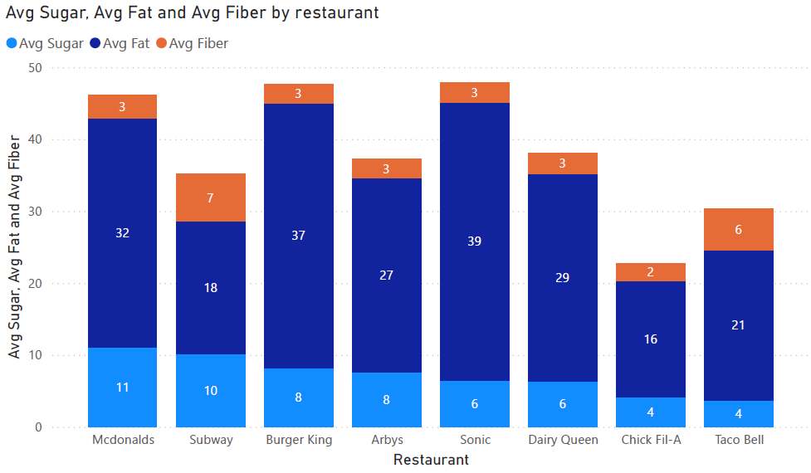
AVG SUGAR, AVG FAT AND AVG FIBER BY RESTAURANT
Sonic has the highest average fat at 39g, followed by Burger King (37g) and McDonald’s (32g), indicating higher fat content in their menu items.
McDonald’s has the highest average sugar at 11g, followed by Subway (10g), while Chick-fil-A and Taco Bell have the lowest at 4g each.
Subway stands out with the highest average fiber at 7g, compared to most restaurants having around 2–3g, indicating relatively healthier options.
Chick-fil-A has the lowest overall nutritional values with 4g sugar, 16g fat, and 2g fiber, suggesting lighter menu items.
Taco Bell shows moderate fat (21g) and higher fiber (6g), indicating a comparatively balanced nutritional profile.

Slide 10
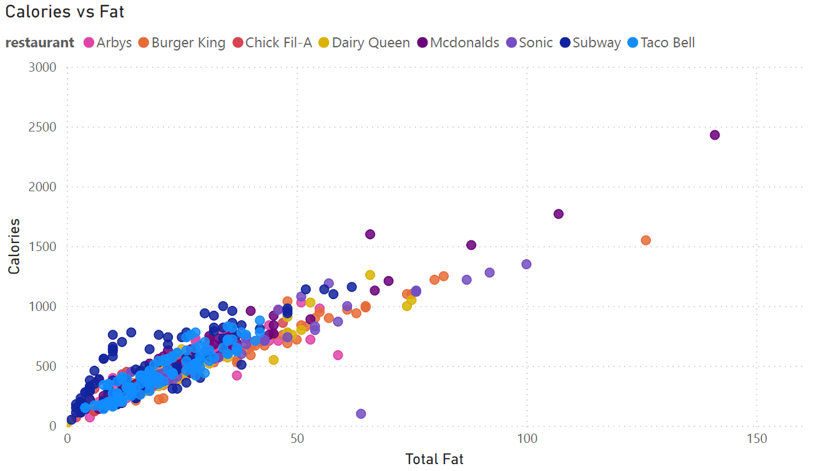
CALORIES VS FAT
There is a strong positive relationship between fat and calories, where higher fat content leads to higher calorie values across all restaurants.
Most food items are concentrated in the range of 10–50g fat and 200–800 calories, indicating common menu offerings fall in this range.
A few outliers exist with extremely high fat (100g+) and calories (1500–2400+), representing highly dense food items.
Restaurants like McDonald’s and Burger King show more spread in higher fat and calorie ranges, indicating heavier menu options.
Lower fat items (below 20g) consistently fall under 500 calories, suggesting lighter and healthier options.

Slide 11
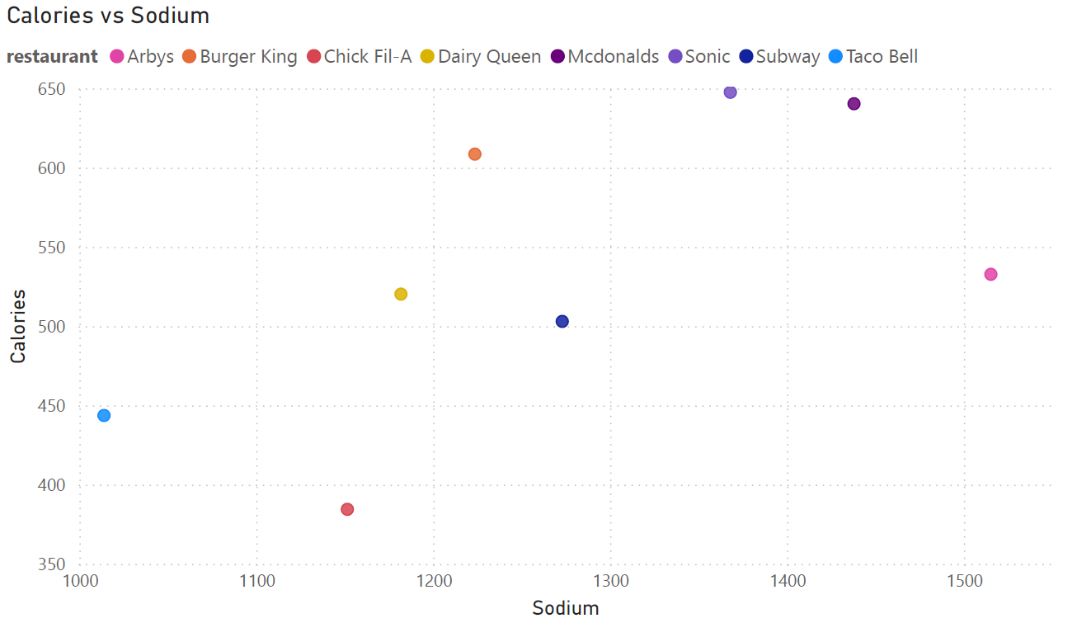
CALORIES VS SODIUM
There is a moderate positive relationship between sodium and calories, where higher sodium levels generally correspond to higher calorie values.
Most restaurants have sodium levels in the range of 1100–1500 mg, indicating consistently high salt content across menu items.
Sonic and McDonald’s show the highest calorie values (around 640–650) along with high sodium levels (above 1350 mg), indicating heavier food options.
Chick-fil-A has relatively lower calories (around 380) despite moderate sodium levels, suggesting comparatively lighter items.
Overall, the chart indicates that high sodium intake is common across restaurants, even in items with moderate calorie levels.

Slide 12
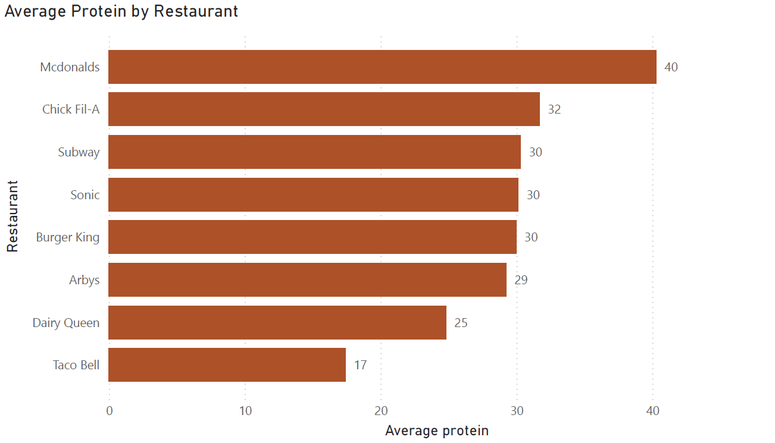
AVERAGE PROTEIN BY RESTAURANT
McDonald’s has the highest average protein at 40g, indicating more protein-rich menu items.
Chick-fil-A follows with 32g, showing strong protein content compared to other restaurants.
Subway, Sonic, and Burger King have similar average protein levels at 30g, indicating consistent mid-range protein offerings.
Arby’s is slightly lower at 29g, closely aligned with the mid-range group.
Dairy Queen has a lower average protein of 25g, while Taco Bell has the lowest at 17g.
There is a noticeable gap of 23g between the highest (40g) and lowest (17g) average protein values across restaurants.

Slide 13
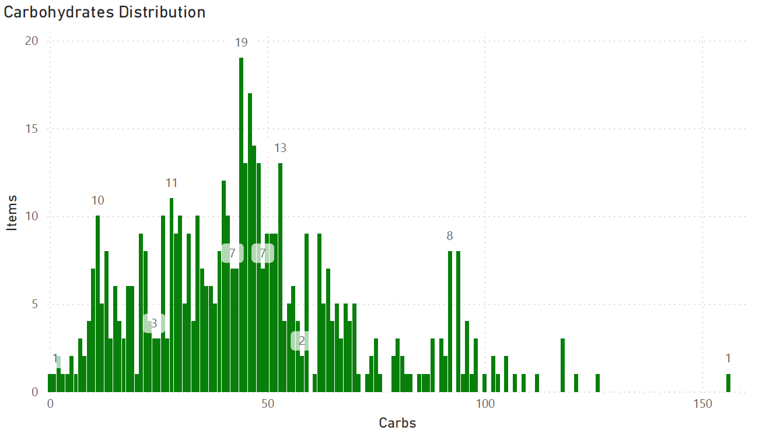
CARBOHYDRATES DISTRIBUTION
The highest concentration of items is in the 30–60g carbohydrate range, where item counts peak at around 13 to 19 items.
The maximum frequency observed is approximately 19 items, indicating this is the most common carb range.
Lower carb items (below 20g) have relatively fewer items, typically around 1–10 items per range.
As carbohydrates increase beyond 80g, the number of items drops significantly to around 1–8 items, showing fewer high-carb options.
Extremely high-carb items (above 120g) are very rare, usually with only 1–3 items, indicating limited availability of such items.

Slide 14
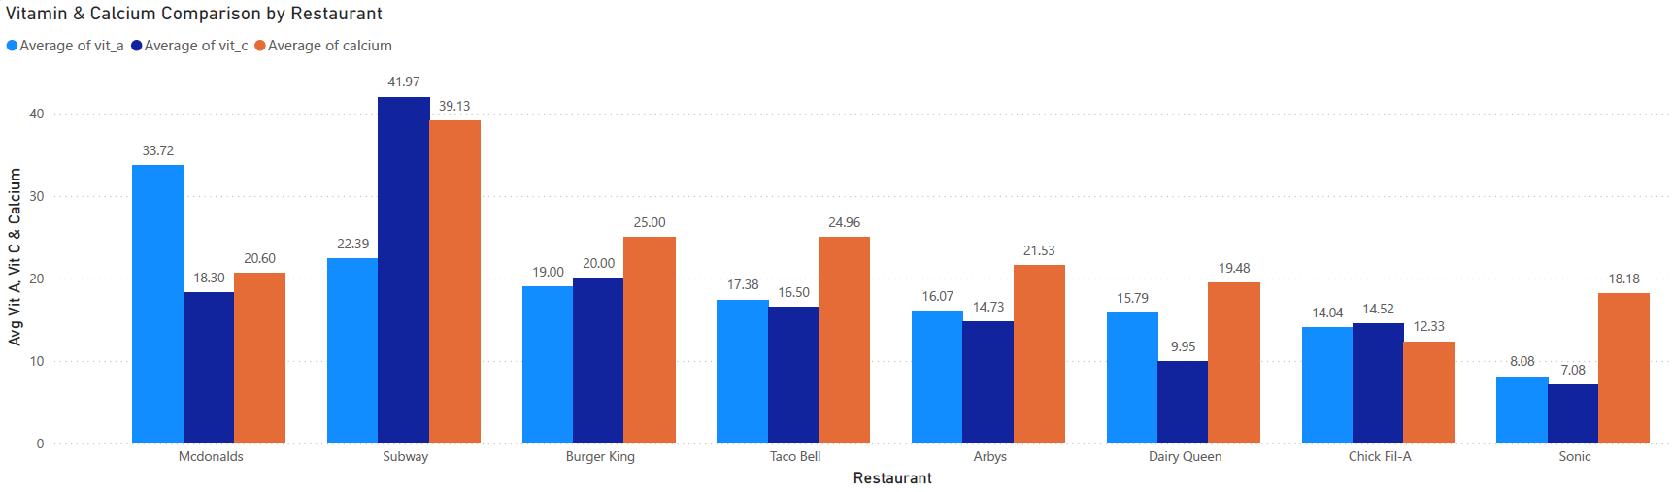
VITAMIN & CALCIUM COMPARISON BY RESTAURANT
Subway has the highest values across nutrients with Vitamin C (41.97) and Calcium (39.13), making it nutritionally strong compared to others.
McDonald’s shows the highest Vitamin A (33.72) but relatively lower Vitamin C (18.30) and Calcium (20.60).
Burger King and Taco Bell have moderate values, with Calcium around 25.00 and 24.96 respectively.
Sonic has the lowest Vitamin A (8.08) and Vitamin C (7.08), but a moderate Calcium level of 18.18.

Slide 15
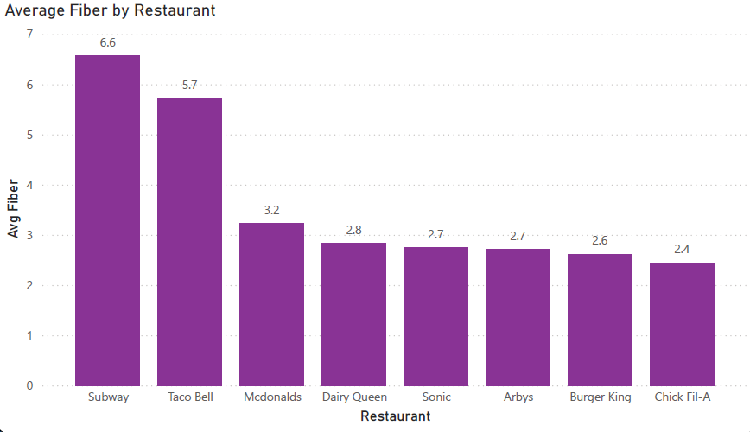
AVERAGE FIBER BY RESTAURANT
Subway has the highest average fiber at 6.6g, followed by Taco Bell (5.7g), indicating better fiber-rich options.
McDonald’s has a moderate fiber level at 3.2g, higher than most other restaurants.
Dairy Queen (2.8g), Sonic (2.7g), and Arby’s (2.7g) show similar mid-range fiber values.
Burger King (2.6g) and Chick-fil-A (2.4g) have the lowest fiber content among all restaurants.
There is a noticeable gap of over 4g between the highest (6.6g) and lowest (2.4g) average fiber values.

Slide 16
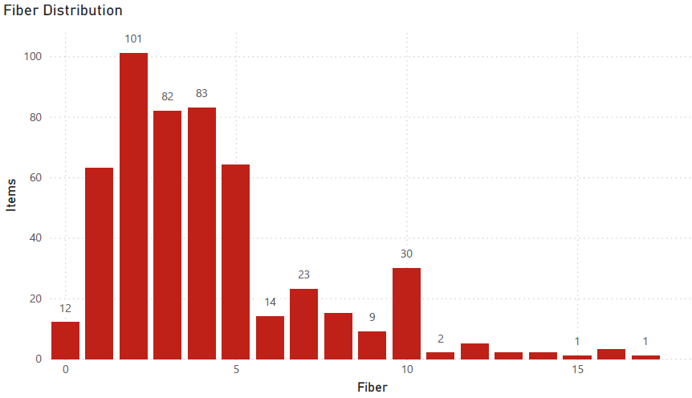
FIBER DISTRIBUTION
The highest concentration of items is in the 2–4g fiber range, with the peak reaching 101 items, indicating most menu items are low in fiber.
Fiber levels between 4–6g also show high counts, around 82–83 items, forming the second major concentration range.
As fiber increases beyond 6g, the number of items drops significantly to around 14–30 items, showing fewer high-fiber options.
Very high fiber items (above 10g) are rare, typically with less than 10 items per range.
Extremely high fiber values (above 15g) are almost negligible, with only 1–2 items, indicating limited availability of fiber-rich foods.

Slide 17
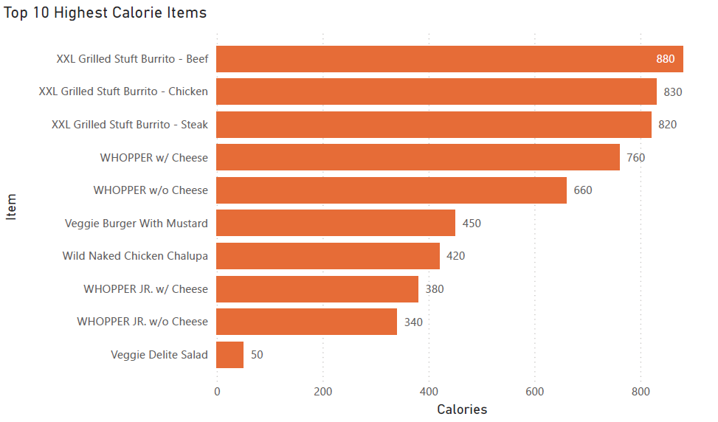
TOP 10 HIGHEST CALORIE ITEMS
The highest calorie item is XXL Grilled Stuft Burrito - Beef with 880 calories, followed by Chicken (830) and Steak (820) variants, indicating extremely high-calorie meal options.
WHOPPER w/ Cheese (760) and WHOPPER w/o Cheese (660) also rank high, showing that burger-based items contribute significantly to calorie intake.
Mid-range items like Veggie Burger with Mustard (450) and Wild Naked Chicken Chalupa (420) still contain substantial calories.
Smaller portion items like WHOPPER JR. w/ Cheese (380) and w/o Cheese (340) have reduced calories but remain moderately high.
The lowest among the top 10 is Veggie Delite Salad (50 calories), showing a significant drop of 830 calories compared to the highest item.

Slide 18
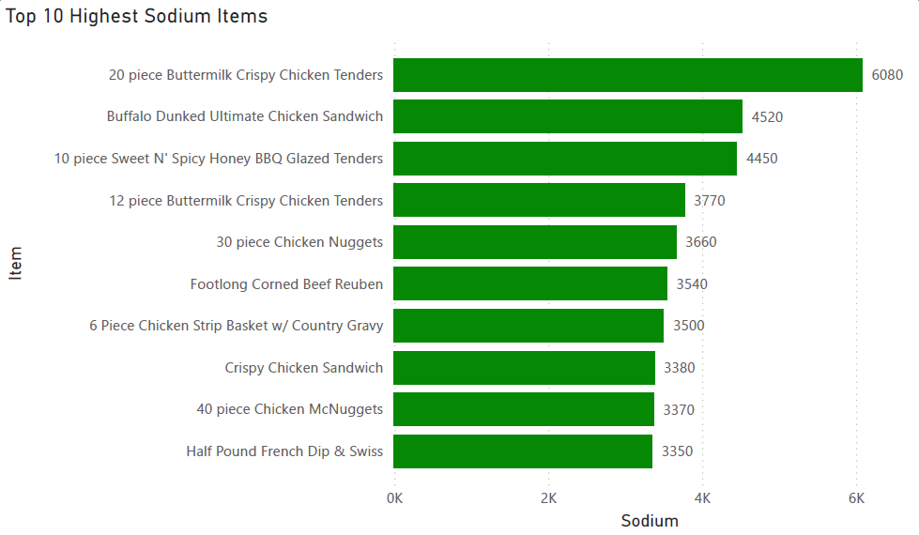
TOP 10 HIGHEST SODIUM ITEMS
The highest sodium item is 20 Piece Buttermilk Crispy Chicken Tenders with 6080 mg, which is extremely high compared to other items.
Buffalo Dunked Ultimate Chicken Sandwich (4520 mg) and 10 Piece Sweet N’ Spicy Honey BBQ Tenders (4450 mg) follow, indicating very high sodium levels in chicken-based items.
Items like 12 Piece Tenders (3770 mg) and 30 Piece Chicken Nuggets (3660 mg) also contain significantly high sodium content.
Mid-range items such as Footlong Corned Beef Reuben (3540 mg) and Chicken Strip Basket (3500 mg) still exceed recommended sodium intake levels.
Even the lowest in the list, Half Pound French Dip & Swiss (3350 mg), has very high sodium, showing that all top items exceed safe consumption limits.

Slide 19
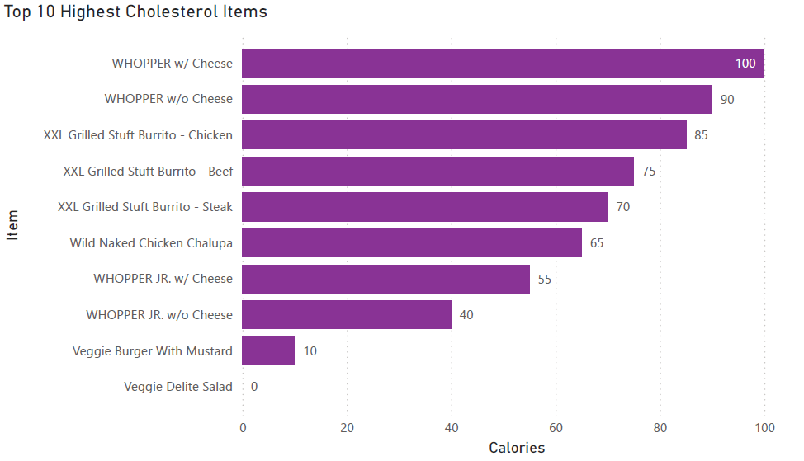
TOP 10 HIGHEST CHOLESTEROL ITEMS
The highest cholesterol item is WHOPPER w/ Cheese with 100 mg, followed by WHOPPER w/o Cheese (90 mg), indicating burger items have high cholesterol content.
XXL Grilled Stuft Burrito – Chicken (85 mg) and Beef (75 mg) also contribute significantly to cholesterol intake.
XXL Grilled Stuft Burrito – Steak (70 mg) and Wild Naked Chicken Chalupa (65 mg) fall in the mid-high range.
Smaller portion items like WHOPPER JR. w/ Cheese (55 mg) and w/o Cheese (40 mg) show reduced but still notable cholesterol levels.
Plant-based options like Veggie Burger with Mustard (10 mg) and Veggie Delite Salad (0 mg) have minimal to no cholesterol, highlighting healthier alternatives.

Slide 20
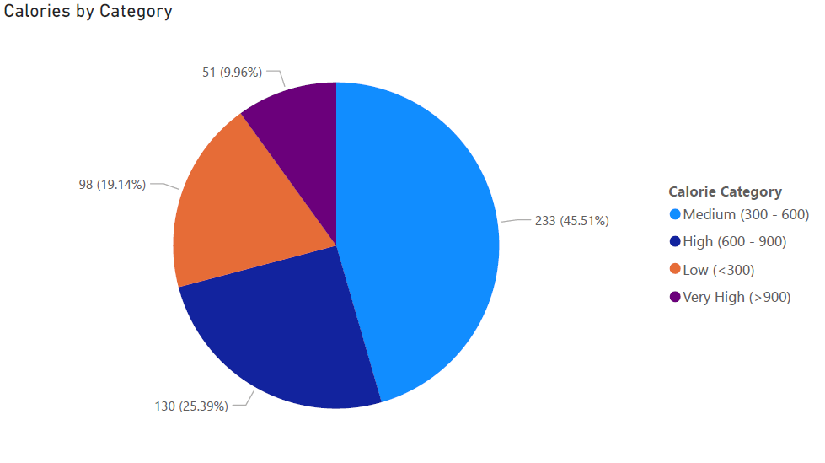
CALORIES BY CATEGORY
The majority of items fall under the Medium calorie range (300–600) with 233 items (45.51%), indicating most menu items are moderately high in calories.
High calorie items (600–900) account for 130 items (25.39%), showing a significant portion of energy-dense food options.
Low calorie items (<300) represent 98 items (19.14%), indicating fewer healthier or lighter choices.
Very high calorie items (>900) are the least, with 51 items (9.96%), but still represent a notable portion of the menu.
Overall, more than 70% of items (363 items) fall in medium to high calorie ranges, highlighting a tendency toward calorie-dense food offerings.

Slide 21
DIAGNOSTIC ANALYSIS
1. Overview of Analysis
The analysis of fast food data across multiple restaurants reveals significant variations in calorie content, nutritional composition, and health risk factors. The study focuses on evaluating how different restaurants perform in terms of energy density (calories) and critical nutrients such as sodium, cholesterol, fat, protein, carbohydrates, and fiber.
The objective is not only to identify high and low values but also to understand the underlying causes and implications of these patterns on consumer health and restaurant positioning.
2. Calorie and Energy Distribution Analysis
The majority of menu items fall within the 300–600 calorie range (45.51%), indicating that most offerings are moderately high in energy. Additionally, 25.39% of items fall within 600–900 calories, showing a strong presence of high-calorie food items.
Restaurants such as Sonic (648), McDonald’s (640), and Burger King (609) exhibit the highest average calorie values. This trend is closely linked to their higher fat content (32g–39g), confirming that fat is the primary contributor to calorie density.

Slide 22
DIAGNOSTIC ANALYSIS
Lower calorie averages in Chick-fil-A (384) and Taco Bell (444) suggest relatively lighter menu options, although they still fall within moderate calorie ranges.
High calorie concentration is primarily driven by fat-rich ingredients, larger portion sizes, and processed food preparation methods.
3. Sodium Analysis
The sodium analysis highlights extremely high values, with top items reaching up to 6080 mg, which is significantly above recommended daily intake levels.
These high sodium levels are predominantly found in:
Fried chicken items
Processed meat products
Items with sauces and preservatives
Even the lower range within the top 10 exceeds 3000 mg, indicating that high sodium is a system-wide issue across restaurants.

Slide 23
DIAGNOSTIC ANALYSIS
High sodium levels are driven by processing techniques, flavor enhancement practices, and preservation requirements, especially in fast food chains.
4. Cholesterol Analysis
Cholesterol values reach up to 100 mg, with the highest concentrations observed in:
Burger-based items
Cheese-loaded products
Red meat and fried items
Lower cholesterol values are seen in:
Vegetarian items
Salads (0 mg in some cases)
Cholesterol levels are directly influenced by ingredient composition, particularly the use of animal fats, cheese, and cooking oils.

Slide 24
DIAGNOSTIC ANALYSIS
5. Nutritional Balance Analysis (Protein, Carbohydrates, Fiber)
Protein:
Highest: McDonald’s (40g)
Lowest: Taco Bell (17g)
Protein levels vary significantly, indicating differences in menu composition and ingredient quality.
Carbohydrates:
Most items fall in 30–60g range, indicating a balanced but carb-heavy diet profile
High-carb items (>80g) are fewer but still present
Carbs are a primary energy source but contribute to overall calorie load.
Fiber:
Highest: Subway (6.6g)
Most restaurants: 2–3g

Slide 25
DIAGNOSTIC ANALYSIS
Low fiber levels indicate limited use of:
Whole grains
Vegetables
Natural ingredients
Fast food menus are generally low in fiber, indicating poor digestive health support and reliance on refined ingredients.
6. Relationship Analysis
Calories vs Fat
A strong positive relationship exists:
Higher fat → Higher calories
Confirms that fat is the primary driver of calorie density

Slide 26
DIAGNOSTIC ANALYSIS
Calories vs Sodium
A moderate positive relationship:
Higher sodium often aligns with higher calorie items
Indicates that processed and high-calorie foods also contain high salt levels
7. Restaurant-Level Performance Comparison
High-risk restaurants:
Sonic, McDonald’s, Burger King → High calories, fat, sodium
Moderate performers:
Arby’s, Dairy Queen → Balanced but still calorie-dense
Relatively healthier options:
Subway, Chick-fil-A → Better fiber, lower calories
Restaurants offering fresh ingredients and customization perform better in nutritional balance.

Slide 27
DIAGNOSTIC ANALYSIS
8. Overall Key Findings
Over 70% of items fall in medium to high calorie ranges
Sodium levels are consistently high across all restaurants
Cholesterol is concentrated in meat and burger-based items
Fiber content is low across most menus, indicating poor nutritional balance
Fat content is the primary driver of high calorie values
9. Business Implications
Increasing health awareness among customers may impact demand for high-calorie and high-sodium items
Restaurants with healthier options (like Subway) may gain competitive advantage
Nutritional transparency can influence customer trust and brand perception

Slide 28
KEY FINDINGS
A significant portion of menu items (over 70%) falls within medium to high calorie ranges, highlighting a strong trend toward energy-dense food offerings.
There is a clear positive relationship between fat and calories, indicating that fat content is the primary driver of high-calorie food items.
High sodium levels (above 3000 mg in top items) are widespread across multiple restaurants, suggesting a consistent reliance on high-salt ingredients.
Cholesterol-heavy items are concentrated in burgers and meat-based products, while plant-based options show significantly lower values.
Nutritional balance varies across restaurants, with chains like Subway and Chick-fil-A offering relatively better options compared to others.
Most menu items fall in the 300–600 calorie and 30–60g carb range, indicating a focus on quick energy rather than balanced nutrition.
Extreme outliers with very high calories, fat, and sodium highlight the presence of highly unhealthy items that increase overall health risk.

Slide 29
BUSINESS RECOMMENDATIONS
Restaurants should focus on introducing low-calorie (below 300) and high-fiber menu options to meet the growing demand for healthier food choices.
Reducing sodium content, especially in fried and processed items, can significantly improve overall menu health quality and reduce health risks.
Menu engineering should prioritize balanced nutritional combinations, including protein-rich, low-fat, and fiber-rich ingredients.
Restaurants can adopt strategies similar to Subway, emphasizing fresh ingredients and customizable meals to enhance nutritional value.
Clear display of nutritional information can improve customer awareness and support better decision-making.
Restaurants should implement portion control strategies for high-calorie and high-sodium items to reduce overall intake while maintaining customer satisfaction.
Develop and promote alternative cooking methods such as grilling, baking, or air-frying instead of deep frying to reduce fat and calorie content without compromising taste.

Slide 30
CONCLUSION
The analysis highlights that fast food menus are largely dominated by high-calorie, high-sodium, and high-fat items, which can pose significant health risks when consumed frequently. A strong relationship is observed between fat and calorie levels, identifying fat as the primary driver of energy-dense food, while sodium and cholesterol are mainly associated with processed and meat-based items.
The study also reveals that most menu items fall within medium to high calorie ranges, with limited availability of low-calorie and high-fiber options, indicating an imbalance in nutritional composition. However, certain restaurants offer relatively healthier alternatives, demonstrating that better menu design is achievable.
Overall, the findings emphasize the need for nutritional optimization, improved ingredient choices, and healthier menu strategies to balance customer preferences with long-term health considerations.

