Slide 1

Disaster Relief Resource Management
Group No - 2
Student Name Register Number Section
1. KULKARANI ABHILASH 2510030231 S-9
2. BHAVYA SREE KANDUR 2510030401 S-2
3. B THANU SREE 2510040112 S-8
4. UTKALIKA PRIYADARSHINEE 2510080004 S-7
5. MARAGANI SATHYA KRISHNA 2510080006 S-2
Department of Freshman Engineering (FED)
KONERU LAKSHMAIAH EDUCATION FOUNDATION

Slide 2
Role played in the project
RollNo - 2510030231
RollNo - 2510030401
RollNo - 2510040112
RollNo - 2510080004
RollNo - 2510080006
Developed Resources class
Developed AffectedAreas class
Developed Inheritance class
Created Class Diagram
Developed ReportManagement and Main Method

Slide 3
OUTLINE
Objective
Project Description
Class Diagram
Workflow of the Application (Flowchart)
Code Screenshots (Module wise)
Output Screenshots

Slide 4
OBJECTIVE : To manage relief materials distribution.
DESCRIPTION:
A management system in which we can track and allocate resources to affected areas based on the disaster type.
In this management system we can generate a report based on the distributed stock.
This system makes the process of tracking and allocating the stock effortless.

Slide 5
WORKFLOW:
start
Display the MainMenu
User selects a option
_{Menu}
Generate Report in File
Distribute Resources
Select Affected Area
Select Type of Disaster
Track Available Resources
Enter Required Resources

Slide 6
Class diagram
DRRM
<<Area>>
mainMenu
# name: String
# disastertype: String
get DisasterType(Scanner): String
+main(String[] args): void
+ AfftectedArea(String name)
+ getName(): String
+setDisastertype(String disastertype):void
<<void display()>>
Resource
food: int
Water: int
Medicines: int
Boats: int
Shelters: int
Fire Extinguishers: int
Report Manager
AffectedAreas
+ Resource(int f, int w, int m)
~ display(): void
Resource: resource
+main(generateReport( AffectedAreas[] areas))
+ AffectedAreas(String name, Resource resource)
~ display(): void

Slide 7
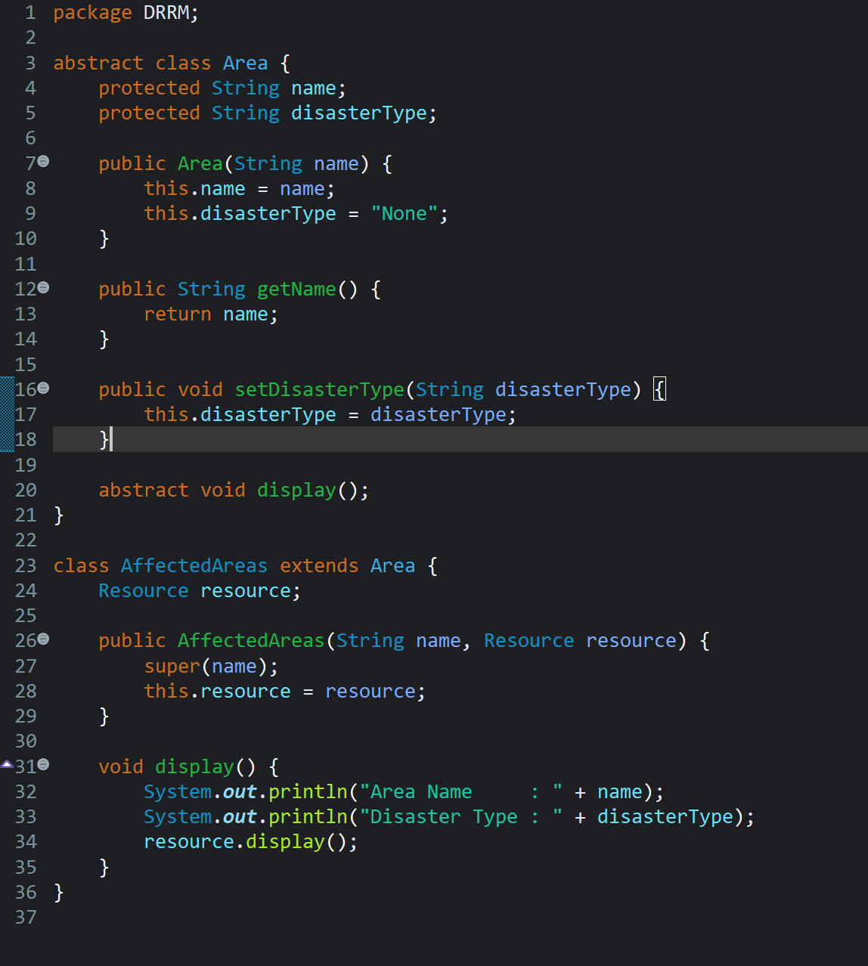
Areas.java

Slide 8
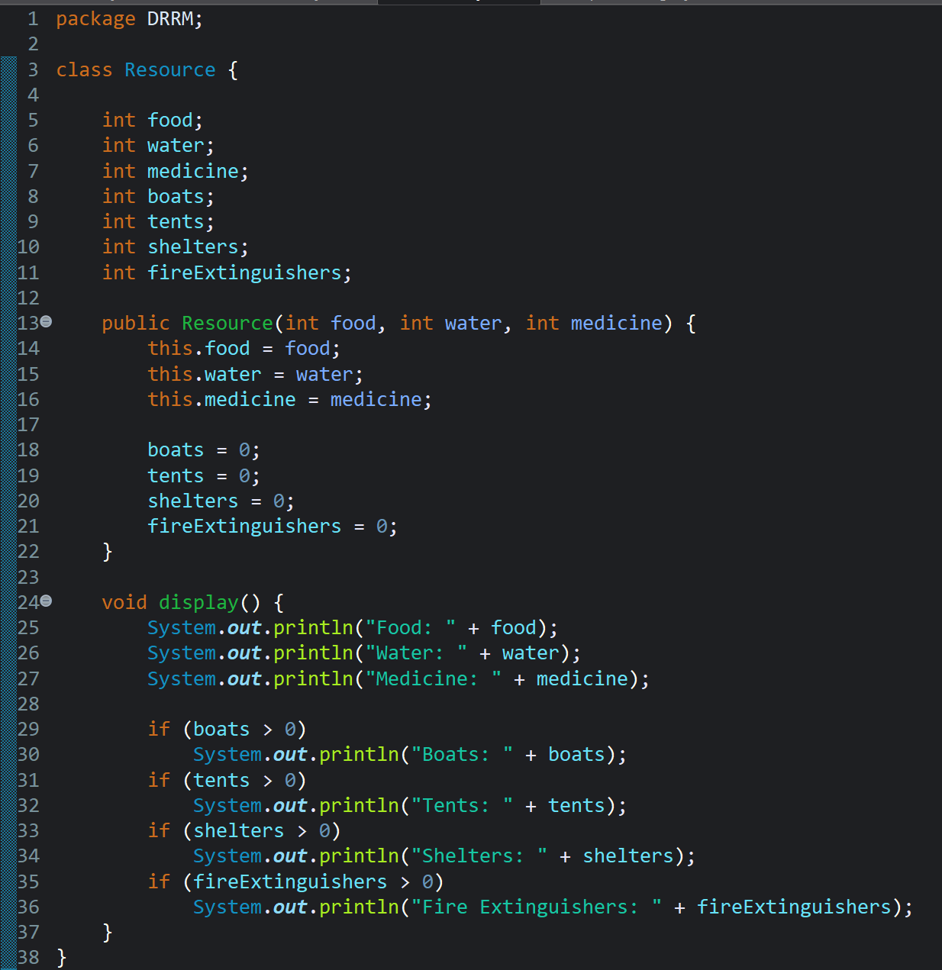
Resource.java

Slide 9
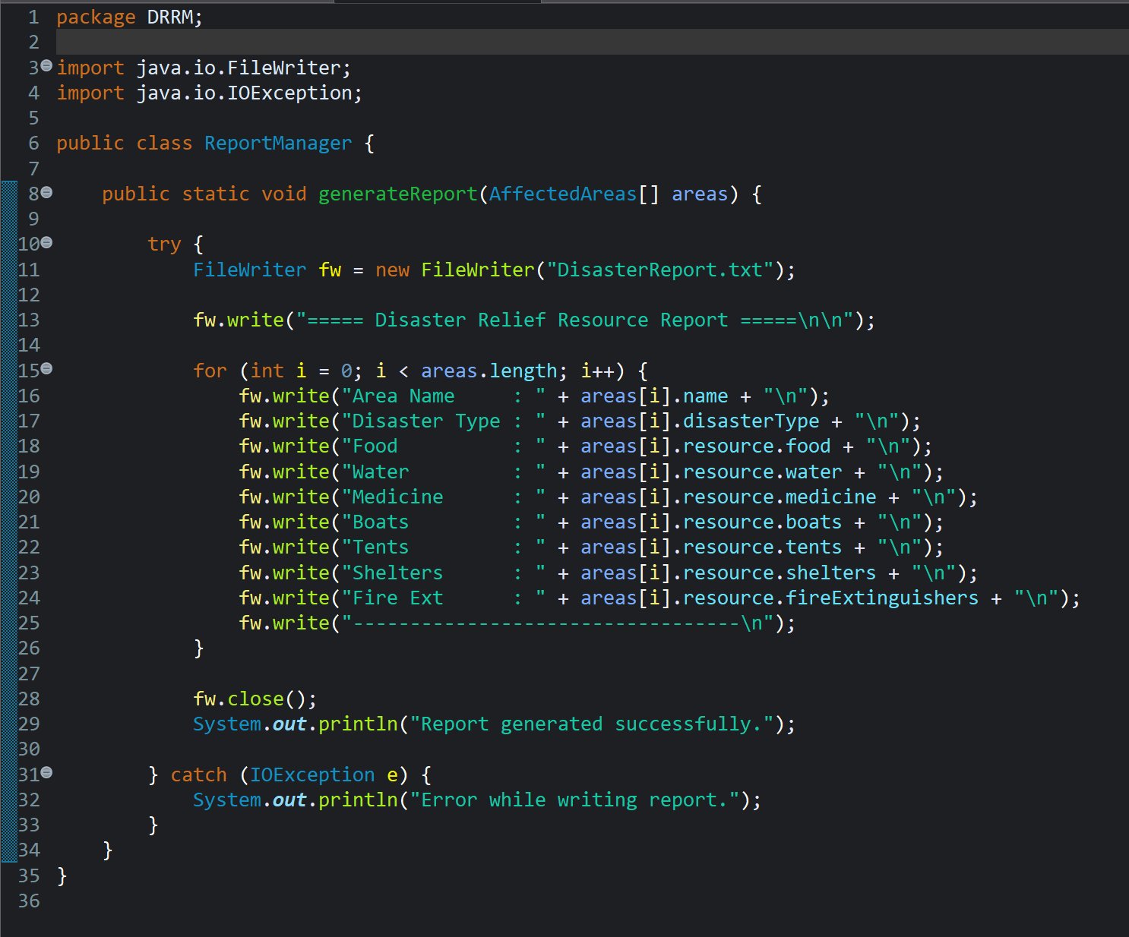
ReportManager.java

Slide 10
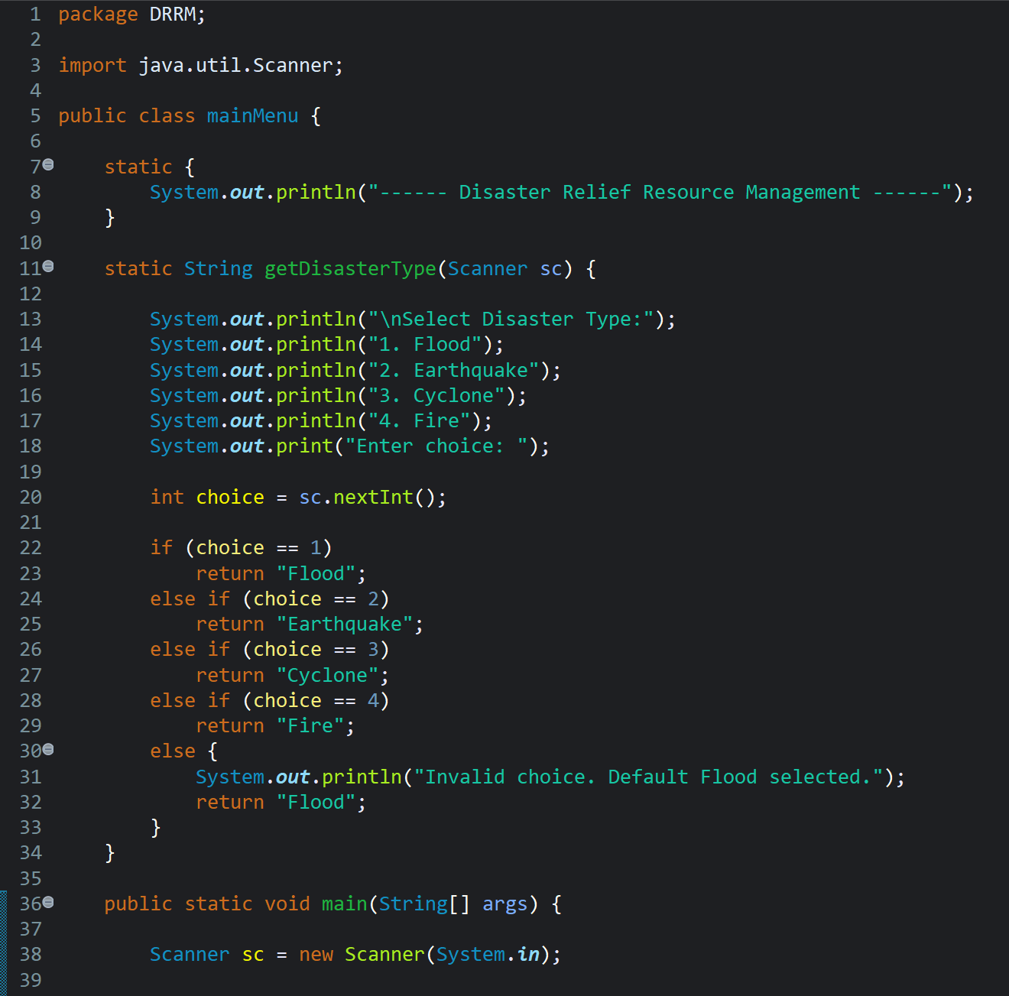
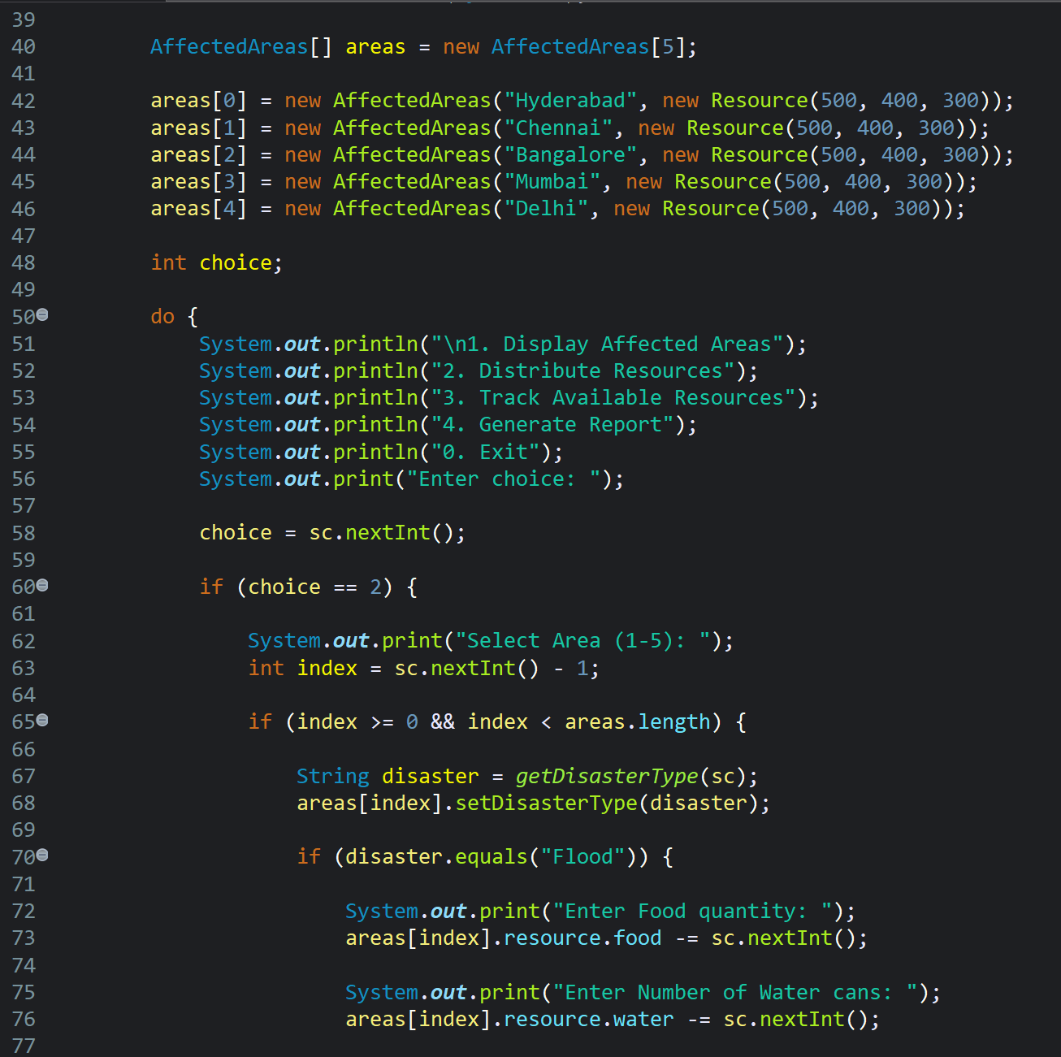
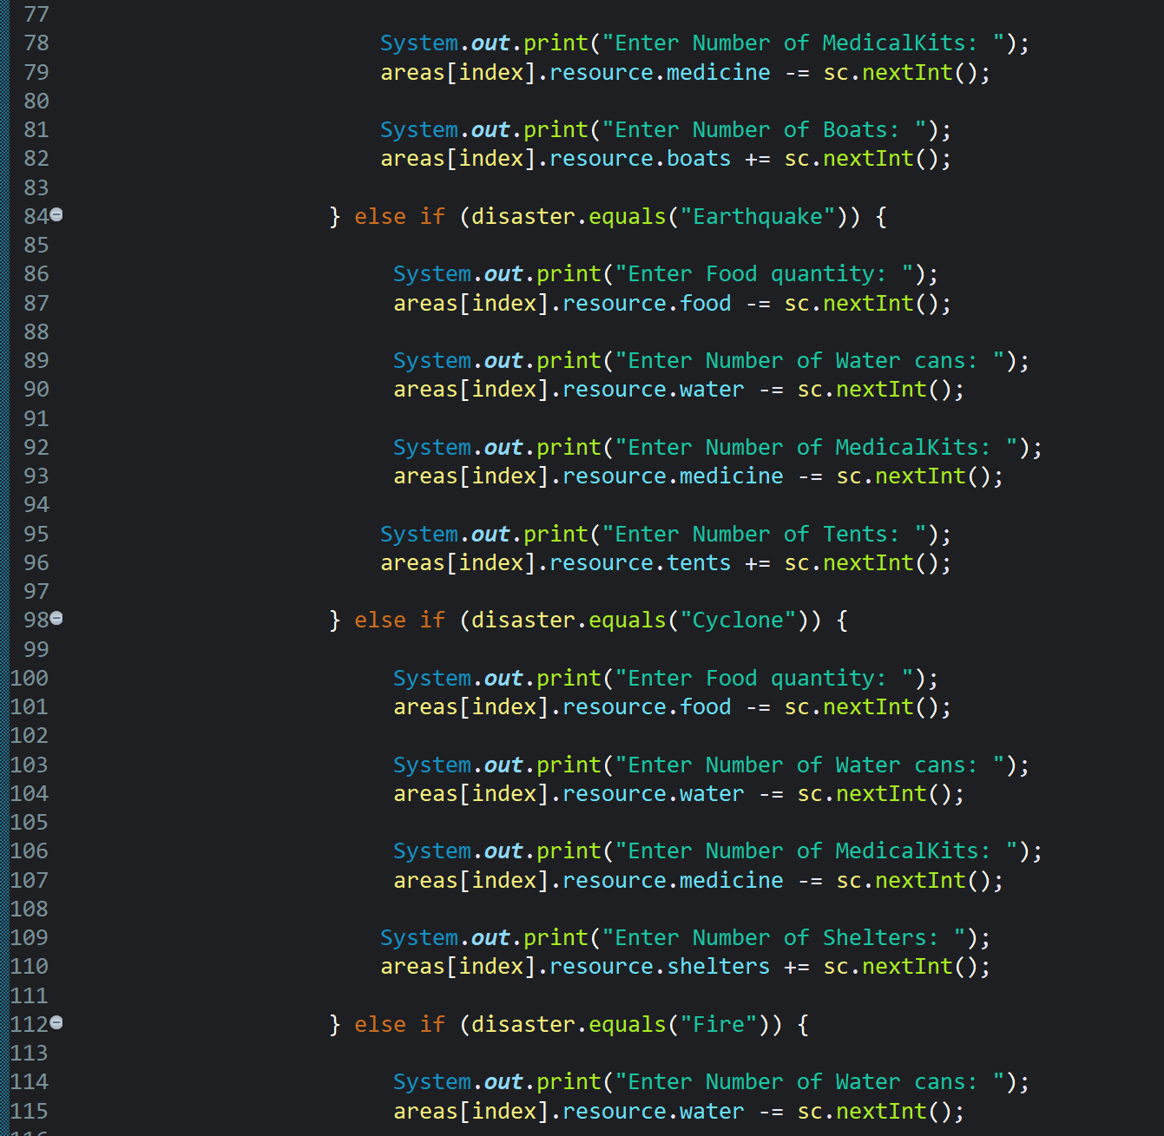
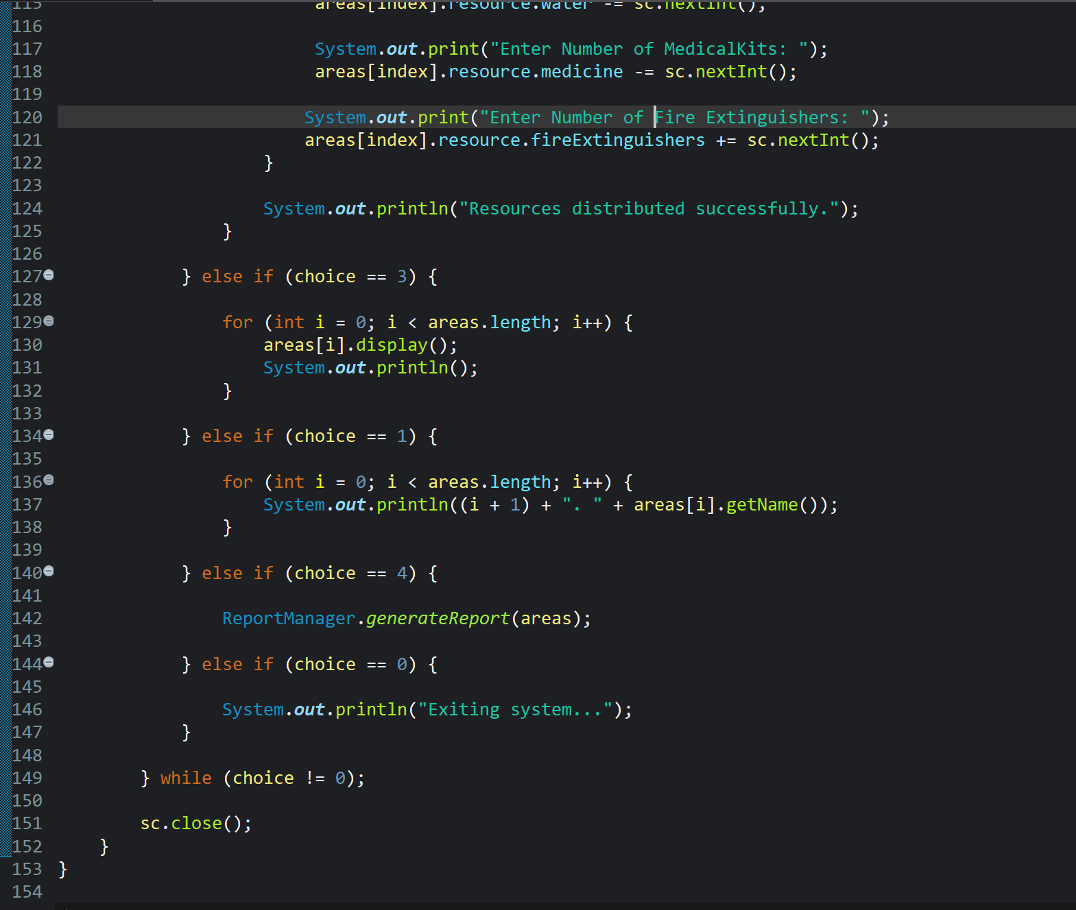
mainMenu.java

Slide 11
THANK YOU

