Slide 1

DBE & DSD · PROJECT REVIEW 1 · 25CS1302E
Enterprise Knowledge Intelligence Platform
Hybrid Relational, Document, and Vector Data Architecture
KLH University · Group Number: 10 · Project Supervisor: L. Melinda
Team Members:
M. Sathya Krishna – 2510080006
Yashwanth – 2510080001
Aneeq – 2510080005
Abhinav – 2510080002

Slide 2
TheKnowledgeFragmentation Problem
Wasted Time
Poor Search Quality
Employees spend significant time searching for information that should be readily accessible.
Traditional keyword-based search returns irrelevant results, failing to understand intent or meaning.
Duplication & Cost
Security Gaps
Knowledge duplication increases storage and maintenance costs across the organisation.
Lack of centralised management leads to version control issues and unauthorised access risks.
Affected sectors: IT Companies · Educational Institutions · Government Organisations · Healthcare Organisations · Research Institutes · Large Enterprises

Slide 3

Why This Project Matters
Beneficiary Groups
Employees, Managers, Researchers, Students, Organisations, Knowledge Admins
Impact Areas
Productivity, Decision-making, Digital Transformation, Knowledge Sharing, Time Savings
Improve collaboration and information sharing across teams
Centralise organisational knowledge in one secure platform
Replace keyword search with intelligent semantic understanding

Slide 4
Project Objectives
Secure Knowledge Platform
1
Develop a robust enterprise knowledge management system with end-to-end security controls.
2
Hybrid Data Storage
Store structured, unstructured, and semantic data using multiple specialised database technologies.
Fast REST APIs
3
Provide high-performance RESTful APIs for seamless knowledge access and integration.
4
Role-Based Access Control
Implement authentication and authorisation with granular permission levels per user role.
AI-Powered Semantic Search
5
Enable natural language document search using vector embeddings and AI models.
6
Scalable Distributed Backend
Build a distributed architecture designed to scale with enterprise growth and cloud deployment.

Slide 5

Proposed Solution & Methodology
Login & Authentication
Embedding Generation
Main Modules
User & Role Management
Knowledge Repository
Document & Semantic Search
REST APIs & Authentication
Deployment & Testing
Knowledge Upload
Database Stack
PostgreSQL
MongoDB
Qdrant / Pinecone
Users, roles, permissions, and metadata
Documents and knowledge articles
Vector embeddings for semantic search

Slide 6
Feasibility Analysis
Hardware Requirements
Software Stack
Public Dataset
Stack Exchange Data Dump
Technical questions and answers
Tags and metadata
Used for semantic search and
document retrieval
Languages
Frameworks
Java · Python · JavaScript
· SQL
Spring Boot · React.js
Laptop / Desktop
Operating System
Databases
Tools
Minimum Intel Core i5 / Ryzen 5,
8 GB RAM, 20 GB free storage
Windows 10/11, Ubuntu Linux
or macOS
PostgreSQL · MongoDB · Qdrant
Docker · Git · Postman · Maven · Visual Studio Code
Internet Connection
Security & AI
Required for APIs & cloud services
Spring Security · JWT · OpenAI / Sentence Transformers

Slide 7
Novelty of the Project
❌ Existing Systems
✅ Our Proposed System
Keyword search only — no semantic understanding
Single-database storage — limited flexibility
Hybrid Database Architecture
AI Semantic Search
Search by meaning: "How do I deploy the backend?"
PostgreSQL + MongoDB + Vector DB working in concert
Poor scalability and version control
Minimal or no role-based access control
Role-Based Security
Scalable & Distributed
Granular permissions for Admin, Manager, and Employee roles
Microservices-ready, cloud-deployable, Docker-containerised

Slide 8
KEY INNOVATION
Three Databases, One Intelligent Platform
The integration of relational, document, and vector databases in a single enterprise platform enables efficient data management, intelligent semantic search, enhanced security, and scalable architecture — making it significantly more powerful than conventional knowledge management systems.
Relational Layer
Document Layer
Vector Layer
PostgreSQL manages users, roles, permissions, and structured metadata with full ACID compliance.
MongoDB stores flexible, schema-less documents and knowledge articles at scale.
Qdrant enables AI-powered semantic search by matching meaning, not just keywords.

Slide 9
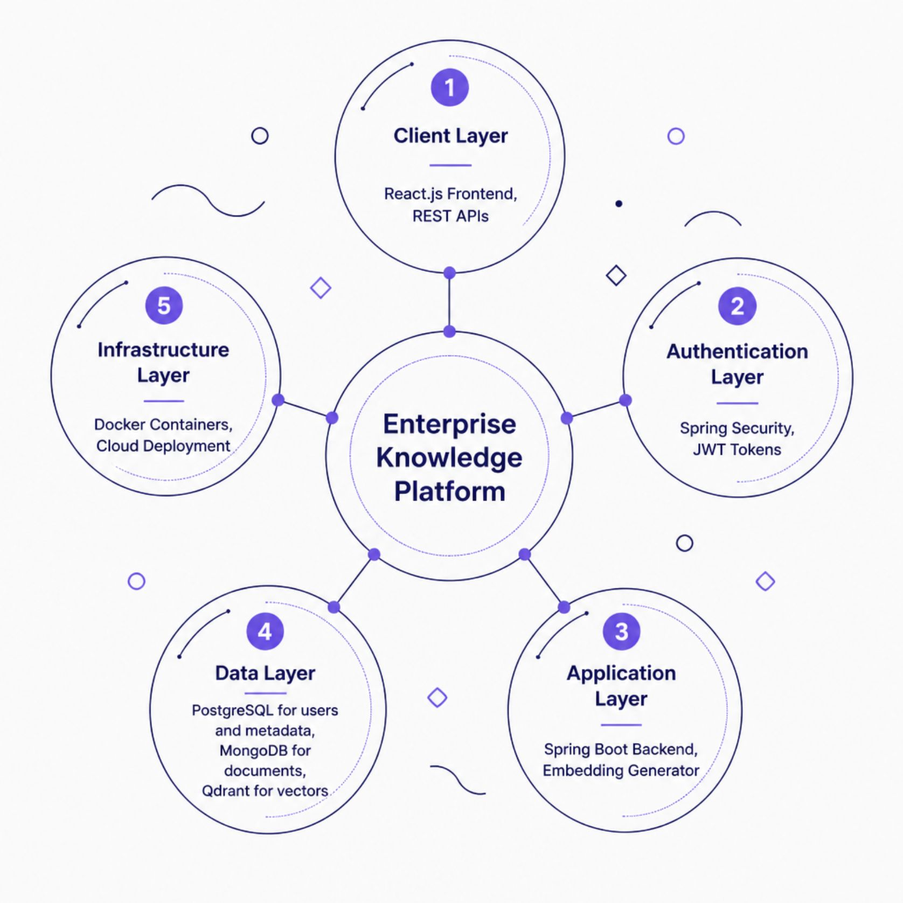
Architecture Overview
System Architecture
Design Principles
Separation of Concerns
Each database handles the data type it is optimised for, ensuring
performance and clarity.
Security by Design
JWT-based authentication and role-based authorisation are
embedded at every layer.
Cloud-Ready
Docker containerisation and microservices patterns enable
seamless cloud deployment.

Slide 10

PROJECT REVIEW 1
Summary & Next Steps
This project presents a novel, hybrid architecture that addresses real-world knowledge management challenges through modern database engineering and AI-powered search.
01
02
Finalise Architecture Design
Set Up Development Environment
Confirm database schemas, API contracts, and embedding model selection.
Configure Docker containers for PostgreSQL, MongoDB, and Qdrant.
03
04
Implement Core Modules
Integrate & Test
Build authentication, document upload, and embedding generation pipelines.
Connect all layers, validate semantic search, and conduct security testing.
Course: Database Engineering & Distributed Systems Design (25CS1302E) · Institution: KLH University · Review: Project Review 1

