Slide 1
TextHack> find "knowledge"
TextHack
Team
M. Sathya Krishna
2510080006
An advanced algorithm engine for enterprise knowledge search
Yashwanth
2510080001
Aneeq
2510080005
Abhinav
2510080002
Enterprise Knowledge Intelligence Platform · DSA-3 Review
Guide
O(n+m)
O(n+z)
O(n log n)
O(n·m)
O(V²E)
Dr. P. Anitha
Department of Artificial Intelligence & Data Science · KLH University
Notes:
TextHack is the Data Structures and Algorithms part of our Enterprise Knowledge Intelligence Platform: an engine of 20 algorithms, written from scratch in Java, that the platform uses for keyword and fuzzy search and for a workbench where users can run the algorithms. The badges are the complexities we will keep coming back to.

Slide 2
INTRODUCTION
Searching enterprise knowledge is a string problem
Background
Need for the project
Organisations keep their knowledge in thousands of documents: policies, handbooks, reports, research.
Finding the right one depends on text search that copes with how people actually type.
Real queries contain typos, reordered words and several terms at once, and documents cite one another.
Database LIKE / ILIKE matches exact substrings only; one typo returns nothing.
Scanning once per search term costs O(k·n) for k terms.
Libraries hide cost and correctness; the course requires building and proving the algorithms.
How strongly two documents are connected through citations is a graph problem.
Three kinds of query the engine must answer
fuzzy "recieve" ~2
findall "vpn" "laptop" "policy"
doc 0 → … → doc 5
a typo
many terms at once
linked documents
TextHack · DSA-3 Review
2
Notes:
Background: knowledge lives in documents, and people search it with imperfect queries. The need: the standard database tools only find exact substrings, and scanning once per term does not scale. The three chips at the bottom are the three kinds of query the engine has to handle.

Slide 3
PROBLEM STATEMENT
What we set out to solve
Build, from first principles and without library shortcuts, a verified engine of string, dynamic-programming, graph, approximation and randomized algorithms, and use it to make enterprise document search tolerant of typos, fast for many terms at once, and able to analyse citation structure, with the correctness and complexity of every algorithm demonstrated.
O(n+m) · O(n+z)
O(n·m)
max flow = min cut
Exact and multi-pattern matching
Approximate matching
Structure
Find every occurrence of one or many terms in linear time, with no worst-case input.
Rank near-misses such as "recieve" for "receive", and align two texts to show where they agree.
Measure how many independent citation chains connect two documents, and which citations every chain depends on.
TextHack · DSA-3 Review
3
Notes:
Read the statement. The three cards split it into the three algorithm families the platform actually needs: exact and multi-pattern matching, approximate matching, and graph structure.

Slide 4
OBJECTIVES
Goals and expected outcomes
1
Implement 20 algorithms from scratch
2
Prove correctness with tests
3
Document and measure complexity
No java.util in algorithm code
Known cases, edge cases, randomised cross-checks
Registry, complexity reference and benchmarks
31 files · 4,287 lines
452 assertions · 0 failures
22 registry entries
4
One engine API and query language
5
Improve the platform's search
6
Let users run the algorithms
find · findall · fuzzy · similar · prime
Keyword and fuzzy scoring in the search backend
REST API and a TextHack workbench page
TextHack facade
KMP · Aho-Corasick · OSA
4 endpoints · 4 panels
TextHack · DSA-3 Review
4
Notes:
Each objective has a measurable outcome, and every outcome on this slide was delivered. The numbers come from the repository and the test run.

Slide 5
LITERATURE REVIEW
The classic algorithms we built on
Problem | Published work | What it gives the engine
Exact matching | Knuth, Morris & Pratt (1977); Karp & Rabin (1987); Gusfield, Z-algorithm (1997) | Linear-time search; Rabin-Karp must verify each hash hit
Multi-pattern matching | Aho & Corasick (1975) | All k patterns in one pass, O(n + z)
Text indexing | Manber & Myers, suffix arrays (1993); Kasai et al., LCP (2001) | Repeated substrings; O(n log n) build, O(n) LCP
Edit distance and alignment | Levenshtein (1966); Damerau (1964); Needleman & Wunsch (1970); Smith & Waterman (1981) | Typo tolerance and global / local alignment, O(n·m)
Network flow | Ford & Fulkerson (1956); Edmonds & Karp (1972); Dinic (1970); Kuhn (1955) | Citation influence as max flow, bottleneck as min cut
Approximation and randomization | Graham (1966, 1969); Miller (1976), Rabin (1980); Carter & Wegman (1979); Vitter (1985) | Scheduling bounds, primality, universal hashing, sampling
TextHack · DSA-3 Review
5
Notes:
The engine implements the classic published algorithms; this is where each came from and what it contributes. Full references are on the last slides.

Slide 6
LITERATURE REVIEW
Existing approaches and their limitations
Database pattern matching
Full-text search engines
Naive textbook code
SQL LIKE / ILIKE in PostgreSQL
Apache Lucene / Elasticsearch
Typical classroom implementations
Exact substrings only: "recieve" never finds "receive"
Reordered words do not match
No relevance ranking
Fuzzy search exists, but as a large external service
Algorithms are a black box to the application
Does not meet the course rule of building algorithms from scratch
Z-algorithm with a sentinel breaks on text containing it
Rabin-Karp reporting unverified hash hits
(a·b) mod m overflowing 64 bits; Fermat tests fooled by Carmichael numbers
Our approach: build each algorithm ourselves, check it against a simple reference, and run the same verified code in the product.
TextHack · DSA-3 Review
6
Notes:
Three existing ways to solve the problem and why each falls short for this project. The third column is important: these textbook pitfalls are exactly the bugs our tests are designed to catch.

Slide 7
PROPOSED SYSTEM
TextHack: one verified engine, used by the whole platform
A dependency-free Java engine of 20 algorithms in five families, behind one facade and a small query language. The platform's Spring Boot backend compiles the same source for keyword and fuzzy search, and a workbench page lets users run the algorithms on their own input.
O(n+m)
O(n+z)
O(n·m)
Exact search
Many terms in one pass
Typo tolerance
KMP, Z-algorithm and Rabin-Karp, with no pathological input for KMP and Z
Aho-Corasick automaton with failure and output links
Levenshtein and Damerau-Levenshtein (restricted OSA and unrestricted)
O(n·m)
O(V²E)
ratio bounds
Alignment
Citation analysis
Provable guarantees
Needleman-Wunsch (global) and Smith-Waterman (local)
Dinic max flow and the Edmonds-Karp minimum cut
Miller-Rabin exact for 64-bit, LPT within 4/3, vertex cover within 2×
TextHack · DSA-3 Review
7
Notes:
The proposal in one sentence: a dependency-free engine that the backend compiles directly, so the same verified code runs in the tests and in production. The six cards are the key features, each with its complexity.

Slide 8
SYSTEM ARCHITECTURE
Where TextHack sits in the platform
React frontend
Verification (runs without the platform)
Search page
keyword, fuzzy and semantic results
TextHack workbench
pattern · similarity · citations · complexity
6 test suites
452 assertions
Spring Boot backend
Benchmarks
timings and growth ratios
SearchService + LexicalScorer
KMP phrase · Aho-Corasick terms · OSA typos
TextHackController
POST /api/texthack/pattern · similarity · citations
Demos
worked examples per module
TextHack engine (DSA-3, pure Java, no dependencies)
engine: TextHack facade · QueryParser · CitationFlow · ComplexityRegistry
compiled together by run-tests.sh with javac -Xlint:all
string
dp
graph
approximation
randomized
core
Search data: document titles and descriptions come from PostgreSQL; MongoDB and Qdrant serve content and semantic vectors.
TextHack · DSA-3 Review
8
Notes:
Bottom layer: the engine, with no dependencies. Middle: the Spring Boot backend compiles that same source as a second source root; the search service uses it for scoring, and the TextHack controller exposes it. Top: the React frontend. On the right, the engine's own verification, which runs without the platform.

Slide 9
SYSTEM ARCHITECTURE
Component description
Package | Responsibility | Main classes
core | Primitives replacing java.util: growable int list, sorted child map, seeded PRNG, matcher contract | IntList, CharMap, Prng, StringMatcher
string | Exact, multi-pattern and suffix-structure algorithms | NaiveSearch, KmpSearch, ZSearch, RabinKarpSearch, AhoCorasick, SuffixArray, LcpArray
dp | Edit distance and sequence alignment | Levenshtein, DamerauLevenshtein, NeedlemanWunsch, SmithWaterman, Alignment
graph | Residual networks, max flow and matching | FlowNetwork, FordFulkerson, EdmondsKarp, Dinic, BipartiteMatching
approximation | NP-hard problems with proven ratios | VertexCover, MakespanScheduling
randomized | Primality, hashing and sampling | MillerRabin, UniversalHashing, ReservoirSampling
engine | One facade, query language, citation analysis, complexity registry | TextHack, QueryParser, Query, CitationFlow, ComplexityRegistry
platform | Search scoring, REST API and workbench page | LexicalScorer, SearchService, TextHackController, TextHackPage
TextHack · DSA-3 Review
9
Notes:
Each package and its classes. The core package exists because the course bars java.util in the algorithms: IntList replaces ArrayList of Integer, CharMap is the trie child map, and Prng is a seeded generator so any failing random test can be reproduced.

Slide 10
METHODOLOGY
How every algorithm was built and verified
1
2
3
4
5
6
Specify
Reference
Implement
Cross-validate
Measure
Integrate
Contract: inputs, output order, edge cases, rejected input
Simple, obviously correct version: naive search, brute-force sort
The efficient algorithm, from scratch, no java.util
Random inputs checked against the reference; fixed edge cases
Complexity documented, benchmarks check growth rates
Engine → backend scoring → REST API → workbench page
Techniques used
failure function
rolling hash + verify
trie + failure/output links
prefix doubling + counting sort
Kasai LCP carry
rolling-row DP
traceback matrices
residual graphs
BFS level graphs + current arc
heapsort (LPT)
Russian-peasant mod-mul
Algorithm R sampling
TextHack · DSA-3 Review
10
Notes:
The same six steps for every module. The key idea is step 2: a simple, obviously correct reference implementation, so step 4 can compare the efficient version against it on thousands of random inputs.

Slide 11
METHODOLOGY
The 20 algorithms, in five families
String
Dynamic programming
Network flow
Approximation
Randomized
Naive search
Levenshtein
Ford-Fulkerson
Vertex cover
Miller-Rabin
O(n·m)
O(n·m)
O(E·f)
ratio 2
O(k log³n)
KMP
Damerau-Lev. (+OSA)
Edmonds-Karp
List scheduling
Universal hashing
O(n+m)
O(n·m)
O(V·E²)
2 − 1/m
O(1)
Z-algorithm
Needleman-Wunsch
Dinic
LPT scheduling
Reservoir sampling
O(n+m)
O(n·m)
O(V²·E)
4/3 − 1/3m
O(n)
Rabin-Karp
Smith-Waterman
Bipartite matching
O(n+m) exp.
O(n·m)
O(V·E)
Aho-Corasick
O(n+z)
Suffix array
O(n log n)
LCP (Kasai)
O(n)
TextHack · DSA-3 Review
11
Notes:
All 20 algorithms from the TextHack list. Damerau-Levenshtein comes in two variants, OSA and unrestricted, and scheduling in two, list and LPT, which is why the complexity registry has 22 entries.

Slide 12
TOOLS & TECHNOLOGIES
Languages, tools and requirements
Languages and tools
Software requirements
Java 21
Engine, tests, benchmarks; also verified on Java 25
Engine: any JDK 21 or later; Windows, Linux or macOS
Full platform: Docker, Node.js 20+, a modern browser
javac + sh
run-tests.sh compiles with -Xlint:all; no Maven or JUnit
Spring Boot 3.4
Backend compiles the engine as a second source root
React 19 + Vite
TextHack workbench and search pages
Hardware requirements
Engine: any dual-core machine with 4 GB RAM
Benchmarks in this review: AMD Ryzen 7 260 laptop, Windows 11
Git · GitHub Actions
Version control; CI runs the DSA-3 suites
Docker
Runs the full platform with its databases
TextHack · DSA-3 Review
12
Notes:
The engine needs only a JDK: no build tool, no test framework, nothing to download. That was deliberate, so anyone can compile and run the 452 assertions. The platform around it uses Spring Boot and React.

Slide 13
IMPLEMENTATION
Modules developed
31
engine source files
4,287
lines of algorithm code
3,113
lines of tests (6 suites)
0
java.util imports in algorithms
0
javac -Xlint:all warnings
TextHack · DSA-3 Review
13
Notes:
The engine is 31 source files and 4,287 lines across seven packages, with another 3,113 lines of tests. The string and engine packages are the largest because they carry the most algorithms and the query language.

Slide 14
IMPLEMENTATION
Working process
Engine query flow
Query text
fuzzy "recieve" ~2
QueryParser
tokens → Query
TextHack facade
picks the algorithm
Algorithm
Levenshtein ≤ 2 edits
Result
relieve 1 · receive 2
Search scoring flow in the platform
User query
"recieve report"
Candidates
PostgreSQL phrase match + TextHack scan
LexicalScorer
KMP · Aho-Corasick · OSA
Fusion
with the semantic score
Results
fuzzy hits flagged FUZZY
Exact phrase in title (KMP)
1.0
Phrase in description
0.75
Term coverage (Aho-Corasick)
≤ 0.9
Term one edit away (OSA)
0.7 credit
Term two edits away
0.5 credit
Terms of ≤ 3 characters
never fuzzed
TextHack · DSA-3 Review
14
Notes:
Top row: how the engine answers a query on its own. Bottom row: how the platform uses it for search. The scoring numbers are the constants in LexicalScorer: an exact phrase in a title scores 1.0; term coverage is capped at 0.9 so a partial match never ties with the exact phrase; a one-edit fuzzy match earns 0.7 credit and a two-edit match 0.5; terms of three characters or fewer are never fuzzed.

Slide 15
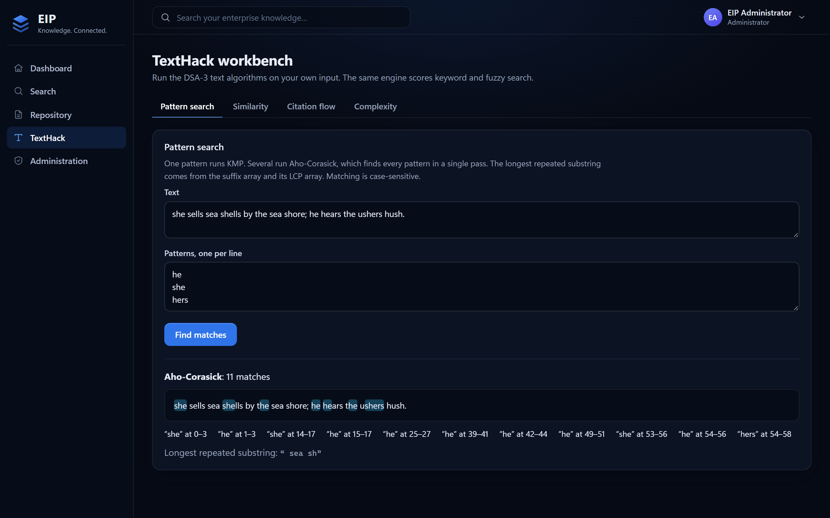
RESULTS AND SCREENSHOTS
Workbench: pattern search
11 matches, one pass
Aho-Corasick finds he, she and hers together
Nested patterns
"he" inside "she", "hers" inside "ushers", found via output links
Longest repeated substring
" sea sh", from the suffix array and LCP array
One pattern → KMP
The API switches algorithm by pattern count
TextHack · DSA-3 Review
15
Notes:
Three patterns, so the backend uses Aho-Corasick and finds all eleven matches in one pass. Note the nested patterns: "he" inside "she", and "he" and "hers" inside "ushers". The automaton reaches "he" through its output links. The longest repeated substring comes from the suffix array and LCP array.

Slide 16
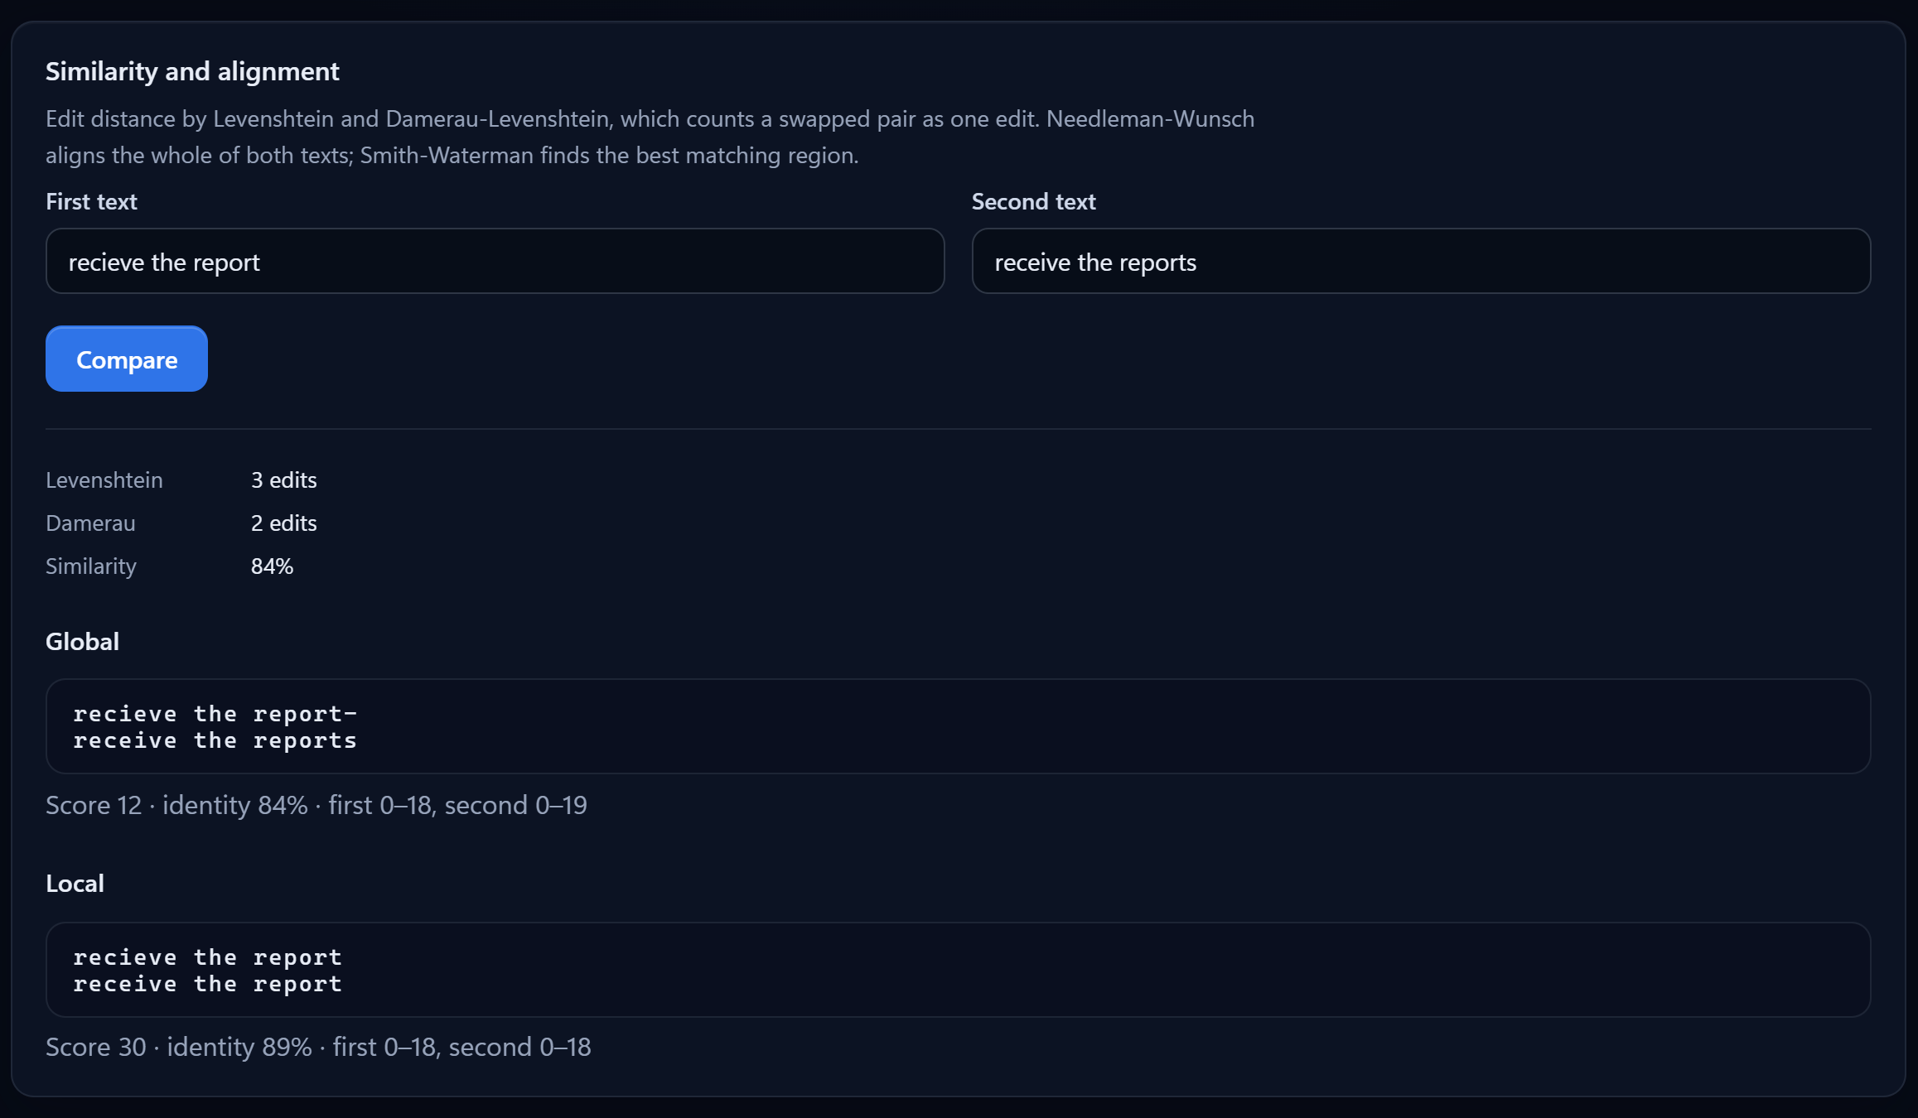
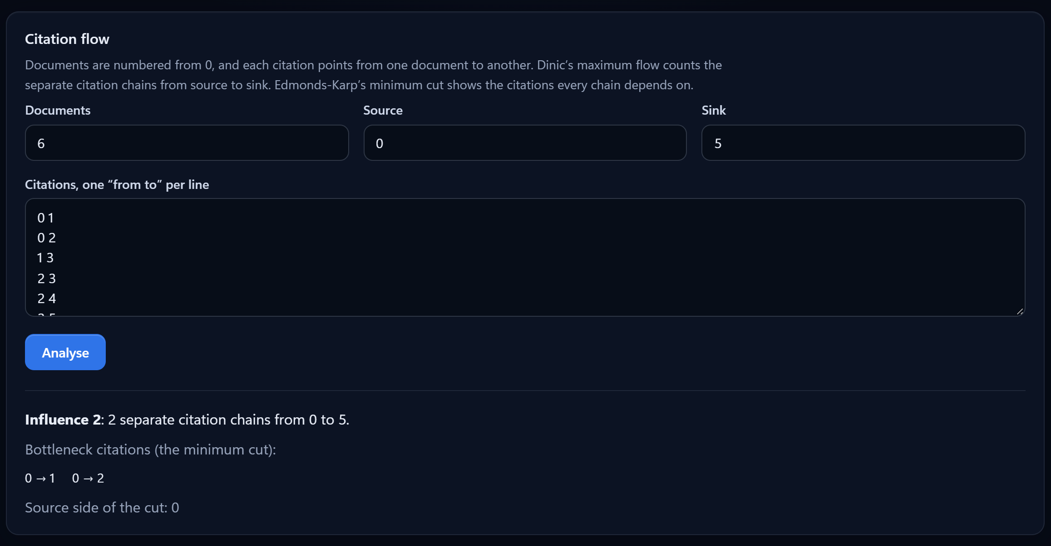
RESULTS AND SCREENSHOTS
Workbench: similarity and citation flow
Levenshtein 3 edits vs Damerau 2: the swapped "ie" is one edit
Global (Needleman-Wunsch) and local (Smith-Waterman) alignment shown with scores
Influence 2: two separate citation chains (Dinic max flow)
Bottleneck citations 0→1 and 0→2 (Edmonds-Karp min cut)
TextHack · DSA-3 Review
16
Notes:
Left: "recieve the report" against "receive the reports". Levenshtein counts the swapped i and e as two edits, Damerau counts it as one, which is why search uses Damerau. Global alignment covers both whole strings; local alignment drops the trailing s. Right: six documents; Dinic finds two independent citation chains from 0 to 5, and the minimum cut is the two citations leaving document 0.

Slide 17
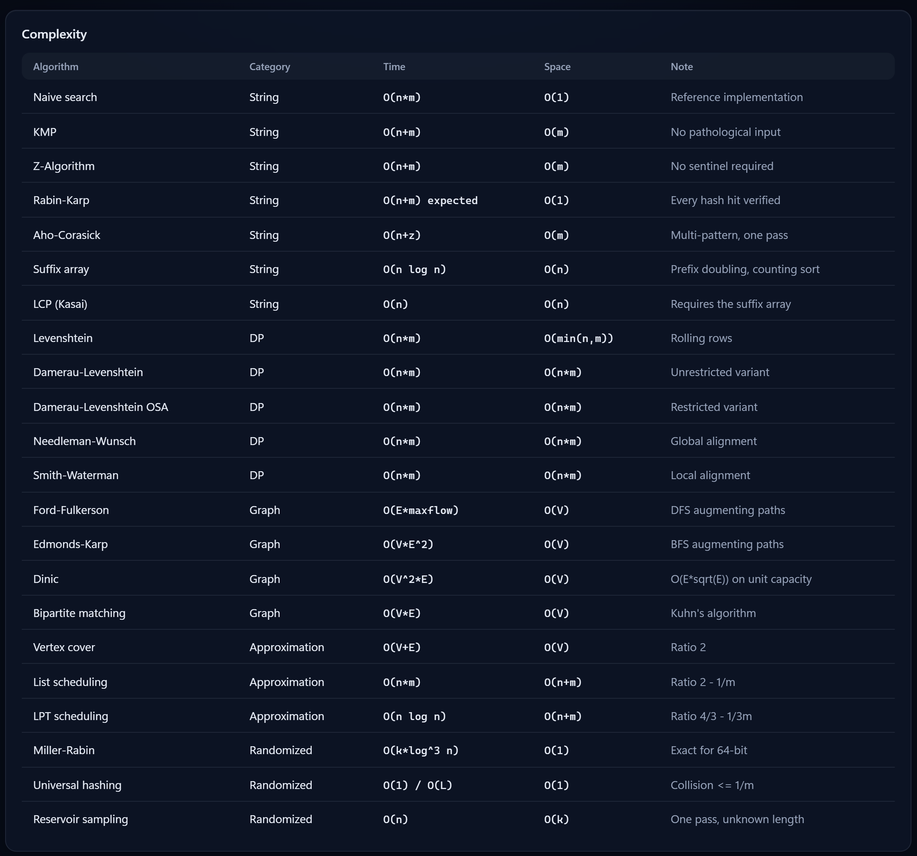
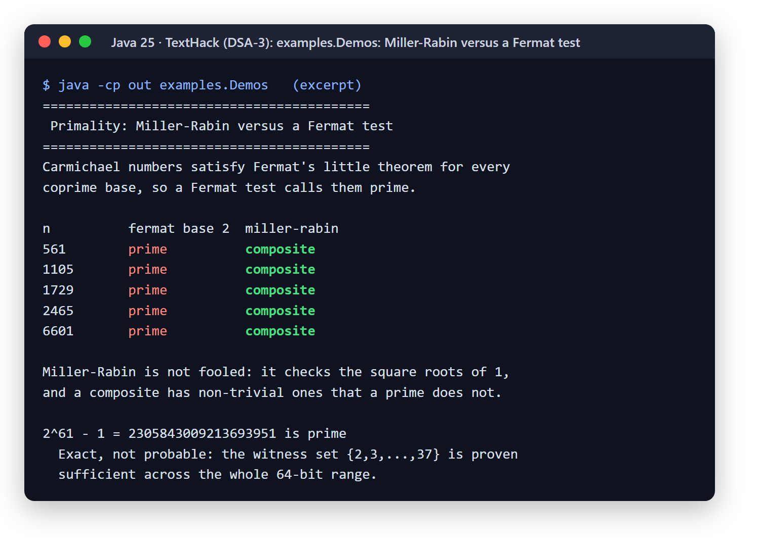
RESULTS AND SCREENSHOTS
Complexity registry and Miller-Rabin
Carmichael numbers 561, 1105, 1729… pass a Fermat test; Miller-Rabin rejects every one.
TextHack · DSA-3 Review
17
Notes:
Left: the workbench shows the engine's complexity registry, all 22 entries, served live from the API. Right: the demo that justifies Miller-Rabin. Carmichael numbers fool a Fermat test, because they satisfy Fermat's little theorem for every coprime base; Miller-Rabin rejects all of them and proves 2^61 − 1 prime exactly.

Slide 18
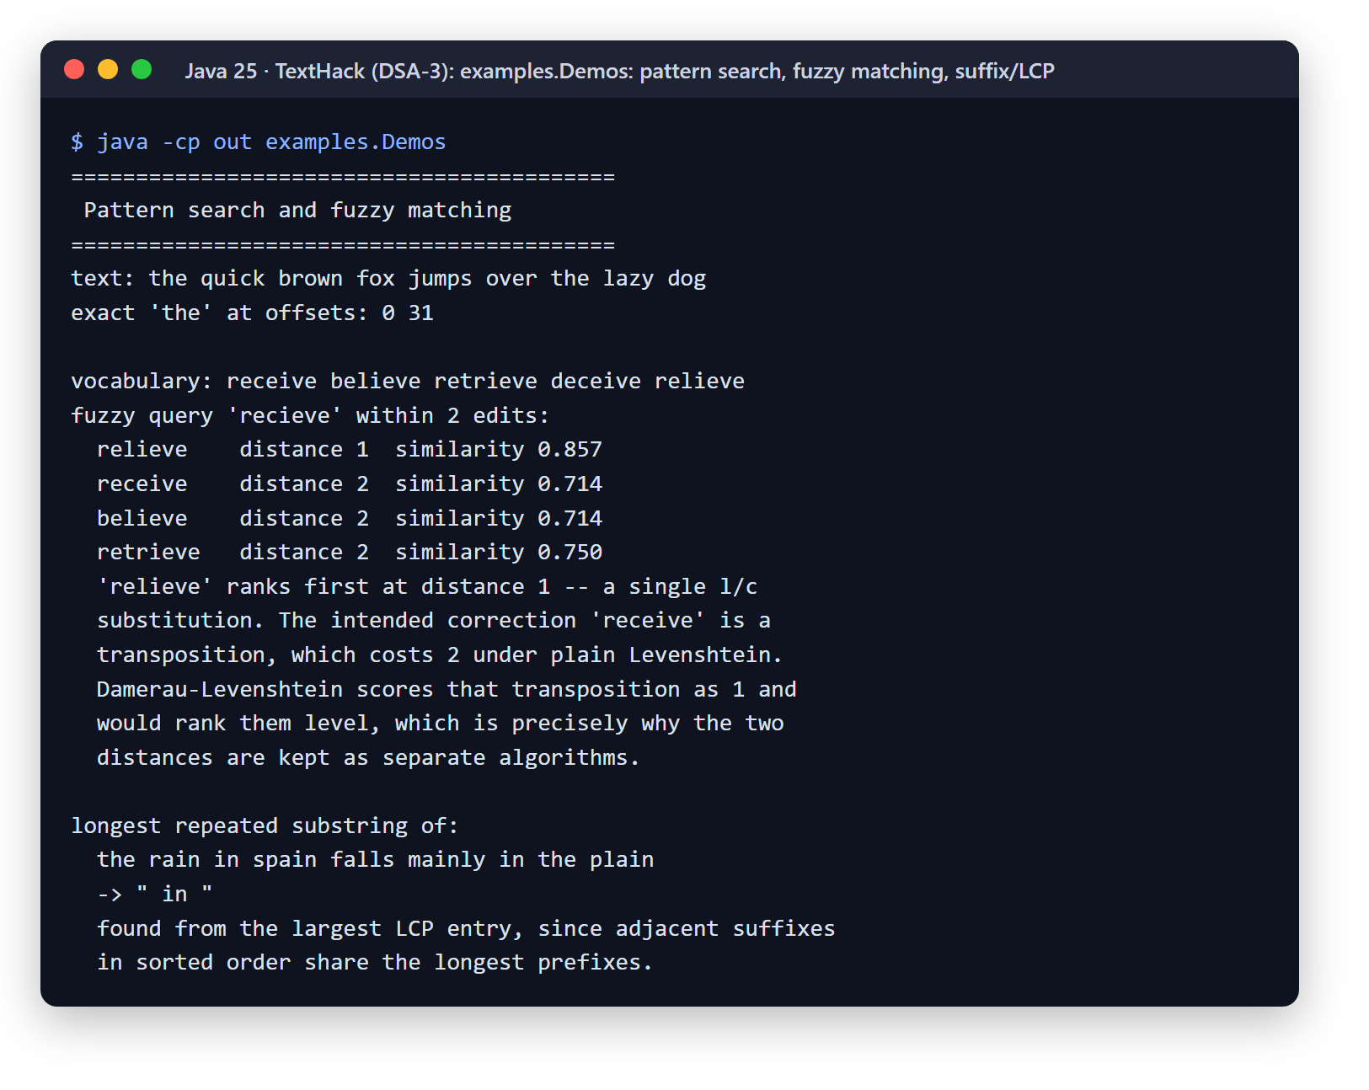
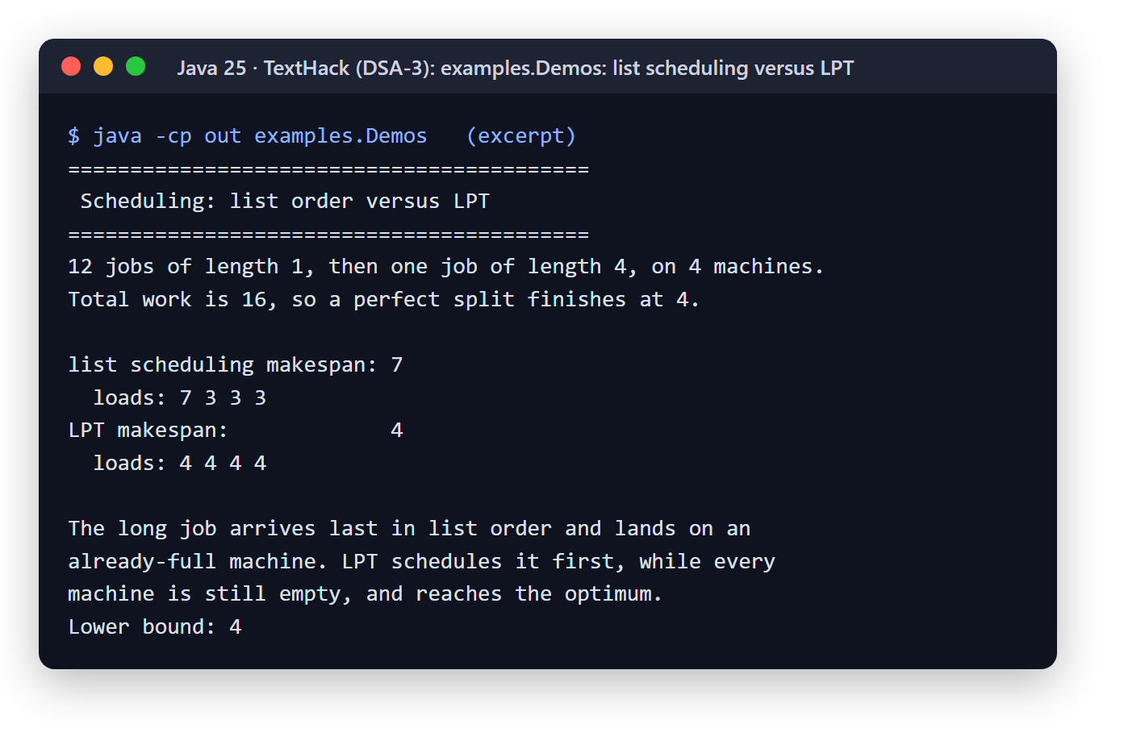
RESULTS AND SCREENSHOTS
Engine demos: fuzzy matching and scheduling
TextHack · DSA-3 Review
18
Notes:
Left: fuzzy search for "recieve". Plain Levenshtein ranks "relieve" first, one substitution, while the intended "receive" is a transposition that costs two, which motivates Damerau. Right: twelve short jobs and one long job on four machines. List scheduling places the long job last and gets 7; LPT sorts longest first and reaches the optimum of 4.

Slide 19
PERFORMANCE OBSERVATIONS
The measured growth matches the theory
13×
KMP over naive at 160,000 characters (1.05 vs 13.68 ms)
15.5×
Aho-Corasick over KMP × k with 80 patterns
≈ 2×
Suffix array time per doubling of n: O(n log n)
≈ 4–6×
Levenshtein time per doubling of both strings: O(n·m)
TextHack · DSA-3 Review
19
Notes:
Measured with benchmarks.Benchmark, best of five runs after three warm-up rounds, on an AMD Ryzen 7 260 laptop. Left: the adversarial input a^40 b in a run of a's. Naive search grows linearly to 13.7 ms at 160,000 characters; KMP and Z stay near 1 ms. The small sizes are noisy because the JIT is still warming up. Right: Aho-Corasick stays flat as patterns are added, while running KMP once per pattern grows linearly.

Slide 20
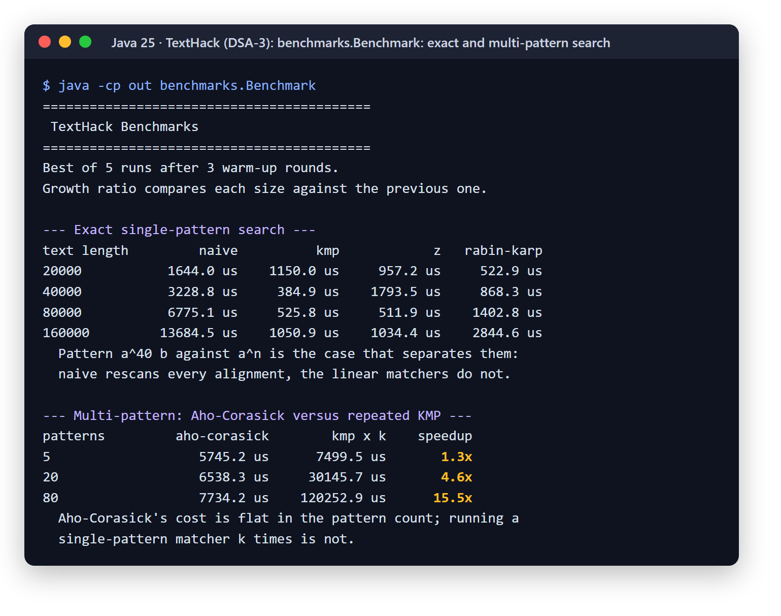
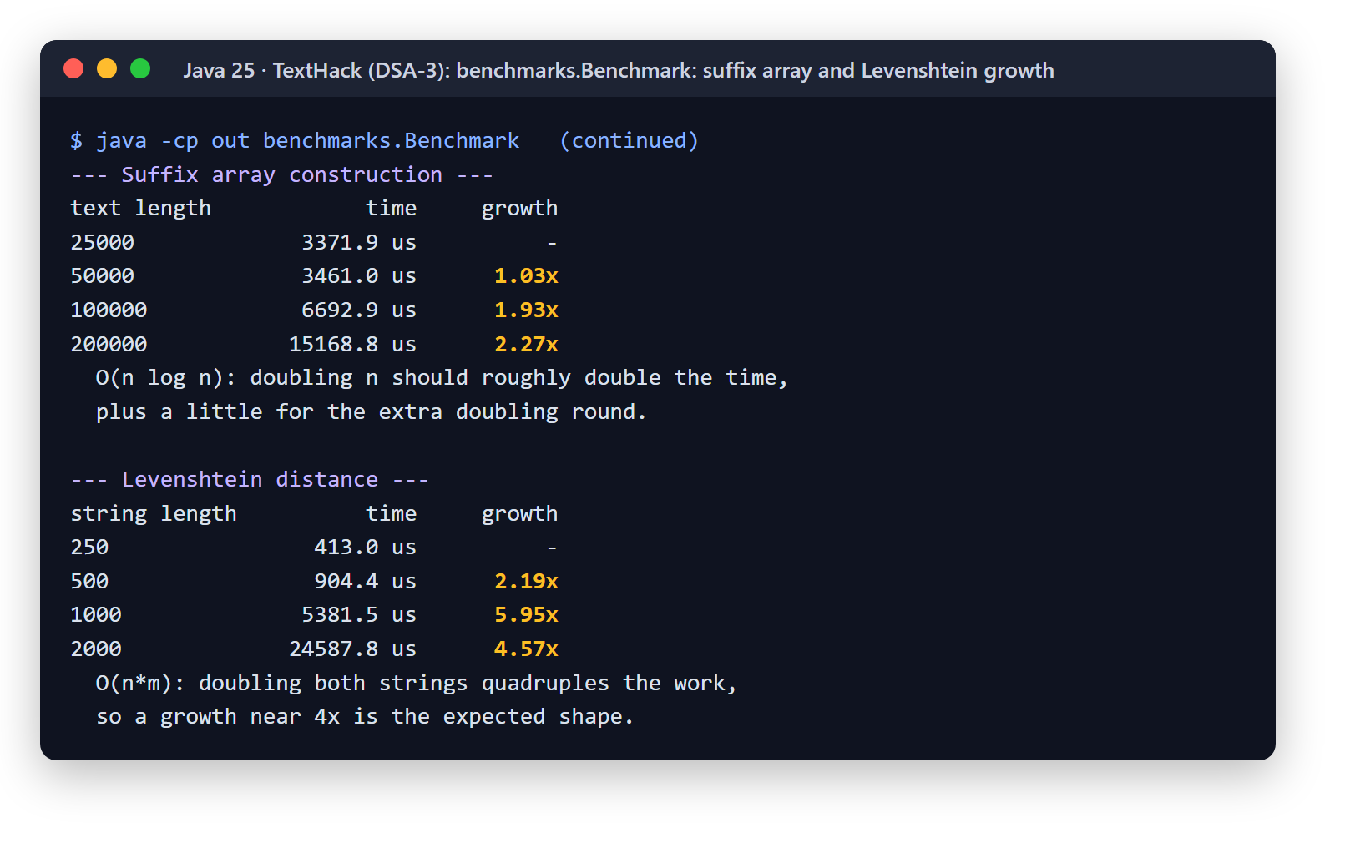
PERFORMANCE OBSERVATIONS
Benchmark output
a⁴⁰b in aⁿ is naive search's worst case: every alignment rescans 40 characters
Aho-Corasick cost is flat in the number of patterns
Growth ratios, not absolute times, confirm each bound
Best of 5 after 3 warm-ups on a laptop, so the smallest sizes are noisy
TextHack · DSA-3 Review
20
Notes:
The raw benchmark output behind the charts. The growth-ratio columns are the point: suffix array construction roughly doubles when n doubles, which is O(n log n); Levenshtein grows four to six times when both strings double, which is O(n·m).

Slide 21
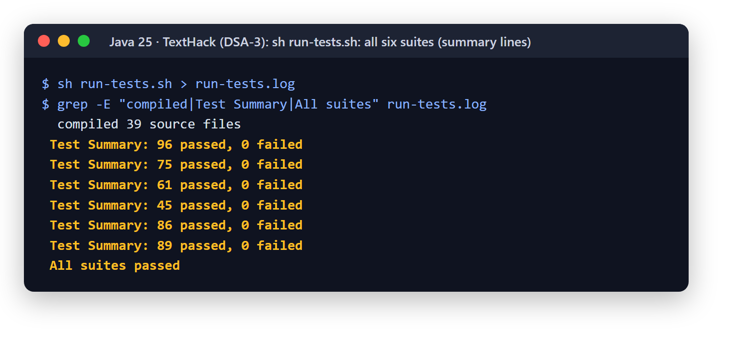
TESTING
Test cases and results
Suite | Assertions | What it covers
StringAlgorithmTests | 96 | Edge cases, overlaps, pathological repeats, Unicode and NUL, 4,000 random cases vs naive
SuffixAndMultiPatternTests | 75 | Aho-Corasick nesting and duplicates, suffix and LCP arrays vs brute force
DpTests | 61 | Metric properties, OSA vs unrestricted Damerau, alignment scores and invariants
GraphTests | 45 | Three max-flow algorithms agree on 600 random networks; max-flow = min-cut
ApproximationAndRandomizedTests | 86 | Ratios vs brute-force optima, Carmichael numbers, sampling uniformity
EngineTests | 89 | Query parser, facade, citation flow, complexity registry
Total | 452 | 0 failures · 0 compiler warnings
Re-run for this review with Java 25; the CI pipeline runs the same script on Java 21.
TextHack · DSA-3 Review
21
Notes:
Six self-checking suites with 452 assertions and no failures. There is no JUnit: each suite is a plain Java program that prints PASS or FAIL and exits non-zero on failure, and run-tests.sh runs all six even if one fails.

Slide 22
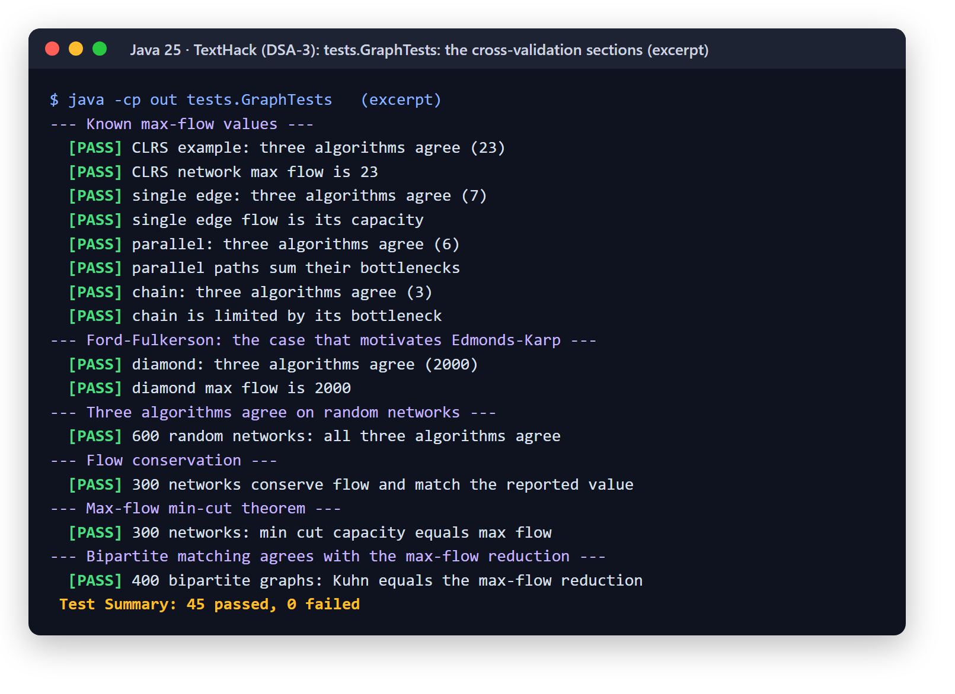
TESTING
How the tests prove correctness
1
Randomised cross-validation
Efficient algorithms are checked against simple references on random inputs: 4,000 strings, 600 networks, 400 graphs.
2
Small alphabets on purpose
2–4 characters make overlaps and accidental matches common, which is where off-by-one errors surface.
3
Reproducible randomness
A hand-written seeded generator replaces java.util.Random, so a failing case can be replayed from its seed.
4
Theory as a test
Max flow equals min cut; approximation ratios hold against brute-force optima; a 40,000-trial check that sampling is uniform.
5
Adversarial inputs
Carmichael numbers, a 2,000-character repeat, text containing \u0000, patterns nested inside patterns.
TextHack · DSA-3 Review
22
Notes:
The strongest technique is cross-validation against a reference. It already found a real bug, in the test rather than the algorithm: a hand-counted index was wrong, and the evidence was that all four matchers agreed with each other on 4,000 random cases while disagreeing with the constant.

Slide 23
ADVANTAGES
Benefits of the proposed system
✓
✓
✓
Typo-tolerant search
Fast for many terms
Guaranteed worst case
Damerau-Levenshtein finds "receive" from "recieve", which SQL LIKE cannot
Aho-Corasick checks every query term in one pass: 15.5× faster than KMP per term with 80 patterns
KMP and Z never degrade; no input makes them quadratic
✓
✓
✓
Proven, not assumed
No dependencies
Explainable results
452 assertions, randomised cross-checks, and theorems verified as tests
Only a JDK to build and test; the same source runs in the backend
Complexity registry, alignments and min-cut citations shown to users
TextHack · DSA-3 Review
23
Notes:
The benefits, each tied to something concrete in the implementation.

Slide 24
APPLICATIONS
Real-world use cases
Enterprise document search
Spell correction and autocomplete
Keyword and fuzzy ranking in the platform's search
Suggest the nearest dictionary words to a mistyped query
KMP · Aho-Corasick · OSA
Levenshtein · Damerau
Plagiarism and duplicate detection
Research citation analysis
Local alignment isolates a shared paragraph between two documents
Count independent citation chains and find the citations they depend on
Smith-Waterman · suffix array
Dinic · min cut
Keyword filtering and security
Bioinformatics
Match thousands of blocked words or signatures in one pass
The alignment algorithms were designed for DNA and protein sequences
Aho-Corasick
Needleman-Wunsch
TextHack · DSA-3 Review
24
Notes:
Where each algorithm family is used in practice. The first three are live in our platform; the rest are the same algorithms in other domains.

Slide 25
CHALLENGES FACED
Issues encountered and how we solved them
Issue | Solution
java.util was barred from algorithm code | Wrote IntList, CharMap and a seeded PRNG; sorted suffixes with counting sort instead of a library sort
Z-algorithm's textbook sentinel breaks on text containing it | Compute the Z-array of the pattern only and match against the text: no sentinel, and O(m) space
Rabin-Karp hash collisions give false matches at scale | Verify every hash hit character by character
(a·b) mod m overflows 64 bits in Miller-Rabin | Russian-peasant modular multiplication; BigInteger would replace the algorithm with a library call
"Interval scheduling" was listed under approximation, but it is solved exactly | Replaced with makespan scheduling, which is NP-hard: list scheduling (2 − 1/m) and LPT (4/3)
Plain Levenshtein counts a swapped pair as 2 edits | Added Damerau-Levenshtein in both variants; the tests pin where they disagree
Aho-Corasick does not fit a one-pattern matcher interface | Gave it its own API returning which pattern matched, instead of one automaton per pattern
TextHack · DSA-3 Review
25
Notes:
Each row is a real issue from the build, documented in the complexity reference and test suites.

Slide 26
FUTURE ENHANCEMENTS
Scope for improvement
01
02
03
Indian-language corpus
Search at larger scale
Faster fuzzy lookup
Build an Indian-language Wikipedia corpus; needs dump selection and a licence review
The fuzzy scan scores up to 5,000 documents in memory; move candidate generation into a trigram index
BK-trees or Levenshtein automata to avoid comparing against every term
04
05
06
Linear-time suffix arrays
More flow algorithms
Parallel matching
SA-IS construction in O(n) instead of prefix doubling
Push-relabel max flow and weighted citation graphs
Split large texts across threads for Aho-Corasick and KMP
TextHack · DSA-3 Review
26
Notes:
The first item is the one algorithm-list item deliberately not done, because it is a data and licensing task. The second is a known ceiling in the platform's search, marked in the code. The rest are algorithmic upgrades.

Slide 27
CONCLUSION
A verified algorithm engine, running in a real product
20
452
22
13×
algorithms, from scratch
assertions, 0 failures
complexity entries
KMP vs naive, worst case
Implemented string, DP, flow, approximation and randomized algorithms with no library shortcuts
Proved them with cross-validation against references, adversarial inputs and theorems-as-tests
Confirmed their complexity with benchmarks, and documented every bound
Made the platform's search typo-tolerant and fast for many terms, and gave users a workbench to explore the algorithms
Notes:
Summary: every objective from the start of the talk was met, with the evidence shown in the results and testing sections.

Slide 28
REFERENCES
Research papers, books and resources
D. E. Knuth, J. H. Morris, V. R. Pratt, "Fast pattern matching in strings," SIAM J. Computing, 6(2), 1977.
A. V. Aho, M. J. Corasick, "Efficient string matching: an aid to bibliographic search," Comm. ACM, 18(6), 1975.
R. M. Karp, M. O. Rabin, "Efficient randomized pattern-matching algorithms," IBM J. Research and Development, 31(2), 1987.
U. Manber, G. Myers, "Suffix arrays: a new method for on-line string searches," SIAM J. Computing, 22(5), 1993.
T. Kasai et al., "Linear-time longest-common-prefix computation in suffix arrays and its applications," CPM, 2001.
V. I. Levenshtein, "Binary codes capable of correcting deletions, insertions, and reversals," Soviet Physics Doklady, 10(8), 1966.
F. J. Damerau, "A technique for computer detection and correction of spelling errors," Comm. ACM, 7(3), 1964.
S. B. Needleman, C. D. Wunsch, "A general method applicable to the search for similarities in the amino acid sequence of two proteins," J. Molecular Biology, 48(3), 1970.
T. F. Smith, M. S. Waterman, "Identification of common molecular subsequences," J. Molecular Biology, 147(1), 1981.
L. R. Ford, D. R. Fulkerson, "Maximal flow through a network," Canadian J. Mathematics, 8, 1956.
J. Edmonds, R. M. Karp, "Theoretical improvements in algorithmic efficiency for network flow problems," J. ACM, 19(2), 1972.
E. A. Dinic, "Algorithm for solution of a problem of maximum flow in networks with power estimation," Soviet Math. Doklady, 11, 1970.
H. W. Kuhn, "The Hungarian method for the assignment problem," Naval Research Logistics Quarterly, 2, 1955.
R. L. Graham, "Bounds for certain multiprocessing anomalies," Bell System Technical J., 45(9), 1966; "Bounds on multiprocessing timing anomalies," SIAM J. Applied Mathematics, 17(2), 1969.
G. L. Miller, "Riemann's hypothesis and tests for primality," J. Computer and System Sciences, 13(3), 1976; M. O. Rabin, "Probabilistic algorithm for testing primality," J. Number Theory, 12(1), 1980.
J. L. Carter, M. N. Wegman, "Universal classes of hash functions," J. Computer and System Sciences, 18(2), 1979.
J. S. Vitter, "Random sampling with a reservoir," ACM Trans. Mathematical Software, 11(1), 1985.
T. H. Cormen, C. E. Leiserson, R. L. Rivest, C. Stein, Introduction to Algorithms, 4th ed., MIT Press, 2022. D. Gusfield, Algorithms on Strings, Trees, and Sequences, Cambridge Univ. Press, 1997.
TextHack · DSA-3 Review
28
Notes:
The primary papers for every algorithm in the engine, plus the textbooks we used.

Slide 29
TextHack> prime 7919
7919 is prime
Thank you
Questions and discussion
M. Sathya Krishna · Yashwanth · Aneeq · Abhinav Guide: Dr. P. Anitha
Department of Artificial Intelligence & Data Science · KLH University
Notes:
Invite questions. Useful follow-ups to be ready for: why Damerau and not Levenshtein for search; why Dinic and Edmonds-Karp are both used; how cross-validation found a bug in a test.

