Slide 1
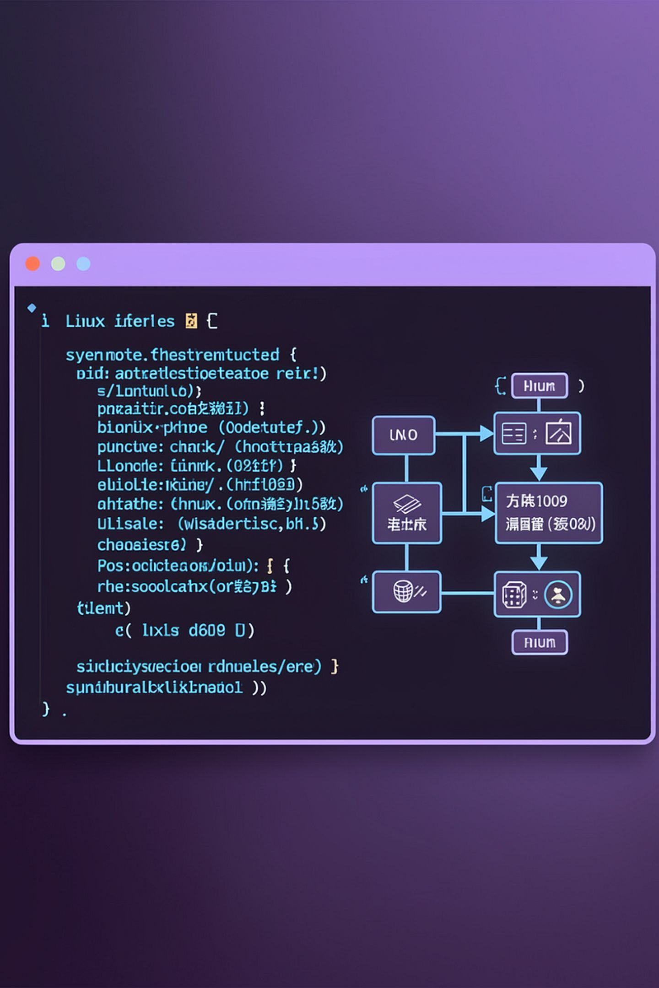
ShellForge
Linux-Based Administration Console for the Enterprise Knowledge Intelligence Platform
OPERATING SYSTEMS AND SYSTEMS PROGRAMMING (OSSP)
Sathya Krishna - 2510080006
Yeswanth - 2510080001
Aneeq - 2510080005
Abhinav - 2510080002
· Course: OSSP · Guide: Dr. P. Kalpana · KLH University

Slide 2
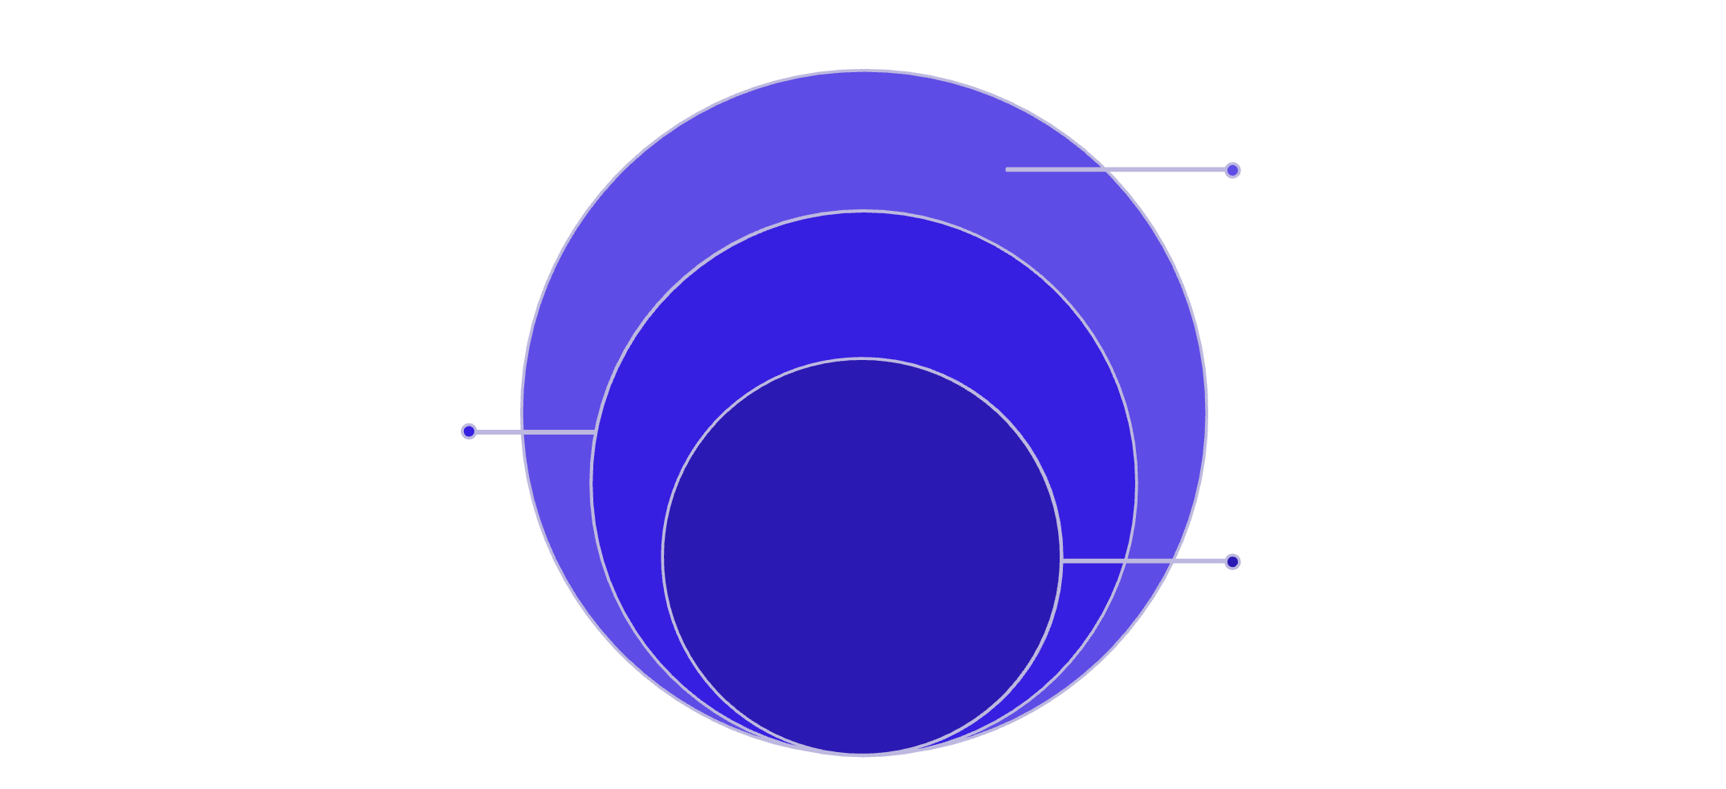
Problem Statement
The Gap
The Solution: ShellForge
Modern enterprise applications rely on graphical interfaces, but system administrators need a fast, lightweight, and scriptable CLI for managing services, monitoring processes, and troubleshooting resources.
A Unix-like shell built in C that serves as the command-line administration console for the Enterprise Knowledge Intelligence Platform — enabling direct interaction with the backend through Linux system programming concepts.
Linux Kernel
Provides system calls and resource control
ShellForge CLI
Lightweight, scriptable command interface
Administrator
Performs management and troubleshooting

Slide 3
Project Objectives
Custom Unix Shell
Process Management
Memory & File I/O
Develop a REPL-based shell in C with command parsing and built-in commands.
Implement fork(), exec(), wait(), and background job control.
Manage virtual memory, dynamic allocation, and Linux file descriptors.
IPC & Concurrency
Platform Integration
Implement pipes, signals, POSIX threads, mutexes, and synchronization.
Integrate ShellForge with the Enterprise Knowledge Intelligence Platform.

Slide 4
Technology Stack
Language
Environment
C (GNU GCC)
Ubuntu / WSL · Visual Studio Code · Make · Git & GitHub
Linux APIs
Tools
System Calls · pthread · Signals · Pipes · File I/O
GDB · Valgrind · Makefile · Bash
Development Workflow
ShellForge is developed on Ubuntu/WSL using GNU GCC and managed via Git/GitHub
Notes:
28. POSIX
Full Form
Portable Operating System Interface
A standard that defines APIs for Unix-like operating systems.
Examples
pthread
signals
file APIs
29. pthread
Full Form
POSIX Thread
Library used to create threads in C.
30. Mutex
Full Form
Mutual Exclusion
Only one thread can access shared data at a time.
Prevents data corruption.
31. Semaphore
A synchronization mechanism that controls access to a limited number of shared resources.
Example
Only 5 document indexing threads can run simultaneously.
32. Deadlock
Two or more processes wait for each other forever.
Example
Thread A waits for Thread B
Thread B waits for Thread A
Neither proceeds.

Slide 5
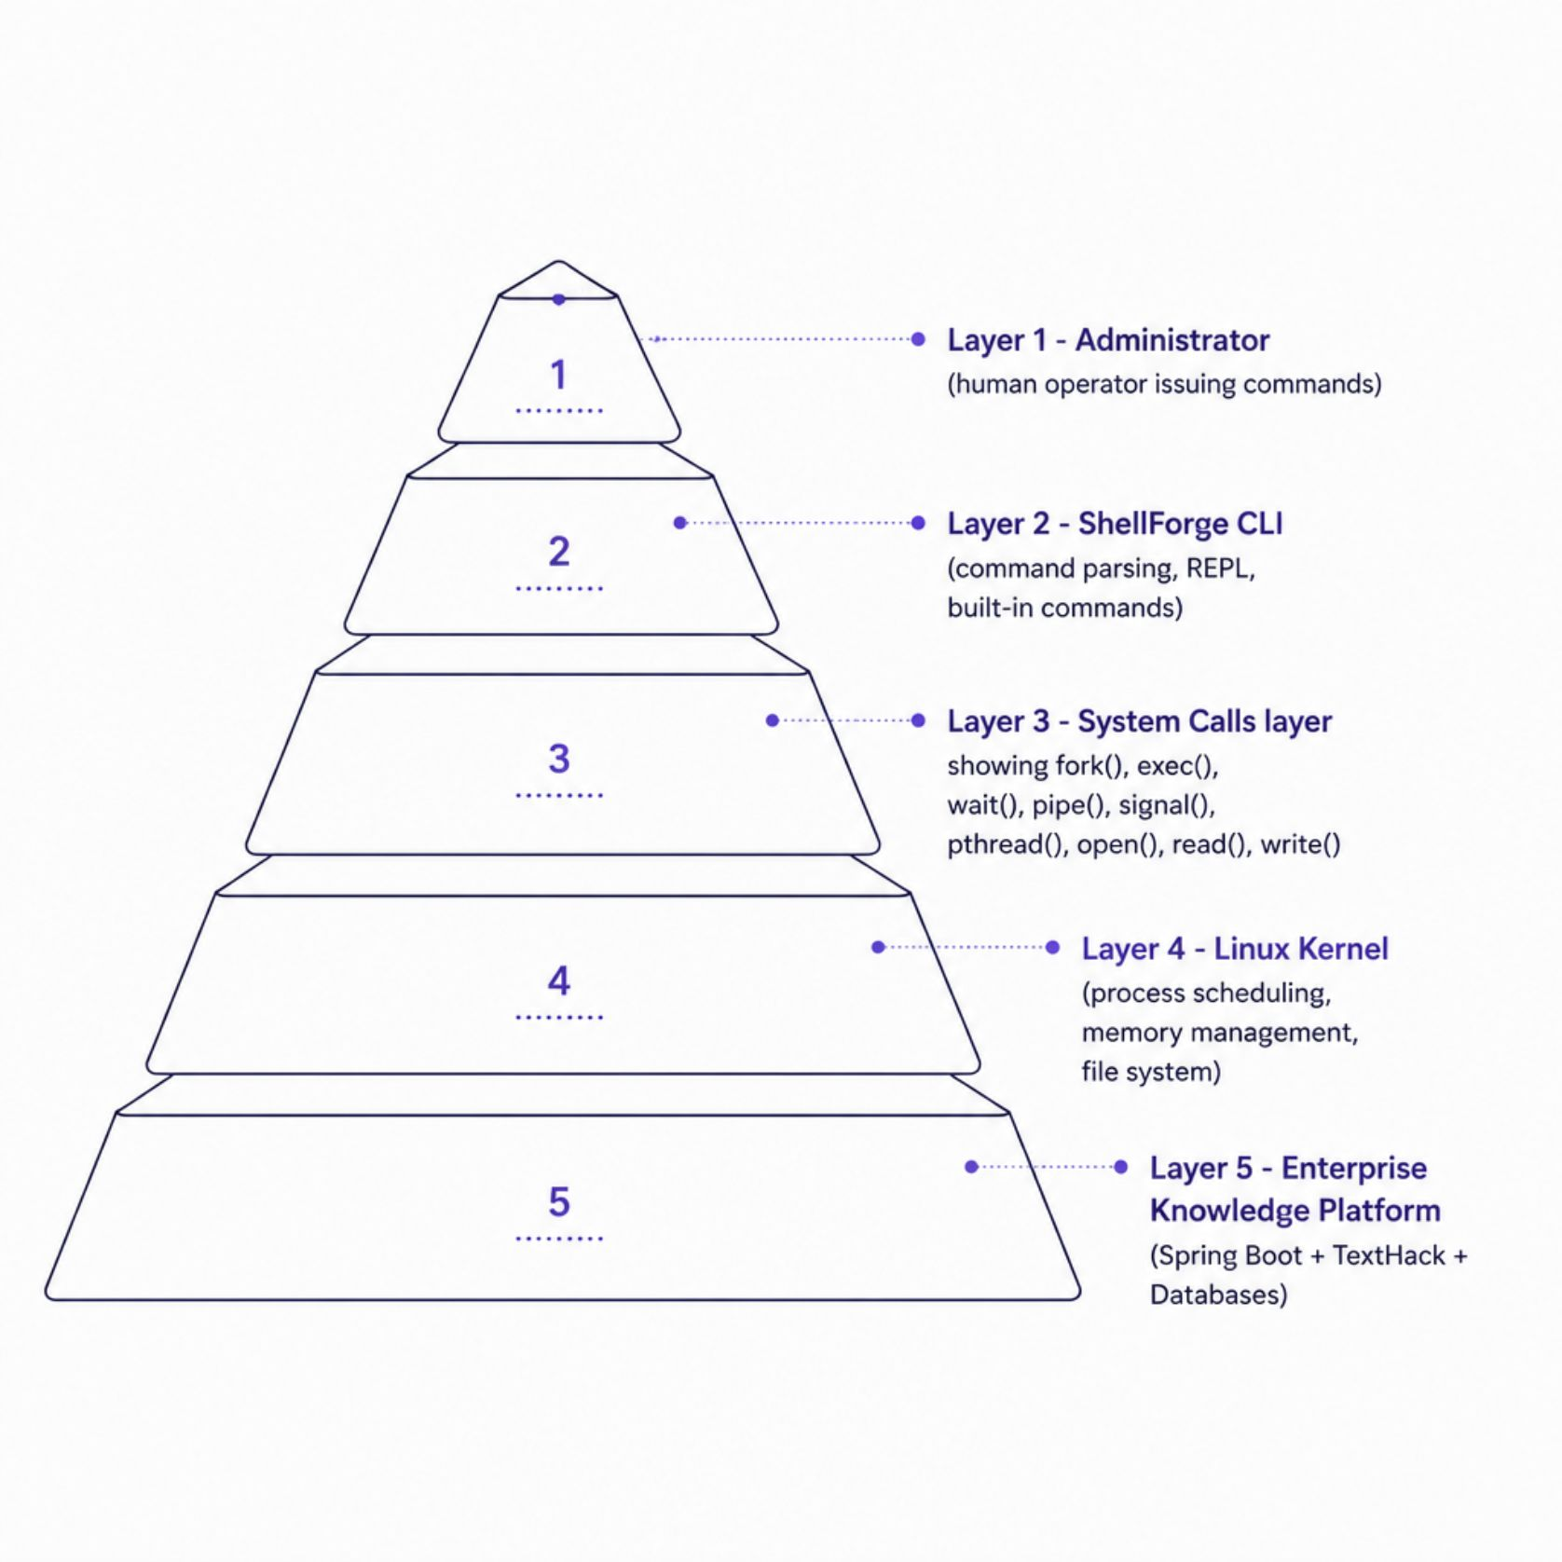
System Architecture
ShellForge acts as the Linux administration interface for the enterprise platform, translating administrator commands into kernel-level system calls.
Layer Breakdown
Administrator
Issues commands via the ShellForge prompt.
ShellForge CLI
Parses input, dispatches system calls.
Linux Kernel
Handles process, memory, and I/O operations.
Enterprise Platform
Spring Boot + TextHack + Databases backend.
Notes:
28. POSIX
Full Form
Portable Operating System Interface
A standard that defines APIs for Unix-like operating systems.
Examples
pthread
signals
file APIs
29. pthread
Full Form
POSIX Thread
Library used to create threads in C.
30. Mutex
Full Form
Mutual Exclusion
Only one thread can access shared data at a time.
Prevents data corruption.
31. Semaphore
A synchronization mechanism that controls access to a limited number of shared resources.
Example
Only 5 document indexing threads can run simultaneously.
32. Deadlock
Two or more processes wait for each other forever.
Example
Thread A waits for Thread B
Thread B waits for Thread A
Neither proceeds.

Slide 6
Project Modules
Shell & REPL
Process Management
Command parsing, prompt rendering, built-in commands.
fork(), exec(), wait(), background jobs.
IPC
Memory Management
Pipes, named pipes, and signal handling.
Virtual memory, dynamic allocation, debugging.
Linux File System
Concurrency
File descriptors, I/O operations, directory management.
POSIX threads, mutex, semaphores, synchronization.
Notes:
Here is a presentation script you can use when you reach the "Project Modules" slide. I have broken it down module by module so you can speak to each point naturally.
### Introduction to the Slide
"Moving on to the core architecture of ShellForge, let's walk through our Project Modules. This slide breaks down the six fundamental areas we are building to create this Linux-based administration console."
### The Modules
Shell & REPL
"Our first module is the Shell & REPL. This is the front-line interface where we handle command parsing, render the user prompt, and build out the essential built-in commands that administrators will use daily."
Process Management
"Next is Process Management. This is where we interact directly with the OS using system calls like fork(), exec(), and wait() to create and control processes, which includes managing background jobs effectively."
IPC (Inter-Process Communication)
"The third module is IPC. To allow different processes to talk to each other, we are implementing standard pipes and named pipes, alongside robust signal handling."
Memory Management
"Fourth, we have Memory Management. This module handles how our shell interacts with virtual memory and manages dynamic allocation, as well as the debugging processes required to keep it stable."
Linux File System
"Our fifth module focuses on the Linux File System. This area is dedicated to managing file descriptors, executing standard I/O operations, and handling directory management."
Concurrency
"Finally, we have Concurrency. To ensure our shell performs efficiently, we are utilizing POSIX threads and implementing synchronization primitives like mutexes and semaphores."
### Conclusion / Transition
"By bringing these six modules together, our expected outcome is a fully functional shell that demonstrates practical implementations of these concepts and integrates smoothly with the Enterprise Knowledge Intelligence Platform."

Slide 7

Implementation Timeline
Week 1
1
Linux environment setup, Shell REPL, Makefile, Git repository.
2
Week 2
Command parser and built-in commands.
Week 3
3
Process creation with fork()/exec() and job control.
4
Week 4
Pipes, signals, and inter-process communication.
Week 5
5
File system operations, File I/O, and memory management.
6
Week 6
POSIX threads and synchronization primitives.
Week 7
7
Integration with Enterprise Knowledge Platform.
8
Week 8
Testing, optimization, and documentation.
Expected Outcome: A fully functional Linux-based administration shell integrated with the Enterprise Knowledge Intelligence Platform, demonstrating practical implementation of process management, IPC, memory management, file systems, and concurrency.
Notes:
28. POSIX
Full Form
Portable Operating System Interface
A standard that defines APIs for Unix-like operating systems.
Examples
pthread
signals
file APIs
29. pthread
Full Form
POSIX Thread
Library used to create threads in C.
30. Mutex
Full Form
Mutual Exclusion
Only one thread can access shared data at a time.
Prevents data corruption.
31. Semaphore
A synchronization mechanism that controls access to a limited number of shared resources.
Example
Only 5 document indexing threads can run simultaneously.
32. Deadlock
Two or more processes wait for each other forever.
Example
Thread A waits for Thread B
Thread B waits for Thread A
Neither proceeds.

