Slide 1

Enterprise Knowledge Intelligence Platform
Team Members
M. Sathya Krishna – 2510080006.
Yashwanth – 2510080001.
Aneeq – 2510080005.
Abhinav – 2510080002.
Guide: Anitha. P
An advanced algorithm-driven system for intelligent document processing, semantic search, and knowledge discovery — built on rigorous data structures and algorithmic foundations.
DSA-3 · PROJECT REVIEW 1
KLH UNIVERSITY

Slide 2

The Problem with Traditional Search
Inefficient Search
Keyword matching misses semantic intent and contextual relevance
No Fuzzy Handling
Spelling errors and variant queries return zero results
Slow at Scale
Linear scans across large document collections are prohibitively slow
No Optimisation
Task assignment and scheduling lack algorithmic intelligence

Slide 3
Project Objectives
TextHack unifies algorithmic rigour with enterprise-grade engineering to deliver a platform that is fast, intelligent, and scalable.
1
Intelligent Query Engine
Build the TextHack Algorithm Engine for fast, multi-pattern document search
2
Fuzzy & Semantic Search
Enable typo-tolerant queries using Dynamic Programming and vector embeddings
3
Document Similarity
Apply suffix structures and LCP arrays for precise similarity analysis
4
Graph-Based Assignment
Use network flow and bipartite matching for reviewer and task allocation
5
Optimisation & Randomisation
Demonstrate approximation and randomized algorithms for scheduling and indexing

Slide 4
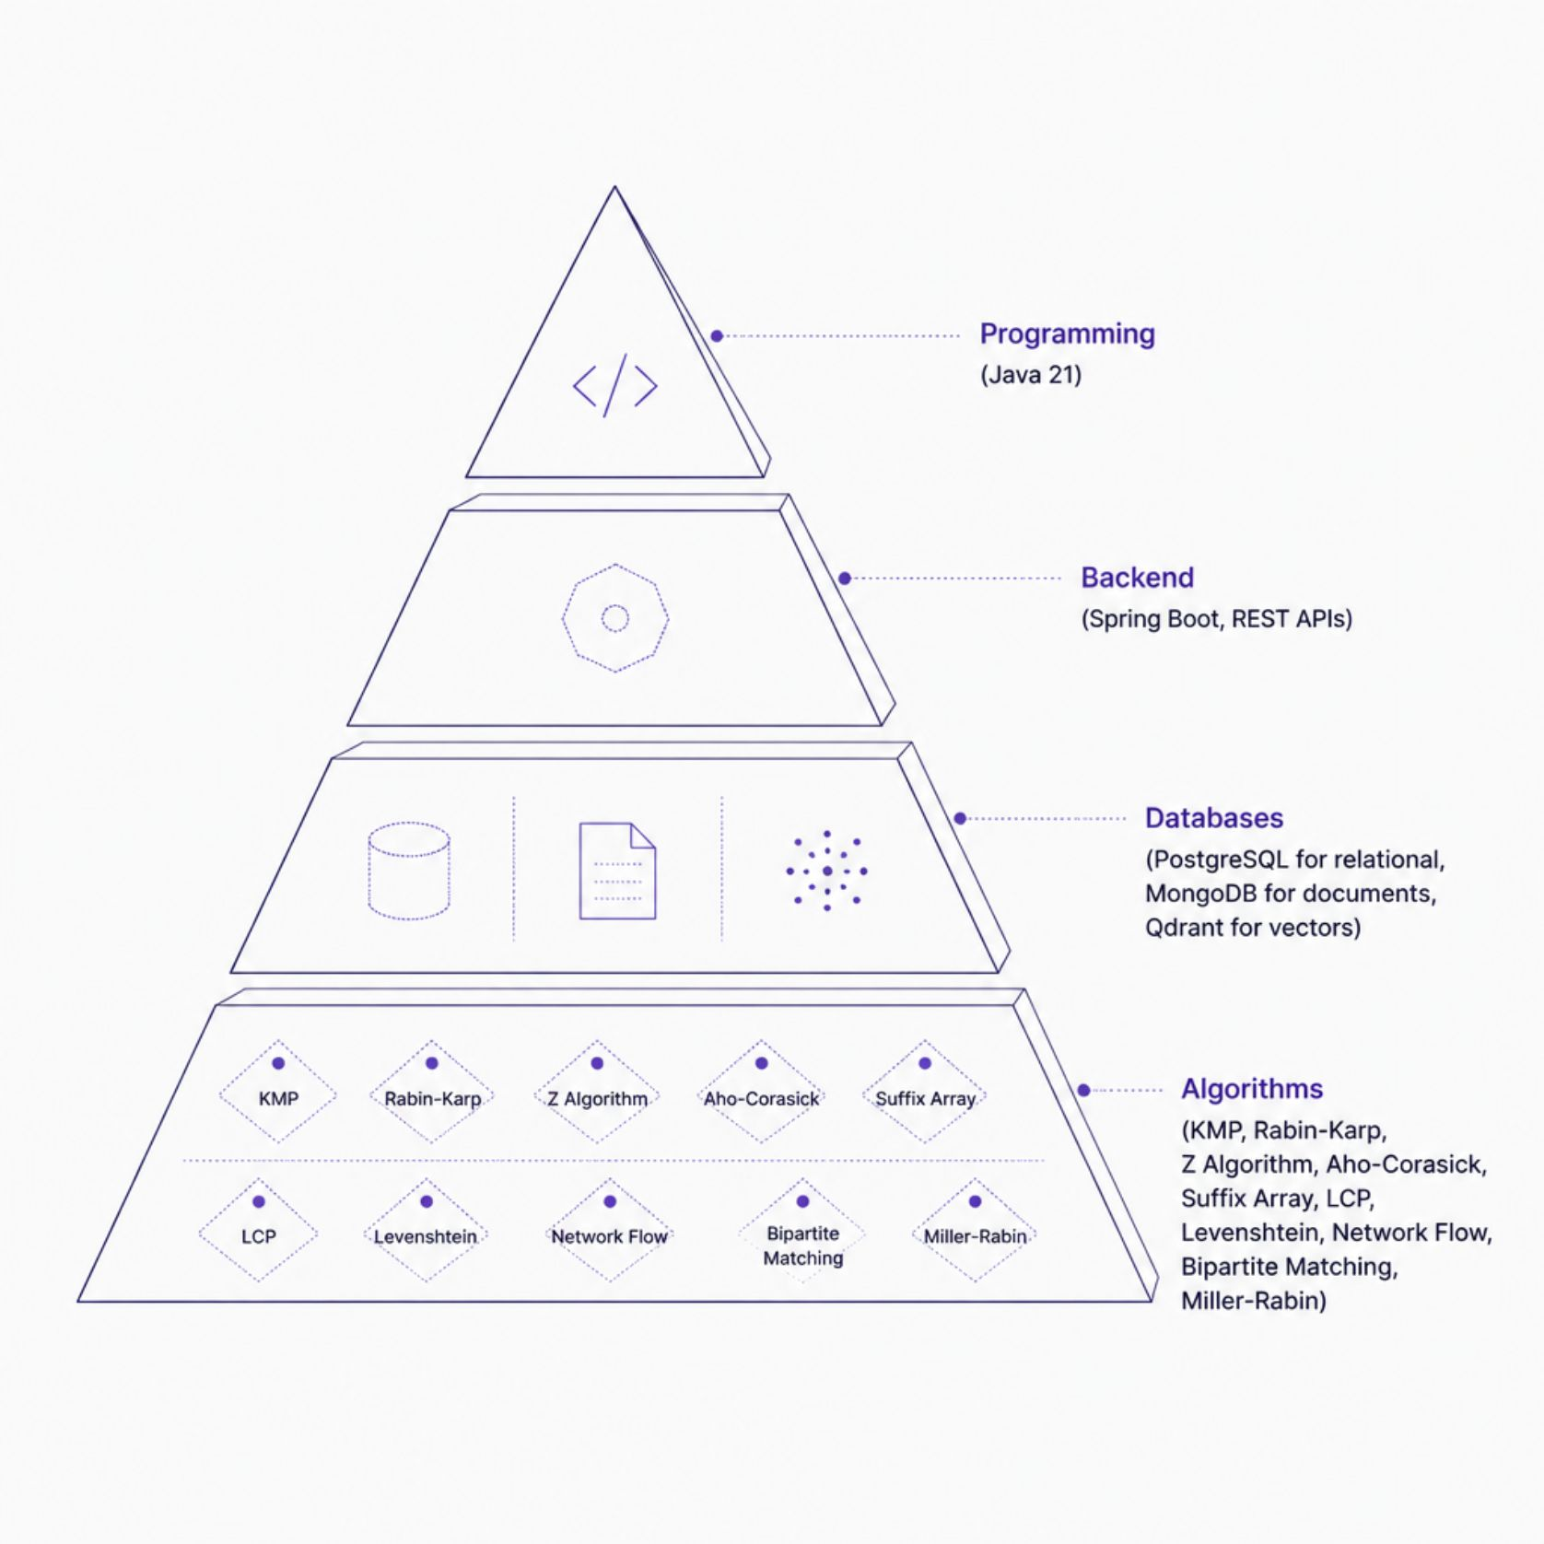
Technology Stack
Core Technologies
Java 21 — primary language for all algorithm implementations
Spring Boot — RESTful backend with role-based authentication
PostgreSQL — structured relational data storage
MongoDB — flexible document-based storage
Qdrant — high-performance vector database for semantic search
Git & Maven — version control and build automation

Slide 5
Expected Outcomes
TextHack will deliver a production-ready knowledge platform combining algorithmic precision with modern software architecture.
Fast Pattern Search
Semantic & Fuzzy Search
Document Similarity
Multi-keyword matching with KMP, Rabin-Karp, and Aho-Corasick
AI-assisted vector search with typo correction via Levenshtein Distance
Suffix Array and LCP-based detection of near-duplicate content
Graph-Based Assignment
Secure REST APIs
Reviewer and task allocation using Ford-Fulkerson and bipartite matching
Role-based authentication with scalable hybrid database architecture

Slide 6
Project Modules
Six modular components, each encapsulating a distinct algorithmic domain.
Module 1 — Query Engine
Module 2 — String Algorithms
Pattern search, query processing, document indexing
KMP, Rabin-Karp, Z Algorithm, Aho-Corasick, Suffix & LCP Arrays
Module 3 — Dynamic Programming
Module 4 — Graph Algorithms
Levenshtein, Damerau-Levenshtein, sequence alignment, similarity
Ford-Fulkerson, Edmonds-Karp, Dinic's, bipartite matching, citation flow
Module 5 — Optimisation
Module 6 — Randomised
Approximation algorithms, task scheduling, reviewer assignment
Miller-Rabin primality test, universal hashing, reservoir sampling

Slide 7
Project Timeline
An eight-week sprint plan moving from system design through algorithm implementation to full deployment.
Week 1
1
Requirements analysis, system design, API planning
2
Week 2
Database design — PostgreSQL, MongoDB, Qdrant
Week 3
3
TextHack Query Engine and string algorithm implementations
4
Week 4
Dynamic programming — edit distance and document similarity
Week 5
5
Network flow and graph algorithm implementations
6
Week 6
Approximation and randomized algorithm modules
Week 7
7
REST APIs, authentication, frontend integration
8
Week 8
Testing, optimisation, deployment, and documentation

