Slide 1
myshell> _
Enterprise-Knowledge Intelligence Platform
OSSP · Operating Systems & System Programming · Weeks 1–6
malloc()
strtok()
fork()
execvp()
waitpid()
chdir()
pipe()
dup2()
Enterprise Knowledge Intelligence Platform · S2-Odd · September 2026
Notes:
ShellForge is the OSSP part of the Enterprise Knowledge Intelligence Platform: a Unix-like shell written in C. Each week of the handbook adds one operating-system concept, and the chips along the bottom are the system calls the shell uses so far.

Slide 2
PROGRESS
Weeks 1–6 are complete and verified
6 / 6
76
742
0
course weeks done
checks passing
lines of C
memory errors or leaks
Built, tested and documented
3 test suites: 21 + 32 + 23
5 modules and 5 headers
ASan, LeakSanitizer, UBSan
What ShellForge 6.0 can do
W1
W2
W3
W4
W5
W6
REPL loop and banner
Input of any length
Command parser
Run programs
Built-in commands
Pipes and IPC
Notes:
Headline numbers. All six weeks so far are implemented. Three automated suites hold 76 checks, and every suite also rebuilds the shell with the memory checkers switched on. The bottom row is what the shell can do after each week.

Slide 3
SYLLABUS
Mapped to four course outcomes
CO-1
Weeks 1–3
CO-2
Weeks 4–5
Shell as the user-space interface
Processes and built-ins
REPL loop, the build pipeline, and command-line parsing with strtok() into an execvp()-ready argv[].
fork(), execvp(), waitpid() and exit status. cd, pwd and env run inside the shell because they change its own state.
CO-3
Week 6
CO-4
Week 2 (foundation)
Inter-process communication
Dynamic memory
Anonymous pipes with pipe() and dup2(), two-process pipelines, parent and child messages, EOF.
Heap buffers with malloc(), realloc() and free(); leaks and memory errors checked with AddressSanitizer.
Notes:
How the six weeks map to the course outcomes in the OSSP syllabus. CO-4 is only started: Week 2 covers dynamic memory, while mmap and page faults are still to come.

Slide 4
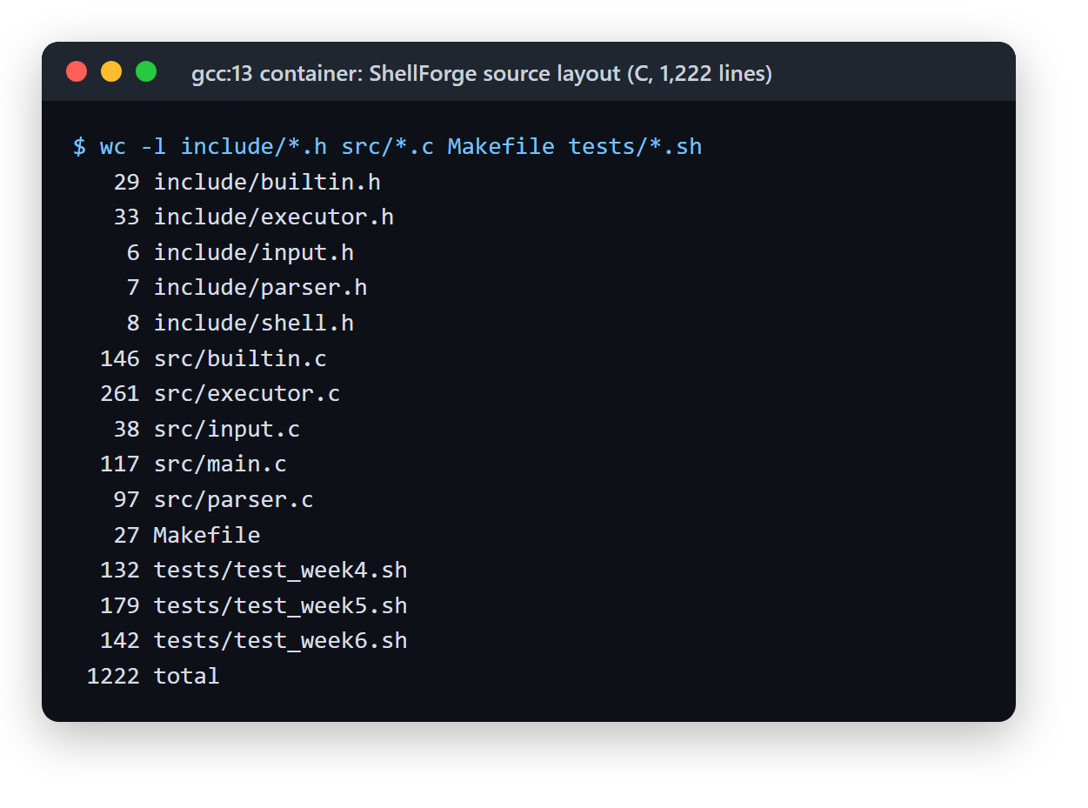
DESIGN
Five small modules, one command loop
main.c
REPL loop: prompt, dispatch, exit
input.c
read_line(): buffer grows with realloc()
parser.c
strtok() → NULL-terminated argv[]
builtin.c
cd pwd env clear help exit (in the shell)
executor.c
fork execvp waitpid pipe dup2 (in a child)
Headers in include/, sources in src/, test scripts in tests/
Weeks 1–5 each added one module; Week 6 extended the parser and executor
1,222 lines in total, including 453 lines of test scripts
Notes:
A command goes down the left column: main.c prompts, input.c reads the whole line whatever its length, parser.c splits it into argv. Then it branches: built-ins run inside the shell, everything else runs in a child process. On the right is the real line count of each file.

Slide 5
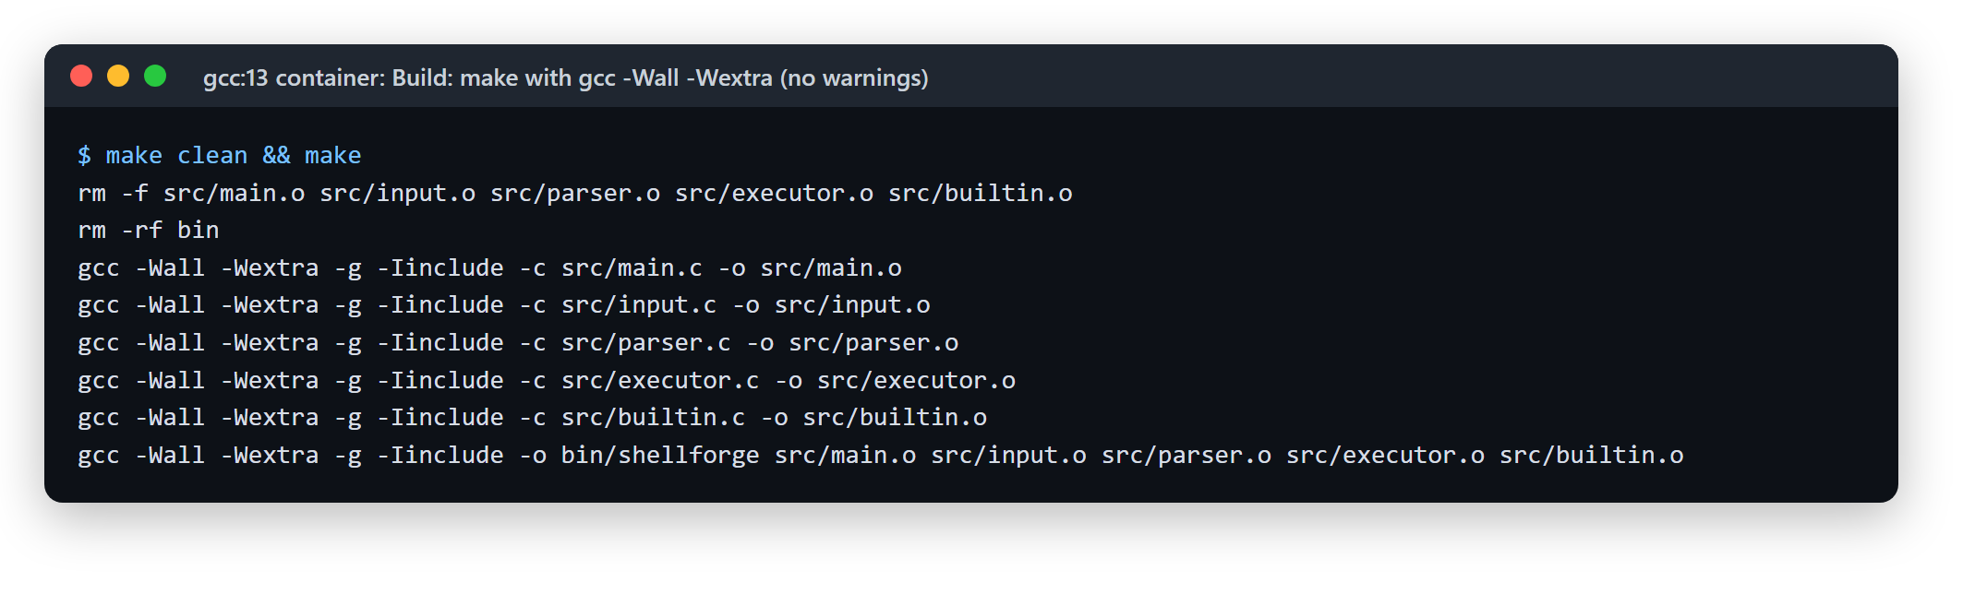
TOOLING
Builds clean with gcc -Wall -Wextra
Makefile
Compiler flags
Where it runs
make · make run · make test · make clean
-Wall -Wextra -g for every build; the tests also build with AddressSanitizer and UBSan
Docker gcc:13 (Debian 12), because this Windows PC has no C compiler
Notes:
The whole project builds with no compiler warnings. For a live demo, from subjects/OSSP/shellforge run: docker run --rm -it -v "$(pwd):/src" -w /src gcc:13 sh -c "make && ./bin/shellforge"

Slide 6
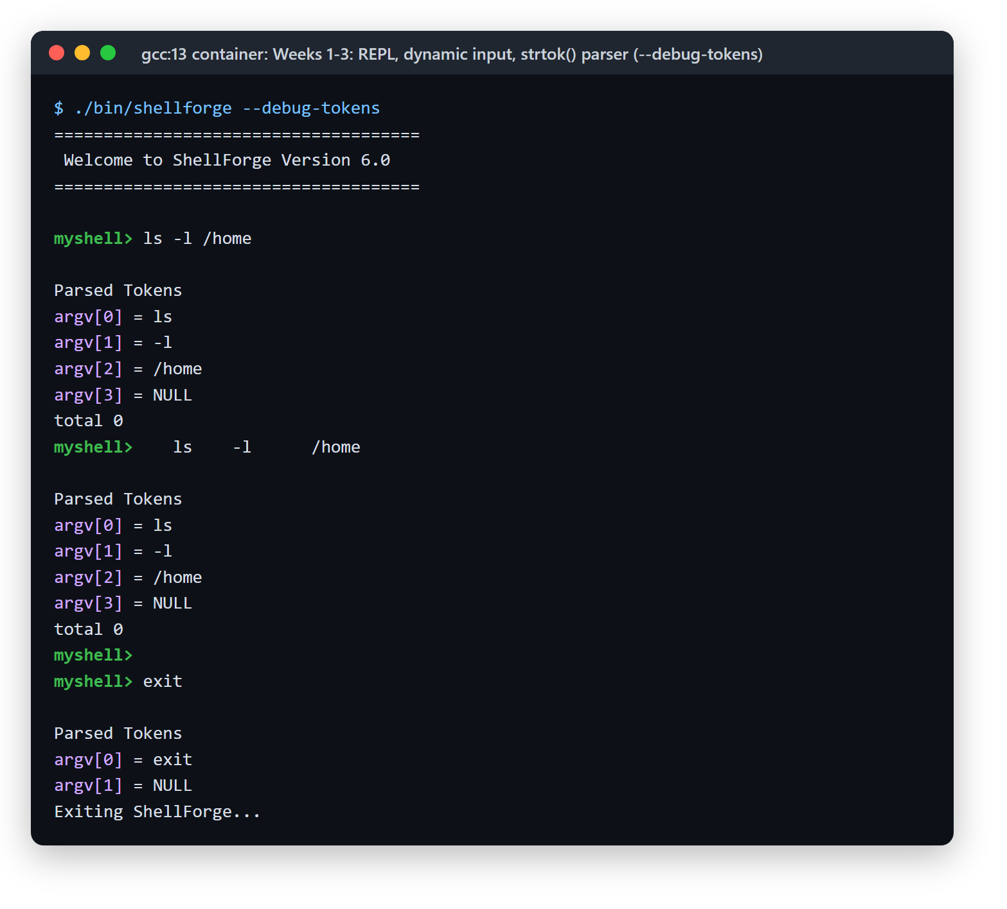
WEEKS 1–3 · CO-1
Read a line, split it, hand it on
W1
REPL loop
Banner, myshell> prompt, exit; Ctrl+D (end of input) exits cleanly. Modular Makefile build.
W2
Input of any length
read_line() starts small and grows with realloc(); a 3,000-character line arrives intact.
W3
Tokenizer
strtok() over spaces and tabs; argv[] grows 64 → 128 → 256 and ends with NULL, the shape execvp() needs.
--debug-tokens prints argv[]; extra spaces collapse to the same three tokens.
Notes:
Weeks 1 to 3 build the front half of a shell: the loop, reading input of any length, and turning a line into argv. The debug flag makes the parser visible: irregular spacing gives the same tokens, and the vector is NULL-terminated for execvp.

Slide 7
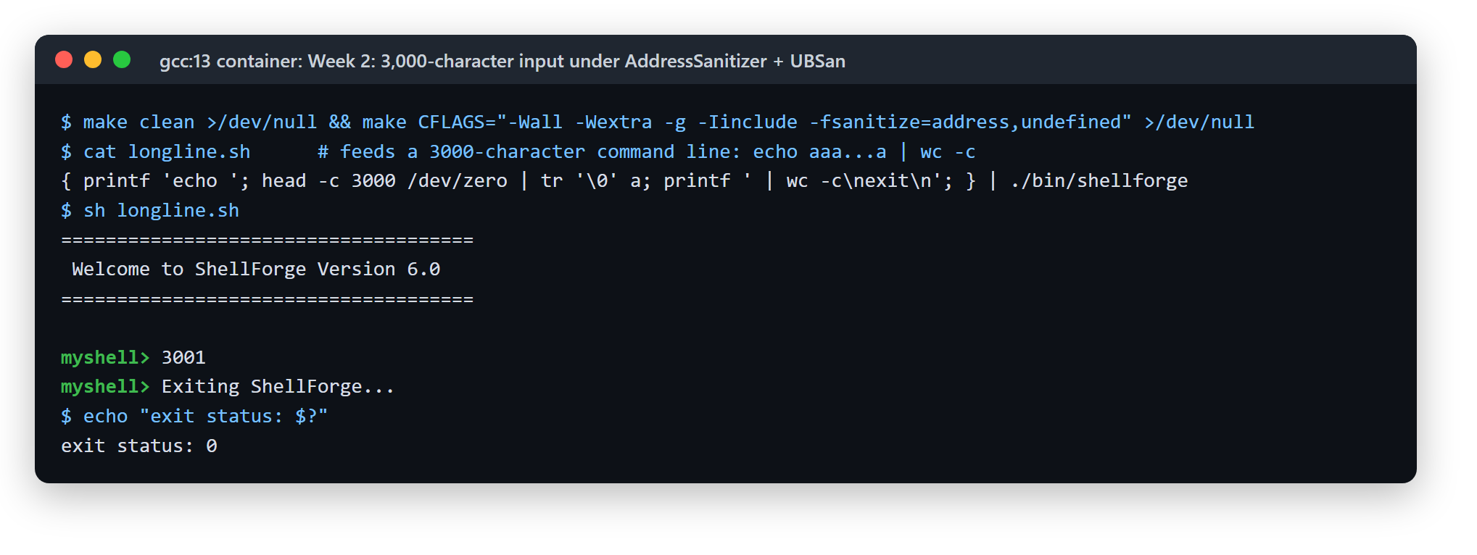
WEEK 2 · CO-4 FOUNDATION
Long input, no memory errors
3,000 characters in
The buffer grows
0 sanitizer reports
wc -c prints 3001: all 3,000 characters plus the newline
malloc() to start, realloc() as the line gets longer, free() at exit
Built with -fsanitize=address,undefined; exit status 0
Notes:
A fixed 1,024-byte buffer would cut this line off. ShellForge grows the buffer instead, and the run is under AddressSanitizer and UndefinedBehaviorSanitizer, which would print a report for any overflow, use-after-free or leak. None appears.

Slide 8
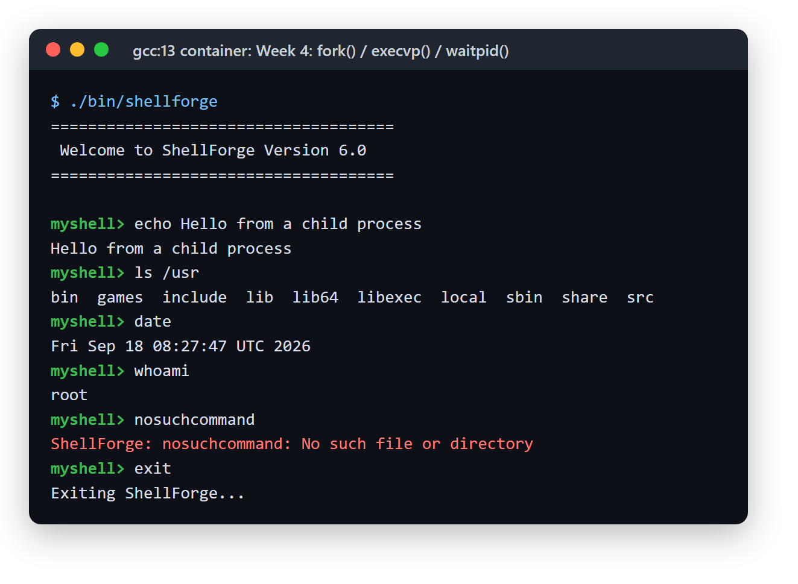
WEEK 4 · CO-2
Every external command runs in its own process
Shell
parent process
fork()
copies the shell
execvp()
child becomes ls
exit
program finishes
waitpid()
parent reaps it
Exit status read with WIFEXITED and WEXITSTATUS; signals with WIFSIGNALED
If execvp() fails, the child calls _exit(), so a second copy of the shell never keeps running
stdout and stderr are flushed before fork(), so buffered text is not printed twice
Unknown commands print an error and the shell keeps running
Notes:
fork, execvp, waitpid is the core of every Unix shell. The details that matter: reaping the child so no zombies are left, _exit in the child when exec fails, and flushing output before fork so it is not duplicated.

Slide 9
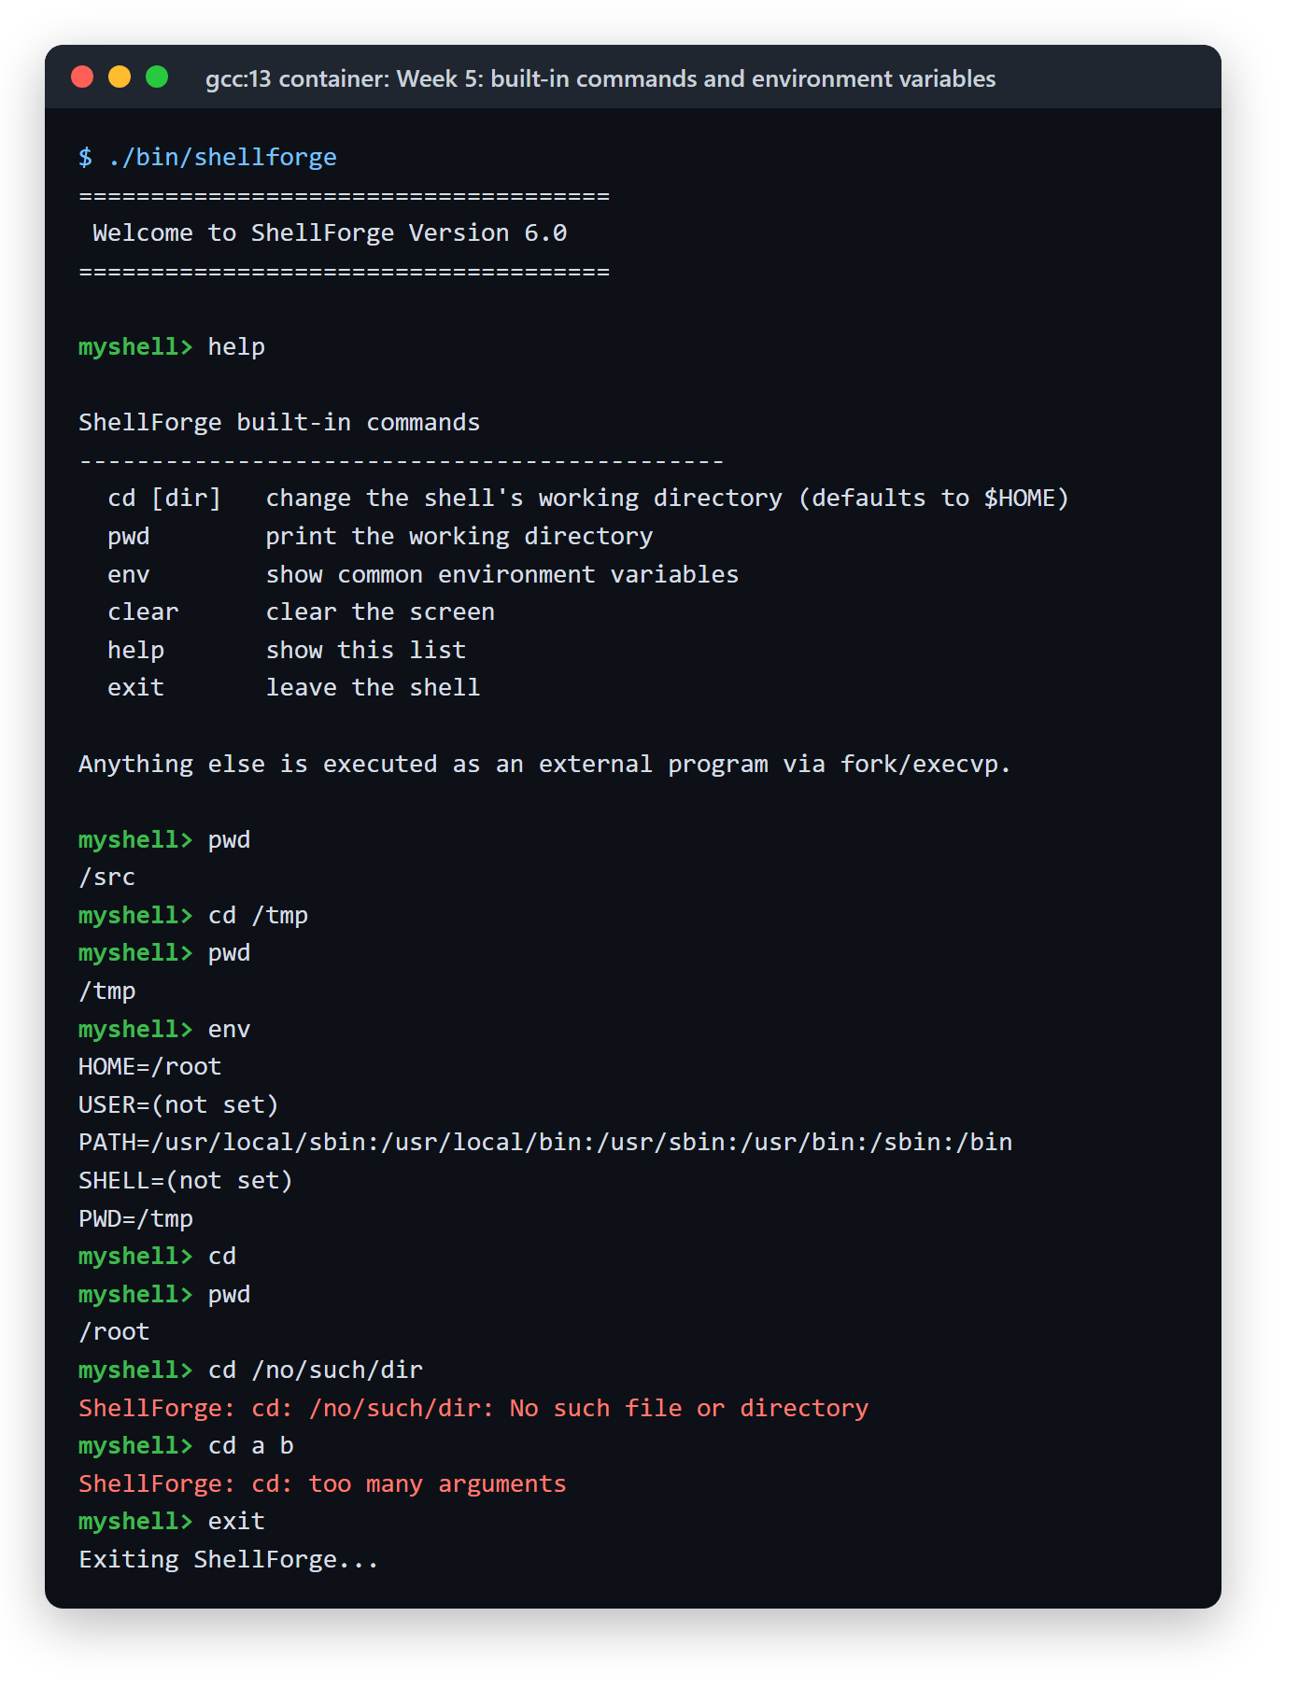
WEEK 5 · CO-2
Built-ins change the shell itself
Why cd can't be forked
The working directory belongs to each process. A child's chdir() would vanish when it exits, so cd has to run inside the shell. The tests prove it: cd /tmp, then pwd prints /tmp.
cd
pwd
env
clear
help
exit
PWD is updated on every cd
Unset variables print (not set) instead of crashing
Errors handled: missing directory, too many arguments
Anything else still goes to fork() and execvp()
Notes:
Built-ins are checked before forking. The key idea is that cd must run in the shell process: a child changing directory would lose that change as soon as it exits.

Slide 10
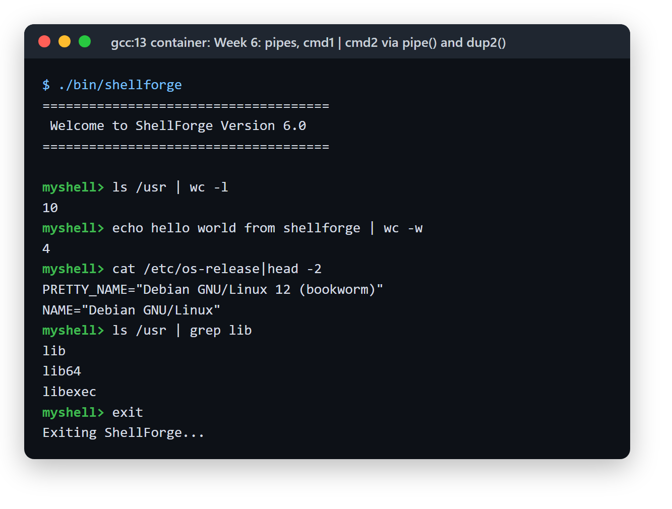
WEEK 6 · CO-3
Two programs, one pipe
ls /usr
child 1
pipe()
kernel buffer
wc -l
child 2
stdout → fd[1]
fd[0] → stdin
dup2() connects each child to its end of the pipe
Works with or without spaces around the pipe symbol
Every unused pipe end is closed, so the reader sees end-of-file and nothing hangs
A leading or trailing | is a syntax error; pipelines have two stages, as this chapter specifies
Notes:
The shell creates the pipe, forks twice, and uses dup2 to point the first child's output and the second child's input at it. Closing the unused ends is what lets wc see end-of-file.

Slide 11
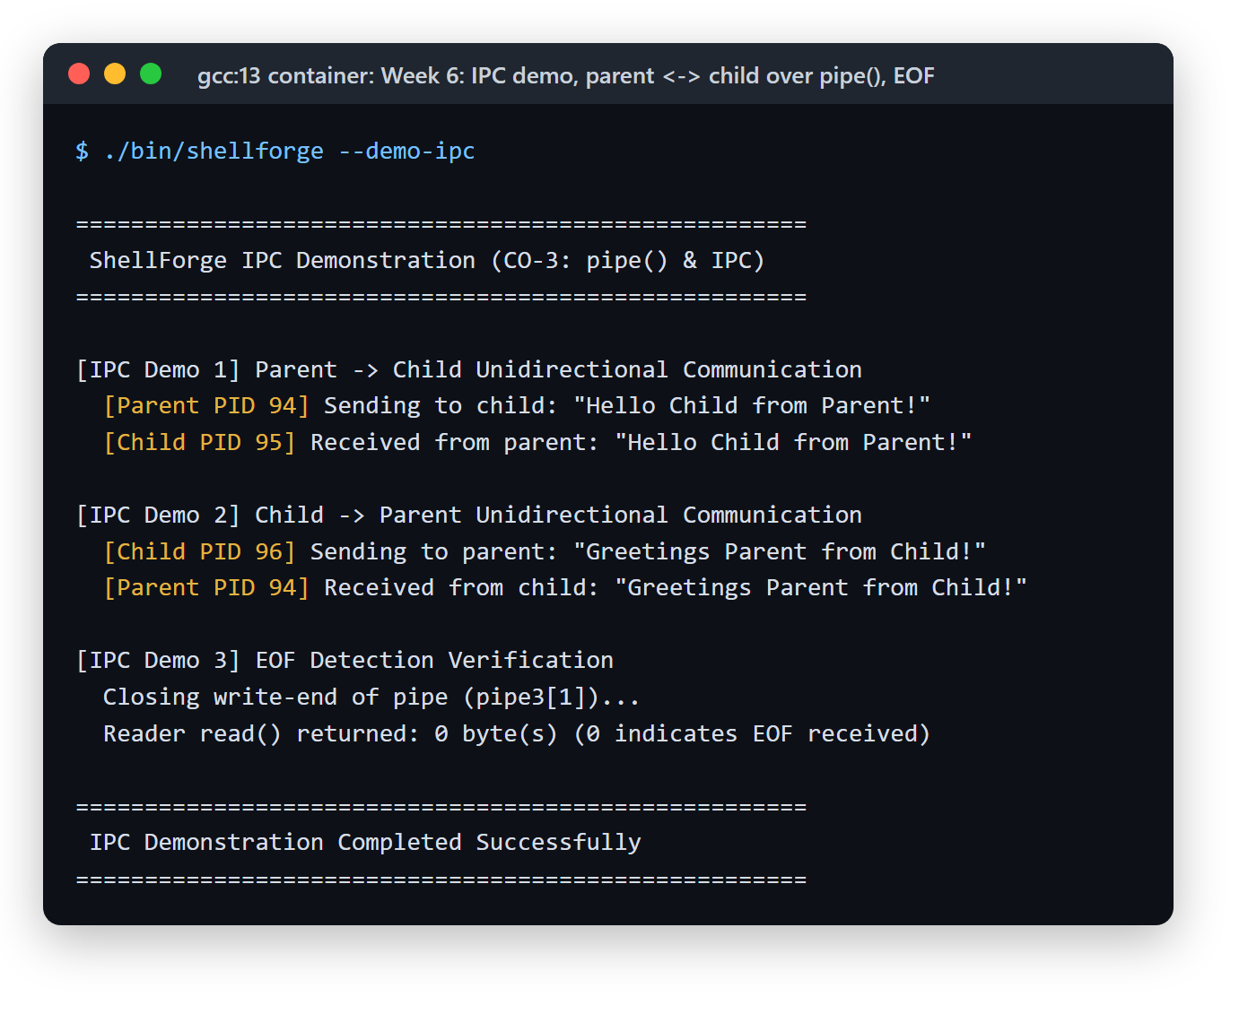
WEEK 6 · CO-3
Talking between processes
1
Parent → child
The parent writes, the child reads; each closes the end it does not use.
2
Child → parent
The same idea with the pipe in the other direction.
3
End-of-file
Once every write end is closed, read() returns 0.
Run it with ./bin/shellforge --demo-ipc, or type demo-ipc at the prompt.
Notes:
The demo shows the raw pipe mechanics without a pipeline: real process IDs on both sides, and the end-of-file rule that the pipeline code depends on.

Slide 12
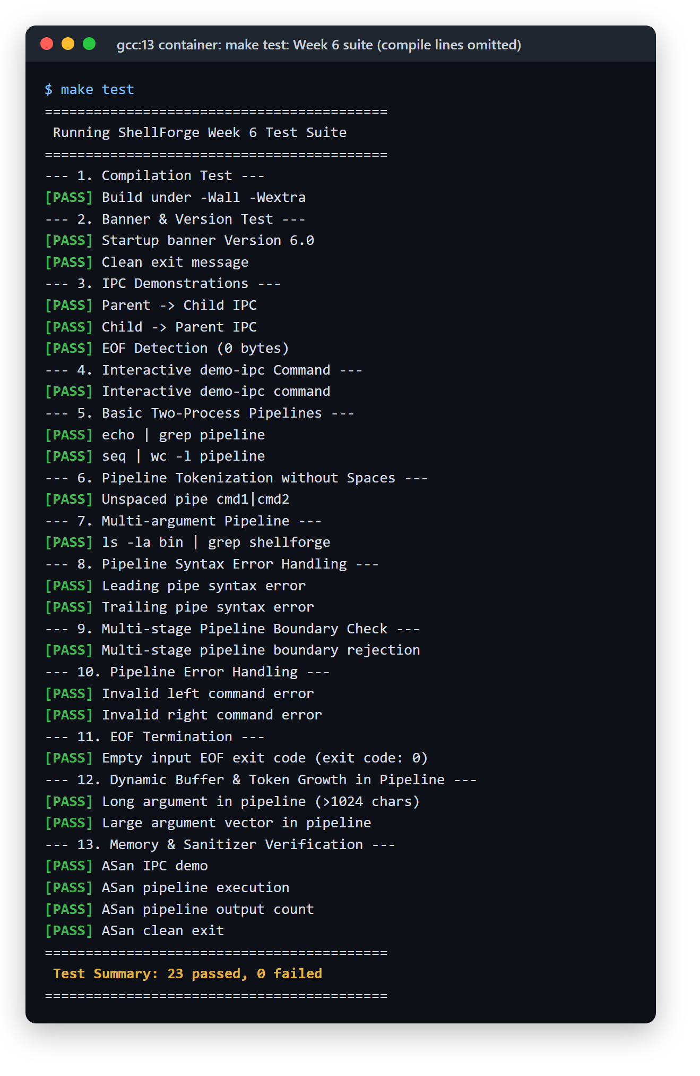
TESTING
76 automated checks, all passing
make test runs all three suites in the gcc:13 container
Each suite rebuilds the shell with AddressSanitizer and UBSan, and fails on any report
Error paths are tested too: bad commands, bad cd, pipe syntax errors
Notes:
Three suites, one per week from Week 4 on, with 76 checks in total. All three full logs are in the appendix.

Slide 13
ENGINEERING
Where ShellForge differs from the handbook
Handbook listing | ShellForge | Why
Week 3: #include ""../include/..." has a stray quote, and the Makefile target has no prerequisites | Keeps -Iinclude and an object-file Makefile | The listing does not compile, and its target never rebuilds
Week 5 env: printf("%s", getenv("USER")) | Prints (not set) when a variable is unset | Passing NULL to printf is undefined behaviour
Week 5 clear: system("clear") | Writes the ANSI clear-screen code | No extra shell process, and clear is missing from many images
Week 5 exit: calls exit() directly | Returns to main(), which frees memory first | Keeps the leak checker clean
Also: pipes and IPC were first filed as Week 5. They were relabelled Week 6 to match the handbook; the code did not change.
Notes:
Each change from the handbook is documented in the weekly notes. None changes what the shell does; they fix code that would not compile or that relies on undefined behaviour.

Slide 14
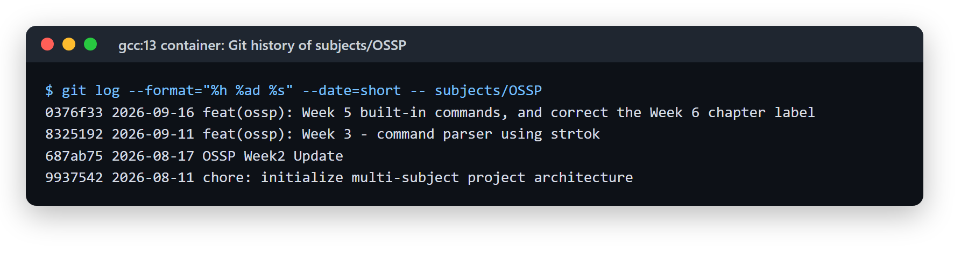
HISTORY
Built in four commits
11 Aug 2026
17 Aug 2026
11 Sep 2026
16 Sep 2026
Project structure created
Weeks 1–2: REPL and dynamic input
Week 3: strtok() parser
Weeks 4–6: processes, built-ins, pipes and IPC
Notes:
The git history for subjects/OSSP. Weeks 4 to 6 were committed together on 16 September; the weekly notes in docs/ describe each week separately.

Slide 15
NEXT
What's left in the syllabus
CO-3
CO-4
CO-5
CO-6
Signals and job control
Memory
Files and I/O
Threads and sync
Signals, named pipes (FIFOs), process groups, sessions
Virtual memory, mmap, page faults, memory debugging
File descriptors, open/read/write/close, directories, buffered I/O
POSIX threads, mutexes, condition variables, semaphores, deadlock
Week 7 starts with the next handbook chapter.
myshell> exit
Notes:
The remaining course outcomes. The shell structure is ready for them: signals and job control build on the process code, and file I/O and redirection build on the dup2 work from Week 6.

Slide 16
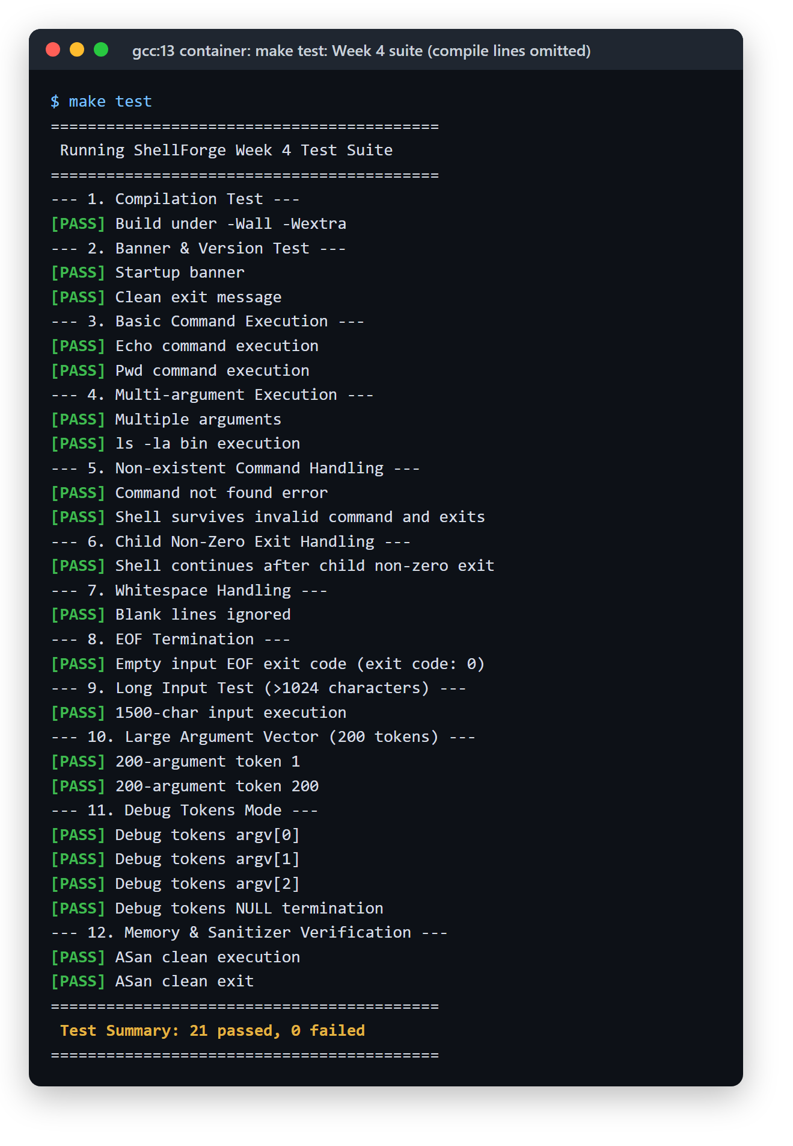
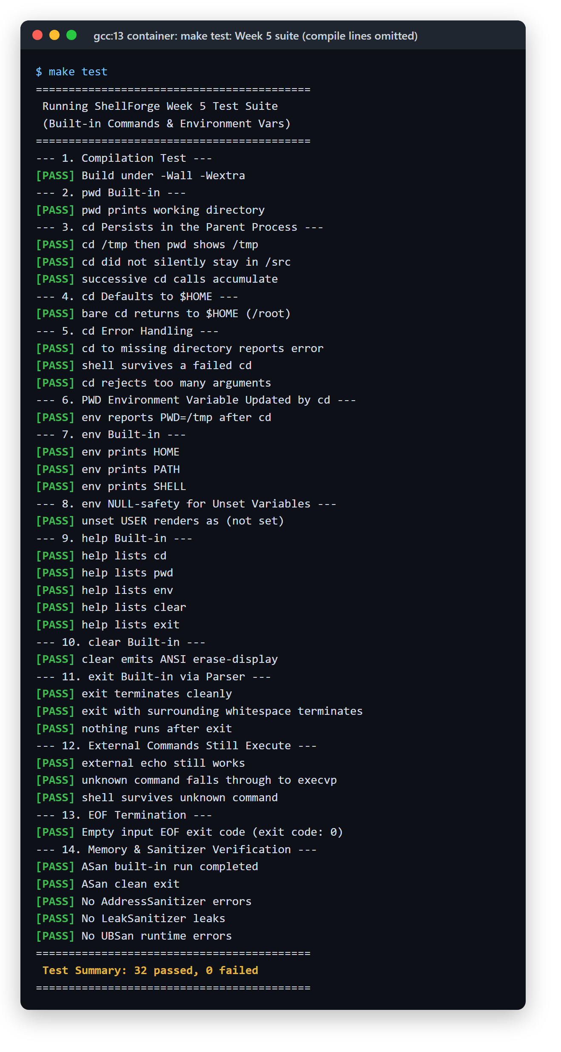
APPENDIX
Test logs: Weeks 4, 5 and 6
Notes:
Full logs of the three suites from one make test run. Compiler lines are omitted.

