Slide 1

ASTROSAGE ANALYSIS
- Sathya Narayan G

Slide 2
ASTROSAGE
AstroSage is an online astrology platform that provides horoscope predictions and astrology tools based on traditional Vedic astrology principles. It allows users to generate birth charts (Kundli) by entering their date, time, and place of birth. The platform offers daily, weekly, monthly, and yearly horoscopes, compatibility analysis, numerology reports, and personalized astrological insights. AstroSage also provides professional astrology software and learning resources for astrologers and beginners. Accessible through both website and mobile applications, it aims to make astrology easy and widely available using modern technology. Overall, AstroSage combines ancient astrological knowledge with digital tools to help users understand personality traits, relationships, career prospects, and future possibilities.

Slide 3
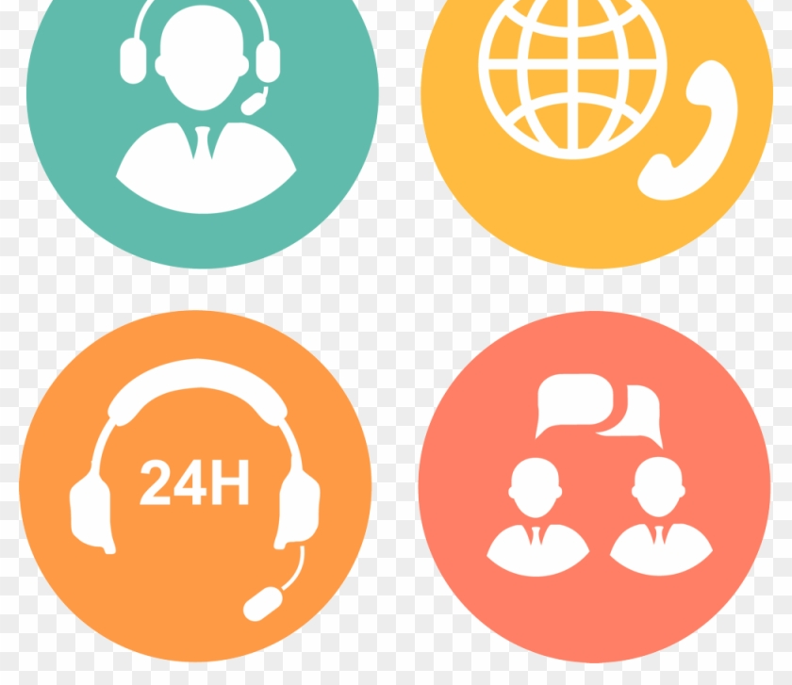
The AstroSage Call Center is the customer support and consultation service of AstroSage, an Indian online astrology platform. It helps users connect with astrologers and resolve service-related queries through phone, chat, or email.
The call center mainly handles customer assistance such as booking astrology consultations, answering questions about horoscope reports, payments, account issues, and product orders like gemstones or spiritual items. Customers can also talk directly with astrologers for guidance related to career, marriage, finance, health, or personal life predictions.
Support is provided via phone and online channels, with customer care available during working hours and email support for queries. The service acts as the communication bridge between users and AstroSage’s astrology experts and digital services.

Slide 4
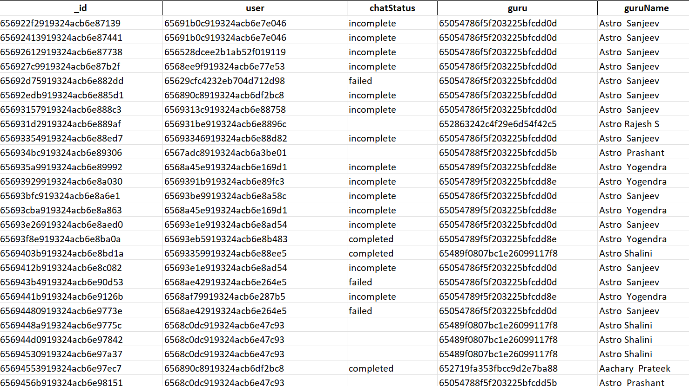
Problem Statement AstroSage has received a 1 crore investment and aims to optimize its call center operations. The goal is to determine how to allocate this investment to maximize operational efficiency, customer satisfaction, and profitability. The analysis will consider historical call data, performance metrics, and market trends to make informed decisions.

Slide 5

ABOUT THE DATASET
The dataset includes operational and performance information from a call center, providing detailed insights into customer conversations, agent tasks, service results, and earnings from various ways people communicate.It covers the following records:
Customer Interactions – the total number of conversations handled through phone calls, chat sessions, and other service types.
Agent Performance – the number of interactions each agent managed, how long calls and chats lasted, and how satisfied customers were with the service.
Operational Metrics – how many calls were received each hour, the status of agents (like busy, done, failed, or no answer), and how well calls were completed.
Customer Experience Indicators – average satisfaction scores and whether issues were resolved during the first call, which helps measure service quality.
Revenue Data – the total income from different types of customer interactions and through various platforms like apps, dashboards, and websites.
Time-Based Information – dates, hours, months, and daily trends that help analyze workloads and busy times.
Overall, this dataset allows for analyzing the efficiency of the call center, how agents' workloads are spread, trends in customer satisfaction, any problems in operations, and how well revenue is performing.It helps management make better decisions about hiring, improving processes, and investing in technology.

Slide 6
METHODOLOGY
1.Data Cleaning: Checked the dataset to find any missing or mixed-up data, we also made sure the dates and times were in the right format so they could be used for calculations. A few abnormal formatting issues were taken care to keep the data accurate. A few functions like TRIM,PROPER,VALUE,IF,SUBSTITUTE,DATE were used to clean the data.
2.Data Preparation & Enrichment: Extracted useful information from the existing data to help with the analysis.A few new fields were introduced when needed to make comparisons and reports easier. Data was sorted into clear groups so it would be easier to look through and assess. LOOKUP functions were used in certain instances when necessary. A few tweaks were made to fields like guru name, call length and satisfaction scores so they were ready for use in analysis.
3.Analytical Techniques used:
Descriptive Analysis: calculated average scores and summaries to get an idea of how customer satisfaction was performing overall.
Comparative Analysis: compared customer satisfaction scores between different gurus to find out who was doing best and who was doing worst.
Correlation Insight: looked at how call length related to customer satisfaction levels.
4.Tools & Spreadsheet Features : Every analytical insight was done through plotting pivot tables and a chart wherever necessary respectively to support the same. Sorting and filtering of the data was done according to our need for different queries. Major repetitive functions used were AVERAGE,COUNT and for visualisation there were multiple charts being plotted to help explain trends and comparisons.
5. Interpretation and reporting : Summarised numbers and the plotted charts helped us in interpretation phase and to also conclude a few insights obtained from the data. Findings were clearly presented to highlight performance differences and highlight key insights.

Slide 7
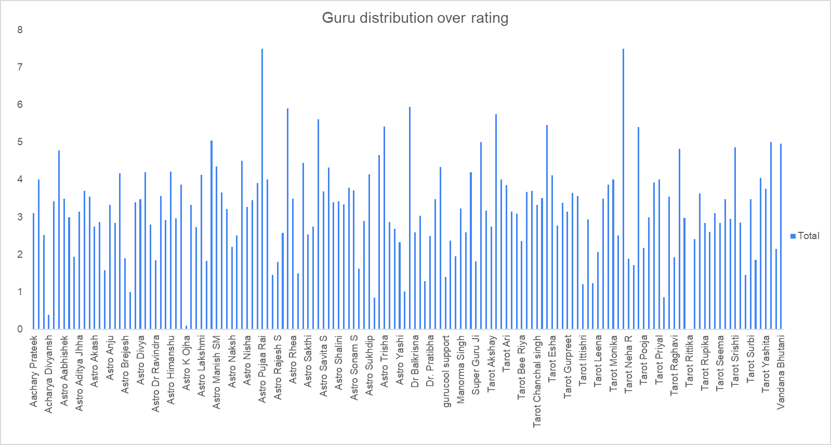
INSIGHT
Average customer ratings for Gurus
The chart clearly shows a wide variation in customer satisfaction across gurus. A few gurus consistently achieve high ratings (above 7), while some have significantly lower ratings. This indicates differences in service quality and highlights top-performing and underperforming agents.

Slide 8
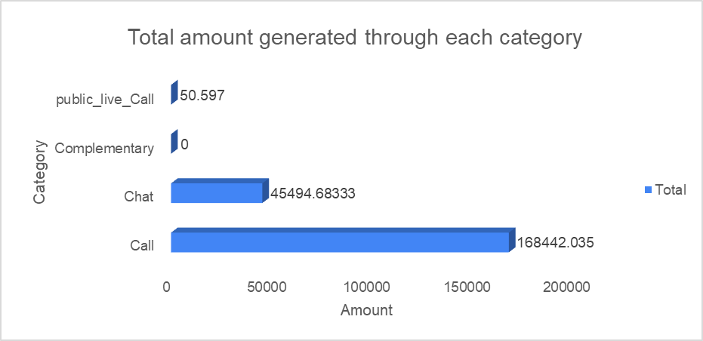
INSIGHT
Amount generated through each category
The Call category dominates revenue generation, contributing significantly more than other categories. Chat contributes a moderate share, while Complementary and Public Live Call generate negligible revenue. This indicates that the platform’s primary revenue driver is call-based consultations.

Slide 9
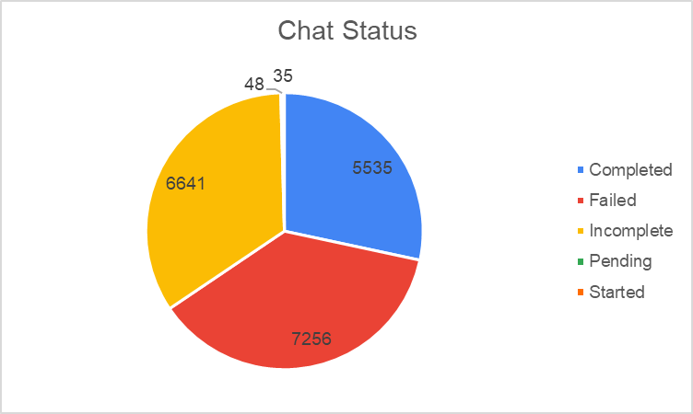
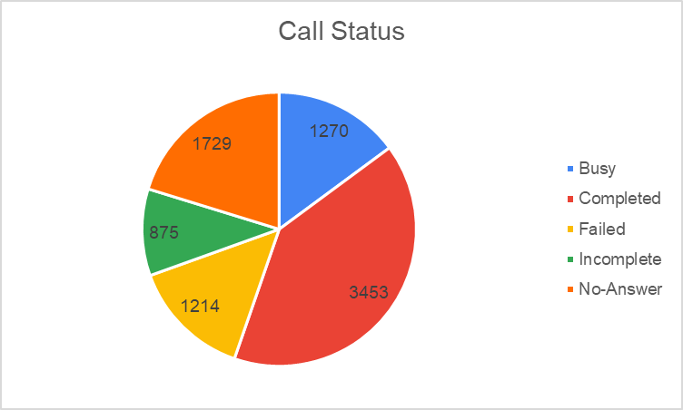
INSIGHTS
Website performance and reliability
Having a breakdown of call and chat statuses gives a clear view of how customer interactions move through the process, from when they start to when they end. This makes it easier to spot where customers stop engaging, like when they’re busy, the call fails, or they don’t answer. With this information, you can make specific changes to improve the process, boost completion rates, and make operations more efficient.

Slide 10
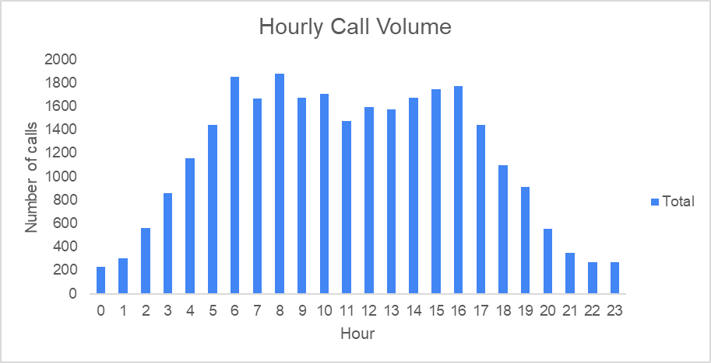
INSIGHT
Hourly basis volume
Call volume increases in the morning and peaks between 7 AM, especially around 8 AM.
Peak hours show higher Busy, Failed, and No-Answer calls due to demand exceeding agent capacity.
Evening and late-night hours have low call volumes, revealing workload imbalance and underutilized resources.

Slide 11
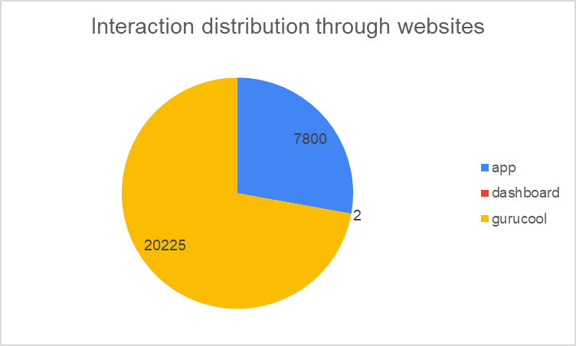
INSIGHT Platform performance
The chart shows that customers mainly use one method to interact, with most consultations coming from a single platform. This means customers are relying heavily on just one channel, which could be risky if that platform experiences any problems. Using the app, website, and dashboard together can help reach more customers, spread out the traffic more evenly, and make the service more dependable overall.

Slide 12
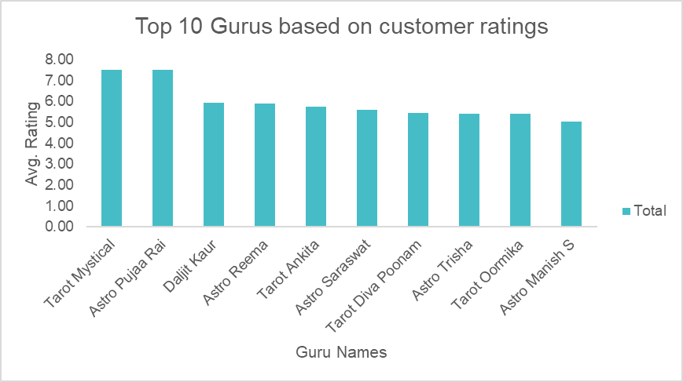
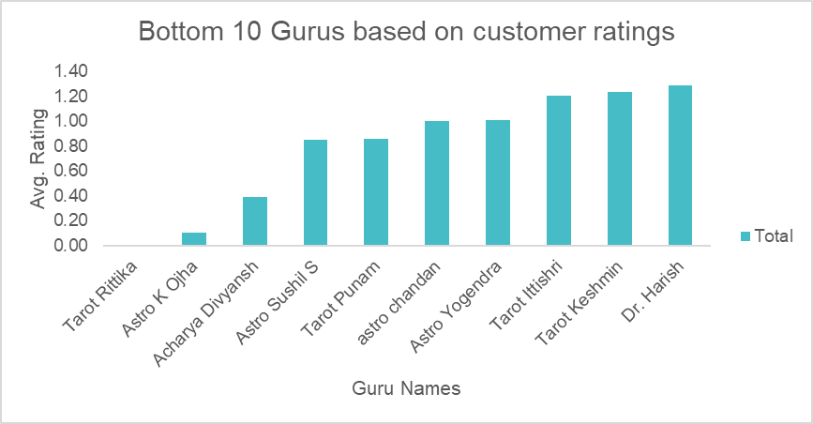
INSIGHTS
GURUs’ performance
Top-performing agents deliver better customer satisfaction because they solve problems quickly and keep calls within a good time frame. Agents who don’t perform as well tend to handle calls in an uneven way—either taking too long or not giving enough attention. The differences in how well agents perform point to skill and process issues, not a lack of staff. This shows that managing conversations well has a bigger impact on customer satisfaction than simply handling more calls.

Slide 13
RECOMMENDATIONS
1. Workforce & Workload Management Implement intelligent workload distribution and peak-hour staffing to balance agent capacity, prevent burnout, and maintain consistent service quality.
2. Performance Improvement & Training Introduce targeted skill-based training programs using best-performing agents’ practices to improve communication, efficiency, and problem resolution.
3. Customer Satisfaction Enhancement Improve customer experience by reducing wait times through callback options and enabling agents with faster problem-solving tools.
4. Monitoring & Data-Driven Decision Making Adopt real-time performance dashboards to continuously monitor workload, agent performance, and customer satisfaction for proactive decision-making.
5. Motivation, Incentives & Strategic Analysis Establish performance-based incentive and recognition programs to boost agent motivation, productivity, and long-term service quality.

Slide 14
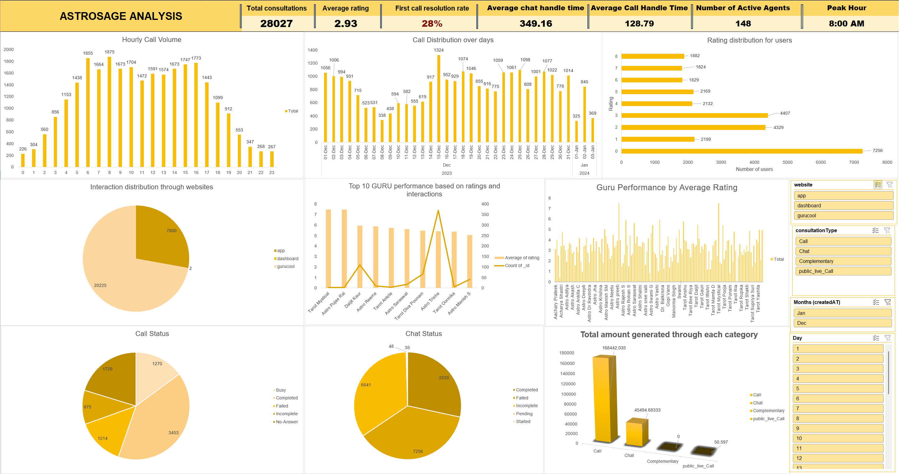
DASHBOARD

Slide 15

CONCLUSION
The dashboard gives a complete picture of how well the call center is performing by connecting customer interactions, how efficiently agents are working, and how much revenue is being generated. The insights show that when agents are overworked, it hurts customer satisfaction, which means it's important to balance the tasks they're given and improve staffing during busy times. Differences in how well agents perform suggest there's room for better training and sharing of knowledge. Since most of the revenue comes from call consultations, making call handling more efficient through better training, managing workload smarter, and using automation can improve service quality, make operations run smoother, and support the company's growth in the long run.

Slide 16

THANK YOU

