Slide 1
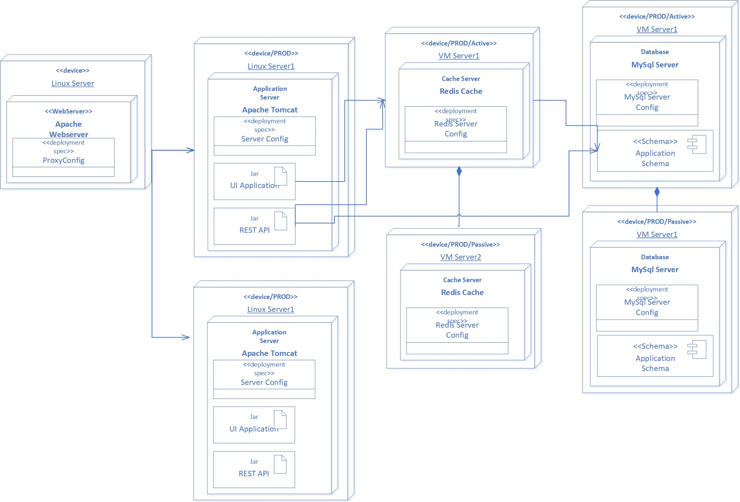
Deployment View of Legay Service
Apache Webserver for load balancing to distribute the load evenly to the two application VM’s
Apache Tomcat as application server for managing/deploying
Both UI application and REST API service running in same server
Interaction between UI and REST API can be considered as local transaction
2 VM’s Active/Active mode for high availability of the services
Redis Cache act as distributed Cache to store the static content/configuration data
2 VM’s is considered with Active/Passive mode for high availability
Replica the cache data between Master/Slave
Relational Database is MySQL to handle the transaction
2 VMS considered with Active/Passive mode for high availability
Replica the data between Active/Passive
CI/CD Servers for Continuous Build and Continuous Deployment

Slide 2
Web Application Architecture
Presentation Layer (Client)
Business Layer
Data Access Layer
Infra Layer
Web Browser
UI
Angular
Template
HTML/CSS
JavaScript
NodeJs
Business Logic
Validation
Responsive Design
Static Content
HTTPS Request
HTTPS Response
HTTPS
REST Microservice
REST Microservice
Messaging
Monitoring
MySQL
Redis
Security
Logging

Slide 3
GIT Branching Strategy
Golden Source Code
Master
Develop
Develop_<<Version>>
Release_<<Sprint_Version>>
Merge Develop Version Branch to Master after production deployment
Cut the branch from the previous Develop branch to work on new Service Version
Cut the branch from the Develop branch to work on Feature US
Merge Release Branch to Develop Version Branch
Cut the branch from the Develop branch to work on Release
US Specific Feature Branch
Deploy from Release branch
GIT Pull request to perform the Code Review

Slide 4
CI/CD Process
Dev Failed
GIT Hook
Build Successful
Publish the artifact in repository
Deploy Dev
Dev Sanity Testing
Create New Pipeline / Job in CI from Release Branch
Build – Release No. 1
Build Failed
QA Select Dev Deployed Version
Integrate with Code Quality Plugin like SonarCube
Deploy QA
Roll Back?
Select previous QA Pass version
Un-Map the test route and Map the Green App Route
Traffic Enabled
Delete the Blue App
Deploy to QA
Blue/Green Deployment for Cloud Platform
Deploy New Blue App with test route
Validate with test route
Success?

Slide 5
Cloud Infrastructure & Application Setup
Chosen PaaS (Platform as-a Service) where application and data is owned by the application team for scalability and High Availability
Chosen Pivotal Cloud Foundry as a cloud platform to host the applications in cloud
Cloud Platform is hosted in two zones for high availability of the services
UI Application and REST Microservices are deployed in cloud
Adoptive Cloud Native Development using Spring Cloud Framework
Spring Actuator with management endpoints
Follow 12-factor principals,
Externalized Configuration using Config Server
Eureka for Service Registry
Hystrix for fault tolerance
API Gateway for routing
Horizontal Scaling using auto-scale
Leverage cloud services like mongo-db, rabbitmq, user defined services and proxy services
Logs are considered as OUT stream and pushing the logs to Logstash / Elastic with Kibana UI
Use Redis Cache service available in cloudfoundry for Cache implementation
Same zone preference configuration for high response time
Considered profile specific configuration to enable easy development and testing in local environment using Spring Boot Frameworks
Grafana is chosen as a Monitoring Tools
Application Metrics like CPU Utilization/Memory Utilization / transaction data can be viewed
Promotheus / Influx DB will be used to persist the metrics data
Alerting can be enabled based on the threshold configuration
Email can be triggered based on the exceptions

