Slide 1
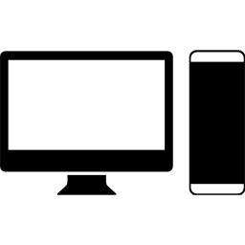
Contracts
A library written in Kotlin
containing
data objects/beans that
will be
sent over the wire as Json.
JDBC
Client
Server
Database
A desktop application
written in Kotlin using
Swing/AWT
Web API returning Json
implemented
as HTTP Servlet.
Written in Kotlin.
Microsoft SQL Server
database containing:
User profiles
Client application profiles
User likes
Books
Figure 1: Bookyard Component Architecture

Slide 2

POST
https://localhost:8443/login
LoginServlet
Returns access token
RecommendServlet
Servlet1
Client
Server
Servlet2
POST
https://localhost:8443/recommend
Figure 2: Bookyard Request / Response Control Flow

Slide 3
1
Server A
Server B
HTTP/1.1 302 Found Location: /authenticationServer
GET /authors
GET /books
HTTP/1.1 302 Found Location: / authenticationServer
Client

Slide 4
2
Login
Login
Server A
Server B
HTTP/1.1 200 OK token=lfgj5t65-
Authentication Server
GET /authenticationServer
Client

Slide 5
3
Server A
Server B
HTTP/1.1 200 OK { …/*data */ }
GET /authors token=ljfgoj56
GET /books token=ljfgoj56
Authentication Server
HTTP/1.1 200 OK { …/*data */ }
Client

